Slide 1

The Power of Resilience-based, Trauma-Sensitive, Strength Focused Communication to Build Youth
Bridging the Gaps 2026
Ken Ginsburg, MD, MS Ed
The Center for Parent and Teen Communication
The Children’s Hospital of Philadelphia
Covenant House Pennsylvania

Slide 2
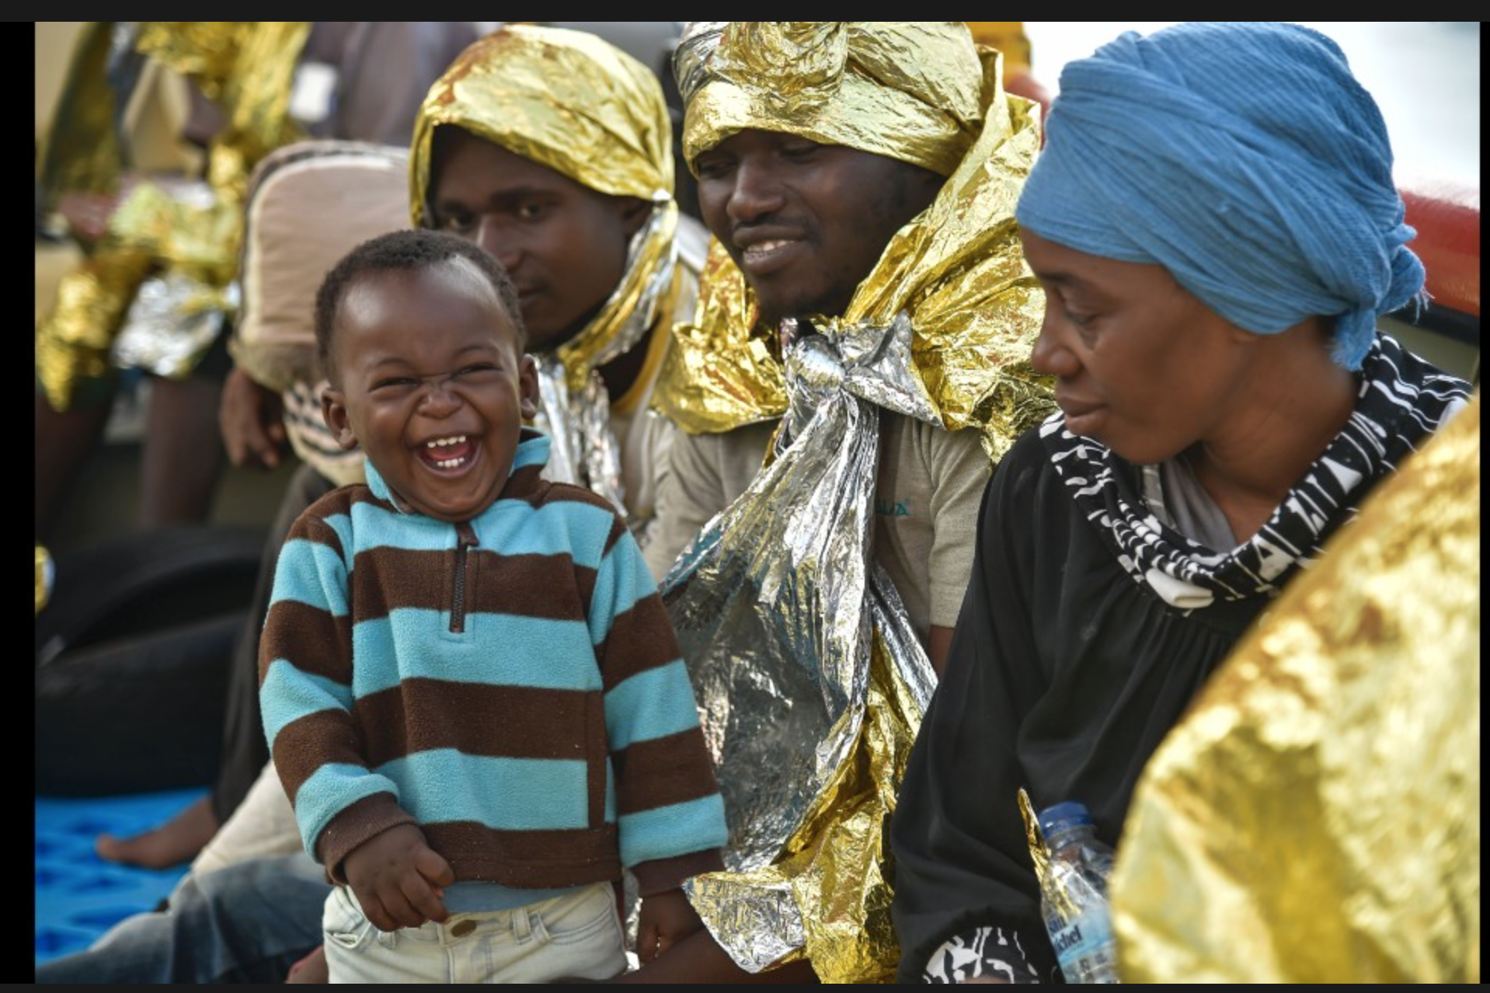
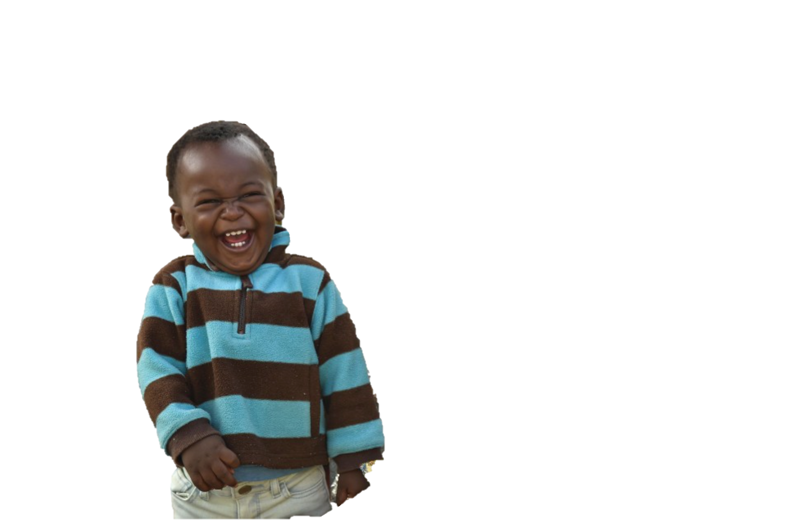

Slide 3
Childhood Trauma May Affect:
The Body
The Brain
Behavior
Genetics

Slide 4
From Trauma-Informed
To
Strength-based and Trauma-Sensitive

Slide 5
To build strong youth, we need to serve them with. . .
A Model that includes all we’ve learned from
  Positive Youth Development
  Resilience Building Strategies
  Trauma-sensitive Practices
  Restorative Practices
A model that acknowledges pain, but sees the best in people.
A model that recognizes the undermining forces of low expectations, but that prevents a new label from being applied to already marginalized communities. In sharp contrast, it must recognize the inherent strengths of individuals, communities, and cultures.
Notes:
90% of the worlds adolescents live in low and middle income countries. The United States, Canada, Australia, and the collective of European countries represented by EuTeach are the countries with the most active and well resourced multidisciplinary adolescent health infrastructures. As countries like India, Indonesia, and South Africa implement youth friendly services to serve their youth, we are poised to offer adaptable approaches with these three elements in mind.
Lee, Dick etc

Slide 6
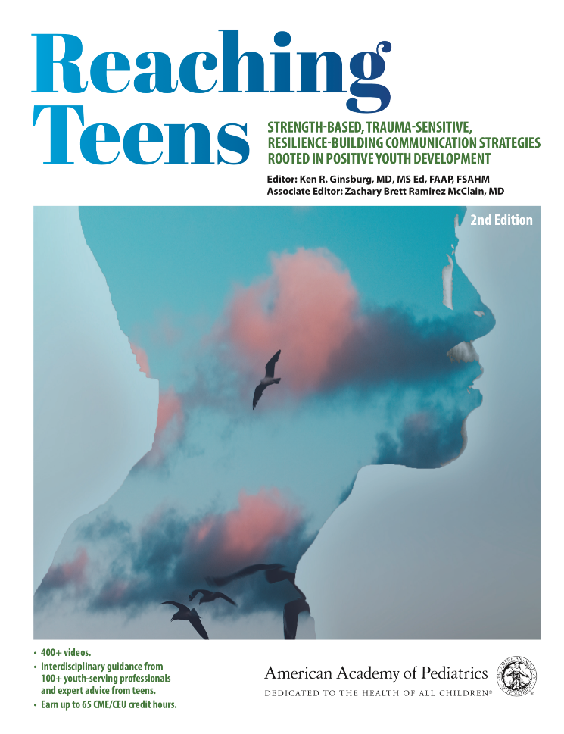

An Integrated Model that includes all we’ve learned from:
Positive Youth Development
Resilience Building Strategies
Trauma-Sensitive Practices

Slide 7
The balance – No Jargon
We know young people need safe, secure, sustained relationships to thrive. We even know that such relationships can allow them to heal from hard pasts. We must guide them so they are accountable to being their best selves. When we do so, they must know that our high expectations are rooted in our caring. Ideally our efforts at accountability must enhance, rather than disrupt, our protective relationships.

Slide 8
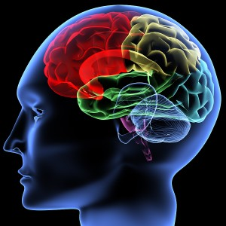
Why the greatest progress with adolescents, but especially for those with the hardest lives, depend on our relationships
A relentless approach to relationships
Bruce Perry, MD, PH D
Neuro Sequential Model of Therapeutics

Slide 9
Our communication strategy should vary depending on the brain pathways a person has earned.
Do they have a sense of security?
Do they lead with emotion?
Are they highly reactive?
Do they believe that people will not or cannot be helpful?

Slide 10
Knowing that dose matters and that young people need safe, secure, sustained relationships, we are called to:
Help parents know how much they matter!!! And build within them the power to be the most effective guides in their children’s lives.
Empower extended family and community-based adults
Recognize that educators are a critical protective force in young lives.

Slide 11
The First Step of Promoting Positive Youth Development:
Engaging Adults to be Pro-Development

Slide 12
The Fundamental Questions of Adolescence
Who Am I?
Am I Normal?
How Do I Fit In?

Slide 13
What is The Fundamental Question Adults Have about Adolescence?
Parents
    Do I still matter?
Youth serving professionals and community members
    Can I make a difference?

Slide 14

Why are these even questions?

Slide 15
We Must Flip the Cultural Narrative About Teens
Flip
Shifting adolescence from a time to be survived to a time to be celebrated

Slide 16
Myths and Misunderstandings that Disempower Parents and Professionals
Adolescents:
  Think they are invincible
  Are wired for risk
  Don’t care what parents think
  Can’t be reasoned with
  Care about fun not learning
  Don’t like adults
  Are self-centered

Slide 17
We Have to Share the Truths about Adolescents
Adolescents:
  Worry about risk and want adult guidance to stay safe
  Are natural experimenters and explore limits to maximize their learning
  Care deeply what their parents think and seek role models in their parents and other adults
  Can be talked with in a way that optimizes their reasoning abilities
  As super learners, optimize experiential learning
  Are inherently idealistic and refuse to avert their eyes to injustice

Slide 18
Brain Development for Communicators

Slide 19
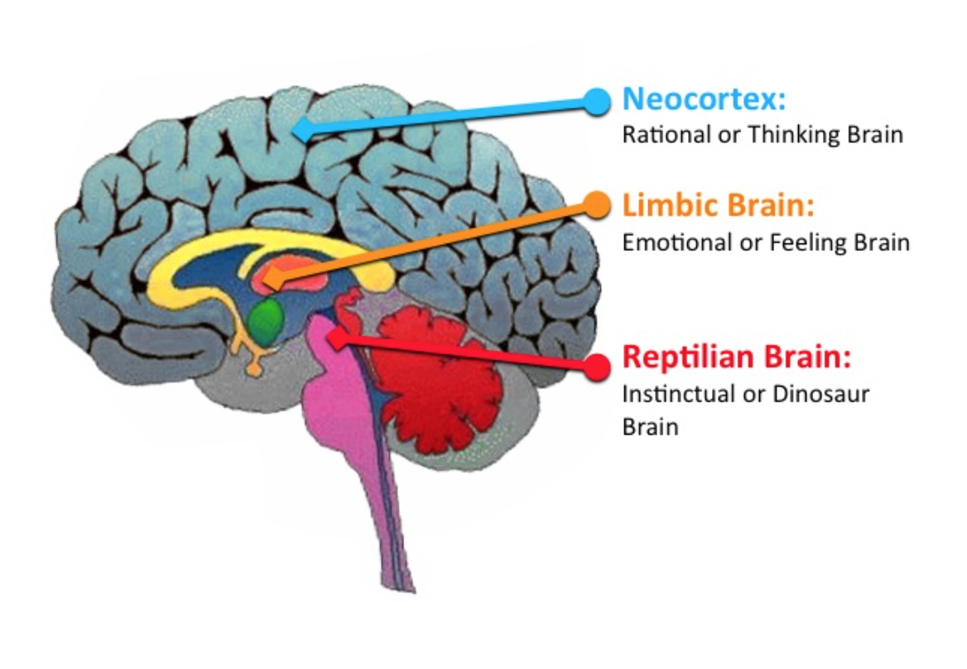
Emotional centers develop first
Development is a process not an event
Reasoning ability ALWAYS exists, but is solidifying

Slide 20
Enrichment and Protection
Adolescents are super-learners
Experimentation is a necessity, it is our job to create enriching, exciting, safe opportunities for growth.
It is also our job to protect from harm

Slide 21

Why super - learners must push the edges. And, our role.

Slide 22
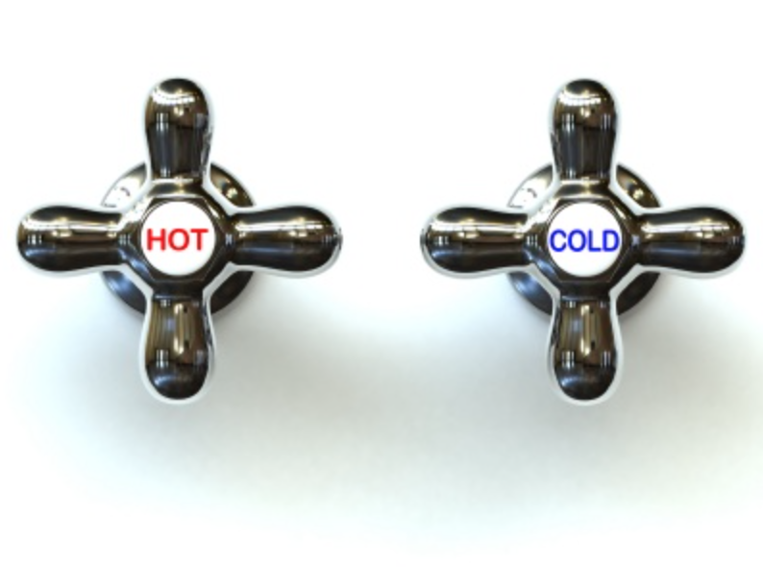
Communication for the Developing Brain (Which incidentally is inside of a person)

Slide 23
Adolescence offers us the opportunity to reshape the brain.

Slide 24
NeuroScience 101
Neuroplasticity – The brain can change and reshape itself – for better or worse – to adapt to its environment.
Adolescence is a time of astoundingly rapid brain growth where brains remain plastic
New pathways can be built and old pathways that are not used become pruned away.

Slide 25



Slide 26
Resilience

Slide 27
Resilience
The ability to overcome adversity
The capacity to bounce back

Slide 28
Resilience
To survive difficult times
To thrive in the best of times

Slide 29

Stress with an Immediate Threat
We can not think or feel when we feel under attack
(Meaning: We can help youth distinguish real tigers from paper tigers or traumatic reminders)

Slide 30
Cortisol Driven Stress
Uncertainty May Be a Major Driver of Harm

Slide 31
The Bottom Line
Young People will be more resilient if the important adults in their lives believe in them unconditionally and hold them to high expectations

Slide 32
Resilience
is
NOT
Invulnerability

Slide 33

Resilience
can
be
Exhausting

Slide 34
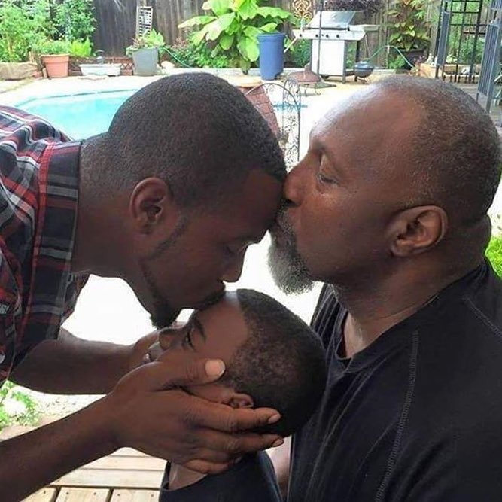
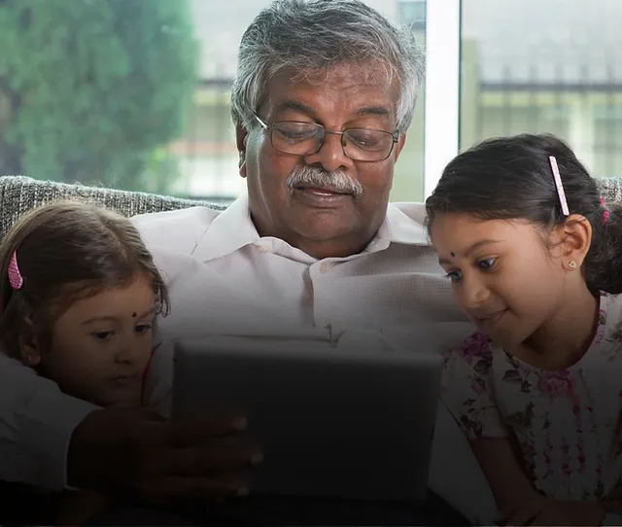
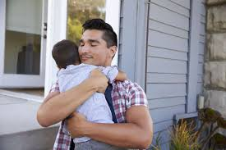
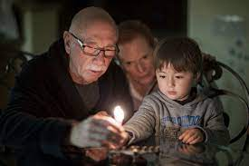



Above all . . . human connection

Slide 35
Trauma-Sensitive Practices

Slide 36
Childhood Trauma May Affect:
The Body
The Brain
Behavior
Genetics

Slide 37
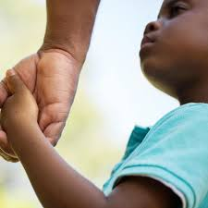
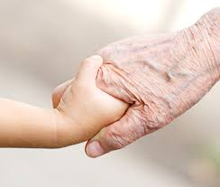
UNLESS

Slide 38

The Potential Effect of ACEs on Behavior

Slide 39
Key Principles of Trauma
Sensitive Practices
Knowing what is about you and what is not about you (Meaning anger or acting out directed towards may not be based on anything you’ve done)
Changing your lens from “What’s wrong with you!” to “What happened to you?”
Seeing people as they deserve to be seen, not based on labels they’ve received or behaviors they’ve displayed
Giving control back to people from whom control has been taken away

Slide 40
Effective Trauma-sensitive Practice Ensures People are Seen and Heard
We must refuse to perpetuate undermining ways they’ve been seen by others

Slide 41
We empower people when risky behaviors are contextualized in the realities they must navigate.

Slide 42
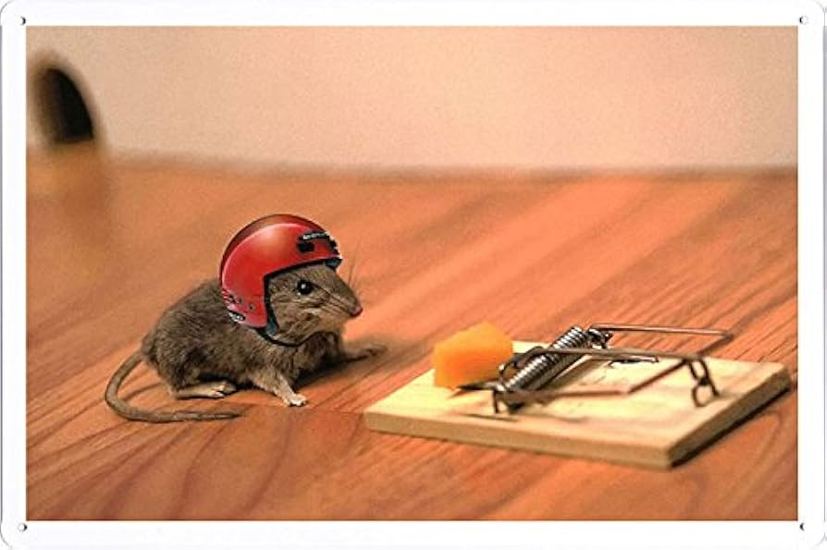

Slide 43
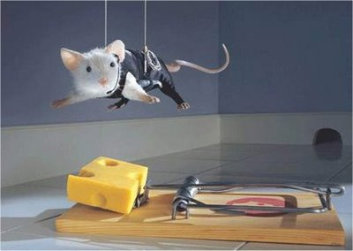
Notes:
Let’s be honest, some kids do test their limits and even I can admit they might be a little more into risk taking than others

Slide 44
Our youth have been hurt by systems and services that have not met their needs and/or applied undermining labels to them.
Anger Problem
Oppositional
Defiant
Explosive
These labels alter how systems view youth and how youth view themselves.

Slide 45
“Doc, I have an anger problem.”
I’ll bet you’ve earned it.
Do you get frustrated or react more quickly than other people do?
Do you see problems before others do? Do you sense danger?
Do you protect the people you care about?
You have a protector’s brain. You’ve earned it. Your sensitivity, you always thinking about keeping yourself and others safe, that is your POWER—your superpower even—you are somebody who is built to protect yourself and others.
Your challenge moving forward is to know when to use your superpower and to better understand when it might get in your way. Can we work together so you can learn how and when to use this strength of yours?”

Slide 46
How Do Hard Lives Make People Experience Interactions and Transitions Differently?
Every new situation is potentially dangerous
Where's the tiger hiding in the grass?
Am I safe?
What if I am judged? Will I be rejected?
Should I pretend I don’t care?
Should I push them away, so they don’t come too close?
Should I strike first?

Slide 47
Every interaction is an opportunity to offer safety and security and thereby quiet the vigilant part of the brain. In doing so, the protector’s brain may have protection to spare - offered through compassion and altruism.

Slide 48
Working with Youth Who Have Suffered is Not Always Affirming
Youth who need us the most are often those who push us away
Youth who need us the most are often those who push our buttons
Youth who need us the most, raise uncomfortable feelings in us
Youth who need us the most withhold rewards from us.

Slide 49
Nobody dared go near the tower. A fearsome dragon sat on its top.
Until one day, a knight rode up. "Do you need help to get down?"
"Please.”
O. Westin. Micro SF/F Stories

Slide 50
Strength-based Communication

Slide 51
Strength- based communication is rooted in potential
Problem Free . . .
. . . Is not fully prepared!
Karen Pittman

Slide 52
What May Be The Most Important Take Away of Today!!

Slide 53
We Must Use Praise Wisely
Praise incorrectly offered is not strength-based

Slide 54
Understanding this element of strength-based practice affects both your relationship and your professional longevity

Slide 55
What is NOT Meant by Strength-Based Communication
Praise backfires
Trying to be a friend undermines safety

Slide 56
We must help people know we’ll be there when they most need us
“”“ I need someone who has my back.”
Behavior involves forward and backward movement
When praise looks like cheerleading it backfires
“Friendship” triggers adolescent fears
Make praise about relationship

Slide 57
Strength-based Communication is about battling shame, stigma, and demoralization
It is about listening until genuine strengths are revealed
It is about highlighting and elevating their strengths

Slide 58
Seeing strengths . . .
. . . Leveraging strengths to address challenges
X
X
X

Slide 59
“Love is seeing someone as they deserve to be seen, as they really are , not through the lens of the behaviors they have sometimes needed to display.”

Slide 60
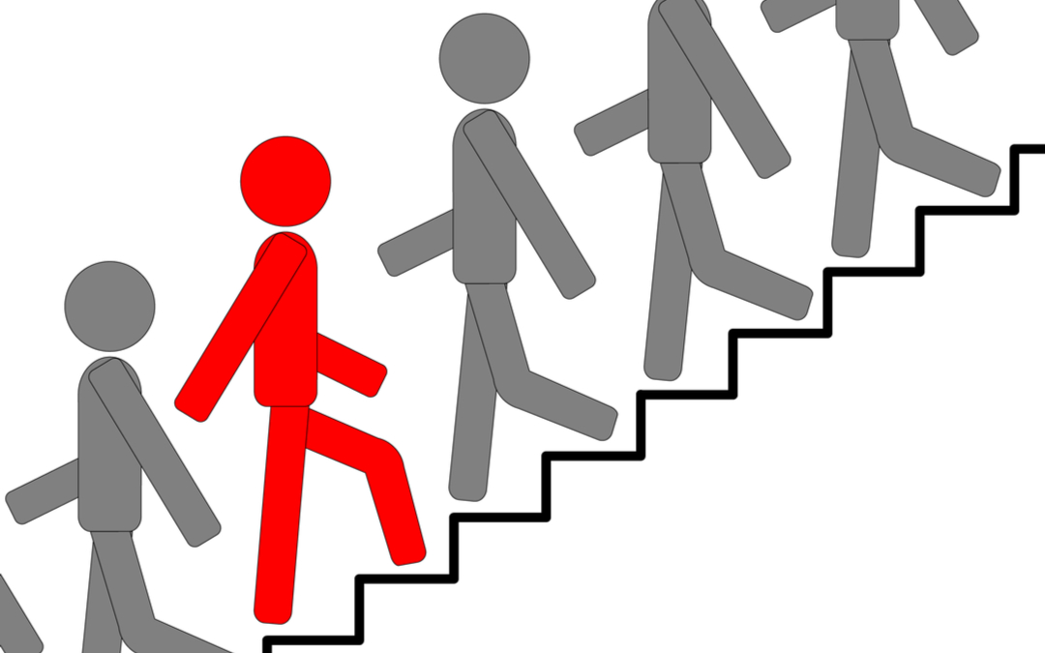
Love!?!

Slide 61
Loving???
Loving is Not the Same as Liking
It is Much Safer
And So Much Easier

Slide 62
Behavioral progress is made by leveraging existing strengths
I know you can ____ because you have ____.

Slide 63

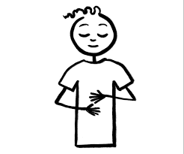
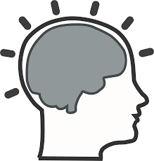

Heart
Belly
Head
Hands

Slide 64
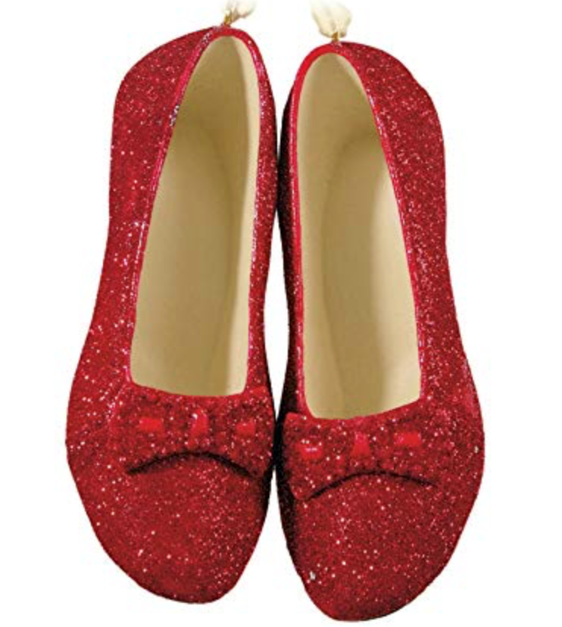
Secure and Sustained

Slide 65


Slide 66
Giving Youth Control Over Their Decisions

Slide 67
When we offer choices
When we expand their window of tolerance through the language of resilience
When we coregulate as a path towards clear thinking
When we calmly guide them a step at a time to make wise decisions
When we parent or “adult” them wisely
When we help them build stress management skills

Slide 68
Every time we enable the choices that come from clear thinking . . . But how do we get there?

Slide 69
Stress, and coregulation

Slide 70
Good Stress
Helps us handle challenges and allows us to stretch just far enough that we are likely to grow from the experience.
We should support young people with the skill-sets that draw the greatest developmental growth from good stress.
Dr. Bruce McEwen

Slide 71
Toxic Stress
Toxic stress is more than we can handle in a healthy way and is disruptive to our well-being. We must protect people of all ages from toxic stress.
Dr. Bruce McEwen

Slide 72
Tolerable Stress
Tolerable stress is uncomfortable but within our window of tolerance because we can cope with it. What is tolerable is subjective and fluid.
It is in the window of tolerable stress that we can make the difference. It’s about how much someone can handle depending on what else is on their plate and what stress management strategies they possess. The power of coregulation is that caring adult presence changes the equation by making challenges tolerable.
Dr. Bruce McEwen

Slide 73
Calmness, even amidst a chaotic reality, helps youth access their thinking powers and compassionate natures
Co-regulation
  Amygdala to amygdala communication
  Key to de- escalation
  Critical to anticipation
  Key to allowing “Mother Teresa” to surface
Self-regulation is a skill to be developed

Slide 74
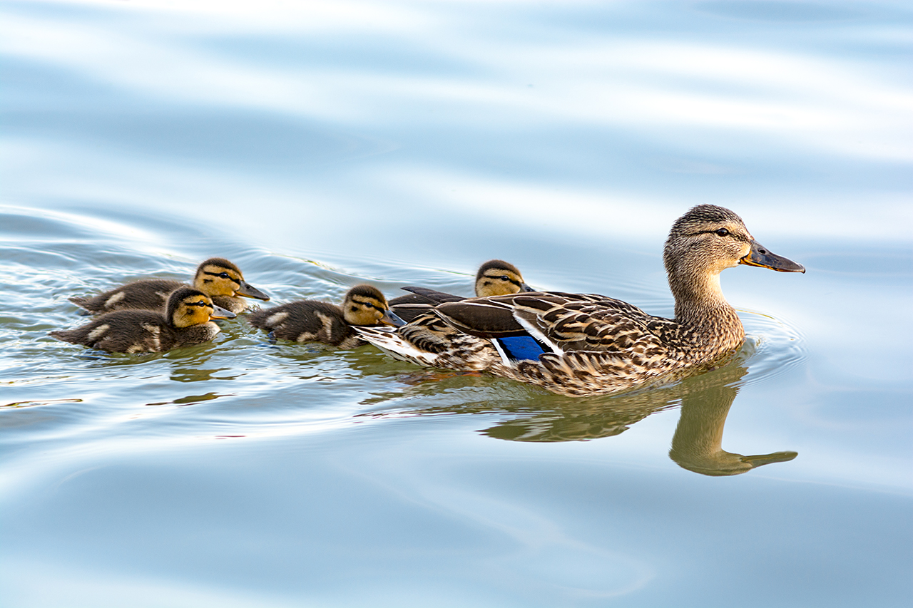

Slide 75


Slide 76
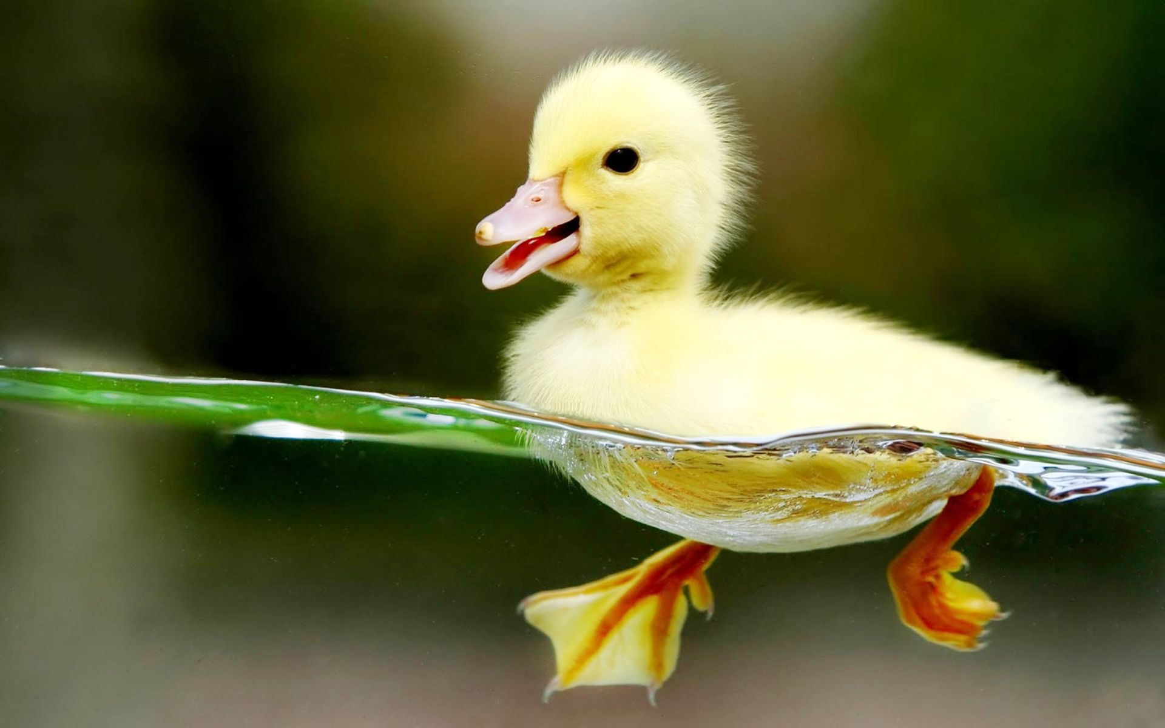

Slide 77
The Language of Resilience . . .
. . . offers support while increasing the window of tolerable stress

Slide 78
Although we’d like to protect young people from what might hurt them, the best we can do is prepare them to handle life even when it gets tough.
That means setting aside our instinctual needs to protect them from a momentary challenge, and to instead choose a strategy that prepares them for the future. We do our best when we help them understand they can take control over their own lives.

Slide 79
Words Express How We Think
With our words, we express whether we see youth as vulnerable. Fragile. Incapable. Our language can also state clearly that we think they are safe. Strong. Capable.
When we say to young people, “Let me help you with that,” we communicate “I don’t think you can do it on your own.”
When we say to someone, “It’s not that bad. Let me give you a hug,” we imply comfort relies on us. Rather, we want young people to know the problem is real and that they’ll be able to handle it . . . with our support.

Slide 80
Words Express How We Think
When we jump in with solutions, we deny adolescents the space to arrive at their own. On the other hand, when we listen to them and act as a sounding board, we give them the opportunity to be thoughtful.

Slide 81
Notice in these examples. . .
Feelings are validated. The problem is acknowledged as real. It is neither magnified nor minimized.
Sensitivity is acknowledged as uncomfortable, but a strength to be developed.
There is an assumption that the young person is developing and learning. Their thoughts and opinions are elicited.
Adults offer their presence and guidance, not the solutions.

Slide 82
Say this . . . When Engaging a Person’s Thoughtfulness | Not that . . .
What do you think. I’m here to listen. | I think . . .
Tell me what you understand | You're too young to understand. or, You wouldn’t understand

Slide 83
Say this . . . about problem solving or solution building | Not that . . .
How do you think you could solve this problem? | Let me help you with that.
You haven’t yet been able to . . . | You can’t . . .
What do you think is the best way to handle this? How can I support your plan? | I’ll handle this for you.
Take one step at a time. When you’ve accomplished something small, you’ll prove you can succeed and feel less overwhelmed. | Just get started

Slide 84
Say this . . . about a bad experience | Not that . . .
This must feel awful. In time, it will hurt less. And you’ll be stronger for the experience. | It’s not that bad.
You’ll get through this . . . | I’ll protect you.

Slide 85
Say this . . . about emotional distress | Not that . . .
The best thing about you is how much you care. Your challenge in life will be to learn how to care without hurting too much inside. | You’re too sensitive.
It is great to think as much as you do. Your challenge is to remind yourself you'll be able to handle this; you just have to think through a solution. | You worry too much.

Slide 86
Say this . . . about seeking help | Not that . . .
A strong person learns how to reach out to others. | A strong person handles tough times
It’ll take time. But your own strength and the support you’ll get from those who care about you, will help you heal. | Just get past it.
You deserve to feel better. | You need help

Slide 87
We also help youth self-regulate when they learn to catch their own thoughts

Slide 88
Dialing Down Catastrophic Thought
1.
Recognize negative thoughts. They often begin with phrases like “I better,” “If I don’t,” or “I should.” This is called thought catching.
Stop. Pause. Evaluate thoughts for accuracy.
Develop more accurate explanations when difficult things happen. Take away self-blame.
De-catastrophize. Let go of harmful thoughts that suggest a mistake or failure will lead to inevitable disaster.
2.
3.
4.

Slide 89
Dialing Down Catastrophic Thought
In conversations between adults and youth, we can miss the opportunity for them to learn how to change their thinking patterns.
We focus on the A (“What happened?”) and C (“How do you feel now?” or “What are you going to do?”). We can help them better understand the B connectors - the silent self-talk that drives their beliefs, determines how they interpret situations, and can lead to a calm versus reactive response.

Slide 90
Dialing Down Self-Defeating Thoughts
Self-defeating thoughts often begin with words like “I never” or “I can’t.” This undermines hope. Help teens add the transformative word “yet” to their thoughts.
“I can’t solve this problem” becomes, “I can’t solve this problem yet.” Hope. Then teens can free their minds to make an action plan.

Slide 91
We build control every time we engage their thinking capacities instead of trigger their emotional responses
Talking in a way young people understand
Recognizing the cognitive development of adolescence
No more lectures!!!!!!
No hot Communication

Slide 92


Slide 93

You fight, but she uses her knife first
Maimed and left in a wheelchair
Stabbed
in back
You fight, but she uses her knife first
Stabbed
in the
heart
You are
killed
You fight
and kill her
How long
are you
Happy?
Jail
20 years
Die poor,
with no family
No
job
No
education
Your mom
is ashamed
You don’t
fight
How long
are you
angry?
You finish school
Your mom
is proud
You have
kids

Slide 94
The World Happens to Me or
I control my Destiny

Slide 95
A Future as an Architect, Building
Your Community
Death and Destruction
Sense of
control returns
Life Running with Gangs

Slide 96
We gain control when we can wisely manage stress

Slide 97
Stress Management and Resilience
Is about learning to cope, in a positive way with life’s inevitable stressors
People who can choose positive coping strategies gain control

Slide 98
Relief
Relief
Positive Coping Strategies
You Feel Awful!!!
You Feel Awful!!!
You Feel Awful!!!
Stress
Discomfort
Discomfort
Discomfort
Negative Coping Strategies

Slide 99
Relief
Relief
Positive Coping Strategies
You Feel Awful!!!
You Feel Awful!!!
You Feel Awful!!!
Stress
Discomfort
Discomfort
Discomfort
Negative Coping Strategies

Slide 100
A Comprehensive Stress Management Plan Includes:
Problem-Focused Strategies
Emotion-Focused Strategies
Strategies that Integrate the Mind and Body
Strategies that Build a Sense of Meaning and Purpose

Slide 101

www.parentandteen.com

Slide 102
For us to support youth to Be OK, We Have to Be Ok, and We DESERVE to Be OK
Integrating Self-care Into Our Real Lives

Slide 103
Becoming a “Protector” or “Sensor” Takes a Personal Toll
We cannot ask for such sacrifice unless we commit to our well-being with the same fidelity as we commit to caring for others

Slide 104

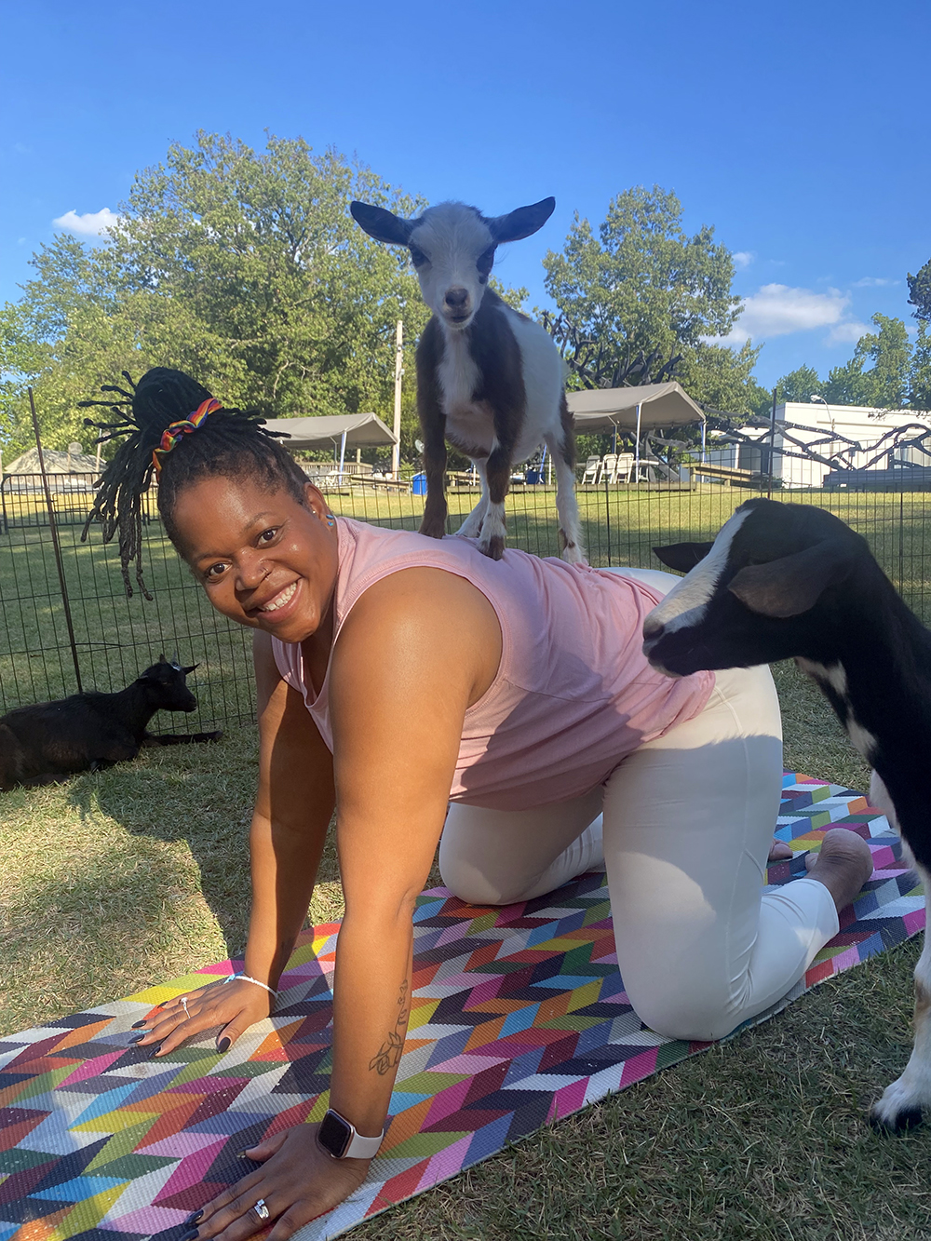
It is not about . . .

Slide 105


Nor about . . .

Slide 106
It is about . . .
How do you love, give of yourself, while remaining whole?
How do you bear witness without shutting down?
How do you see suffering, while limiting your own reexperience?
How can our work enhance rather than disrupt our relationships at home?

Slide 107
It is about . . .
Experiencing our feelings

Slide 108
The Worst thing is not to be stressed . . . it is to be NUMB

Slide 110
Do the work in real time, there is no choice
Get to calm . . .
Remember the mission . . .
Remember today is just a moment. If nothing else, maintain the relationship to try again another day.
Commit to really doing the reflective and freeing work at home, or at work with colleagues

Slide 112
I ________________ it out!

Slide 113
Boundaries
Not the easy stuff. How do you love and still remain whole?
Knowing our buttons
Being sensitive
Knowing who is the expert
Avoiding the rescue fantasy
Giving control back
How much do we share?
How much do we give to each youth?
I or We?
How do we treat those at home

Slide 114
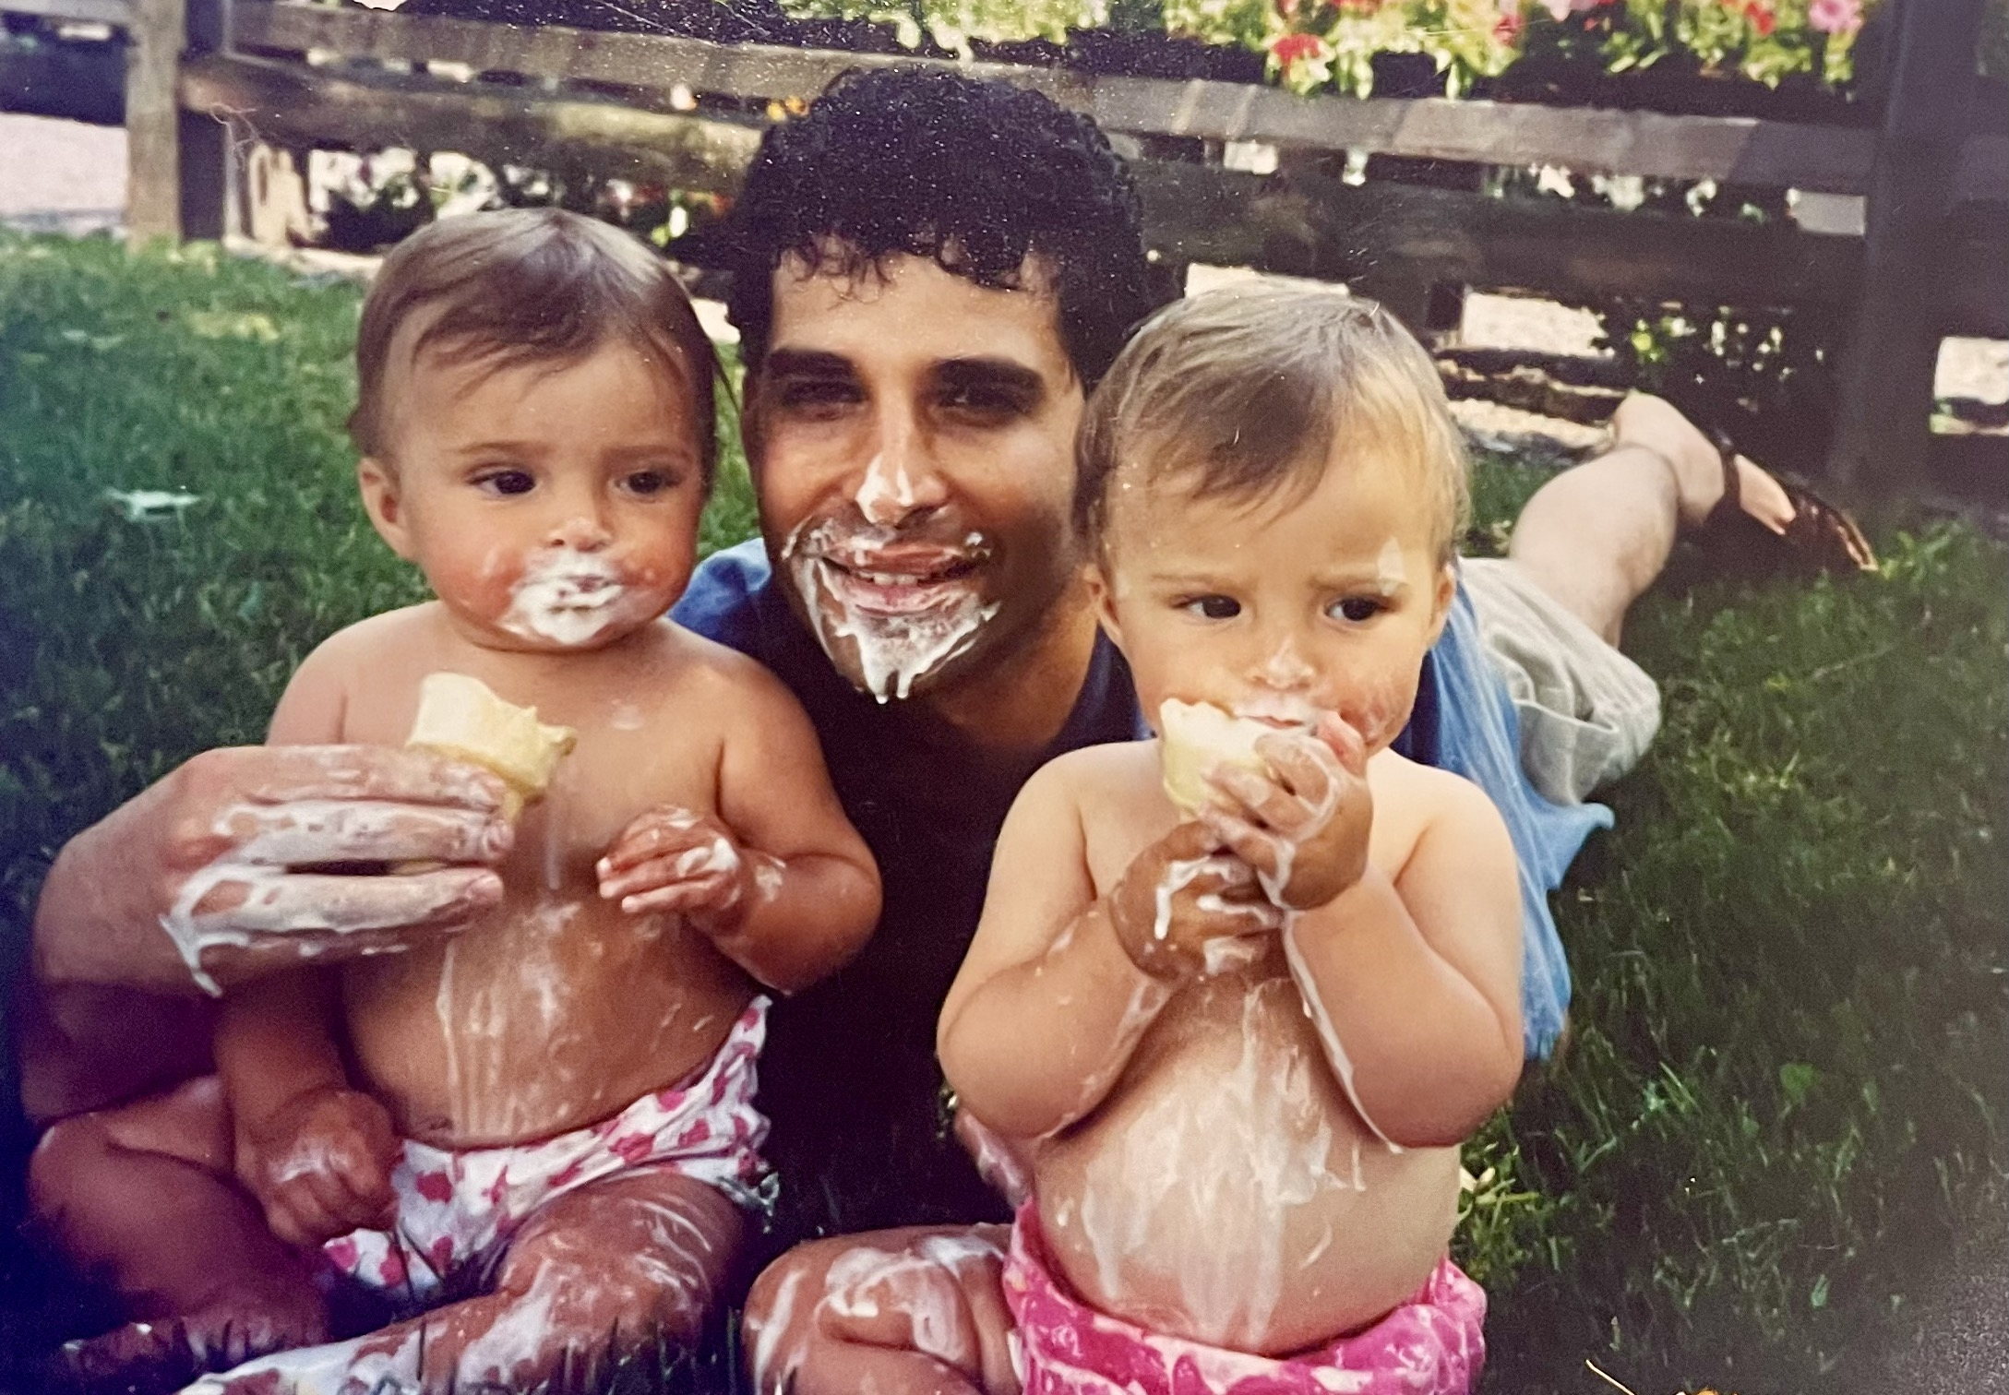
Preventing Our Work From Damaging Our Home Relationships

Slide 115
Almost done!!

Slide 116
How will we judge our success?
Through easy measurements: placements, grades, jobs, health status. . . and mental health rates
But mostly in vital ways not easily measured . . .

Slide 117
How will we judge our success?
When people feel, seen, heard, and empowered.

Slide 118
Why Do We Love?
So people know they are worthy of being loved . . .
Kevin Ryan, Former CEO Covenant House International
Why Do We Respectfully Listen?
So people know they should be heard . . .
Why Do We Protect?
So people know they deserve to feel safe . . .
Why Do We Offer Relentless Support?
So people know that nobody should give up on them, and they must always hold hope for progress . . .

Slide 119
Why Do We Ask Nothing in Return?
So people can learn that some people can be worthy of trust. . .

