Slide 1
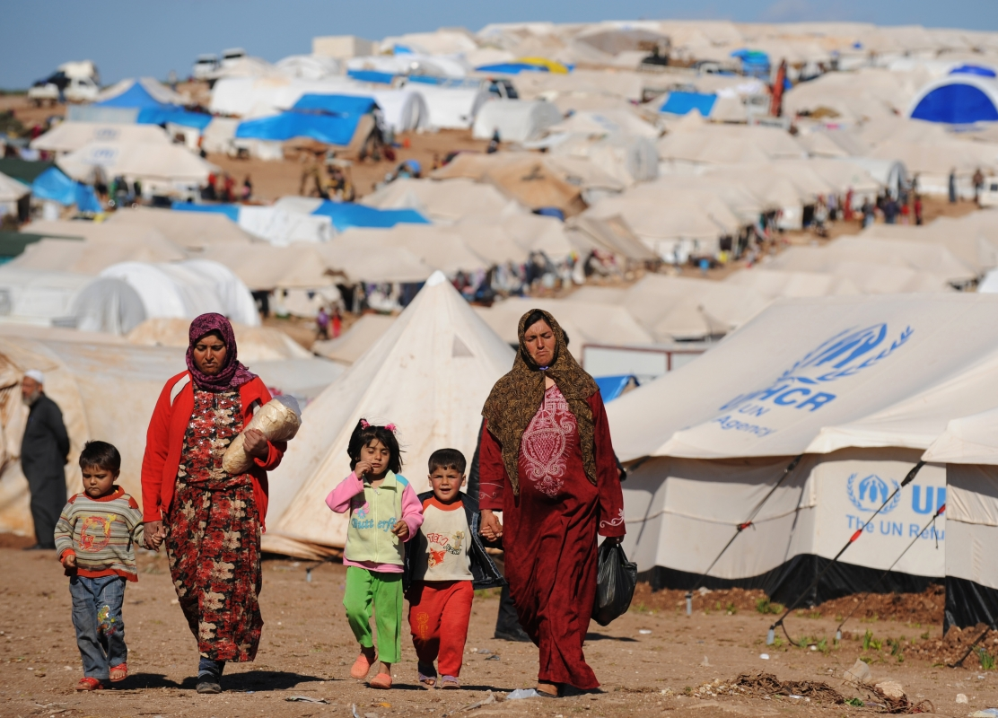
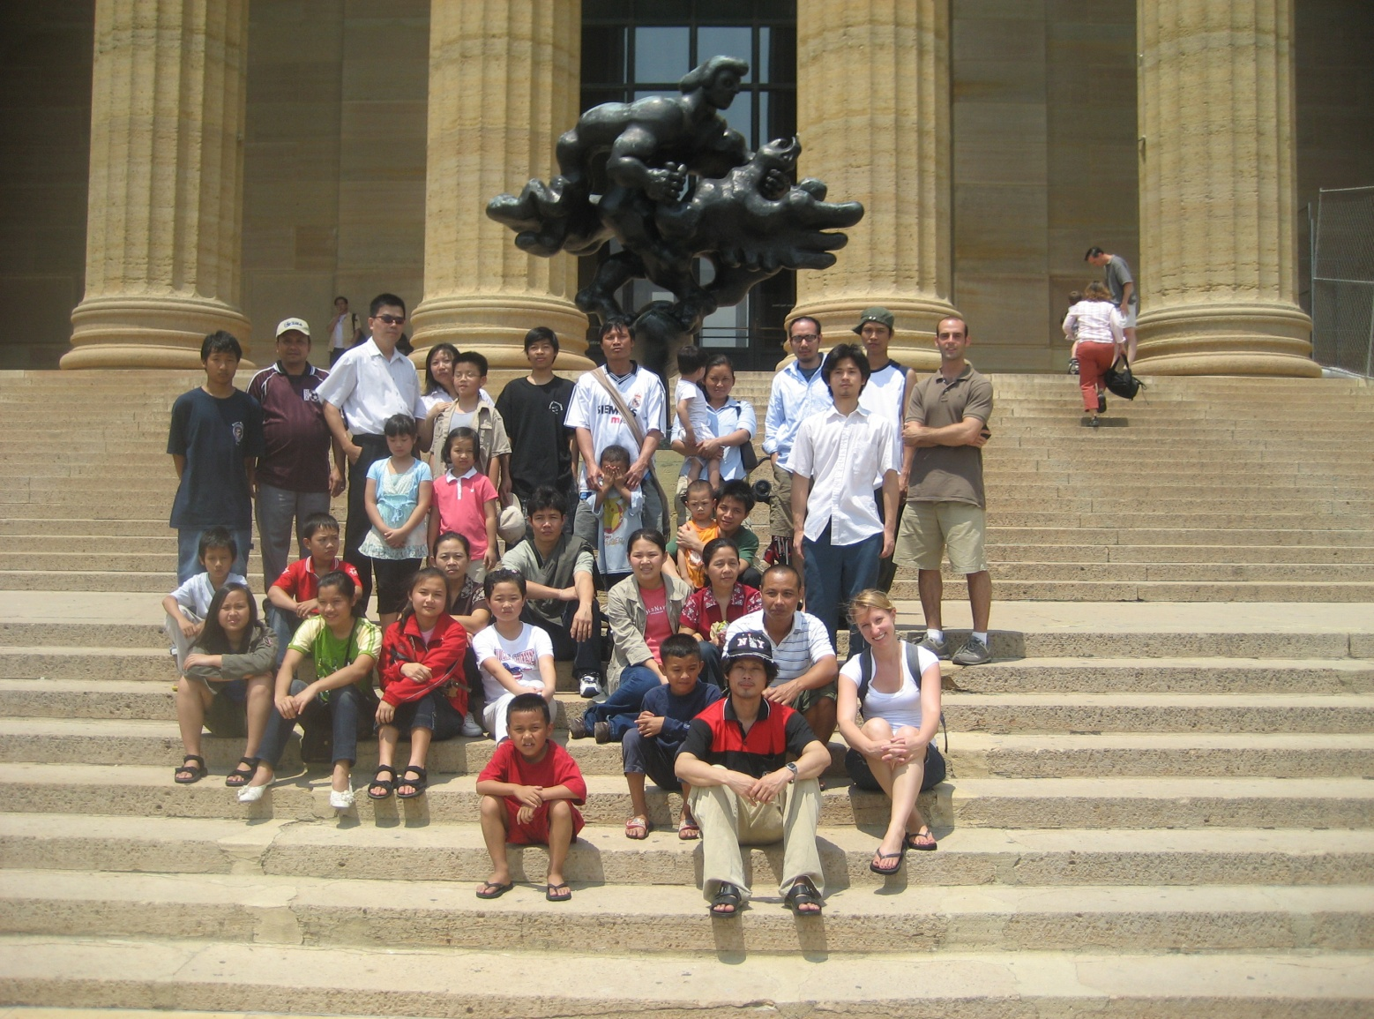
Refugee Health in Philadelphia
Marc Altshuler, MD
Professor, Department of Family and Community Medicine
Director, Jefferson’s Center for Refugee and Immigrant Health
Thomas Jefferson University

Slide 2
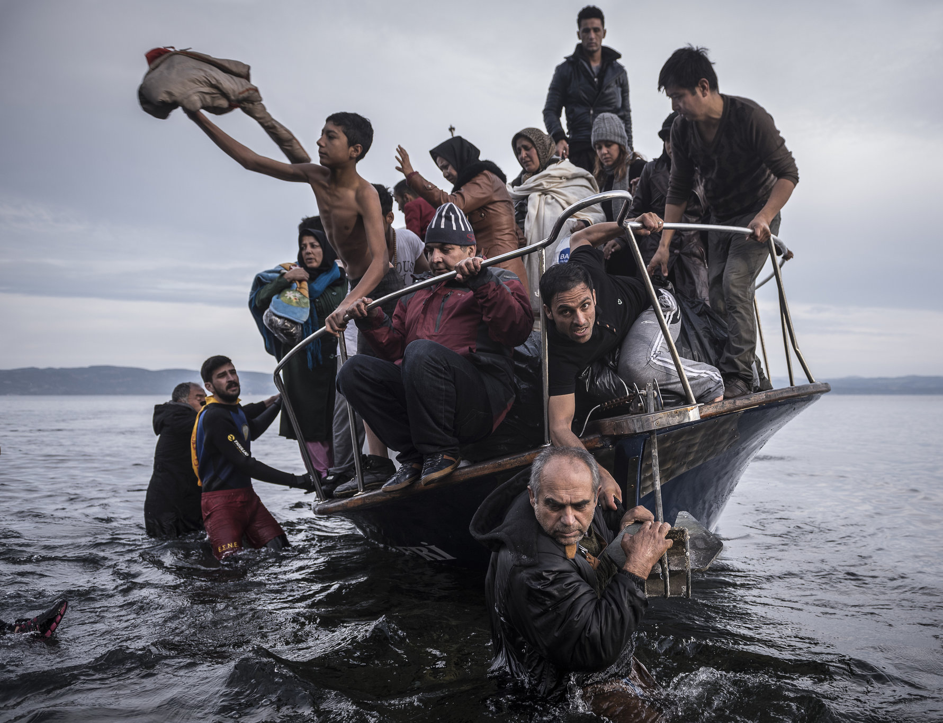
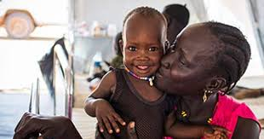
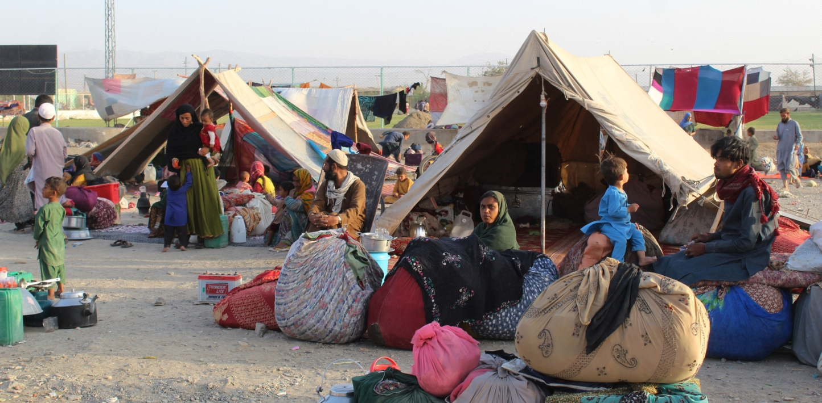
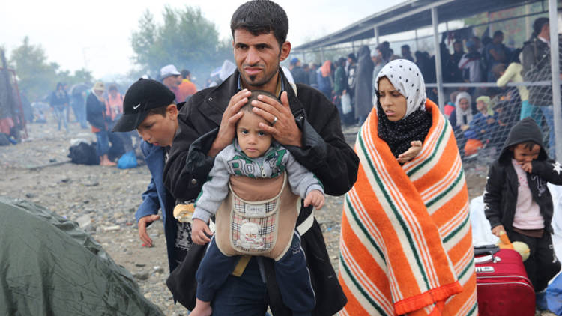
What does a refugee look like?

Slide 3
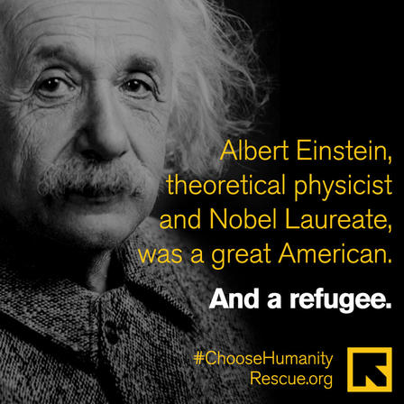

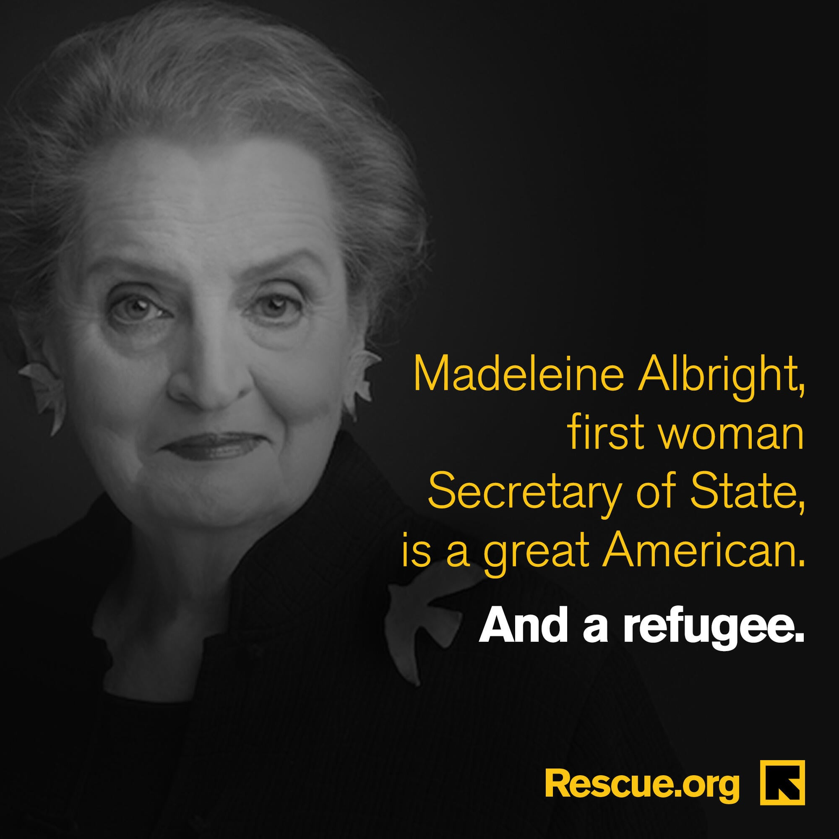


Slide 4
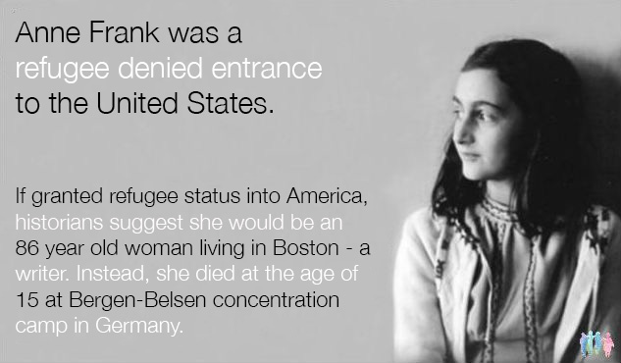

Slide 5
Objectives
Define
Define refugee resettlement and the creation of the U.S. Refugee Resettlement Program
Learn about
Learn about creation of the Jefferson Center for Refugee Health and the Refugee Health Partners
Discuss
Discuss the current state of refugee resettlement in the U.S.

Slide 6
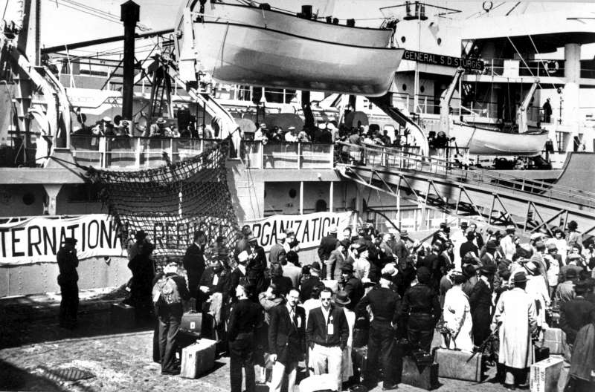
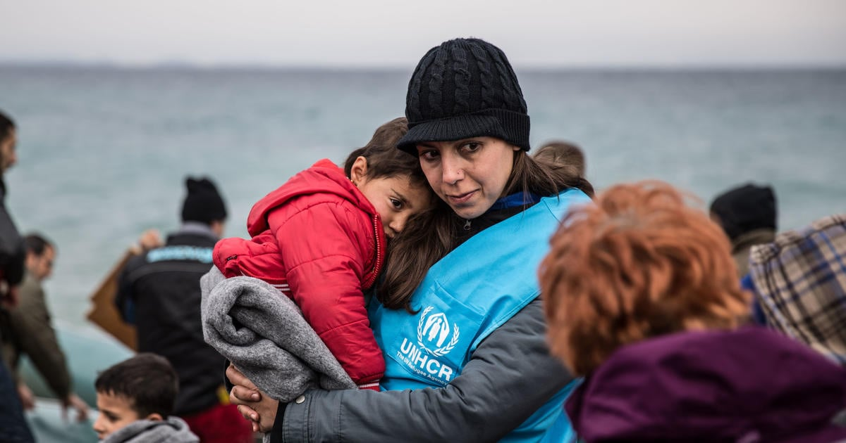
How it all started….UNHCR
Following World War II, the United Nations High Commissioner for Refugees (UNHCR) was formed in 1950 to help the millions of Europeans who fled Europe and lost their homes.
They were given 3 years to complete their work and then disband.
70+ years later, the UNHCR is still in existence.

Slide 7
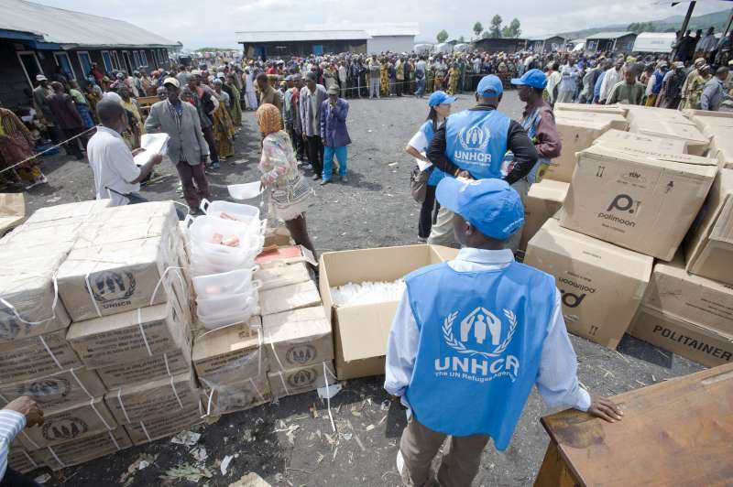
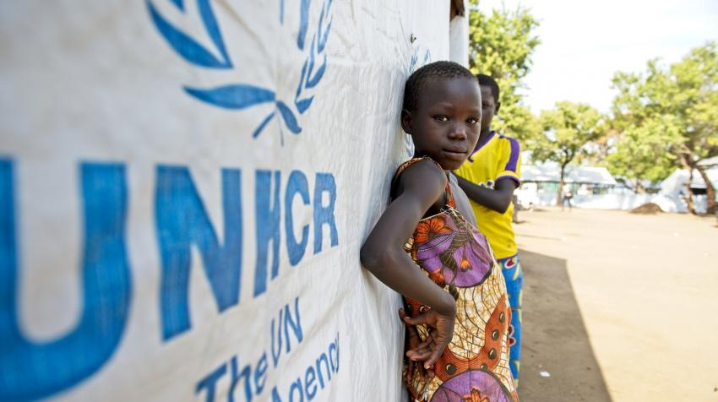
UNHCR 2026
Goal to safeguard the rights and well-being of individuals forced to flee
Ensures that everyone can exercise the right to seek asylum and find safe refuge in another State
Today, a staff of some 19,000 people in more than 137 countries continues
UNHCR has helped over 50 million refugees successfully restart their lives, and supports over 120 million displaced persons
www.unhcr.org

Slide 8
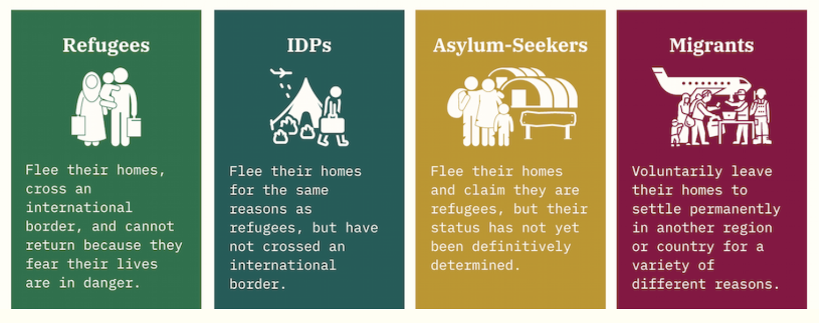
Definitions:

Slide 9
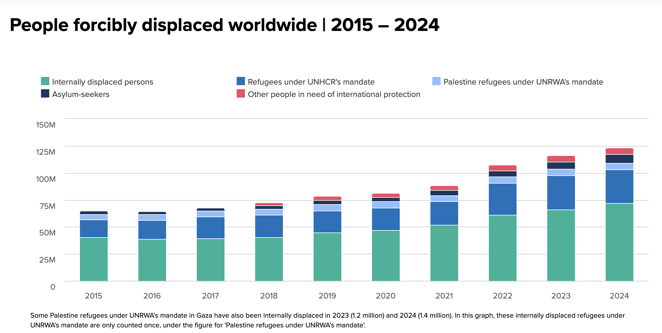

Slide 10
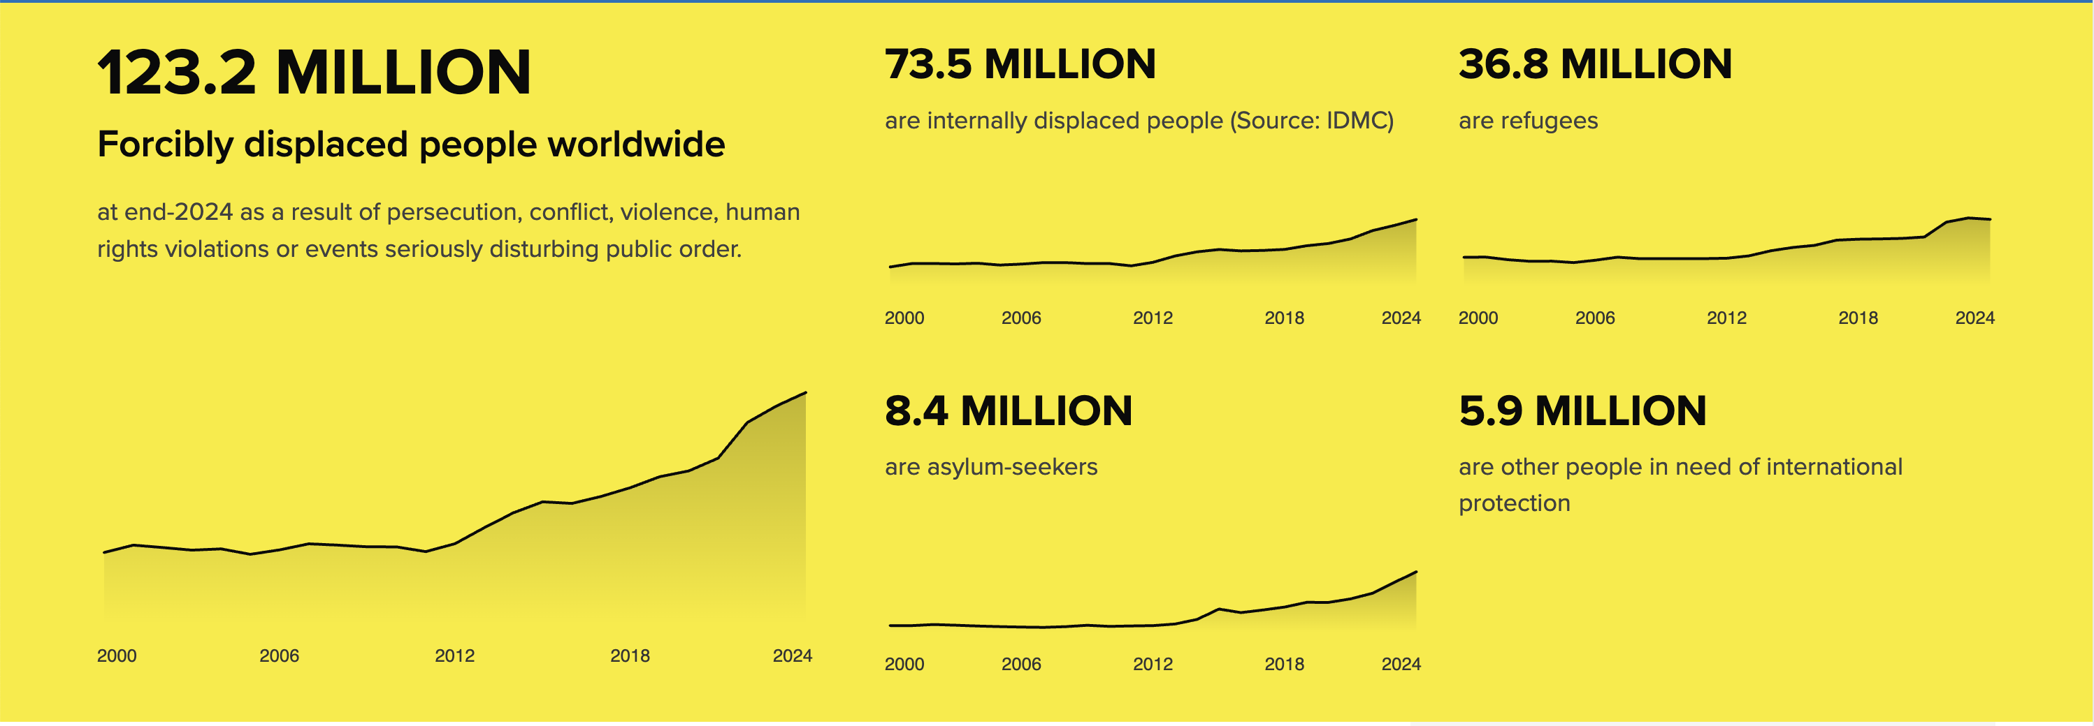
UNHCR Global Trends 2025 Report

Slide 11
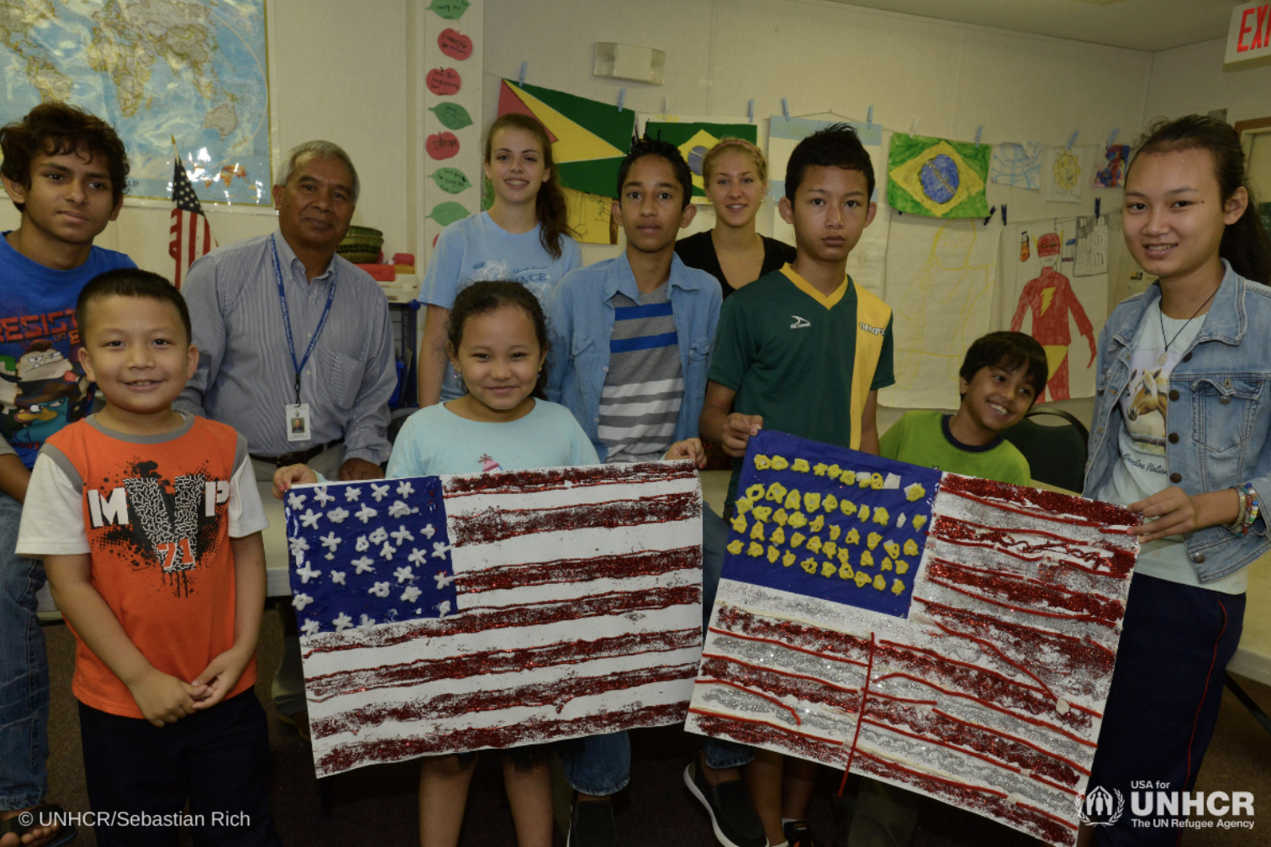
U.S. Refugee Resettlement Program
Notes:
(granted under the Trafficking Victims Protection Act of 2001)

Slide 12
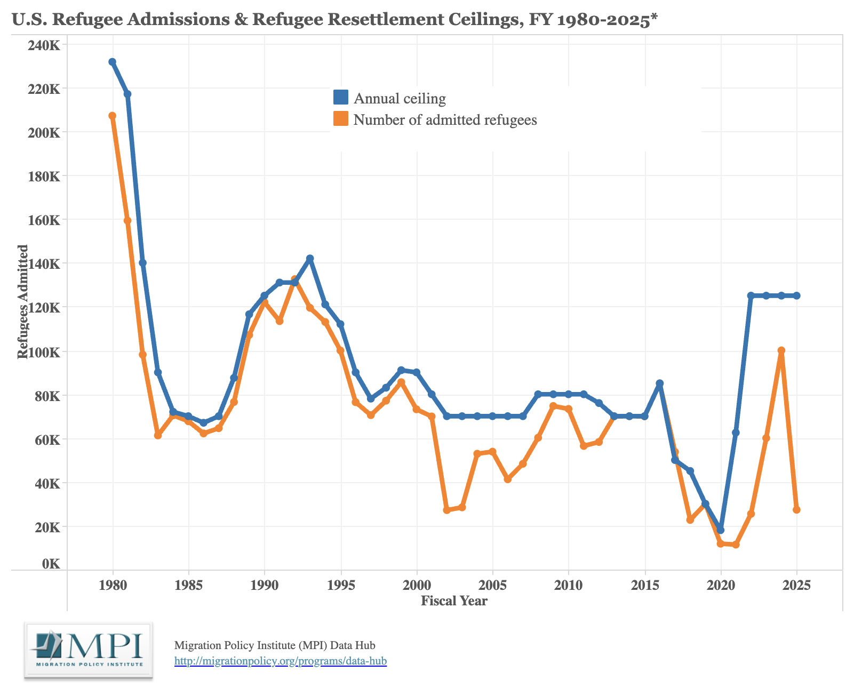

Slide 13



Refugee Health 2005
2005
Refugee Arrives in Philadelphia
HIAS and
Council
Lutheran Children & Family Service
Nationalities Service Center
Referrals from family and friends

Slide 14
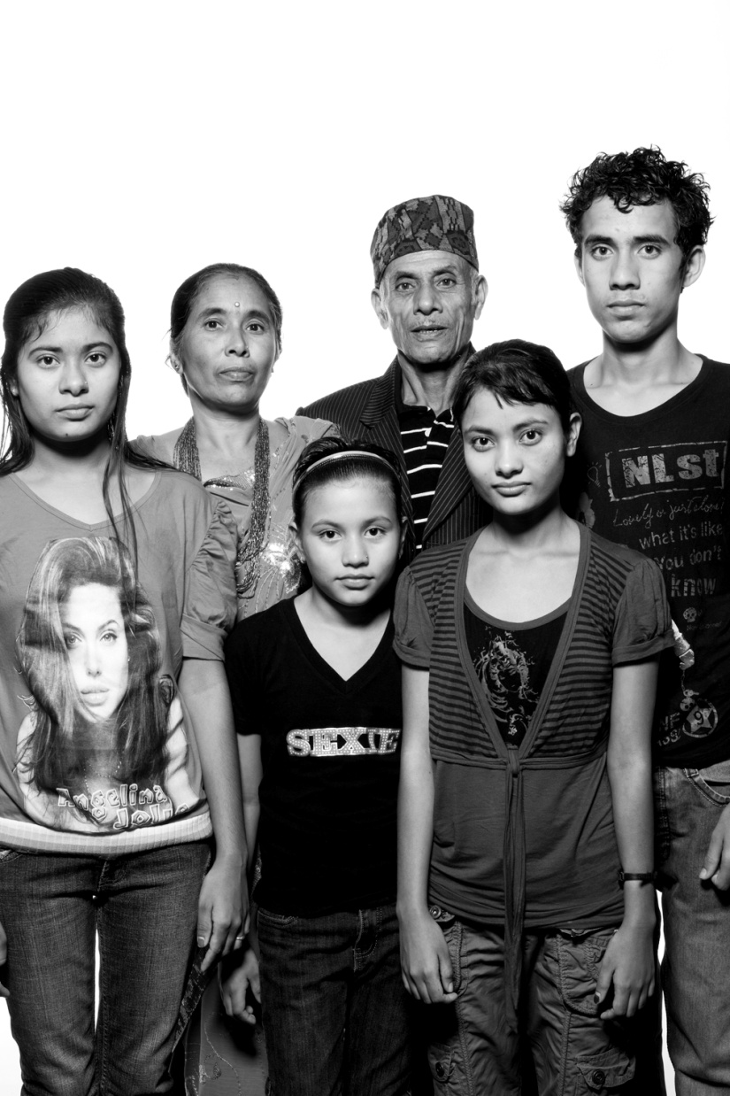
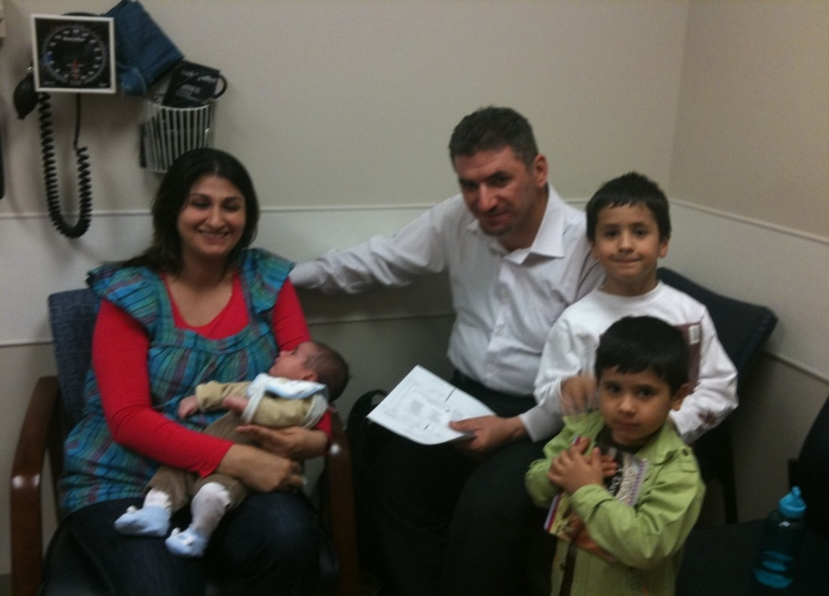
Jefferson Center for Refugee and Immigrant Health
The mission for the Jefferson Center for Refugee and Immigrant Health is to achieve equity in healthcare access and health outcomes for newcomers in Philadelphia, including refugees, immigrants, and asylum seekers.

Slide 15

Refugee Resettlement Agency Responsibilities:
Reception Services:
    Airport pickup
    Housing
    Hot culturally appropriate meal
    Basic furnishings and household items
    Culturally appropriate food staples (until food stamp case is opened)
Core Services:
    Social security cards (w/in 10 days)
    Welfare benefits (w/in 10 days)
    Medical screening (w/in 30 days)
    Enroll children in school (w/in 30)
    ESL referral (w/in 10 days)
    Employment referral (w/in 10 days)
    Home visits (24 hr, 30 and 90 days)

Slide 16
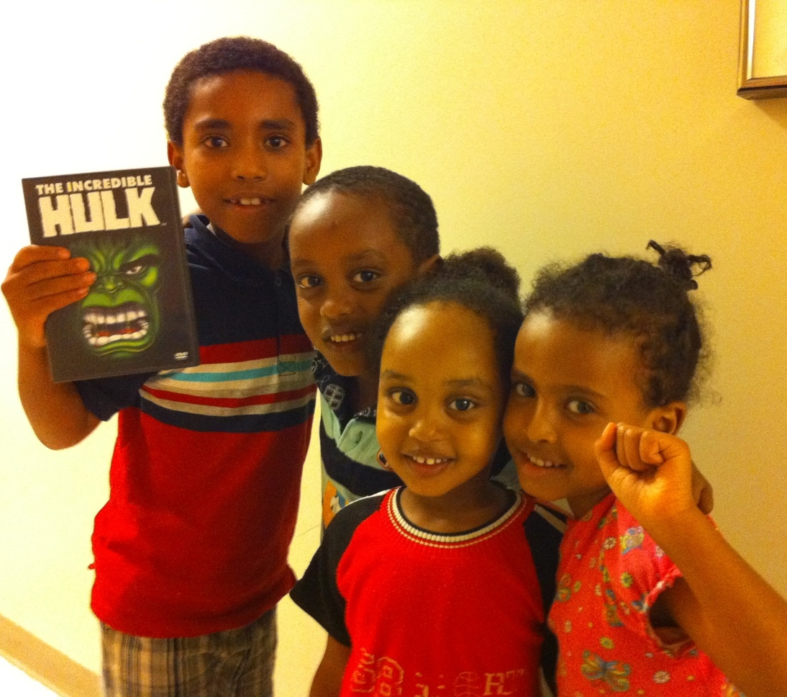
Timeline Highlights:
2007: Partnership between Jefferson and NSC to create 1st refugee medical home in Philadelphia.
2010: Creation of the Philadelphia Refugee Health Collaborative
2011: Refugee Health Partners is founded
2016: Designated by CDC as a Center for Excellence in Refugee Health
2021: Opened the Wyss Wellness Center
2025: 5-year gift to create the Wyss Institute

Slide 17


Refugee Health 2024
Refugee Arrives in Philadelphia
HIAS
Pennsylvania
Nationalities Service Center
Lutheran Children & Family Service
Evaluation based on medical needs, geographic location and availability
Children’s Hospital of Philadelphia (HIAS Coordinated)
Jefferson Family Medicine
(NSC Coordinated)
Drexel Women’s Care Center
(NSC Coordinated)
Einstein Community Practice
(LCFS Coordinated)
Penn Center for Primary Care
(HIAS Coordinated)
Nemours
Pediatrics
(NSC Coordinated)
Fairmount Primary Care Center
(NSC Coordinated)
Einstein Pediatric Clinic
(LCFS Coordinated)

Slide 18
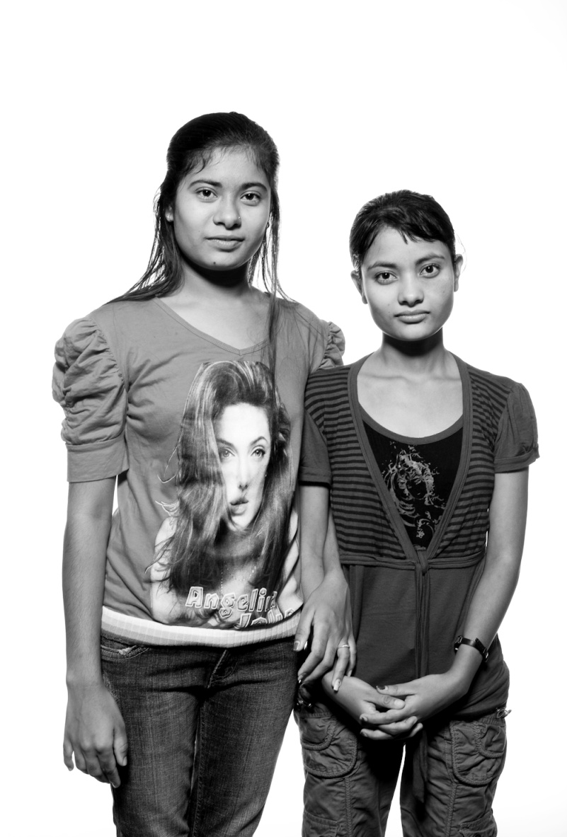
Some patient stories:

Slide 19
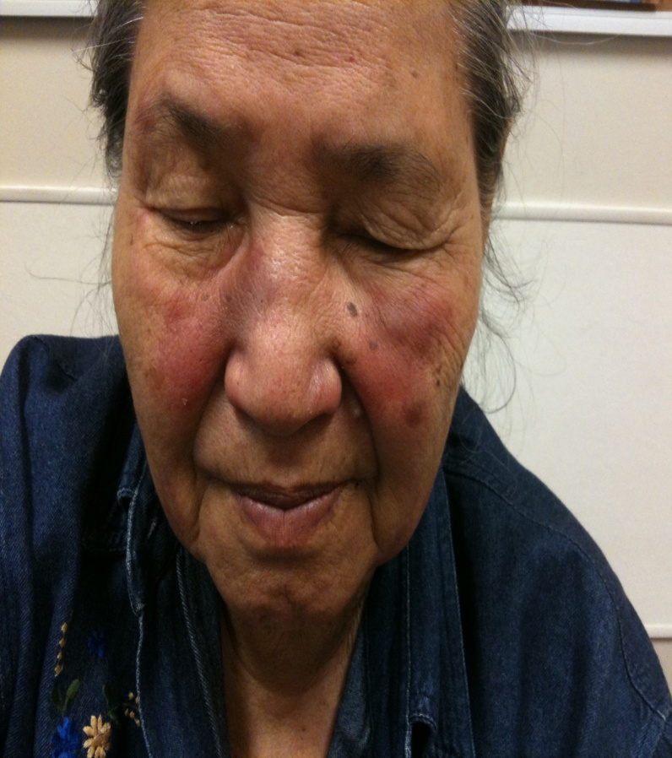
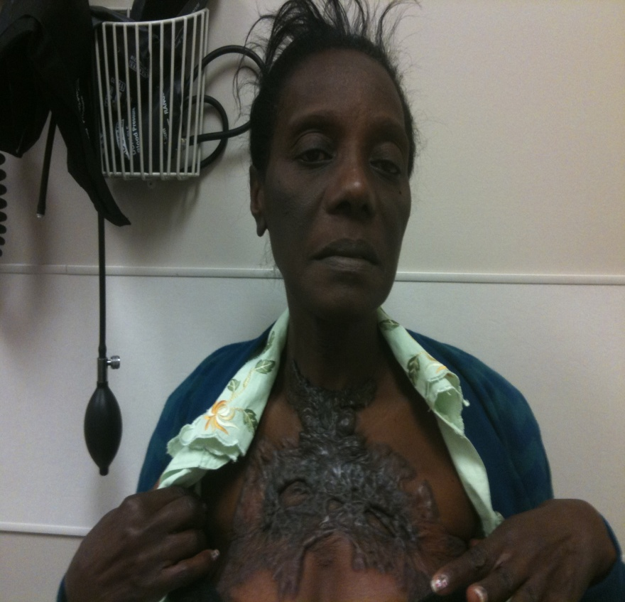

Slide 20
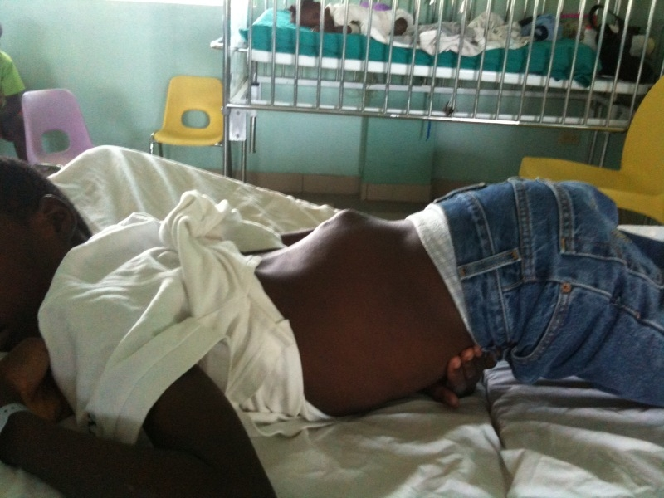

Slide 21





Refugee Health Partners - Mission
Our mission: Refugee Health Partners aims to empower refugees to navigate a foreign system and be active participants in their own healthcare, as well as foster culturally-conscious, equitable care within the Jefferson community.
Founded in 2011
> 700 student members since then
Notes:
Our names are Leela and Naomi and we are the presidents of Refugee Health Partners. We are a student led organization at SKMC and have members across all years of the medical school and we host events open to the greater Jefferson community outside the medical school as well. Our group officially because a Jefferson organization in 2011, and we’ve had 700+ members come through our organization since then.
As medical students, our mission is to empower refugees to be active participants in their own healthcare within a foreign system, and to foster culturally conscious, equitable care within the Jefferson community. Our first and foremost priority is the safety and dignity of the populations we work with. Over the years, we have come to form strong, trusted relationships with several cultural community organizations and leaders, including the Southeast Asian Mutual Assistance Coalition, the African Cultural Alliance, Puentes de Salud, the Cambodian Association of Philly, and the African Family Health Organization.

Slide 22
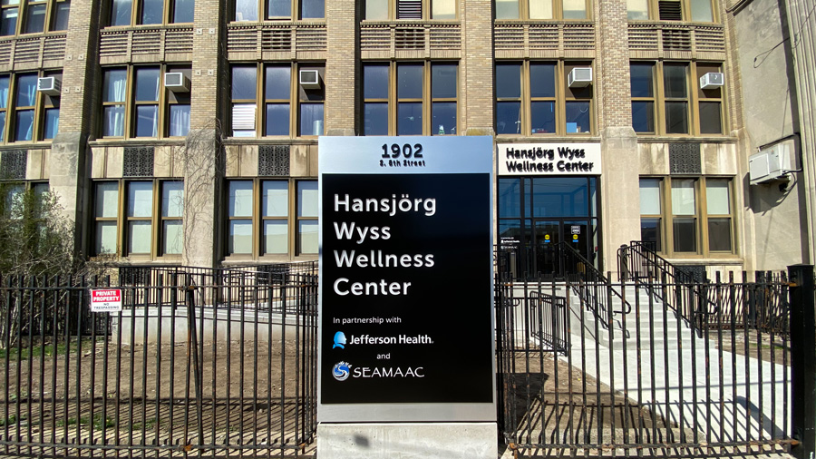

Slide 23
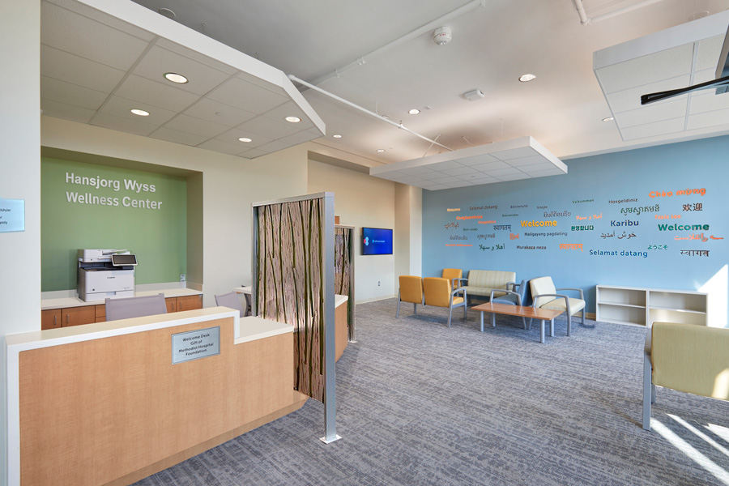

Slide 24
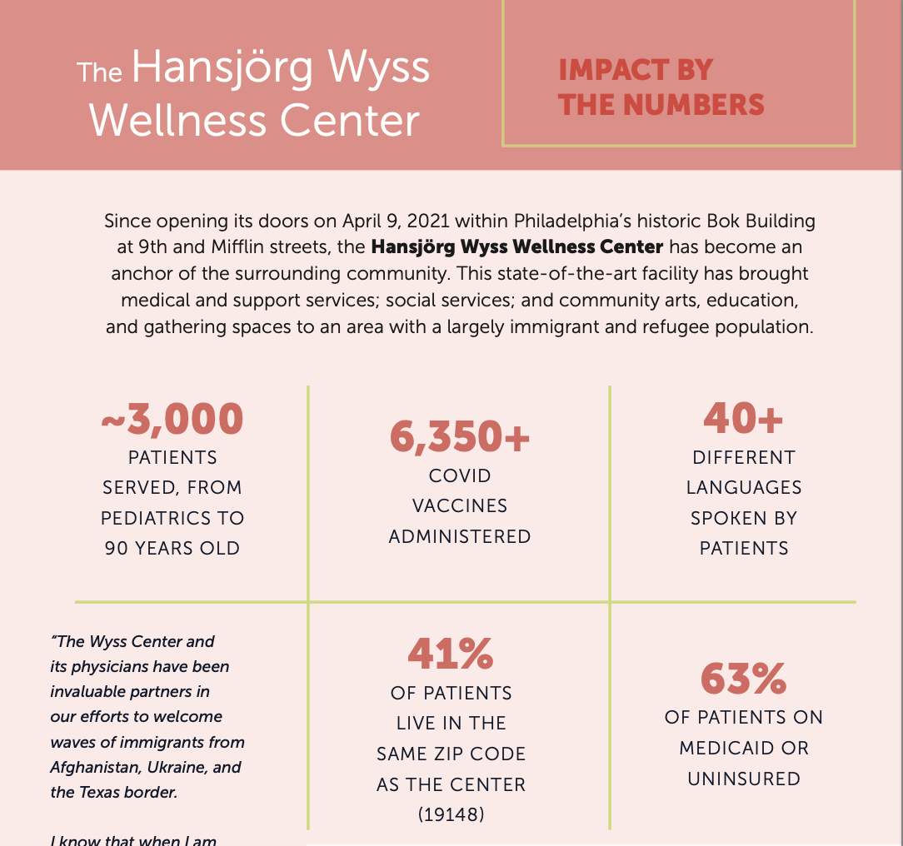
Wyss 2021-2024

Slide 25
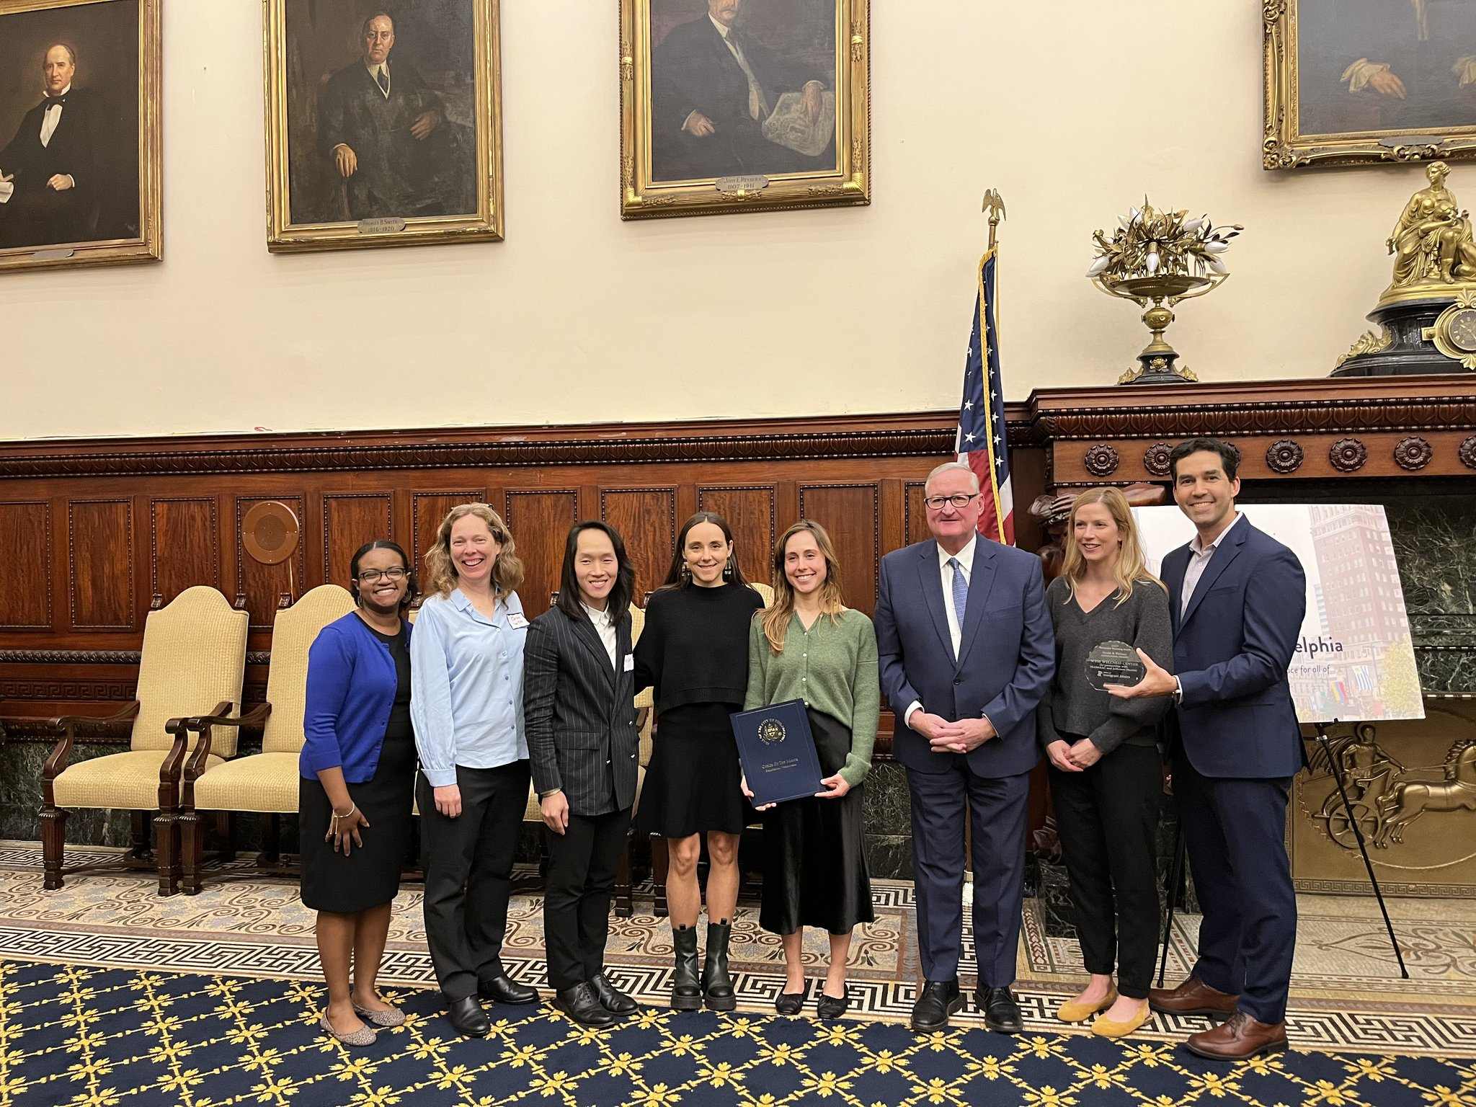
Health and Wellness Achievement Award for 2023 Philadelphia Welcoming Award

Slide 26

U. S. Refugee Resettlement 2025
On 9/30/24, President Biden announced a target of 125,000 refugees to be resettled in the U.S.
On 1/26/25, President Trump suspended the U.S. Refugee Program
  Cancelled travel for refugees accepted to US
  Freeze on funding for current refugees

Slide 27
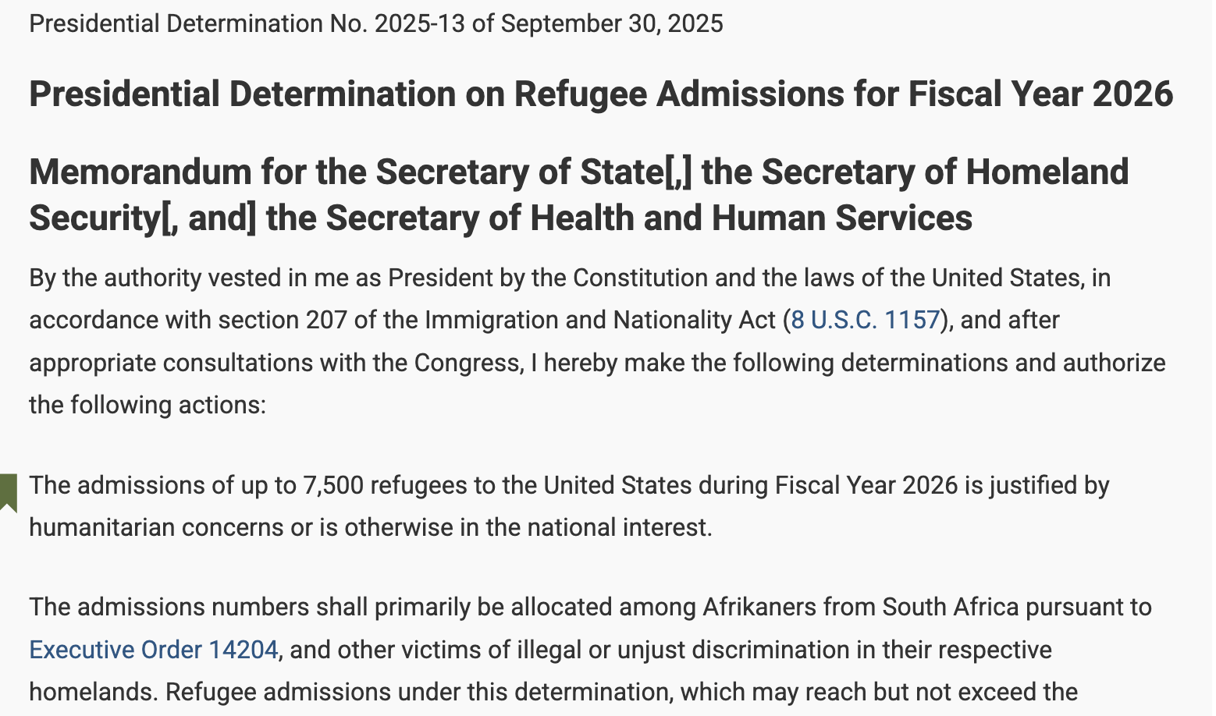
Presidential Determination for Refugee Arrivals 2026
Granted asylum to white South Africans “Afrikaners”
Due to post-apartheid policies that returned land to the people, Afrikaners claimed “racial discrimination.”
Decision occurred without proper consultation with Congress as required by law.
Afrikaners are the only “refugee” group allowed in the US. Current refugee ceiling set at 7500 for 2026

Slide 28
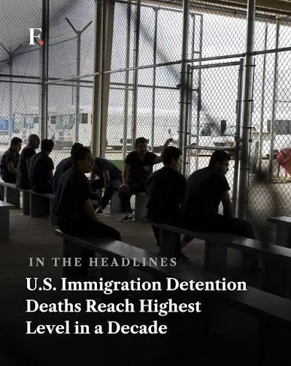
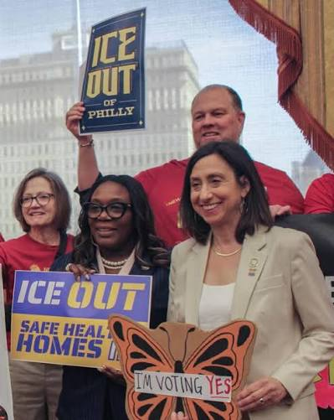
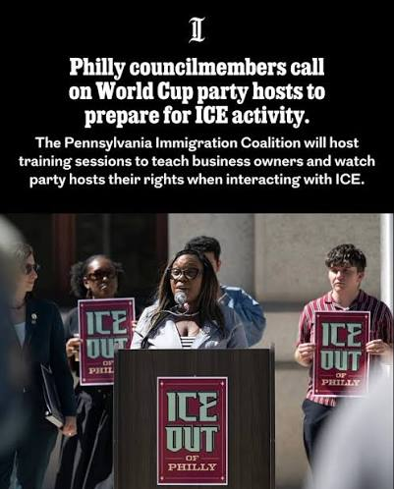
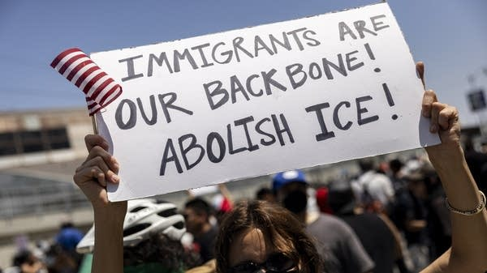
Current state for Immigrants in the U.S.

Slide 29
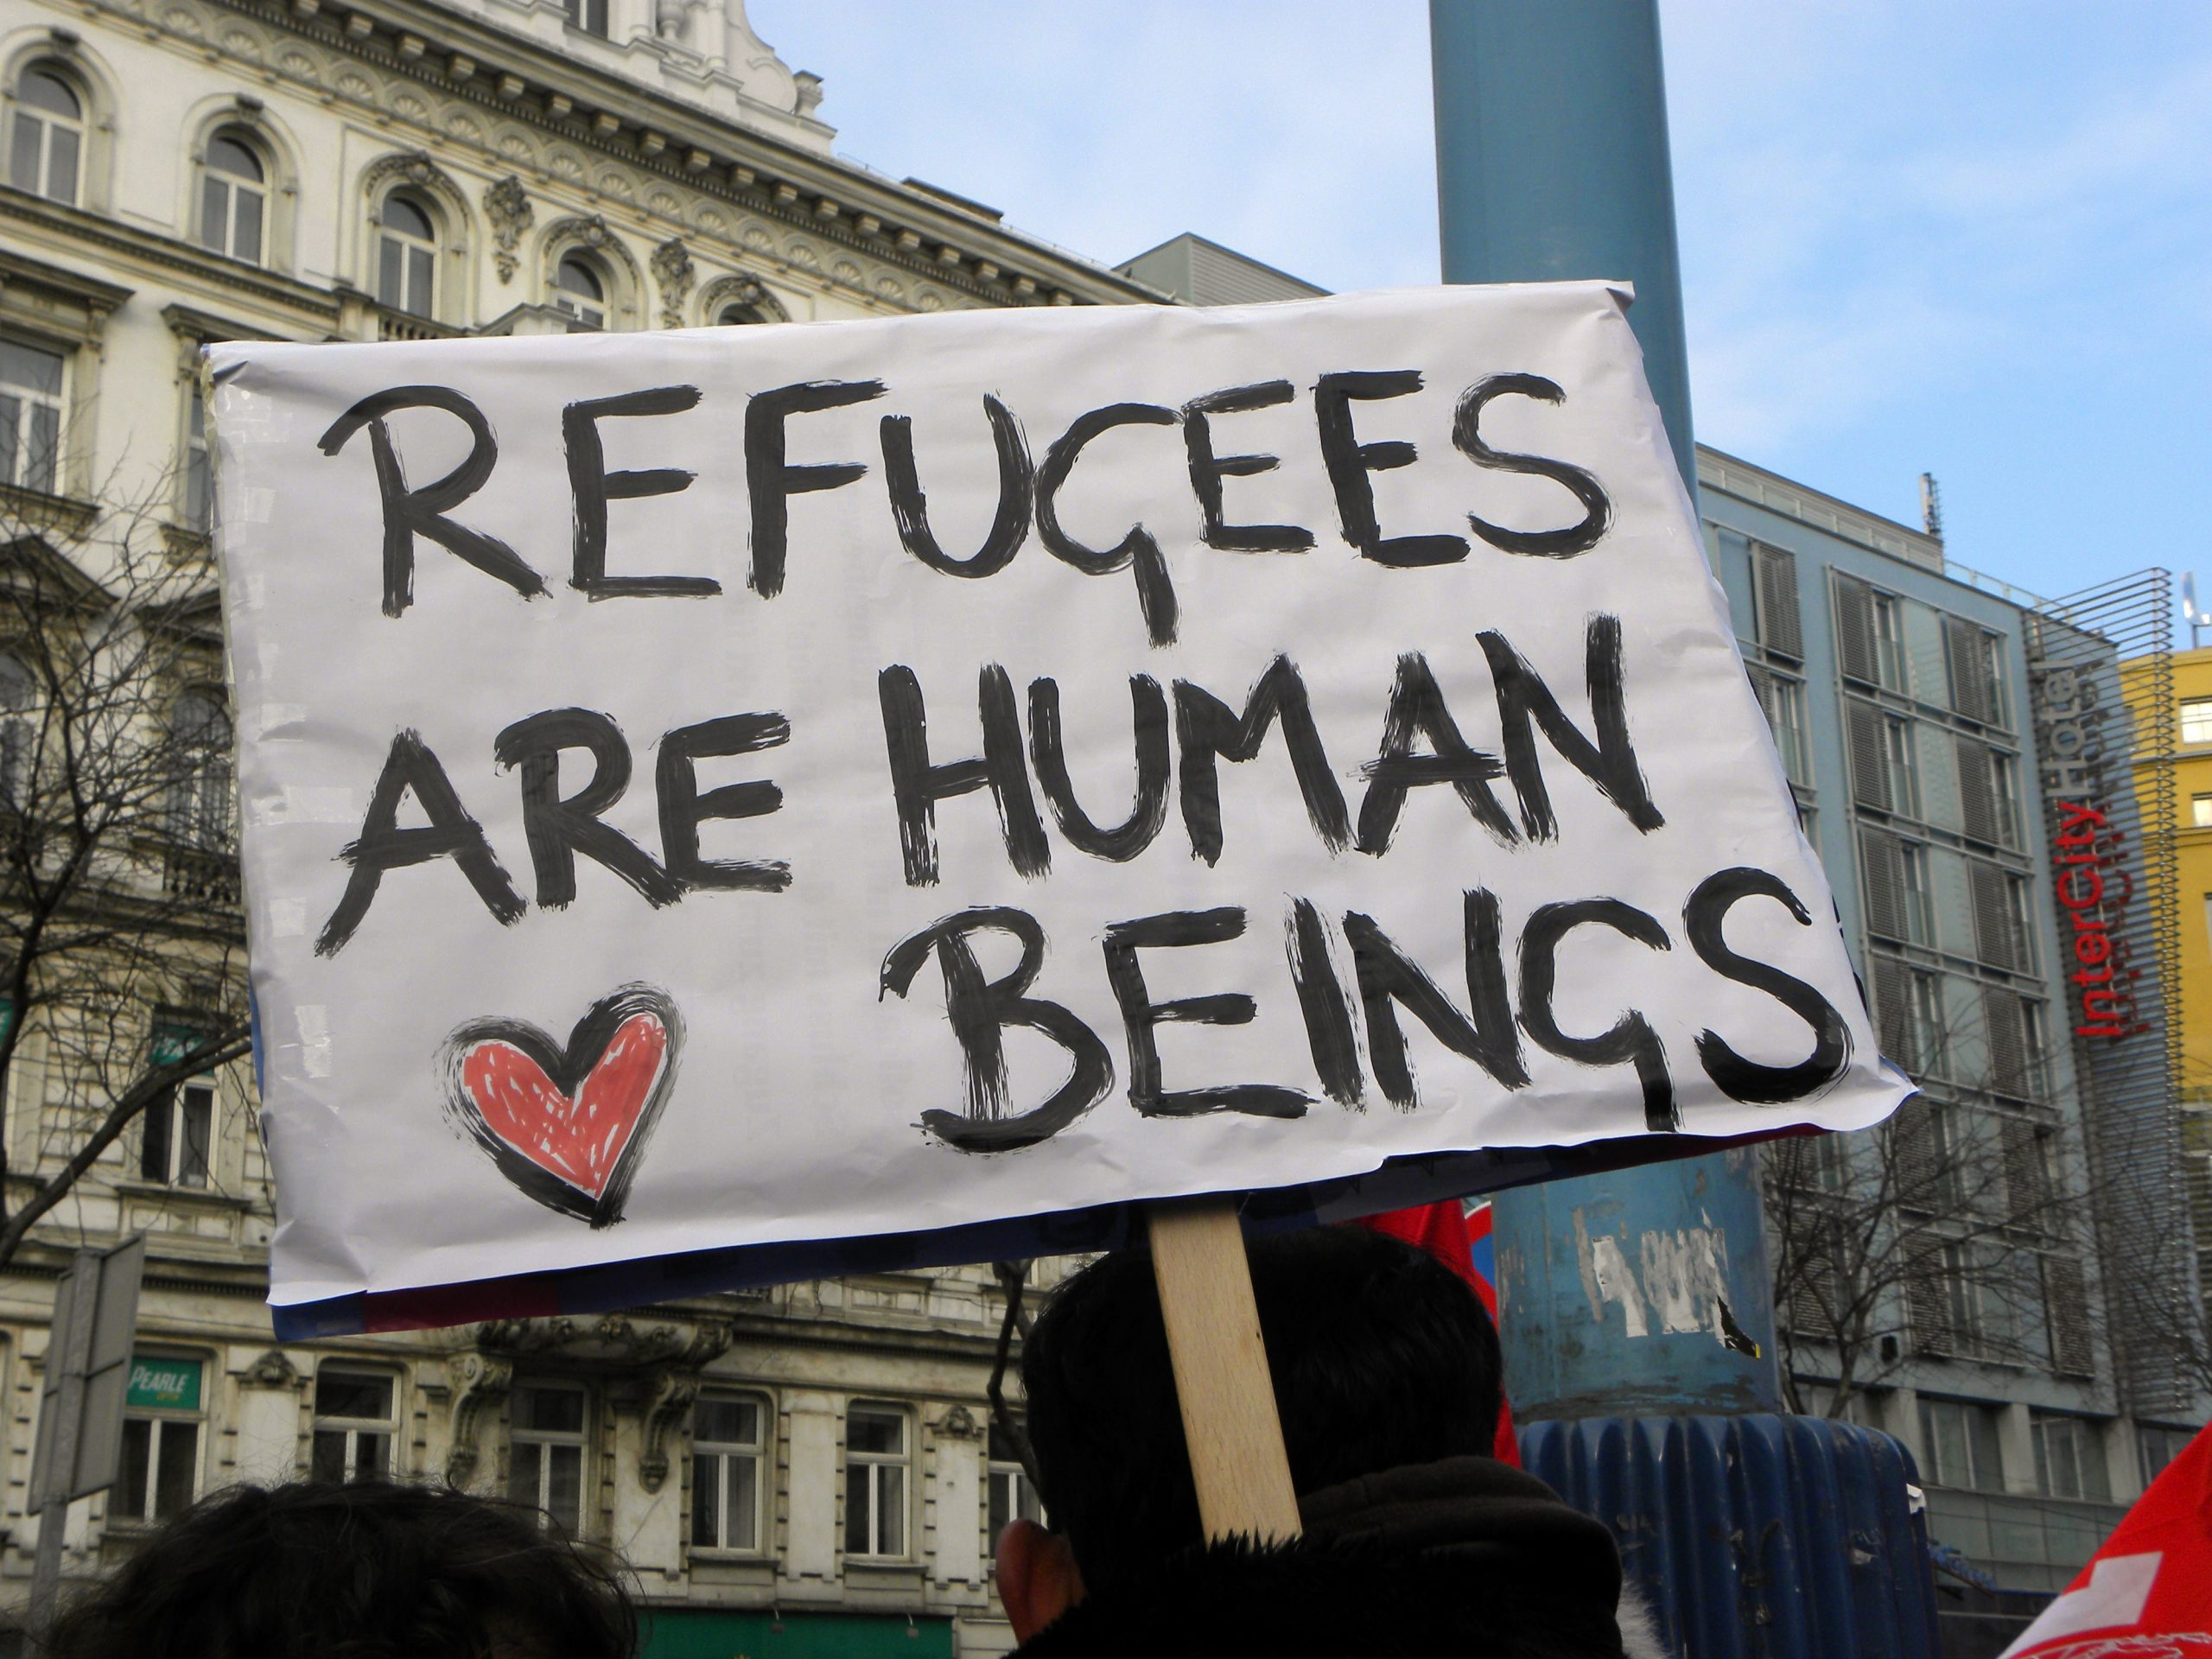
What can you do? Time to stand up!
Educate others about refugees and the immigrant community
Volunteer with local groups supporting refugees and immigrant communities
Call your congressional representative to let them know you support the US Refugee Resettlement Program
In your clinical settings, spend the extra time with your immigrant community to show them you care
Notes:
Refugees and asylees will continue to grow as a population aslong as armed conflicts continue worldwide
Refugees have unique health care needs
They come from areas where disease control, diagnosis and treatment are lacking and health systems and surveillance are interrupted
Lack of immunization and failure to detect transmissible diseases could pose public health risk in country of arrival
Dispel myths about the health of the foreign born
Cross-cultural training
Insure that your patients are not denied services for which they are eligible
Allow other providers and administrators to understand the additional time required to work with these populations
Use the Healthy Migrant Phenomenon as an argument against those who claim that immigrants are a health threat and a burden to our society.
From an economic standpoint, it makes sense to maintain the comparatively good health of this population.
3. Cross-cultural training - Study the backgrounds, culture, and traditions of your patients. Have an open mind and recognize that many immigrants are likely to be unfamiliar with appointment systems, health insurance regulations, compliance with medical recommendations, and standard use of medications.
5. Avoid assumptions - be conscious of the stresses associated with migration and acculturation

Slide 30
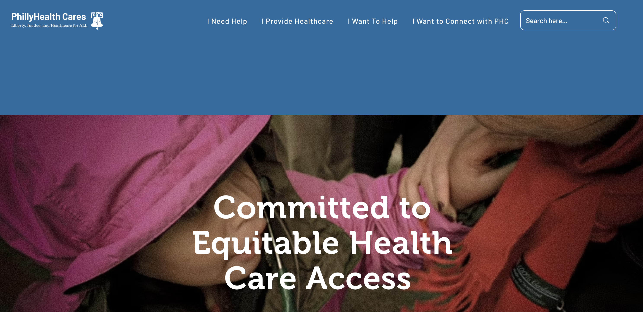

Phillyhealthcares.org

Slide 31
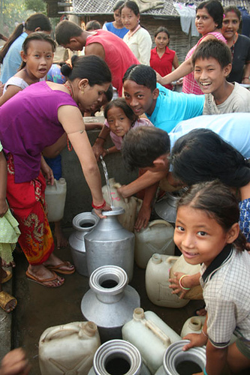
Suggested reading
Fadiman, Anne
  The Spirit Catches You and You Fall Down.
Housseini, Khaled
  A Thousand Splendid Suns
Beah, Ishmael
  A Long Way Gone
Eggers, Dave
  What is the What?
Kidder, Tracy
  Mountains Beyond Mountains
  A Strength in What Remains

Slide 32
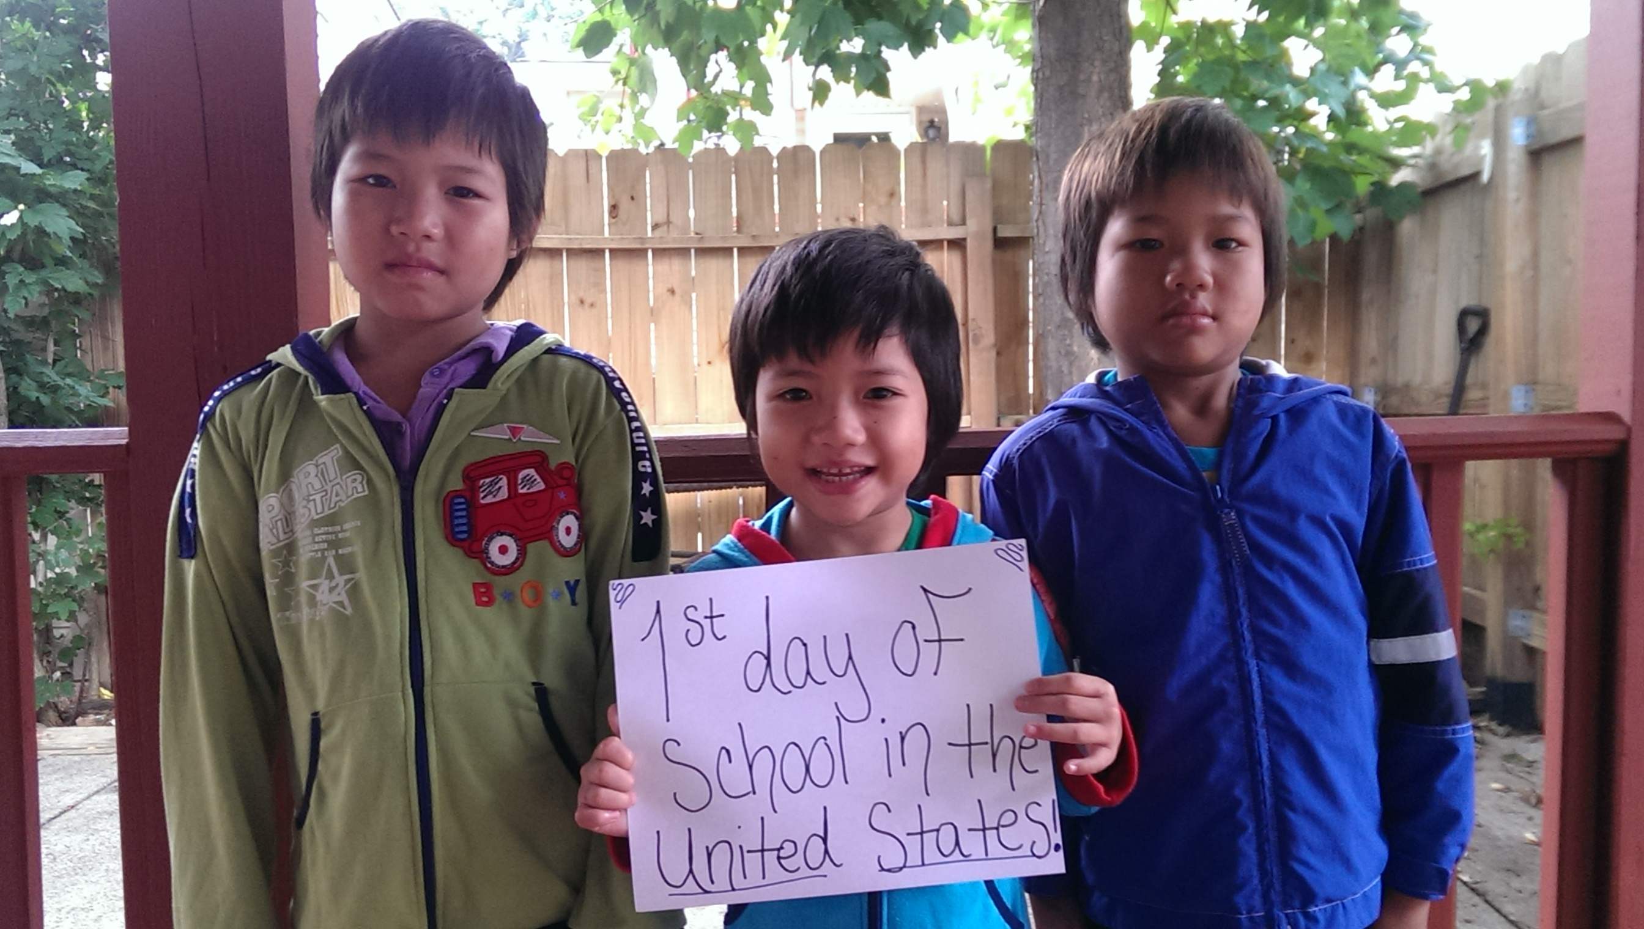
THANK YOU!!

