Slide 1

  Anthony L. Rostain, MD, MA
  Chair, Department of Psychiatry and Behavioral Health
  Cooper University Health Care
  Professor of Psychiatry and Pediatrics
  Cooper Medical School of Rowan University
  Paul Offit, MD
  Professor of Pediatrics
  Perelman School of Medicine of the University of Pennsylvania
  Director, Vaccine Education Center
  The Children’s Hospital of Philadelphia

Slide 2
What is the MAHA report?
Why are we reading it this summer?
What do we expect students to learn?
Key topics for discussion
  Who are the authors of the report?
  Why was the report written?
  Who is the intended audience?
  What are the main arguments?
  How well are these substantiated?
    Evidence provided
    Evidence omitted
  WHAT ‘S BEEN ITS IMPACT ON THE HEALTH OF OUR COUNTRY?

Slide 3
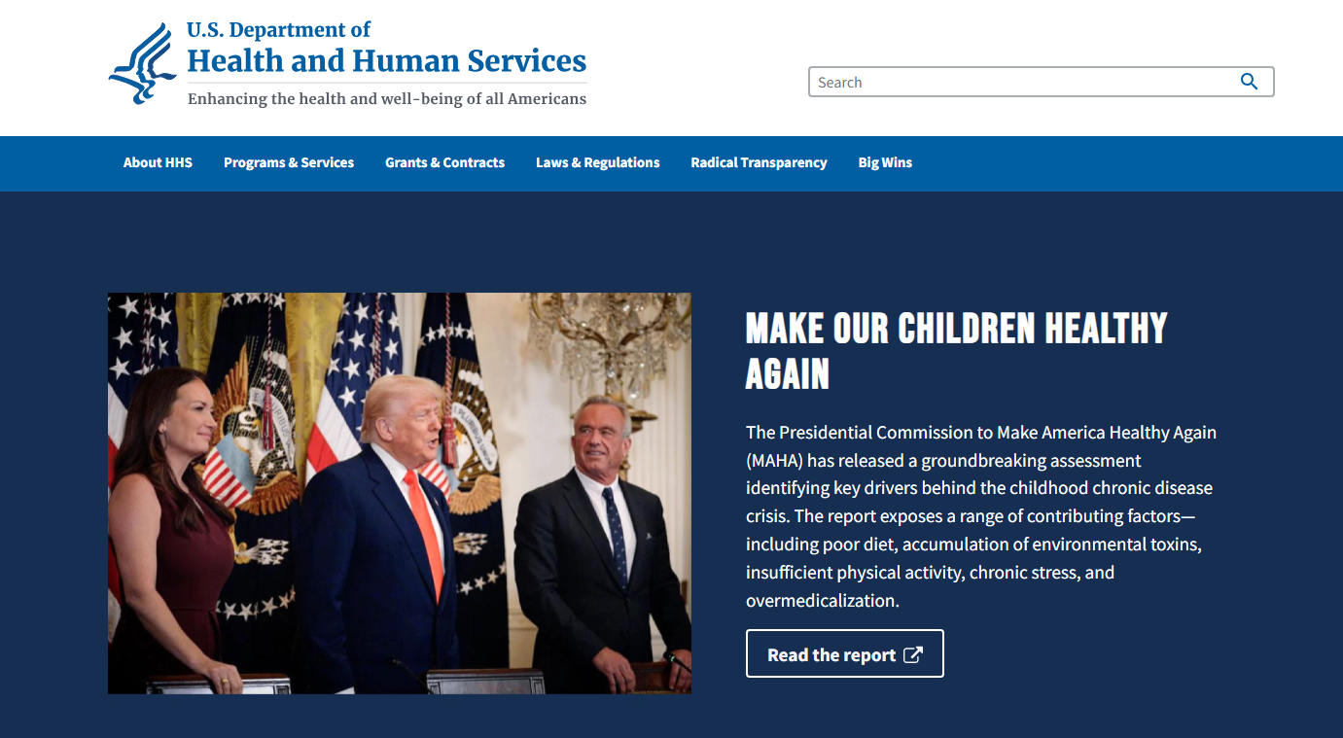
Department of Health & Human Services | HHS.gov
9/25

Slide 4
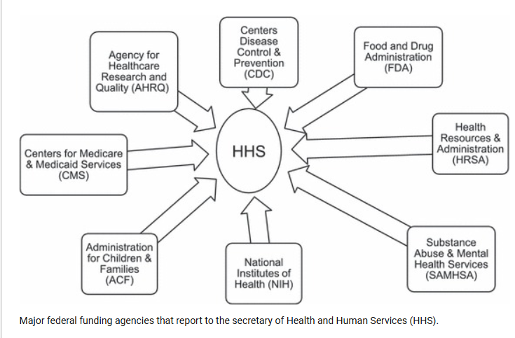

Slide 5
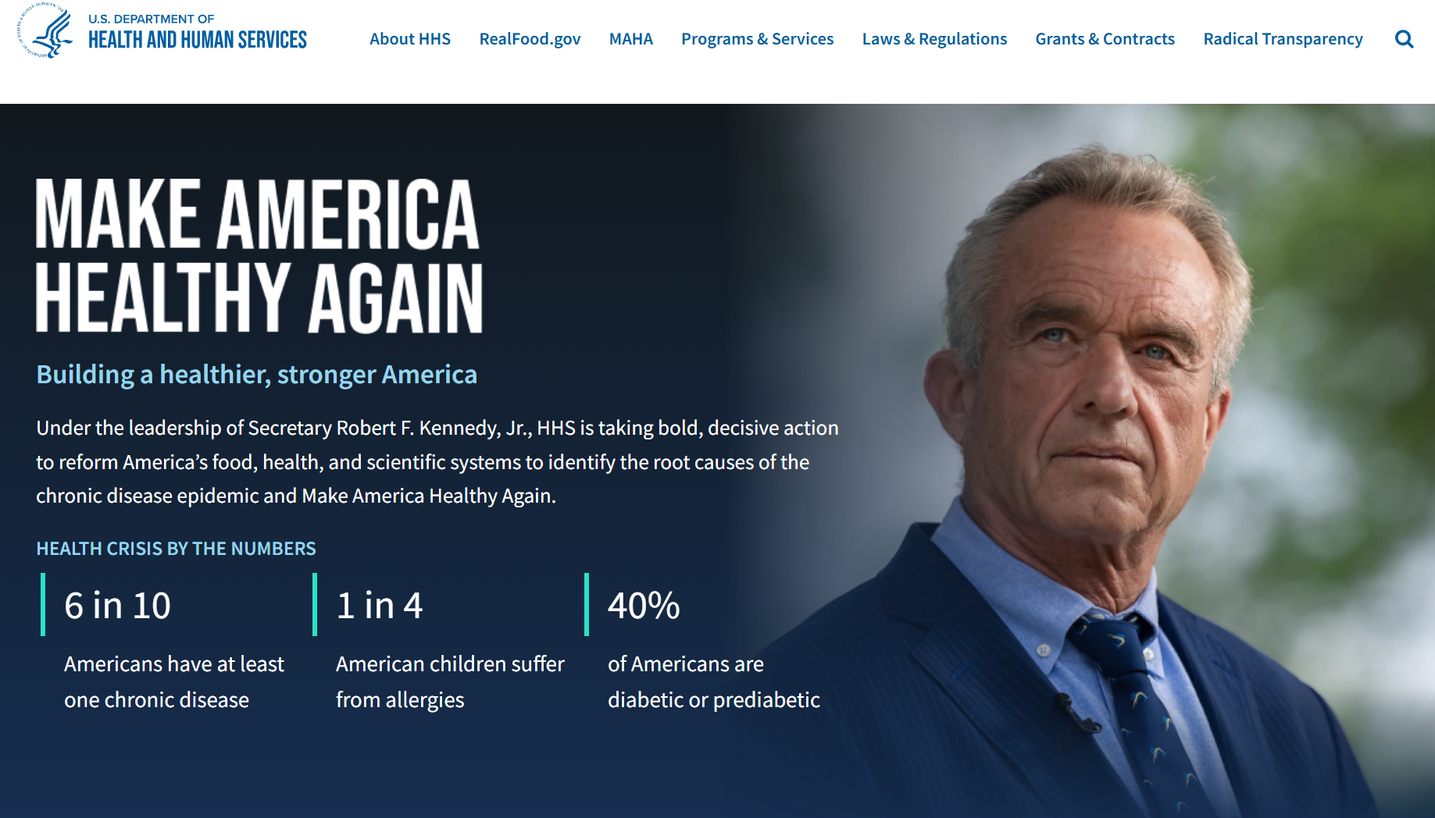
6/26

Slide 6
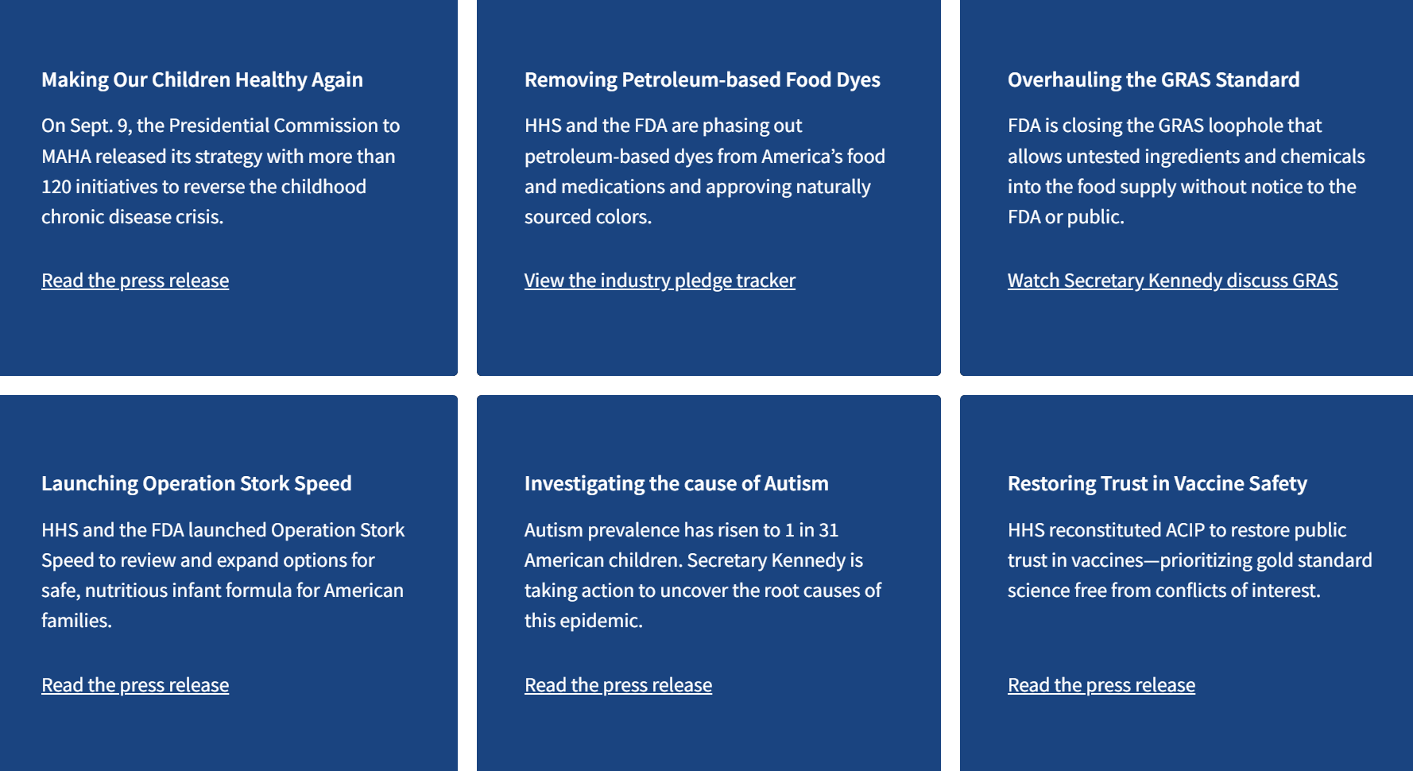

Slide 7
Major Funding and Structural Changes at HHS
The MAHA agenda has been accompanied by sweeping budget cuts and workforce reductions across HHS agencies, which many experts argue directly contradict the strategy's stated goals:
CDC: The proposed FY2026 budget includes a 50% reduction in CDC funding (from $9.2 billion to $4.3 billion). The National Center for Chronic Disease Prevention and Health Promotion would be eliminated. Since January 2025, 15% of the CDC workforce (~3,000 workers) has departed, and HHS has already slashed more than $12 billion in federal grants to states, including $11.4 billion distributed by the CDC.
NIH: Initial reports indicate a roughly 40% cut to the 2026 NIH budget, with a proposed cap on indirect costs at 15% (down from up to 70%). Hundreds of grants have been terminated, and new grant approvals dropped to approximately 50% of normal levels in early 2025. Over 10% of NIH employees have lost their jobs.

Slide 8
Major Funding and Structural Changes at HHS
FDA: More than 1 in 6 FDA employees have been laid off, including leaders responsible for food safety, prescription drug approval, and tobacco regulation.
AHRQ: The Agency for Healthcare Research and Quality has lost half its staff and is being restructured within another part of HHS.
Proposed "Administration for a Healthy America": Secretary Kennedy has proposed centralizing chronic disease functions into a new, yet-unformed HHS agency, though its status remains uncertain.
Supplemental Nutrition Assistance Program (SNAP) waivers for ultra-processed foods (UPFs): The USDA has approved state waivers to restrict the purchase of certain UPFs (including sugary beverages and candy) by SNAP beneficiaries, a step no prior administration had taken. However, the One Big Beautiful Bill Act simultaneously enacted the largest budget cuts to SNAP benefits in history, reducing benefits for millions and eliminating all federal funding for SNAP Education — undermining the strategy's own nutritional goals.

Slide 9
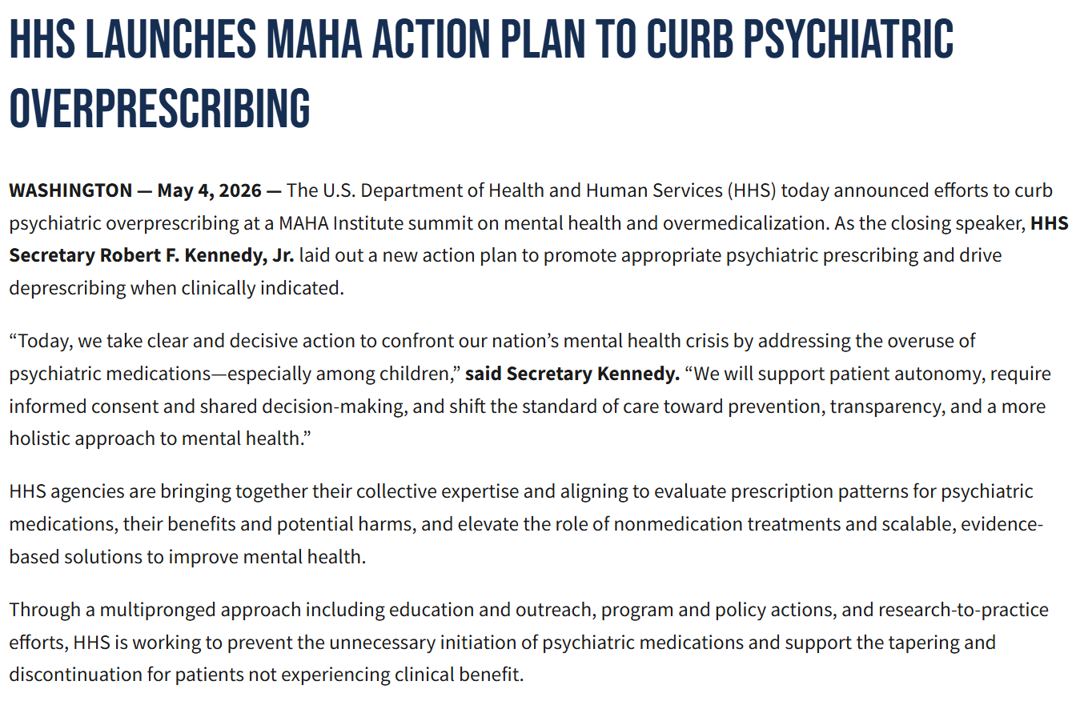

Slide 10
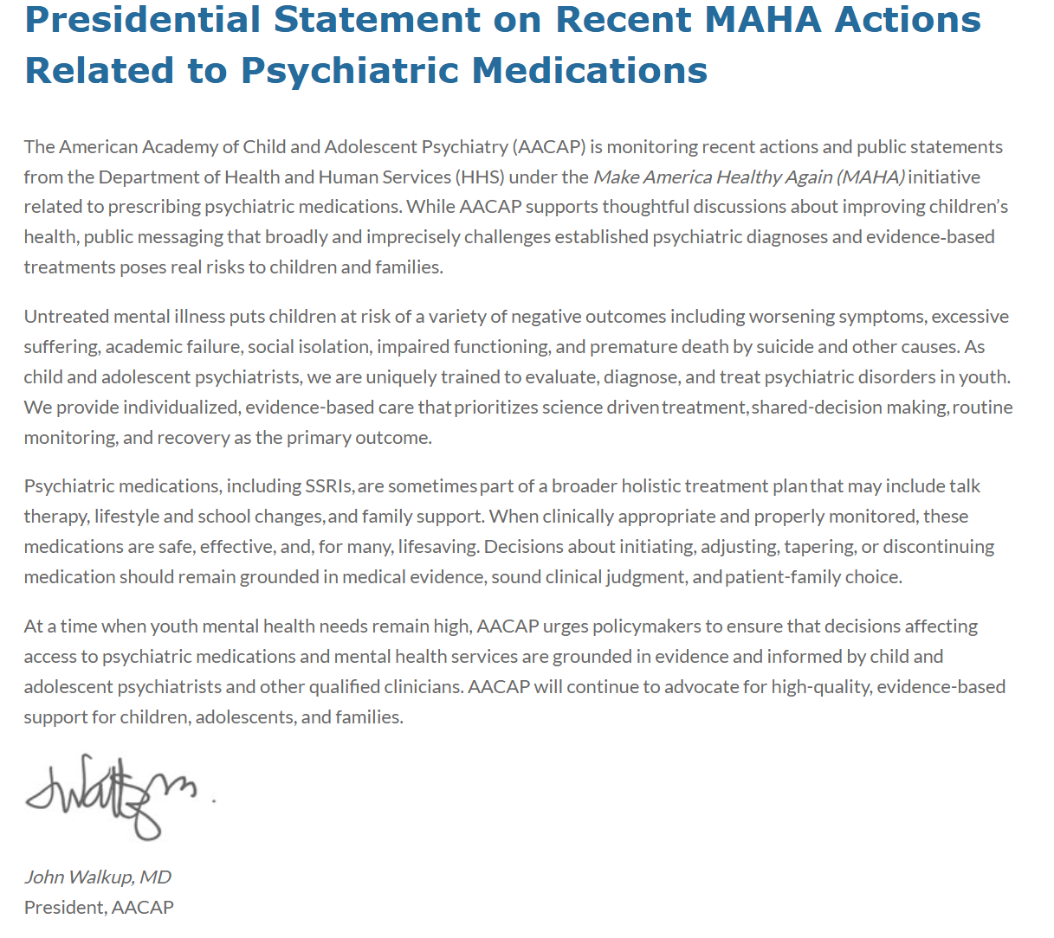
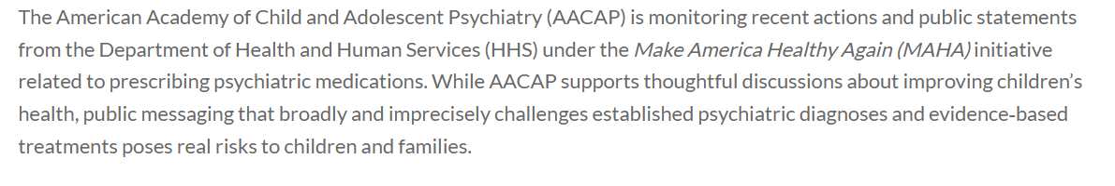

5.7.2026

Slide 11


Slide 12


