Slide 1

What Advocacy Means To Me!
I use my talent, resources and power to improve social situations for vulnerable populations
I protect my personal well-being and work-life balance, so that I can continue to serve vulnerable communities for as long as possible.

Slide 2
So Many Ways to Advocate!
Patient-Level Advocacy
Advocacy Scholarship
Educational Scholarship / Leadership
Clinical Leadership
Mentorship and coaching

Slide 3
Individual Advocacy
As a pediatrician, I have direct access to families who have a great distrust of the healthcare system, which worsens their health
I use a range of techniques to build genuine relationships that rebuild trust in our system.
Outcome: Patients are more open to “suspect” aspects of healthcare (e.g. vaccines, medications) and have better health

Slide 4
Advocacy Scholarship
I performed research on screening for intimate partner violence in healthcare settings
This work was presented at several national conferences and published
Work was replicated at other organizations
Outcome is that more families, in Philly and across the nation, have obtained access to IPV services.

Slide 5
Educational Scholarship / Leadership
As an Associate Residency Program Director, I led of key components of curriculum design.
I leveraged this role to implement an advocacy scholarship curriculum for our residents.
Residents presented their work at national conferences, some of this work was replicated
Outcome: Increased advocacy scholarship activity across the nation

Slide 6
Efficient Compassion
Served as medical director for a new pediatric FQHC clinic to serve under and uninsured children. Currently serves 6,000 children.
With limited resources, I was forced to optimize efficiency. I utilized principles of Lean Six Sigma to improve efficiency, clinical outcomes, and patient satisfaction.
Outcome: 8 years later, the practice is still operational with excellent patient and staff satisfaction. Families trust the care they receive.

Slide 7
Mentorship & Coaching
As an experienced mentor and coach, I have attained skills to help professionals overcome personal and work stress.
I use these skills to preferentially support individuals who struggle in serving vulnerable populations.
Outcome: Professionals who work in high-stress, low-resource settings are better equipped to prevent burnout.

Slide 8

EIHCTRSDUE: Ethical and legal dilemmas in child abuse reporting
Mario Cruz, MD
Jefferson Einstein Philadelphia Hospital
Mario.Cruz@5WhyCoaching.com

Slide 9

Objectives
Become familiar with Pennsylvania laws on child abuse and mandated reporters
Develop strategies for managing difficult on-the-job scenarios related to potential child abuse
List strategies that can be used to minimize the risk of an erroneous child abuse report

Slide 10
Would You Rather Over-Report Abuse?
Child Abuse Perpetrators
People Reported for Child Abuse
Or would You rather under-report child abuse?

Slide 11
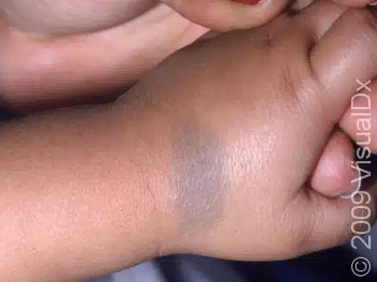

On the first day of daycare, staff sees dark spots. "I think somebody has been hitting the baby." Would you report this as child abuse?

Slide 12
”If you suspect abuse, report it”
Yes, AND….let’s define the word “suspect”
Your suspicion may be different than mine
Differences between reporter’s stem from varying knowledge, life experiences, cultural expectations, and relationship with patients
Any of the above could result in overreporting or underreporting
Child Abuse reporting is a “difficult decision” that requires a systematic approach

Slide 13
What is child abuse?
An act or failure to act that results in the harm or reasonable likelihood of harm of a child
  Can be physical, emotional, sexual, or neglect
www.keepkidssafe.pa.gov
Childline 1-800-932-0313

Slide 14
What is child abuse?
Causing or creating a reasonable likelihood of “bodily injury” to a child
Causing or creating a reasonable likelihood of sexual abuse or exploitation of a child
Causing or contributing to serious mental injury to a child
Causing serious physical neglect of a child
Kicking, biting , throwing, burning….that endangers a child
Unreasonably RESTRAINING OR CONFINING a child
Forcefully shaking or striking a child under one year of age
Leaving a child with a registered sex offender
Fabricating or exaggerating a medical condition
Exposing a newborn to elicit drugs
www.keepkidssafe.pa.gov
Childline 1-800-932-0313
Notes:
http://www.c4cj.org/ Center for Children’s Justice
Child Protection Services Law
Defines:
Child Abuse
Parents rights to use force
Mandated reporters
Penalties for not reporting
Intentionally….by an act or a failure to act
Bodily injury: Impairment of physical condition or
substantial pain"Serious physical neglect."
A repeated, prolonged or egregious failure to supervise a child in a manner that is appropriate considering the child's developmental age and abilities.
The failure to provide a child with adequate essentials of life, including food, shelter or medical care

Slide 15

When Should I suspect Child Abuse?
Your knowledge of the circumstances
Your observations
Your familiarity with the individuals
Your feelings about the circumstances
www.keepkidssafe.pa.gov
Childline 1-800-932-0313

Slide 16
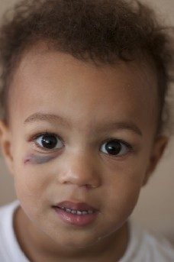
Parent has “no idea” how the child got a black eye. Would you report?

Slide 17




Consequence of erroneous child abuse reporting

Slide 18
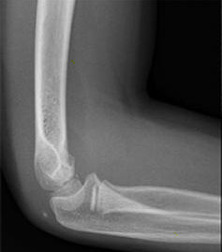
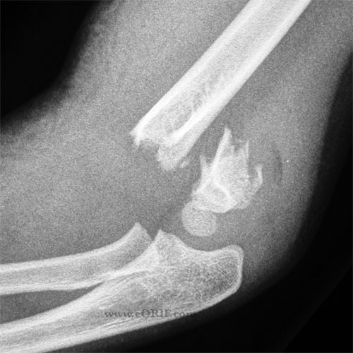
Would You Report This As Abuse?
5 Year old Male
Mother rushed him to the hospital
“He fell off the monkey bars at the park”
Arm is severely swollen and painful
No other bruises noted
No history of broken bones

Slide 19
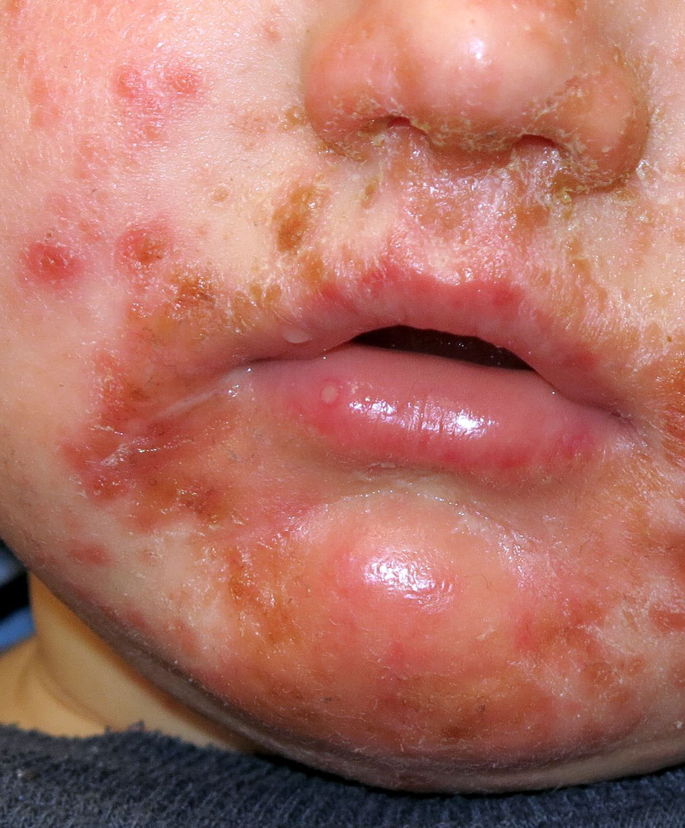
The baby came back from her father's house looking like this. He's not taking care of the baby right.
Would you report?

Slide 20
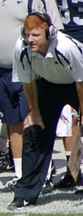
Penn State Child Abuse Scandal: Design a Law to Keep this from happening ever again…
Witnessed Gerald Sandusky sexually abusing a boy.
He tells his boss (Joe Paterno)
Joe Paterno tells his boss
No report is ever made to the police or to child welfare authorities
Over next ten years Mr. Sandusky continues to abuse children
Eventually convicted of 45 counts of child abuse; 60 years in prison
Notes:
Raise your hand if you already know about Mike McQueary and you already have a strong opinion about him?

Slide 21

Child Protective Services Law Amendments (Dec 31st, 2014)
Must directly report their suspicion to the state (Can’t just tell your boss)
3 hours of required training for all licensed health professionals in the state
3rd degree felony if you don’t report abuse
www.keepkidssafe.pa.gov
Childline 1-800-932-0313

Slide 22

Protections for Child Abuse Reporters
You are protected from litigation if you report in “good faith”
Your report is confidential
You cannot lose your job because you file a report
Anyone who tries to retaliate or intimidate you can be punished
www.keepkidssafe.pa.gov
Childline 1-800-932-0313

Slide 23

Mandated Reporters
Raise your hand if plan to:
  Become a physician, nurse, NP or PA
  Become a licensed social worker
  Hold a license in the state of Pennsylvania
  Become a religious leader
  “Routinely” see children in your work
  Supervise any of the above people
www.keepkidssafe.pa.gov
Childline 1-800-932-0313

Slide 24
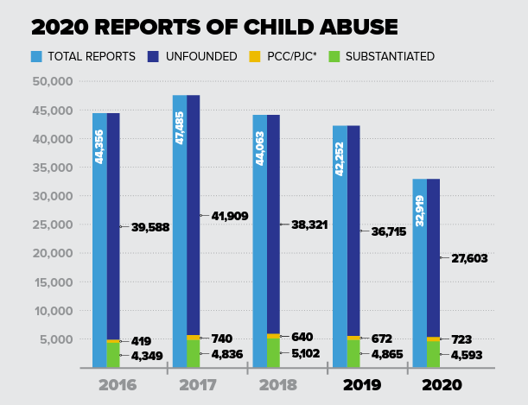
Substantiated Reports are a small fraction of all reports
Covid Pandemic Reduced Child Abuse Reporting
https://www.dhs.pa.gov/docs/Publications/Pages/Child-Abuse-Reports.aspx

Slide 25
How Disparities Are Born…
Race-Based Disparities
Person in a position of power
Race-Based Stereotypes
Make high-stakes decisions

Slide 26
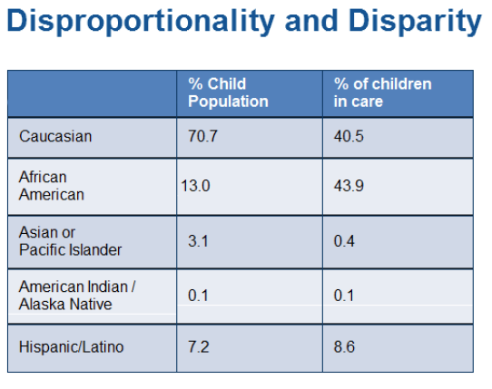
BIAS IN CHILD ABUSE REPORTING

Slide 27
Minimizing Bias in Child Abuse Reporting
Know Your Stuff!
“Would I report this family had more money? Or were from a different race?”
Standardize your workflows
Focus on objective behaviors, not demographic traits

Slide 28

Would you report this?
You are in a medical clinic and hear a parent saying repeatedly to her toddler, “Stop, don’t touch that…..Stop….you better stop……[SMACK!]”

Slide 29

Mnemonic to remember for life:
Don’t know what to do??
EIHCTRSDUE!

Slide 30
Steps to approaching most difficult scenarios
Establish the facts
Identify the core issue
How do you feel?
Check yourself…
Triage the situation
Remember your professional obligation
Stand in the other person’s shoes
Develop an action plan
Use your resources
Educate yourself
Notes:
Empathy
Be kind; everyone you meet is fighting a hard battle.
Trauma informed approrach:
Instead of:
“what’s wrong with you?”
Try:
“What happened to you?”
Acknowledge that you may not have all the answers
They may be some pitfalls that you may be unable to anticipate
BTG sexual harassment story
You go to Macy’s to purchase boots, you meet a “grumpy-looking” salesman who pays no attention to you as he does his work
In fact, you have to practically chase him to get his attention
He frowns when you ask him to find your size boot
What are your thoughts? What do you do?

Slide 31
Parent’s rights?
“Nothing in this chapter shall be construed to restrict the generally recognized existing rights of parents to use reasonable force on or against their children for the purposes of supervision, control and discipline of their children.”
www.keepkidssafe.pa.gov
Childline 1-800-932-0313

Slide 32
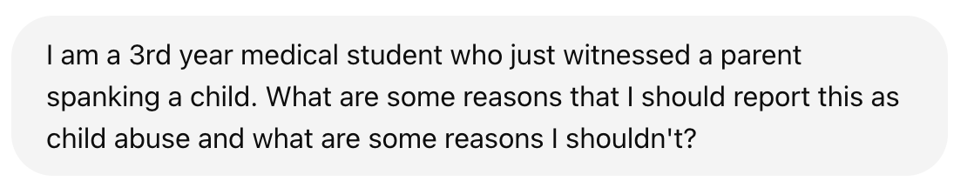
AI As An Emerging Tool for Difficult Decision-Making

Slide 33
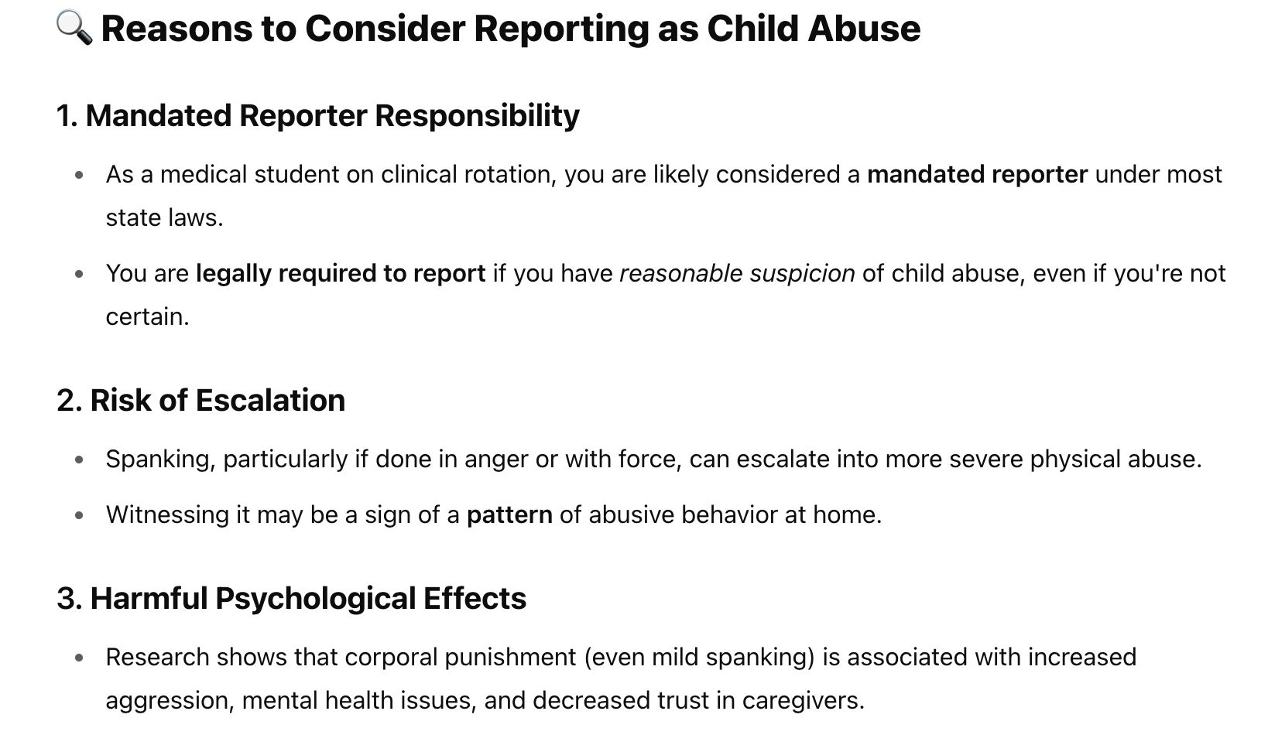
Chat GPT Response pt 1

Slide 34
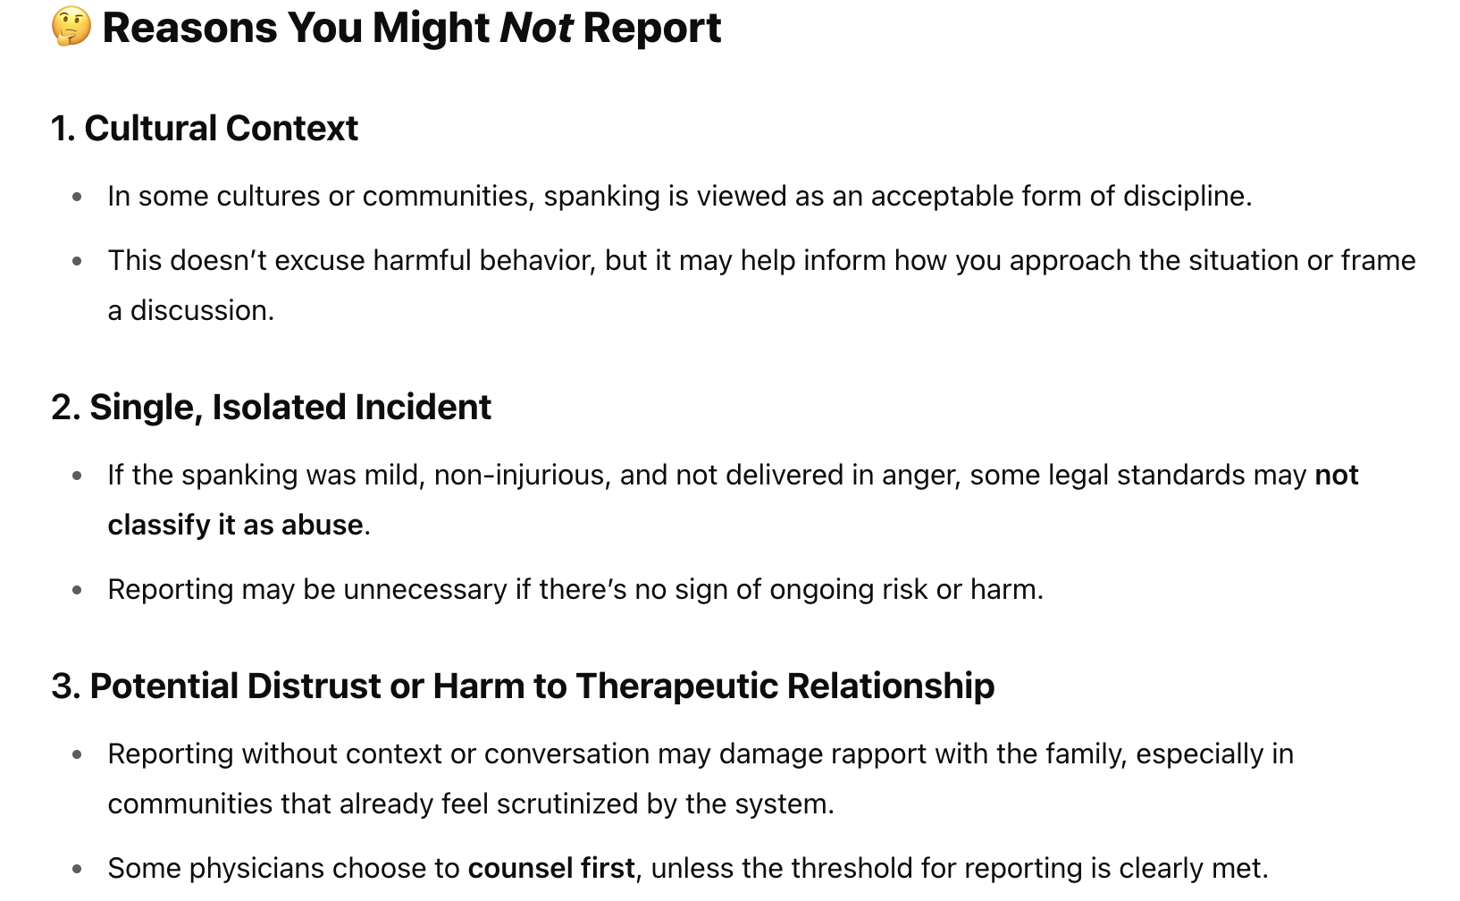
Chat GPT Response pt 2

Slide 35

Would you report this?
15 year old adolescent was assigned female sex at birth and given the name "Joanna" at birth.
Patient has identified as a male for the last 5 years and has chosen the name "Jo" and uses he/him pronouns
Parents refuse to use the patient's chosen name or pronouns and will not permit visiting with a gender-affirming medical provider
Parents call the child the F-word and have kicked him out of the home on at least 2 occasions
The child expressed deep discomfort with home situation

Slide 36
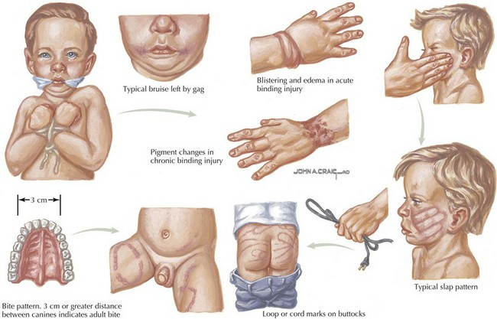
“Oh you know how rough the kids play sometimes”

Slide 37
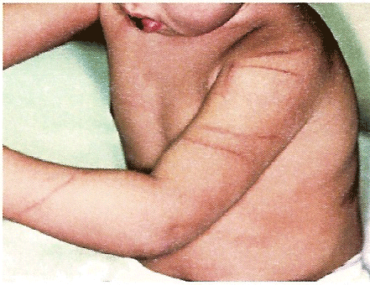
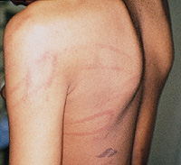

Slide 38

Would you report this?
You are playing “house” with a 6-year-old child.
You are bothered by how the child plays with the dolls. You notice that they are positioning the dolls in a sexual manner, that appears to be imitating sexual acts (humping and oral sex).
www.keepkidssafe.pa.gov
Childline 1-800-932-0313

Slide 39
Summary
You are mandated reporters of suspected child abuse
Must ensure that suspected cases get reported (can’t just tell your supervisor and forget it)
Approaching challenging scenarios requires a systematic, thoughtful approach

Slide 40

Questions?
Mario Cruz, MD
Jefferson Einstein Philadelphia Hospital
Mario.Cruz@5WhyCoaching.com

