Slide 1
FYI: Health Literacy Tenets
Mary Ellen T. Miller PhD, RN, PHNA-BC
Former Director, Lehigh Valley Affiliate
Bridging the Gaps Community Health Internship
Associate Professor, DeSales University, Retired
maryellen.miller@desales.edu

Slide 2
Learning Outcomes
After this session, participants will be able to:
1. Describe health literacy and its' impact on health outcomes
2. State methods individuals use to conceal their literacy status
3. Assess written health information for literacy level appropriateness

Slide 3
True Stories about the Impact of Low Health Literacy
Case Study #1
Mr. Smith’s new prescription for Lasix
Cornett, S., (Sept. 30, 2009) "Assessing and Addressing Health Literacy" OJIN: The Online Journal of Issues in NursingVol. 14, No. 3, Manuscript 2.

Slide 4
E-Prescribing Utilization
E-prescribing all U.S. prescriptions:
2017 @ 66%
2018 @ 73%
2019 @ 80%
2020 @ 84%
2021@ 94%
Statistica (2024). Rate of elecgronic prescriptions in the United States 1017-2021
https://www.statista.com/statistics/864380/share-of-us-e-prescriptions/

Slide 5
Let’s Talk About “Literacy”
Literacy is defined as a set of reading, writing, basic mathematics, speech, and speech comprehension skills (Kirsch, 2001)
Oral literacy: Speech and speech comprehension
Numeracy literacy: Ability to read numbers, complete mathematical problems
Print/Prose literacy: Reading and writing
Basic print literacy ability: the ability to read, write, and understand written language that is familiar to the person
Functional literacy: the use of literacy in order to perform a particular task
From: Health literacy: A prescription to end confusion (2004) at:
https://www.ncbi.nlm.nih.gov/books/NBK216035/#ddd00042

Slide 6
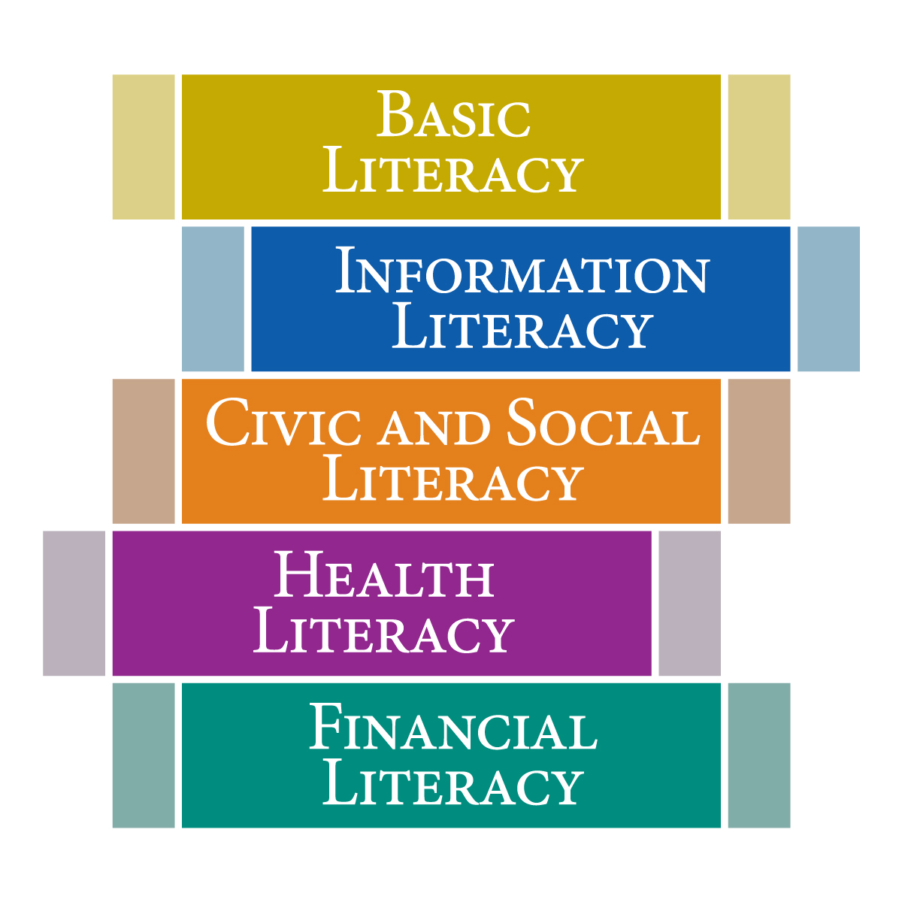
University of Scranton (2016; 2022) https://sites.scranton.edu/library/2016/02/03/pa-forward-pennsylvania-libraries/

Slide 7
Historical Definition of Health Literacy
Health literacy is the bridge between an individual’s literacy skills and the health context
Defined as: the degree to which individuals have the capacity to obtain, process, and understand basic health information and services needed to make appropriate health decisions (Ratzan and Parker, 2000; Patient Protection and Affordable Care Act of 2010)

Slide 8
Revised Definition: What is Health Literacy?
Definition of Health Literacy was revised for the publication of Healthy People 2030 to include:
Personal health literacy is the degree to which individuals have the ability to find, understand, and use information and services to inform health-related decisions and actions for themselves and others.
Organizational health literacy is the degree to which organizations equitably enable individuals to find, understand, and use information and services to inform health-related decisions and actions for themselves and others.
Centers for Disease Control and Prevention (2023). What is health literacy?
https://www.cdc.gov/healthliteracy/learn/index.html#wnd

Slide 9
Why update the definition of health Literacy?
These new definitions:
Emphasize people’s ability to use health information rather than just understand it
Focus on the ability to make “well-informed” decisions rather than “appropriate” ones
Acknowledge that organizations have a responsibility to address health literacy
Incorporate a public health perspective
Centers for Disease Control and Prevention (2023). What is health literacy?
https://www.cdc.gov/healthliteracy/learn/index.html#wnd

Slide 10
What is the Rate of Low Health Literacy in the US?
Approximately 80 million US adults have low health literacy skills (Hickey, et al., 2018)
Nearly 9 out of 10 adults struggle with health literacy (National Libraries of Medicine, 2023)
Even people with high literacy skills may have low health literacy skills in certain situations.
For example, someone who is stressed and sick when they’re accessing health information may have trouble remembering, understanding, and using that information.

Slide 11
Why is Health Literacy Important?
Health literacy involves more than reading — it also includes specific skills, like calculating the right dose of a medicine, following directions for fasting before a surgery, or checking a nutrition label to make sure an item is safe for someone with a food allergy.
People with low health literacy skills may have trouble doing these things.
Low health literacy skills contribute to poor health outcomes
National Libraries of Medicine (2023)

Slide 12

Question #1
What is the reading level of adults in the United States?

Slide 13
What is the Reading Level of Adults in the US?
The average American adult reads at an eighth-grade level (Doak CC, Doak LG, Friedell GH, & Meade CD, 1998; Eltorai et al., 2014; Wylie, A. 2019)
However, nearly one-fifth of adults in America cannot comprehend fourth-grade-level text (Doak CC, Doak LG & Root JH, 1996; Literacy Mid-South, 2010; Wylie, A. 2019)
BUT……in times of high stress, even an adult with a reading level higher than 8th grade can have difficulty interpreting and processing health information

Slide 14
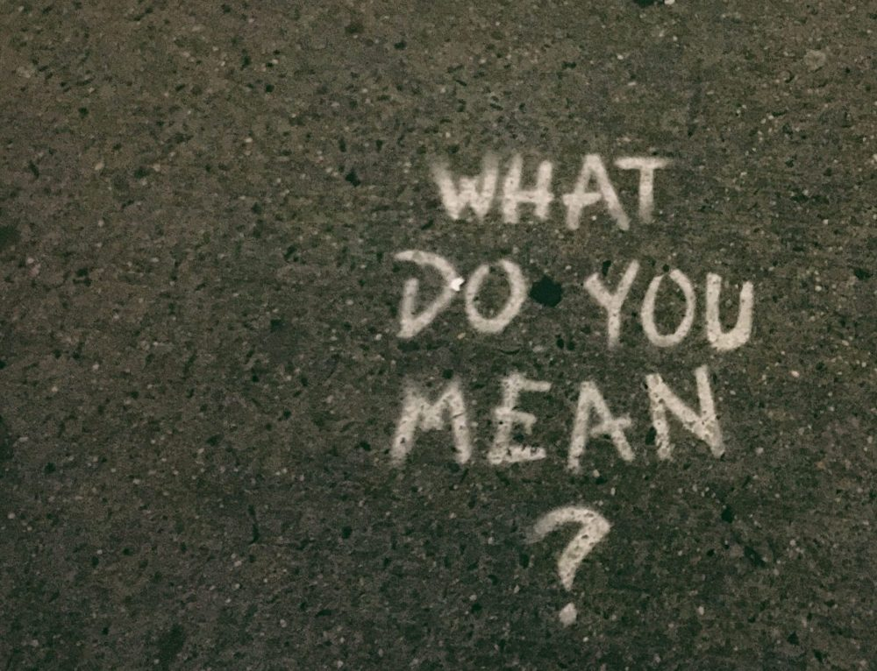
Question #2
Why do people need health literacy skills?
This Photo by Unknown Author is licensed under CC BY-NC

Slide 15
Why Do People Need Health Literacy Skills?
People need health literacy skills to:
Find information and services
Communicate their needs and preferences
Process the meaning and usefulness of the information and services
Understand the choices, consequences and context of the information and services
Decide which information and services match their needs and preferences so they can act
From: Centers for Disease Control and Prevention (2023), page 1. From: https://www.cdc.gov/healthliteracy/learn/index.html

Slide 16

Question #3
Why do YOU need awareness of health literacy?
This Photo by Unknown Author is licensed under CC BY-ND

Slide 17
Why Do Providers Need Awareness of Health Literacy?
Providers need awareness of health literacy to:
Build trust
Advance health equity
Decrease medical errors
Decrease ER visits and hospitalizations
Utilize recommendations*
a, plain language
b. utilize culturally and linguistically
appropriate language
* Recommendations from the National Academies of Science, Engineering and Medicine proceedings from three workshops in a series titled: The Roles of Trust and Health Literacy in Achieving Health Equity.
From: Centers for Disease Control and Prevention (2023). What is health literacy? From: https://www.cdc.gov/healthliteracy/learn/index.html

Slide 18
Case Study #2
Jill’s visit with her public heath nurse
From: Graham, S. and Brookly (2008). Kaiser Permanente Journal, Vol. 12, Number 3. Do patients understand?

Slide 19
International Adult Literacy Data: PIAAC
The most current adult literacy data is from the Program for the International Assessment of Adult Competencies (PIAAC), a 23-country comparative study (Note: Cycle 2 of this assessment started in September 2022 and data for PIAAC Cycle 2 is scheduled to be released in December 2024)
This study assessed 150,000 adults’ aged 16-65 proficiency in three domains: literacy, numeracy, and problem-solving in technology-rich environments
In each of these domains, adults perform tasks with different levels of complexity
Their skills with these tasks are quantified and categorized into “proficiency levels.” The proficiency level “below level 1” is the lowest level and “level 5” is the highest proficiency level
From The Centers for Disease Control and Prevention (2019). Understanding literacy and numeracy @
https://www.cdc.gov/healthliteracy/learn/understandingliteracy.html

Slide 20
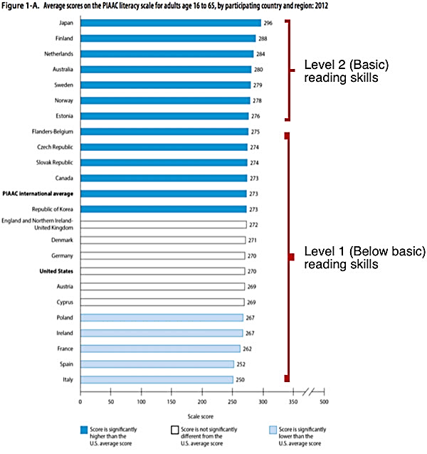
PIAA Data by Country: International Average = 273 https://www.wyliecomm.com/2019/03/us-literacy-rate/

Slide 21
States and Counties with the Highest and Lowest Levels of Adult Literacy and Numeracy Skills
The National Center for Education Statistics (NCES, 2020) analyzed the estimates of adults' literacy and numeracy skills for all U.S. states, counties, and the District of Columbia to determine the highest and lowest levels of adult literacy and numeracy proficiency, as well as the average scores.
Highest Performing States
Top 25% (by average score for literacy and numeracy, combined) Alaska, DC, Iowa, Maine, Massachusetts, Minnesota, Montana1, New Hampshire, North Dakota, Oregon, Utah, Vermont, Washington, Wisconsin2
Lowest Performing States
Bottom 25% (by average score for literacy and numeracy, combined) Alabama, Arkansas, California, Florida, Louisiana, Nevada, New Mexico, Mississippi, New York, Tennessee, Texas, West Virginia
Note: States are listed in alphabetical order
1 Numeracy only 2 Literacy only
National Center for Education Statistics (2020). U.S. Skills Map: State and County Indicators of Adult Literacy and Numeracy
From: https://nces.ed.gov/surveys/piaac/skillsmap/

Slide 22
Health Outcomes Due to Low Health Literacy
Evidence shows that limited health literacy is associated with:
more hospitalizations
greater use of emergency departments for care
lower receipt of mammography screening and influenza vaccine
poorer ability to demonstrate taking medications properly; medication errors
poorer ability to interpret drug labels and health messages
loss of wages
greater healthcare costs
poorer overall health status and higher mortality rates
From: McDonald, M. & Shenkman, LJ (2018) at:
https://nsuworks.nova.edu/ijahsp/vol16/iss4/2/
Roopa Mahadevan, Center for Health Care Strategies (October 2013) Health Literacy Fact Sheet at:
https://www.chcs.org/resource/health-literacy-fact-sheets/

Slide 23
Case study #3
Mr. Rodgers leg ulcer
From: personal communication to ME Miller, summer 2018

Slide 24
Economic Burden of Low Health Literacy
Research on a conceptual model placed the cost of low health literacy between 7-17% of all healthcare expenditures
In 2003 this dollar amount was estimated to be between $106- $238 billion annually
In the year 2015, the annual health care expenditures are estimated to be $3.6 trillion, which would provide a cost of low health literacy at approximately $612 billion dollars
Leuck, S. (2017) The cost of low health literacy from:
https://www.pharmacytimes.com/contributor/steve-leuck-pharmd/2017/04/the-cost-of-low-health-literacy

Slide 25
Healthy People 2030
Healthy People 2030 objectives are organized into topic areas
Health Communication is found under “Health Behaviors”
Healthy People 2030 focuses on “improving health communication so that people can easily understand and act on health information”
https://health.gov/healthypeople/objectives-and-data/browse-objectives/health-communication

Slide 26
Health
Communication and
HP 2030
HP 2030 Health Communication Objectives
Total = 19 Objectives
8 Baseline
9 Developmental
2 Research

Slide 27
Selected HP 2030
Health Communication Objectives
Increase the health literacy of the population
Increase the proportion of adults whose health care provider checked their understanding
Decrease the proportion of adults who report poor communication with their health care provider
Increase the proportion of adults with limited English proficiency who say their providers explained things clearly
Increase the proportion of people who can view, download and send electronic health information
Increase the proportion of people who say their on-line medical information is easy to understand
US Department of Health and Human Services Office of Disease Prevention and Health Promotion:
https://health.gov/healthypeople/objectives-and-data/browse-objectives/health-communication

Slide 28
Case study #4
Mr. Doe and his heart failure
Cardiology Magazine Editors (October 18, 2019). Recognizing and addressing health literacy in your patients: Low health literacy impacts prevention, treatment. From: https://www.acc.org/latest-in-cardiology/articles/2019/10/06/24/42/cover-story-recognizing-and-addressing-health-literacy-in-your-patients

Slide 29
Health Communication Models and Theories
Many models and theories exist; some examples are:
Communication Model: Shannon-Weaver (1949)
Therapeutic Model: Carl Rodgers (1951)
Health Belief Model: Rosenstock (1966, 1974)
Interaction Model: King (1971, 1981)
Theory of Reasoned Action: Fishbein and Ajzen (1967, 1975)
Social Cognitive Theory: Bandura (1986)
Health Communication Theory: Northouse and Northouse (1998)

Slide 30
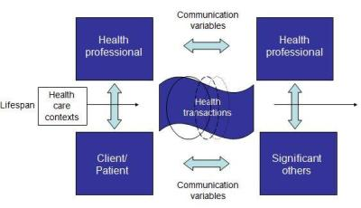
Northouse and Northouse Health Communication Model
From: Northouse, L. & Northouse, P. (1998) Health Communication: Strategies for Health Professionals, Prentice Hall: Stamford CT, p. 17

Slide 31
Half-time = Stretch-time
2 Minute Guided Meditation for Spring: Johns Hopkins Medicine
https://www.youtube.com/watch?v=-V3OU_NF4qs

Slide 32
How Clients Cope with Low Health Literacy
Remember…..you can’t tell someone’s health literacy level just by looking at them
People use single or multiple strategies to hide their low health literacy
Some people always bring along a friend or family member into the exam room
Some people make statements like:
“I forgot my glasses. Can you read this to me?”
“I forgot my glasses. I'll read this when I get home.“
“Let me bring this home so I can discuss it with my wife/husband/children."

Slide 33
Assessing Printed Materials
REALM: Rapid Assessment of Adult Literacy in Medicine
TOFHLA: Test of Functional Health Literacy in Adults
Newest Vital Sign
SMOG Readibility Formula: Simple Measure of Gobblydegook

Slide 34

REALM
The REALM document measures a patient's ability to pronounce 66 common medical words and lay terms for body parts
Scoring is completed after the person states aloud these terms
The number of correct term pronunciation is calculated to a readability score
My personal thoughts on the REALM document
https://library.med.utah.edu/Patient_Ed/workshop/handouts/realm_test.pdf

Slide 35
TOFHLA
The Test of Functional Health Literacy in Adults TOFHLA) is a valid, reliable indicator of patient ability to read health-related materials (Parker et al., 1995)
It measures both reading comprehension and numeracy
Is designed to assess adult literacy in the healthcare setting
Was developed using actual hospital related materials, such as prescription bottle labels and appointment slips
The TOFHLA consists of a 50-item reading comprehension and 17-item numerical ability test, taking up to 22 minutes to administer
Parker, R.M., Baker, D.W., Williams, M.V. et al. The test of functional health literacy in adults. J Gen Intern Med 10, 537–541 (1995). https://doi.org/10.1007/BF02640361

Slide 36
Newest Vital Sign
The NVS consists of a nutritional label accompanied by 6 questions that assess both the patient's reading and numeracy skills
Not specifically validated as a self-administered tool, but has been validated as a reliable measure of health literacy
Sensitivity (72% in English and 77% in Spanish) and specificity (87% in English and 57% in Spanish) in predicting limited health literacy
A score of fewer than 4 out of 6 correct answers on the NVS indicates the possibility of limited health literacy
https://www.jabfm.org/content/24/3/281.full

Slide 37
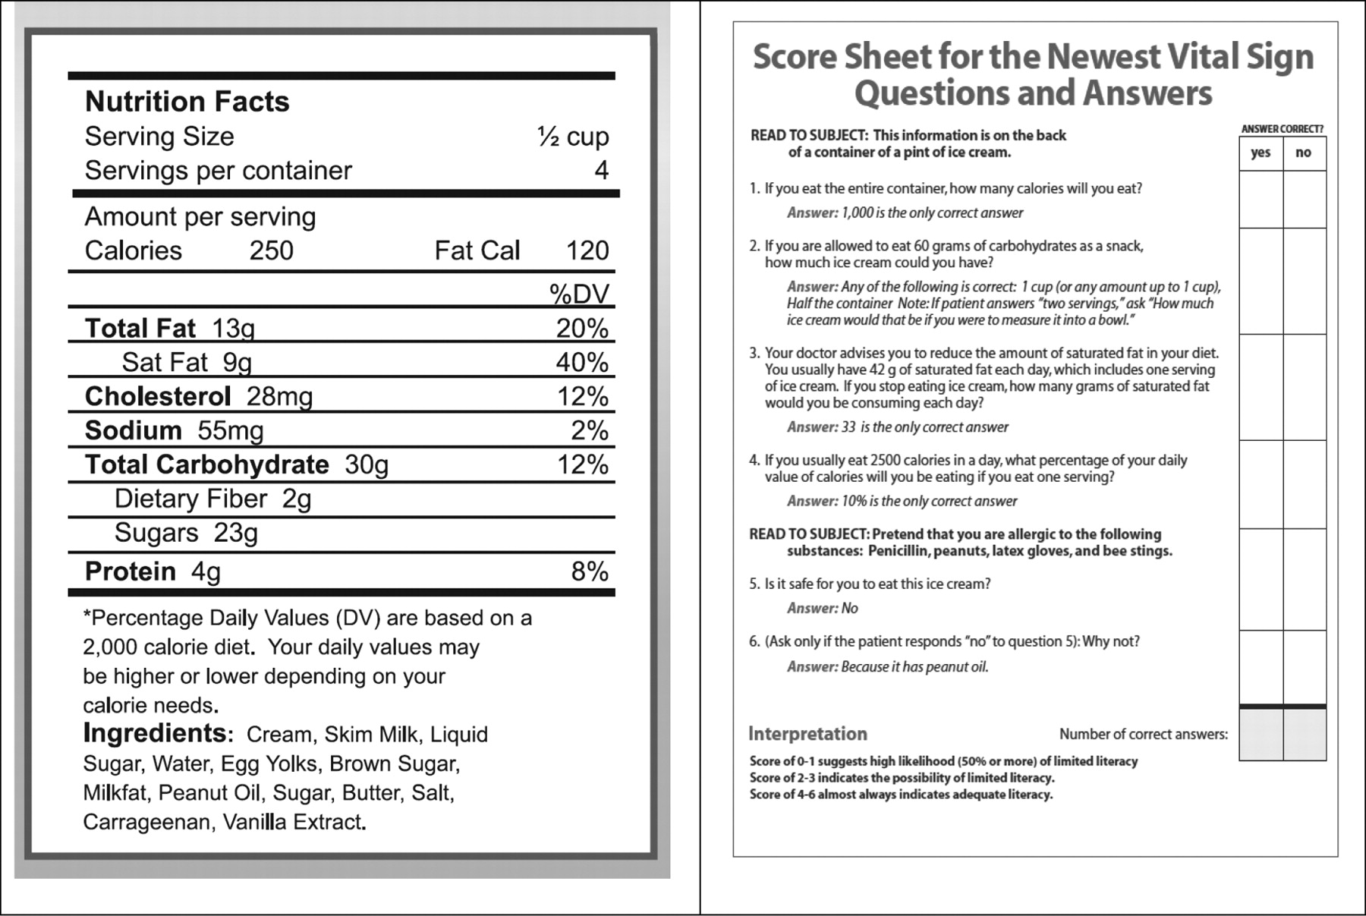
The Newest Vital Sign (NVS) screening instrument for health literacy. The Newest Vital Sign (February 2011; 2024). file:///C:/Users/owner/Downloads/nvs_flipbook_english_final.pdf

Slide 38
SMOG Readability Formula
From: https://www.readabilityformulas.com/smog-readability-formula.php
The SMOG Readability Formula
Step 1: Take the entire text to be assessed.
Step 2: Count 10 sentences in a row near the beginning, 10 in the middle, and 10 in the end for a total of 30 sentences.
Step 3: Count every word with three or more syllables in each group of sentences, even if the same word appears more than once.
Step 4: Calculate the square root of the number arrived at in Step 3 and round it off to nearest 10.
Step 4: Add 3 to the figure arrived at in Step 4 to know the SMOG Grade, i.e., the reading grade that a person must have reached if he is to understand fully the text assessed.
SMOG grade = 3 + Square Root of Polysyllable Count

Slide 39
SMOG Readability Formula (cont.)
1. A sentence is defined as a string of words punctuated with a period, an exclamation mark, or a question mark.
2. Consider long sentences with a semi-colon as two sentences.
3. Words with hyphen are considered as a single word.
4. Proper nouns, if polysyllabic should be counted.
5. Numbers that are written should be counted. If written in numeric form, they should be pronounced to determine if they are polysyllabic.
6. Abbreviations should be read as though unabbreviated to determine if they are polysyllabic. However, abbreviations should be avoided unless commonly known.
7. If the text being graded is shorter than 30 sentences, follow the steps below:
i. Count all the polysyllabic words in the text
ii. Count the number of sentences in the text.
iii. Divide the figures obtained in i. by the figure obtained in ii. to arrive at Average Polysyllabic Words per sentence.
iv. Multiply the figure obtained in iii. with the average number of sentences short of 30.
v. Add the figure obtained in iv. to the total number of polysyllabic words.

Slide 40
SMOG Conversion Table
SMOG Conversion Table
Total Polysyllabic Word Count | Approximate Grade Level (+1.5 Grades)
1 - 6 | 5
7 - 12 | 6
13 - 20 | 7
21 - 30 | 8
31 - 42 | 9
43 - 56 | 10
57 - 72 | 11
73 - 90 | 12
91 - 110 | 13
111 - 132 | 14
133 - 156 | 15
157 - 182 | 16
183 - 210 | 17
211 - 240 | 18

Slide 41

Name a Common Health Document Used in the U.S.

Slide 42
Example: Patient Consent Form
file:///C:/Users/owner/Downloads/english-maternity-consent-form---updated-jan-2018.pdf
First 10 sentences: I, ___________ up to “A planned cesarean is sometimes necessary, too”
Middle 10 sentences: “Induction of Labor” section
Last 10 sentences: “TOLAC may be unsuccessful” to the last bullet “Lower risk of my placenta having problems attaching in future pregnancies”

Slide 43
What SMOG Score did you obtain?
First 10 sentences = ?
Middle 10 sentences = ?
Last 10 sentences = ?
Square root of this number + 3 = ?

Slide 44
Exercise
Search on-line for a patient information form/educational form written for the general public that is of interest to you
Assess this resource using the SMOG technique
What is the SMOG score?

Slide 45
Resources for Individuals Families
&
Professionals
Institute for Healthcare Improvement (IHI)
“Ask Me 3”
Designed by health literacy experts, Ask Me 3 can help patients become more active members of their health care team and improve communication between patients, families, and health care professionals
Encourages patients to ask:
What is my main problem?
What do I have to do for it?
Why is it important for me to do this?
Website has resources for healthcare professionals
http://www.ihi.org/resources/Pages/Tools/Ask-Me-3-Good-Questions-for-Your-Good-Health.aspx

Slide 46
Resources for
Professionals
Health Literacy On-line
This research-based guide helps you to develop health websites and digital tools that can be easily accessed and understood by all users — including the millions of Americans who struggle to find, process, and use online health information
From: United States Department of Health and Human Services, Office of Disease Prevention and Health Promotion (2016)
https://health.gov/healthliteracyonline/

Slide 47
Resources For Professionals (Cont,)
Health Literacy Studies at the Harvard T.H. Chan School of Public Health
Health Literacy Studies is located in the Department of Social and Behavioral Sciences with Dr. Rima Rudd as Principal Investigator
This HSPH Health Literacy website was designed for professionals in health and education who are interested in health literacy
This was the first academic site to provide resources and links for health literacy research studies and practice
The website has unique tools as well as links to key resources – documents, articles, materials, and organizations
https://www.hsph.harvard.edu/healthliteracy/

Slide 48
Resources for Professionals (cont.)
Milken Institute: Health Literacy in the United States: Final Report: Enhancing Assessments and Reducing Disparities
Authors: CLAUDE LOPEZ, PHD, BUMYANG KIM, PHD, AND KATHERINE SACKS, PHD
Contains 11 reference pages for additional resources
https://milkeninstitute.org/sites/default/files/2022-05/Health_Literacy_United_States_Final_Report.pdf

Slide 49
What Can YOU Do to Improve HC and HL?
Use 4 Simple Strategies
Plain language
Visual aids
Technology (mobile apps; telemedicine)
Effective teaching methods (Teach Back and Show Back)
ACP Decisions (Sept 30, 2019) Four simple strategies for improving patient health literacy. https://acpdecisions.org/four-simple-strategies-for-improving-your-patients-health-literacy/
************************************************************
Limit the amount of information you give at one time
Give printed information/handouts written at a 5th grade reading level
• Prioritize the information you give the patient; the most important information should be repeated first and last
• Repeat the information in different ways
Demonstrate what you want the patient to do
Involve the patient's family members in discussions. Use educators to provide one-on-one instructions in busy outpatient settings to complement the healthcare providers education
From: Mayeaux, E. J. Jr., P. W. Murphy, C. Arnold, T. C. Davis, R. H. Jackson, and T. Sentell (1996). Improving patient education for patients with low literacy skills. American Family Physician 53 (1): 205-11.

Slide 50

Reflection Questions
Do you now feel better prepared to:
Perform a self-assessment regarding your
knowledge of health literacy and its impact on
health outcomes
*Assess individuals for their health literacy skills?
* Evaluate written material for readability level?
This Photo by Unknown Author is licensed under CC BY-SA

Slide 51
References

Slide 52
References
ACP Decisions (Sept 30 2019) Four simple strategies for improving patient health literacy. https://acpdecisions.org/four-simple-strategies-for-improving-your-patients-health-literacy
Cardiology Magazine Editors (October 18, 2019). Recognizing and addressing health literacy in your patients: Low health literacy impacts prevention, treatment. https://www.acc.org/latest-in-cardiology/articles/2019/10/06/24/42/cover-story-recognizing-and-addressing-health-literacy-in-your-patients
Centers for Disease Control and Prevention (2019-a). Talking points about health literacy. https://www.cdc.gov/healthliteracy/shareinteract/TellOthers.html
Centers for Disease Control and Prevention (2019-b). Understanding literacy and numeracy. https://www.cdc.gov/healthliteracy/learn/understandingliteracy.html
Centers for Disease Control and Prevention, National Center for Health Statistics. National Center for Health Statistics (2019). Healthy People 2020. https://www.cdc.gov/nchs/healthy_people/hp2020.htm
Centers for Disease Control and Prevention (2022). Centers for Disease Control and Prevention (2022). What is health literacy?
https://www.cdc.gov/healthliteracy/learn/index.html#wnd
Centers for Disease Control and Prevention (2023). What is health literacy? https://www.cdc.gov/healthliteracy/learn/index.html
Cornett, S. (2009). Assessing and addressing health literacy. The Online Journal of Issues in Nursing. Sept., Vol 14, (3), Manuscript 2.
Doak, LG, & Doak, CC. Lowering the silent barriers to compliance for patients with low literacy skills. Promot Health. 1987;8(4):6–8.
Doak, CC, Doak LG, & Root JH. Teaching Patients with Low Literacy Skills. 2nd ed. Philadelphia, PA: JB Lippincott; 1996.
Doak CC, Doak LG, Friedell GH, & Meade CD. Improving comprehension for cancer patients with low literacy skills: strategies for clinicians. CA Cancer J Clin. 1998;48(3):151–62.

Slide 53
References
Eltorai, A., Ghanian, S., Adams, C., Born, C. & Daniels, A. Readability of patient education materials on the American Association for Surgery of Trauma website. Achieves of Trauma 2014 Jun; 3(2): e18161.
Graham, S. & Brookey, J. (2008). Do patients understand? The Kaiser-Permanente Journal. Summer, 12 (3); 67-69.
Hickey, K. T., Masterson Creber, R. M., Reading, M., Sciacca, R. R., Riga, T. C., Frulla, A. P., & Casida, J. M. (2018). Low health literacy: Implications for managing cardiac patients in practice. The Nurse practitioner, 43(8), 49–55. https://doi.org/10.1097/01.NPR.0000541468.54290.49
Kirsch IS. (2001). The framework used in developing and interpreting the International Adult Literacy Survey (IALS). European Journal of Psychology of Education . 16(3): 335–361.
Mahadevan, R. (2013). Center for Health Care Strategies Health Literacy fact sheet, October 2013.
McDonald M, & Shenkman LJ. (2018). Health literacy and health outcomes of adults in the United States: Implications for providers. The Internet Journal of Allied Health Sciences and Practice. Oct 03: 16(4), Article 2.
Milken Institute: Health Literacy in the United States: Final Report: Enhancing Assessments and Reducing Disparities Authors: Lopez, C., Kim, B., & Sacks, K. https://milkeninstitute.org/sites/default/files/2022-05/Health_Literacy_United_States_Final_Report.pdf
National Libraries of Medicine (2023). An introduction to health literacy: What is heath literacy? https://www.nnlm.gov/guides/intro-health-literacy
National Center for Education Statistics (June, 2020). States and counties with the highest and lowest levels of adult literacy and numeracy. https://nces.ed.gov/surveys/piaac/doc/us-piaac-skillsmap_summary.pdf
Parker, R.M., Baker, D.W., Williams, M.V. et al. The test of functional health literacy in adults. J Gen Intern Med 10, 537–541 (1995). https://doi.org/10.1007/BF02640361
Surescripts (2021). 2020 National Progress Report. From: https://surescripts.com/news-center/national-progress-report-2020
The Harvard T.H. Chan School of Public Health: Health Literacy Studies Web Site. http:www.hsph.harvard.edu/healthliteracy
United States Department of Health and Human Services, Office of Disease Prevention and Health Promotion [ODPHP) Healthy People 2030
https://health.gov/healthypeople/objectives-and-data/browse-objectives/health-communication
Welch, V., VanGeest, J., & Caskey, R. (2011). Time, costs and clinical utilization of screening for health literacy: A case study using the Newest Vital Sign (NVS) instrument. The Journal of the American Board of Family Medicine, 24 (3), 281-289. DOI: https://doi.org/10.3122/jabfm.2011.03.100212

