Slide 1
Bridging the Gaps
Oral Health Education
& Dental Mentors
Summer 2024
Notes:
Hello and welcome to BTG! The purpose of this video is to orient you to the oral health education component of BTG and, more importantly, to reassure you that you have plenty of back up when it comes to providing oral health education at your community sites! Faculty and students at Penn Dental Medicine (PDM) serve as resources and dental mentors for Bridging the Gaps interns to plan and implement oral health prevention programs that include education and referral for dental care at their community sites. I will work with the team to include two dental students – Adeayo Adenusi and Matt Lam- with the Community Health Academic Coordinator. The team will post a video presentation with power point slides explaining the significance of oral health for general health and describing best practices for designing community oral health programs.
Through a generous grant from the Pennsylvania Department of Health, Bridging the Gap provides oral hygiene supplies, including toothbrushes, toothpaste, dental floss and denture supplies, as well as educational materials (puppets, story books and flip charts) for you to use in your community project. Please take advantage of these supplies and order through our Dental team by filling out the Request form for Oral Health Educational Materials, posted below. After you complete the form, please email the form to me (email address is on the form) so that we can pack your supplies for you. Supplies will be distributed through your home school.
We also have mentoring support available from two dental students who were in last year’s Bridging the Gaps program. Adeayo and Matthew are available by phone and video consultation to help you plan your oral health program at your community site, and their contact information is available in this presentation. They will send you resources and discuss ideas for fun, interactive dental activities, and can also answer questions and provide dental referrals. It is our goal that each Bridging the Gap site has a dental program so that we can increase oral health education in the Philadelphia community as well as increase access to dental care by sharing information about the number of public health clinics in Philadelphia.

Slide 2
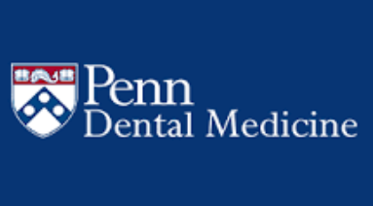
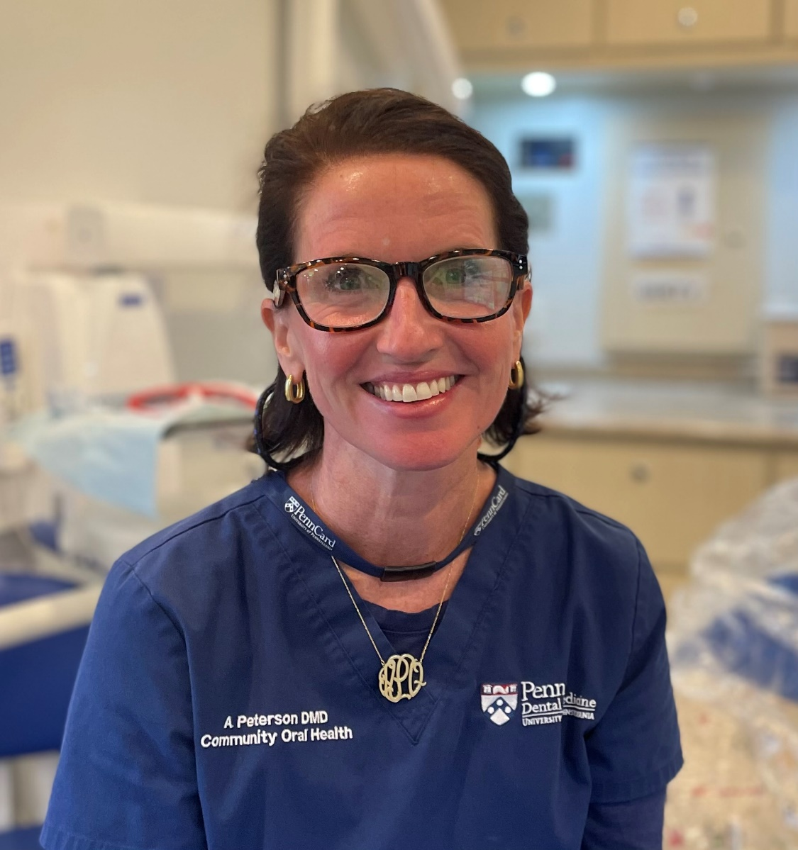
Abby Quinn Peterson, DMD, MPH
Email: abquinn@upenn.edu
Phone: 215-519-5536
Notes:
My name is Abby Peterson and I am the faculty member representing Penn Dental. I worked at a non profit childrens dental center in West Philadelphia for many years before coming to Penn. I’ve had the great opportunity to work on Penn Smiles, our mobile dental unit, for almost 4 years now. We take Penn Smiles to sites in the community such as schools, camps and foster care agencies, where the dental students provide much needed treatment meeting the kids where they are. The idea is to remove the barrier of access to care by providing care where the children are!

Slide 3
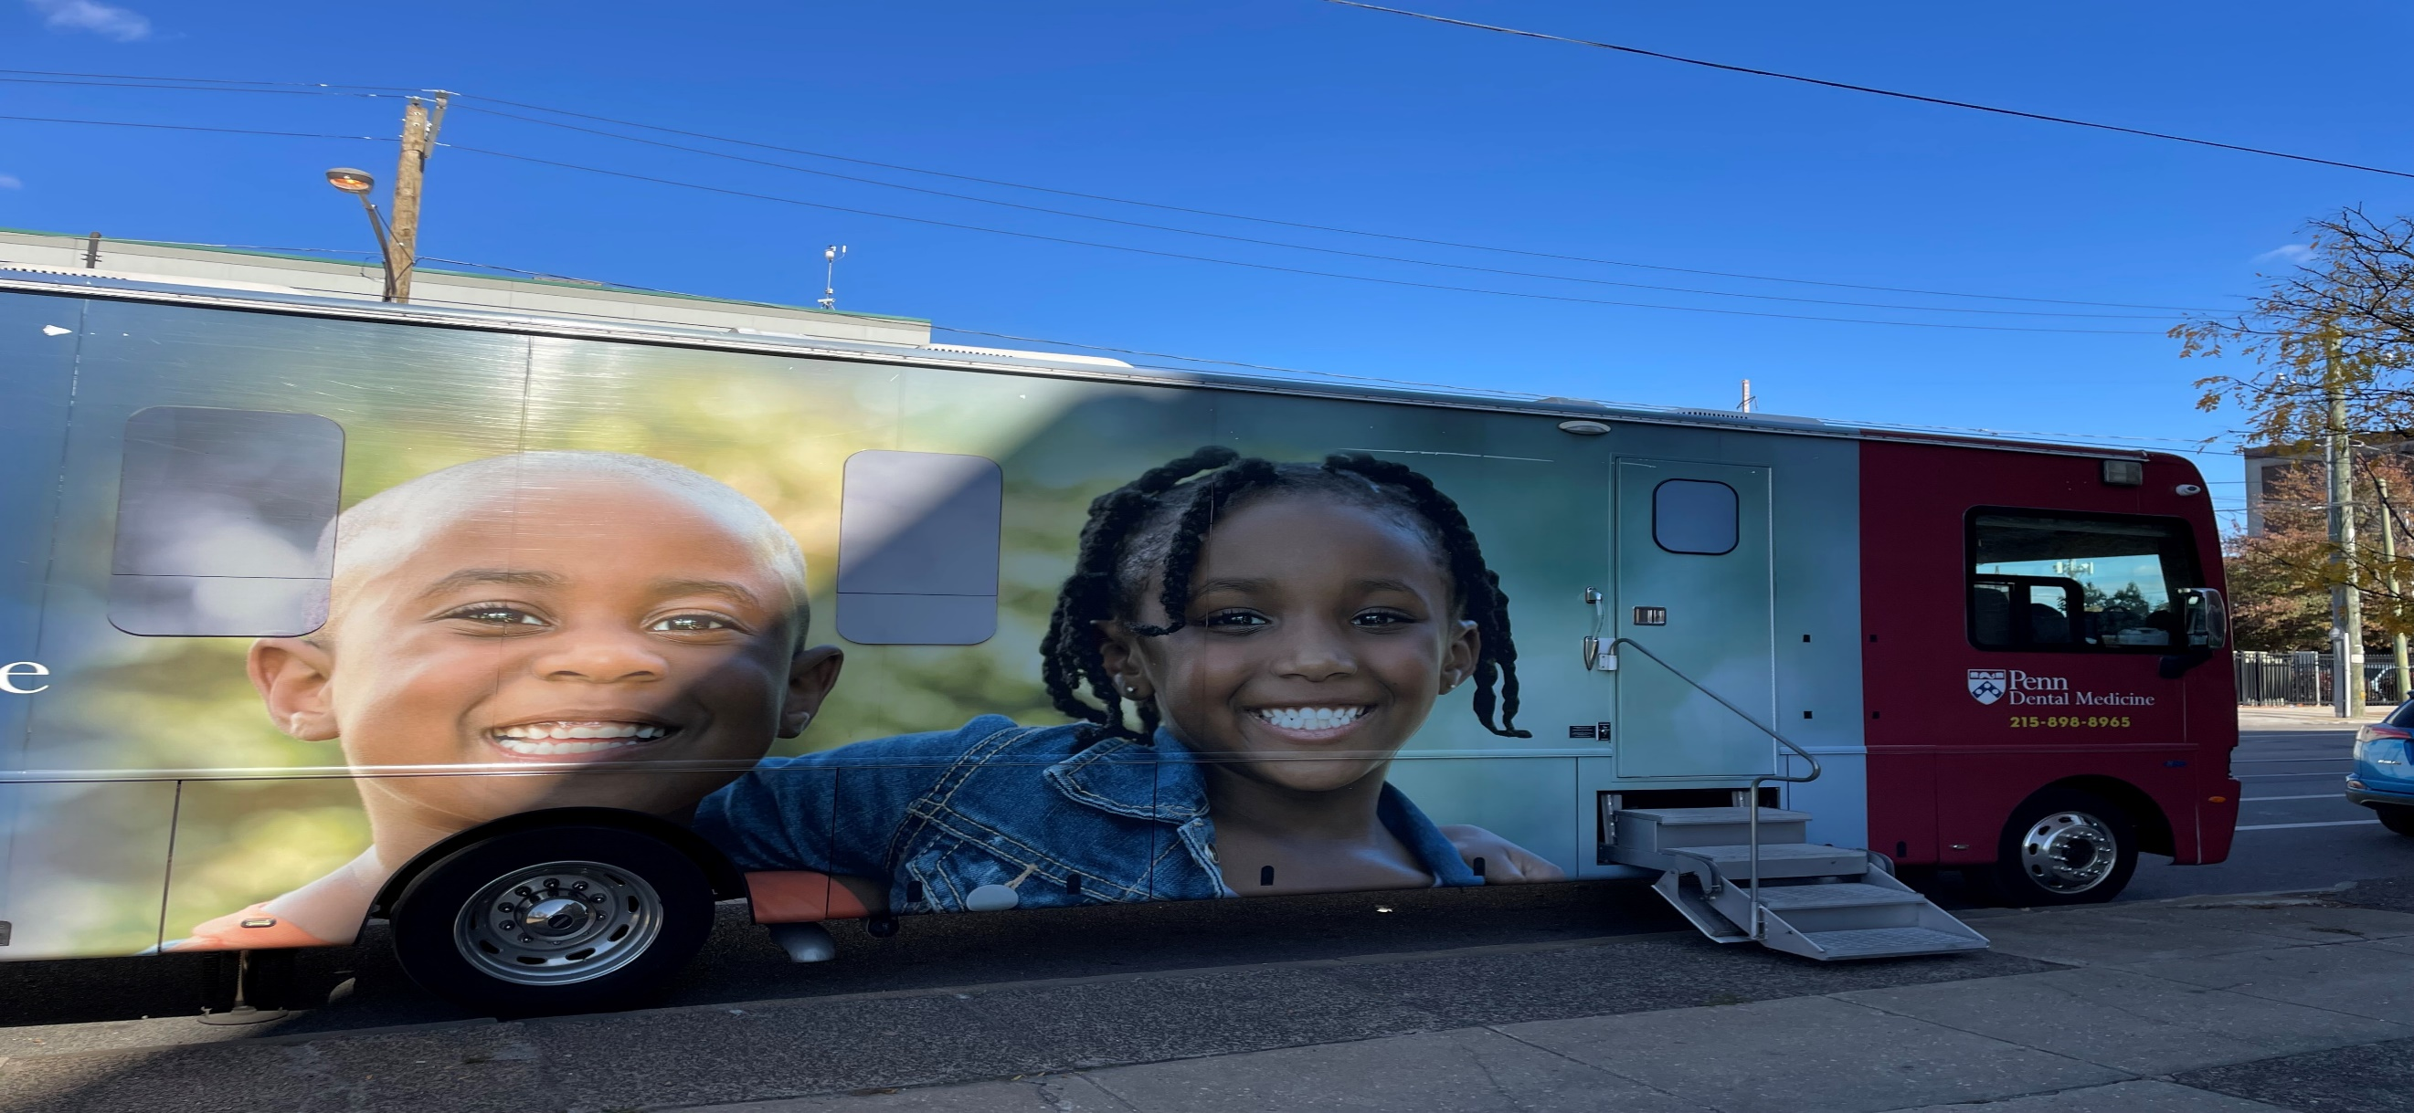
Penn Smiles
Notes:
So this is Penn Smiles! I’m there on Wednesdays, Thursdays and Fridays- so if you see us out in the community on one of those days, please pop in and say hi!

Slide 4
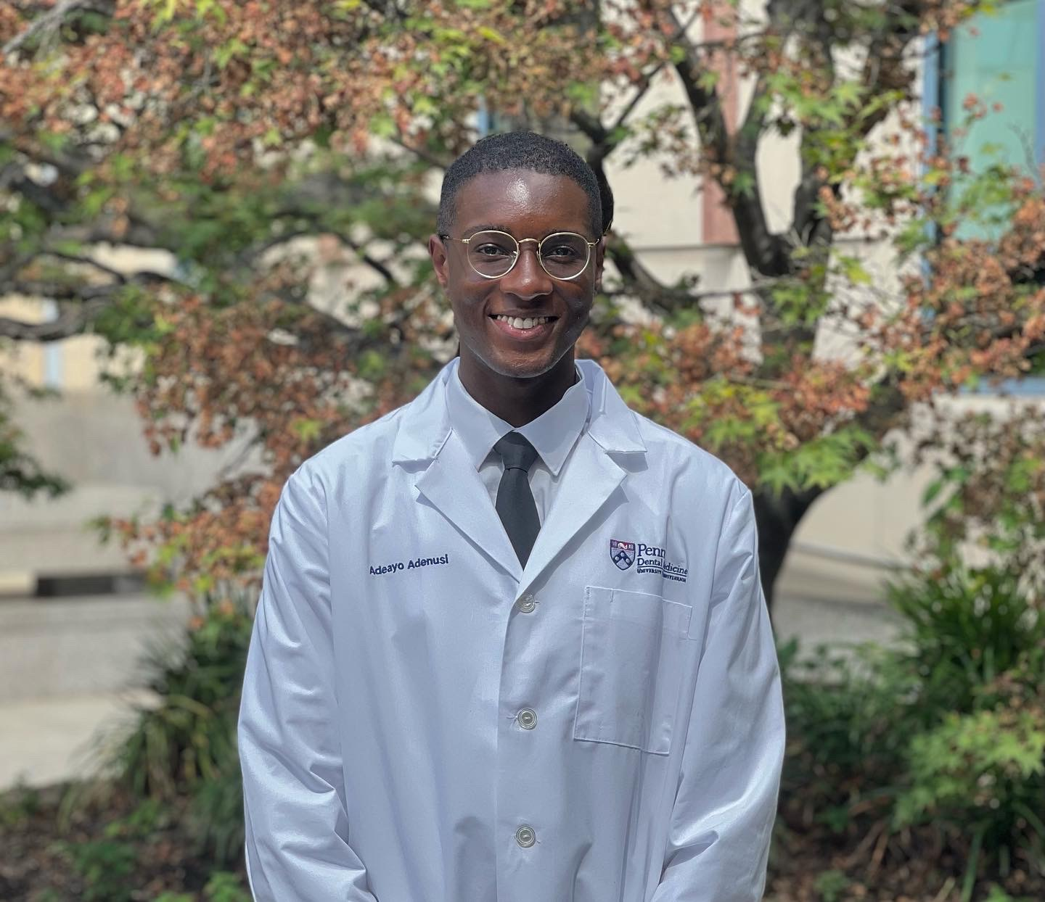
Dental Education Mentor
Adaeyo Adenusi
Email: adeayo1@upenn.edu
Phone: 240-687-3574
Notes:
You are in the very capable hands of this years 2 dental mentors. They both completed BTG last summer and we are thrilled that they have signed back on to assist you with your oral health education activities. I’ll ask Adeayo to introduce himself first- please tell everyone a little about yourself, including your BTG site last summer and your current involvement with HMS School.

Slide 5
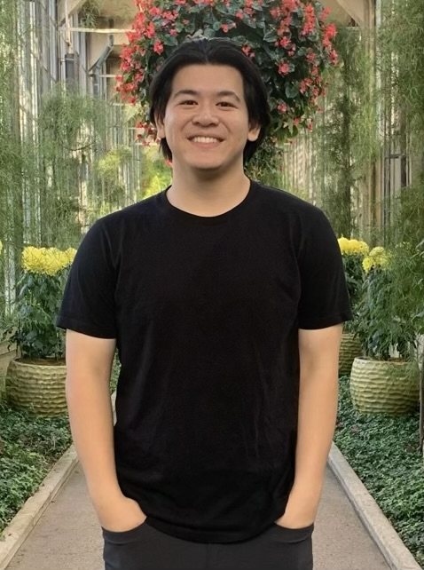
Dental Education Mentor
Matt Lam
Email: mtlam09@upenn.edu
Phone: 301-272-7230
Notes:
Next we will hear from Matt Lam about his BTG experiences.

Slide 6
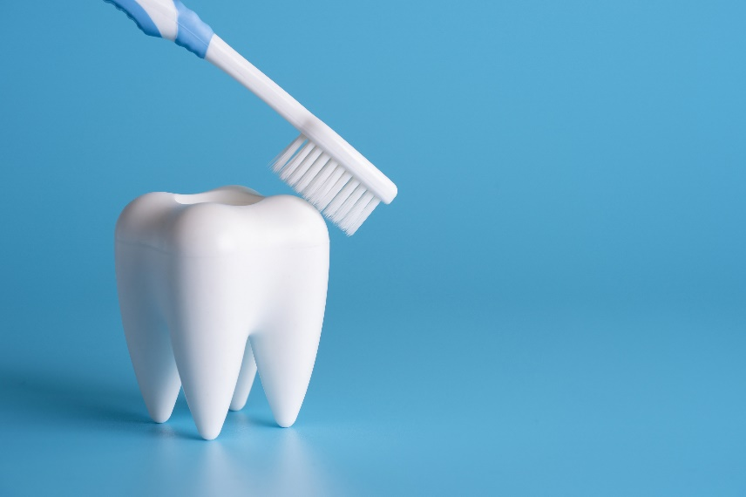
Oral health is ESSENTIAL for total body health!
-Oral health/systemic health connection
- bacterial translocation
- increased inflammatory levels throughout body
-Disparities in access to care based on race, ethnicity and income
Notes:
What happens in the mouth impacts the whole body. There are two mechanisms by which this happens. One- the bacteria that causes gum disease can translocate throughout the body and can promote development of systemic disease such as pneumonia. This is especially a consideration for older adults. Another important relationship to consider is the link between gum (or periodontal) disease and diabetes- as increase inflammatory levels such that are seen in gum disease make it difficult for good blood sugar control. Individuals with diabetes tend to have greater rates of gum disease and dental cavities. In Philadelphia, we see great disparities in access to care as well as rates of gum disease and cavities based on race, ethnicity, and income. African American and Latino children have twice the rate of decay of their White peers. And sadly, we know that Philadelphia is the poorest of all the large cities in America.

Slide 7
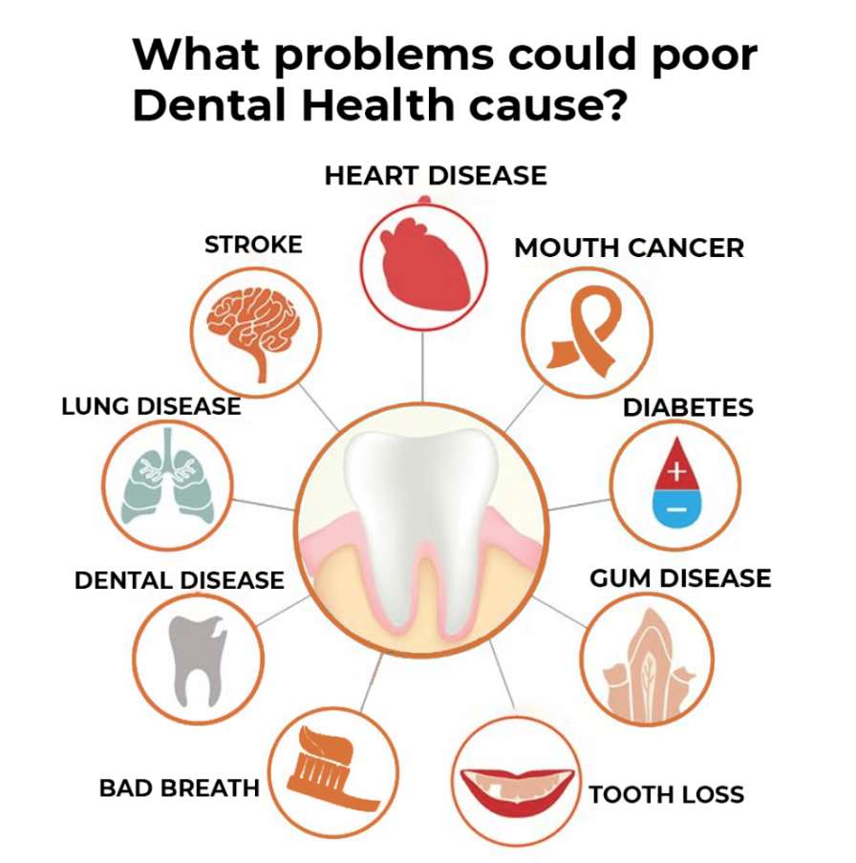
Oral Health General Health Significance
Notes:
This slide gives us a sense of how many systemic conditions are related to poor dental health. Getting back to diabetes, at Penn Dental, if we encounter a new patient with significant dental disease, we will test their blood sugar level and refer back to primary care. So sometimes it is the dentist who is the first health care provider to recognize the signs of poorly controlled blood sugar- particularly in the case of a patient who has not had a primary care visit in quite some time, but a toothache sends him to the dentist. Furthermore, there are specific markers of inflammation such as C reactive protein, that correlate with higher levels of heart disease and stroke. This highlights the significance of the interdisciplinary nature of Bridging the Gaps- once you all are out in the world, practicing your profession, you will find that you will quite often consult with each other about patients.

Slide 8
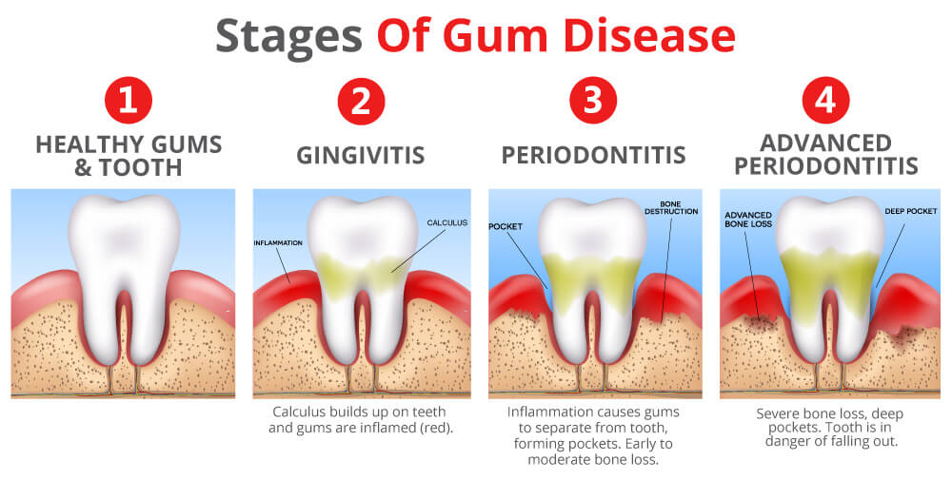
RANGE OF PERIODONAL (gum) HEALTH
Healthy tissue: pink, firm and tight to tooth
Gingivitis: red, enlarged tissues that bleed
Advanced Periodontitis: loss of tissue and bone support
Notes:
We often say the gums in the mouth are a mirror to the body- so if we see a patient in dramatically poor periodontal health, we have to investigate further if there is other systemic disease present- HIV, diabetes, heart disease, etc.

Slide 9
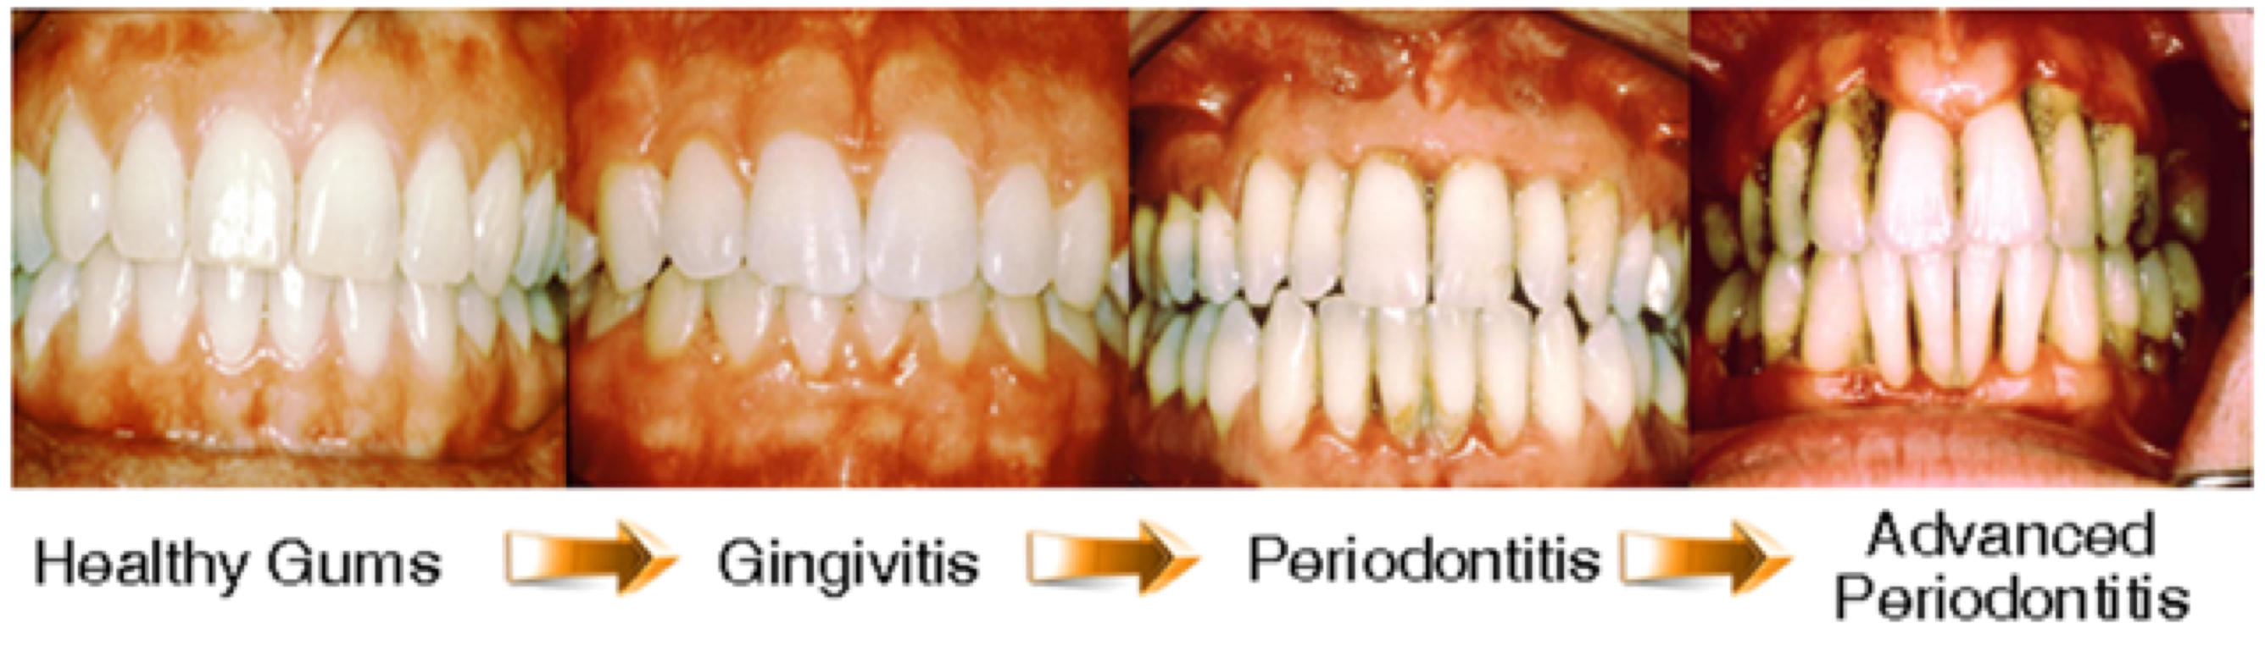
Progression of Periodontal Disease

Slide 10
Dental Decay is the MOST common childhood disease- and it is preventable!
How many experience dental decay?
Children 2-5 years: 27% of young children have cavities of baby teeth
Children 5-11 years: 49% of baby teeth and 20% of adult teeth
Teens 12-17 years: 67% adult teeth
Adults: 91% adult teeth
Notes:
I’ll get to this in a little more depth later, but I want to point out that I am using really plain language here- using the terms baby and adult teeth instead of primary and permanent. This is intentional, because this is how you will talk when you are out in community. It is so important to avoid medical jargon! So dental decay is the most common disease of childhood- and the heartbreaking thing is that it is almost entirely preventable! Many people seem to think that cavities are unavoidable and just a part of childhood- and that is why it is so important that you all provide this dental education at your sites! With babies, we want them to have their first dental visit by age 1- and teeth need to be brushed as soon as they come in. Teenage years are the cavity prone years – so its really important to engage with the teenagers about oral health. The nice thing is that we have some newer, less invasive ways to deal with cavities, especially if we catch them when they are still in the developing stages. And if we catch them before they have any cavities, we can prevent cavities with sealants. Now if you encounter people at your sites with a lot of decay, you may want to talk to them about other factors that may be causing dry mouth, such as antihistamines (which many of us, including myself, are using for seasonal allergies) all the way to individuals with addiction issues. We know that meth causes significant dry mouth and sustained meth use results in severely high rates of cavities.

Slide 11
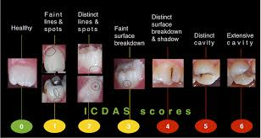
Progression of Dental Caries (Cavities)
Notes:
.

Slide 12
Dental Educational Presentations on Oral Hygiene, Fluorides, Nutrition and Frequent Dental & Medical Care
Notes:
This is where Adeayo and Matt come in- to help you brainstorm activities appropriate to the life stages you are seeing at your sites. You might play Bingo or Jeopardy at sites with older adults as part of your teaching – and you will definitely use the dinosaur puppets at any sites with children! We will provide you information on the benefits of fluoride so that you can share with your communities – and respond to misinformation circulating on the internet!

Slide 13
Tobacco Cessation is KEY in Oral Health Promotion
- tobacco use is linked to oral cancer and periodontal disease
- disparities in tobacco use and oral health
Notes:
Not just smoking and cigarettes- also spit tobacco, chew tobacco which is routinely held in the same pocket of the mouth. And we see these same disparities with higher rates of oral cancer in AA men than in their White peers.

Slide 14
Promote Regular Dental Visits!
-describe experience at sites
-provide referral list
Do You Need Help Finding A Dentist?
Call the Dental and Dental Hygiene Schools:
Penn Dental 240 S. 40th Sts 215-898-8965
Temple Dental 3223 N. Broad St 215-707-2900
Community College of Philadelphia 1700 Spring Garden Sts 215-751-8625
Call the Health Centers:
District Health Center #2 1720 S. Broad St 215-685-1822
District Health Center #3 555 S. 43rd St 215-685-7506
District Health Center #4 4400 Haverford Avenue 215-685-7605
District Health Center #5 1920 N. 20th St 215-685-2938
District Health Center #6 321 W. Girard Ave 215-685-3816
District Health Center #9 131 E. Chelten Avenue 215-685-5738
District Health Center #10 2230 Cottman Avenue 215-685-0608
Einstein Hospital Dental Clinic 5501 Old York Rd., 215-456-7130
Eleventh St Family Services* 850 North 11th st 215-769-1100
Esperanza Health Center* 3156 Kensington Avenue 215-831-1100
Fairmount Health Center* 1412 Fairmont Avenue 215-684-5349
Frankford Ave Health Center 4510 Frankford Avenue 215-535-1990
Health Annex* 6120-B Woodland Ave 215-727-4721
Hunting Park Health Center 1999 W. Hunting Park Avenue 215-229-1390
Marie De Los Santos Center* 452 W Allegheny Avenue 215-291-2500
Philadelphia FIGHT Dental* 1207 Chestnut Street 215-525-3046
Quality Community Health* 2501 West Lehigh Avenue 215-227-0300
Sayre Health Center* 5900 Walnut Street 215-474-4444
Stephen Klein Wellness Dental* 2144 Cecil B Moore Avenue 215-320-6187
Wilson Park Medical Center 2520 Snyder Avenue 215-755-6866
* Accepts a Sliding Fee Schedule
For Children & Those with Special Needs, Call:
Penn Dental 240 S. 40th Sts 215-898-8965
Temple Dental 3223 N. Broad St 215-707-2900
Episcopal Hospital Front and Lehigh Ave. 215-426-6760
Special Smiles Ltd Front and Lehigh Ave. 215-427-7495
St. Christopher’s Erie Av. At Front St., 215-427-5065
Kids Smiles 2924 Island Avenue 215-492-9291
Kids Smiles 5828 Market Street 215-747-6901
If You Need Referral to A Private Dentist, Call:
Philadelphia County Dental Society 215-925-6050
Notes:
Dental schools in both West and North Philadelphia. District Health Centers and FQHCs which have discounts and sliding fee scales. Our dental mentors will be happy to help connect your community members with dental offices in their communities. The good news for children is that Medicaid covers dental care for children up to age 18, so no out of pocket expenses for them.

Slide 15
BTG Request for Oral Health Educational Materials
Bridging the Gaps: Philadelphia Community Health Internship Program 2024
Request for Oral Health Materials
Please email this request sheet to Nasheeka.Conix@pennmedicine.upenn.edu by July 1st. (June 24th for Lehigh Valley)
The BTG Dental Mentors will contact you to coordinate your drop off date and time.
School & Discipline: ___________________________________________
Today’s date: _____________________________________________­­­­­­­­­­­­­­­___
Requested drop off date(s):­­­­­­­­­­­­­­______________________________________
Contact Phone #: _____________________________________________
Contact email address: _________________________________________
Each institution will be provided with 2 puppets, a dentoform (mouth model) and an oral health flip book. These materials will stay with the institution for use in future years.
Number of oral health supplies needed for all sites served by Temple BTG interns:
BTG Dental Mentor Signature: __________________________________________________
Date delivered: ______________________
Updated May 2024
# _______ oral health kits for adults and children aged 9 & older (toothbrush, flossers, toothpaste) | # ______ denture kits (denture brush, bath, adhesive and denture cleaning tablets for older adults)
# _______ oral health kits for juniors aged 3-8 (toothbrush, junior flossers, toothpaste, 2 minute timers) | # _______ disclosing tablets
# _______ oral health kits for babies aged 2 & under (toothbrush, junior flossers, toothpaste)
Notes:
Request form will be on the website. Supplies will be distributed through your home school. Please fill it out completely and we can provide all the supplies you need to distribute to your sites.

Slide 16
Oral Health Resources
For Children: American Dental Association Smile Starts
http://www.mouthhealthykids.org/en/educators/smile-smarts-dental-health-curriculum
Cavity Free Kids http://www.healthyteeth.org/
Oral health-General health connection http://www.colgate.com/en/us/oc/oral-health/conditions/gum-disease/article/how-poor-dental-care-can-affect-your-overall-health-0313
Older adults: http://toothwisdom.org/

Slide 17
Communication
GO BACK TO BASICS
-avoid health related jargon!
-simple black & white line drawn pictures
-effective communication requires assessing what the patient knows about their illness
-sufficient time allotted to provide answers
-short summary of what the patient conveyed and giving additional information so they learn more
-body language, facial expressions, and tone of voice

Slide 18
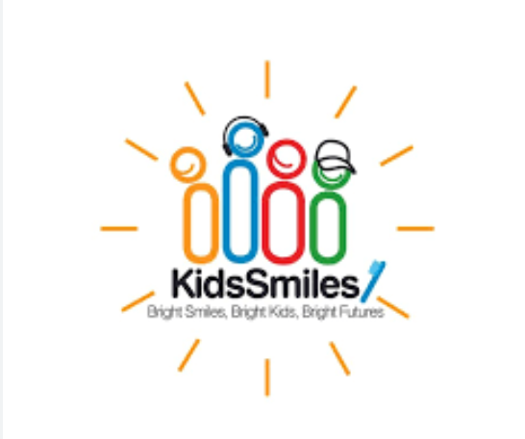
Kids Smiles
NONPROFIT CHILDREN’S DENTAL CENTERS

Slide 19
To raise and expand the practice of oral healthcare in under-served communities by providing clinical care, education, and by partnering with community and healthcare organizations to create positive health behaviors among the children and families we serve.
Mission Statement of Kids Smiles

Slide 20
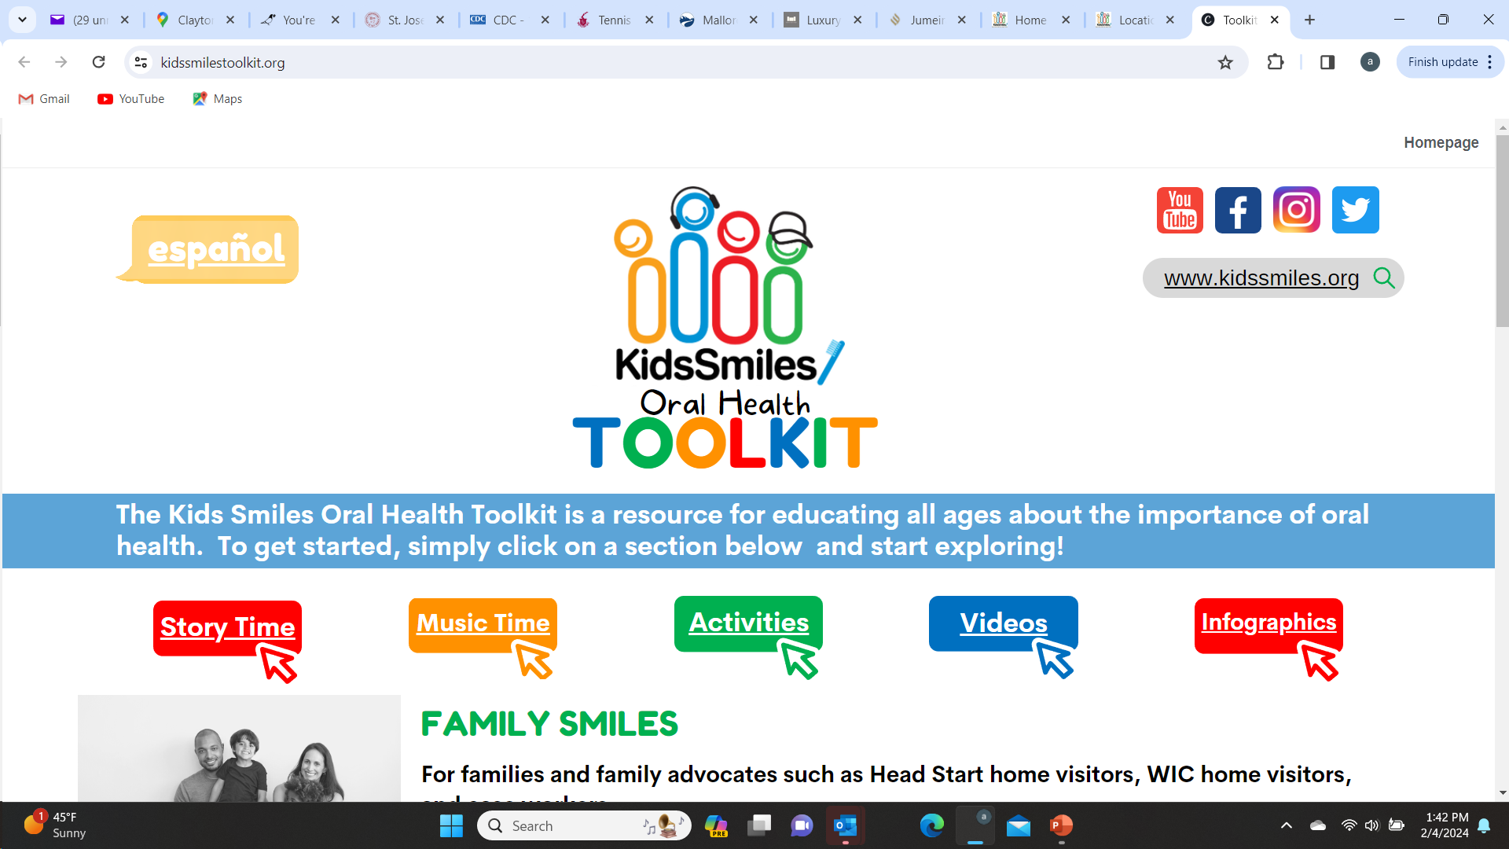
Kids Smiles
NONPROFIT CHILDREN’S DENTAL CENTERS

Slide 21
FAMILY SMILES
For families and family advocates such as Head Start home visitors, WIC home visitors, and case workers.
DENTAL EDUCATION
For educators who work with students from pre-school through high school.
INCLUSIVE DENTAL HEALTH
For families and children with disabilities and special health care needs.
DENTAL HEALTH FOR TEENS
For teens and those working with teens. Utilize the resources in this section to manage dental anxiety, learn about the dental industry, and how to maintain a healthy mouth.
RELATED RESOURCES
Access other trusted oral health resources.
COMMUNITY PARTNER PORTAL
Information and resources designed for current and potential community partners.
Components of the toolkit

Slide 22
Thank you!
abquinn@upenn.edu
215-519-5536

Slide 23
Please be advised that Penn Dental Medicine is neither supporting nor endorsing this presentation, product(s), or services.
Students are urged to use an evidence-based approach by utilizing scientific research and position papers and guidelines from the ADA and specialty professional associations.

Slide 24
DISCLOSURE
I do NOT have any relevant financial relationships with any commercial interests.
My presentation will contain NO reference to an investigational and/or off-label use of a product.

