Slide 1
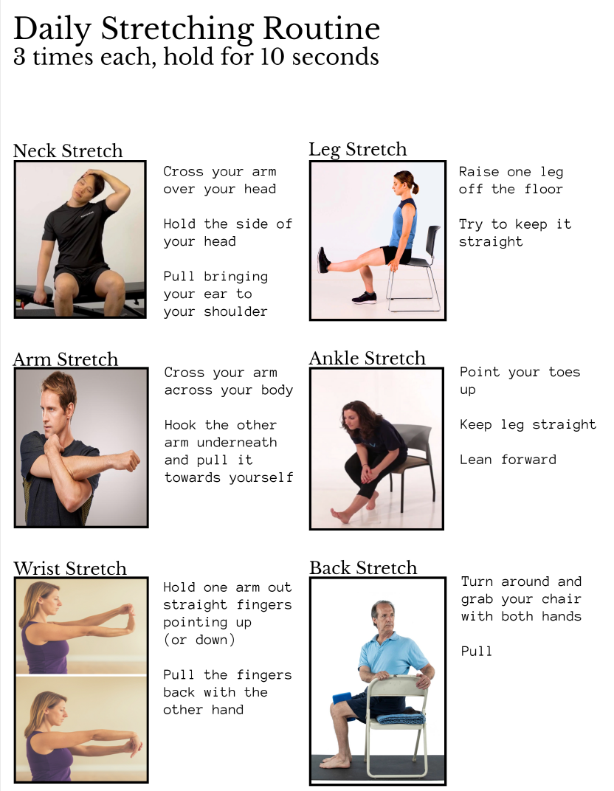
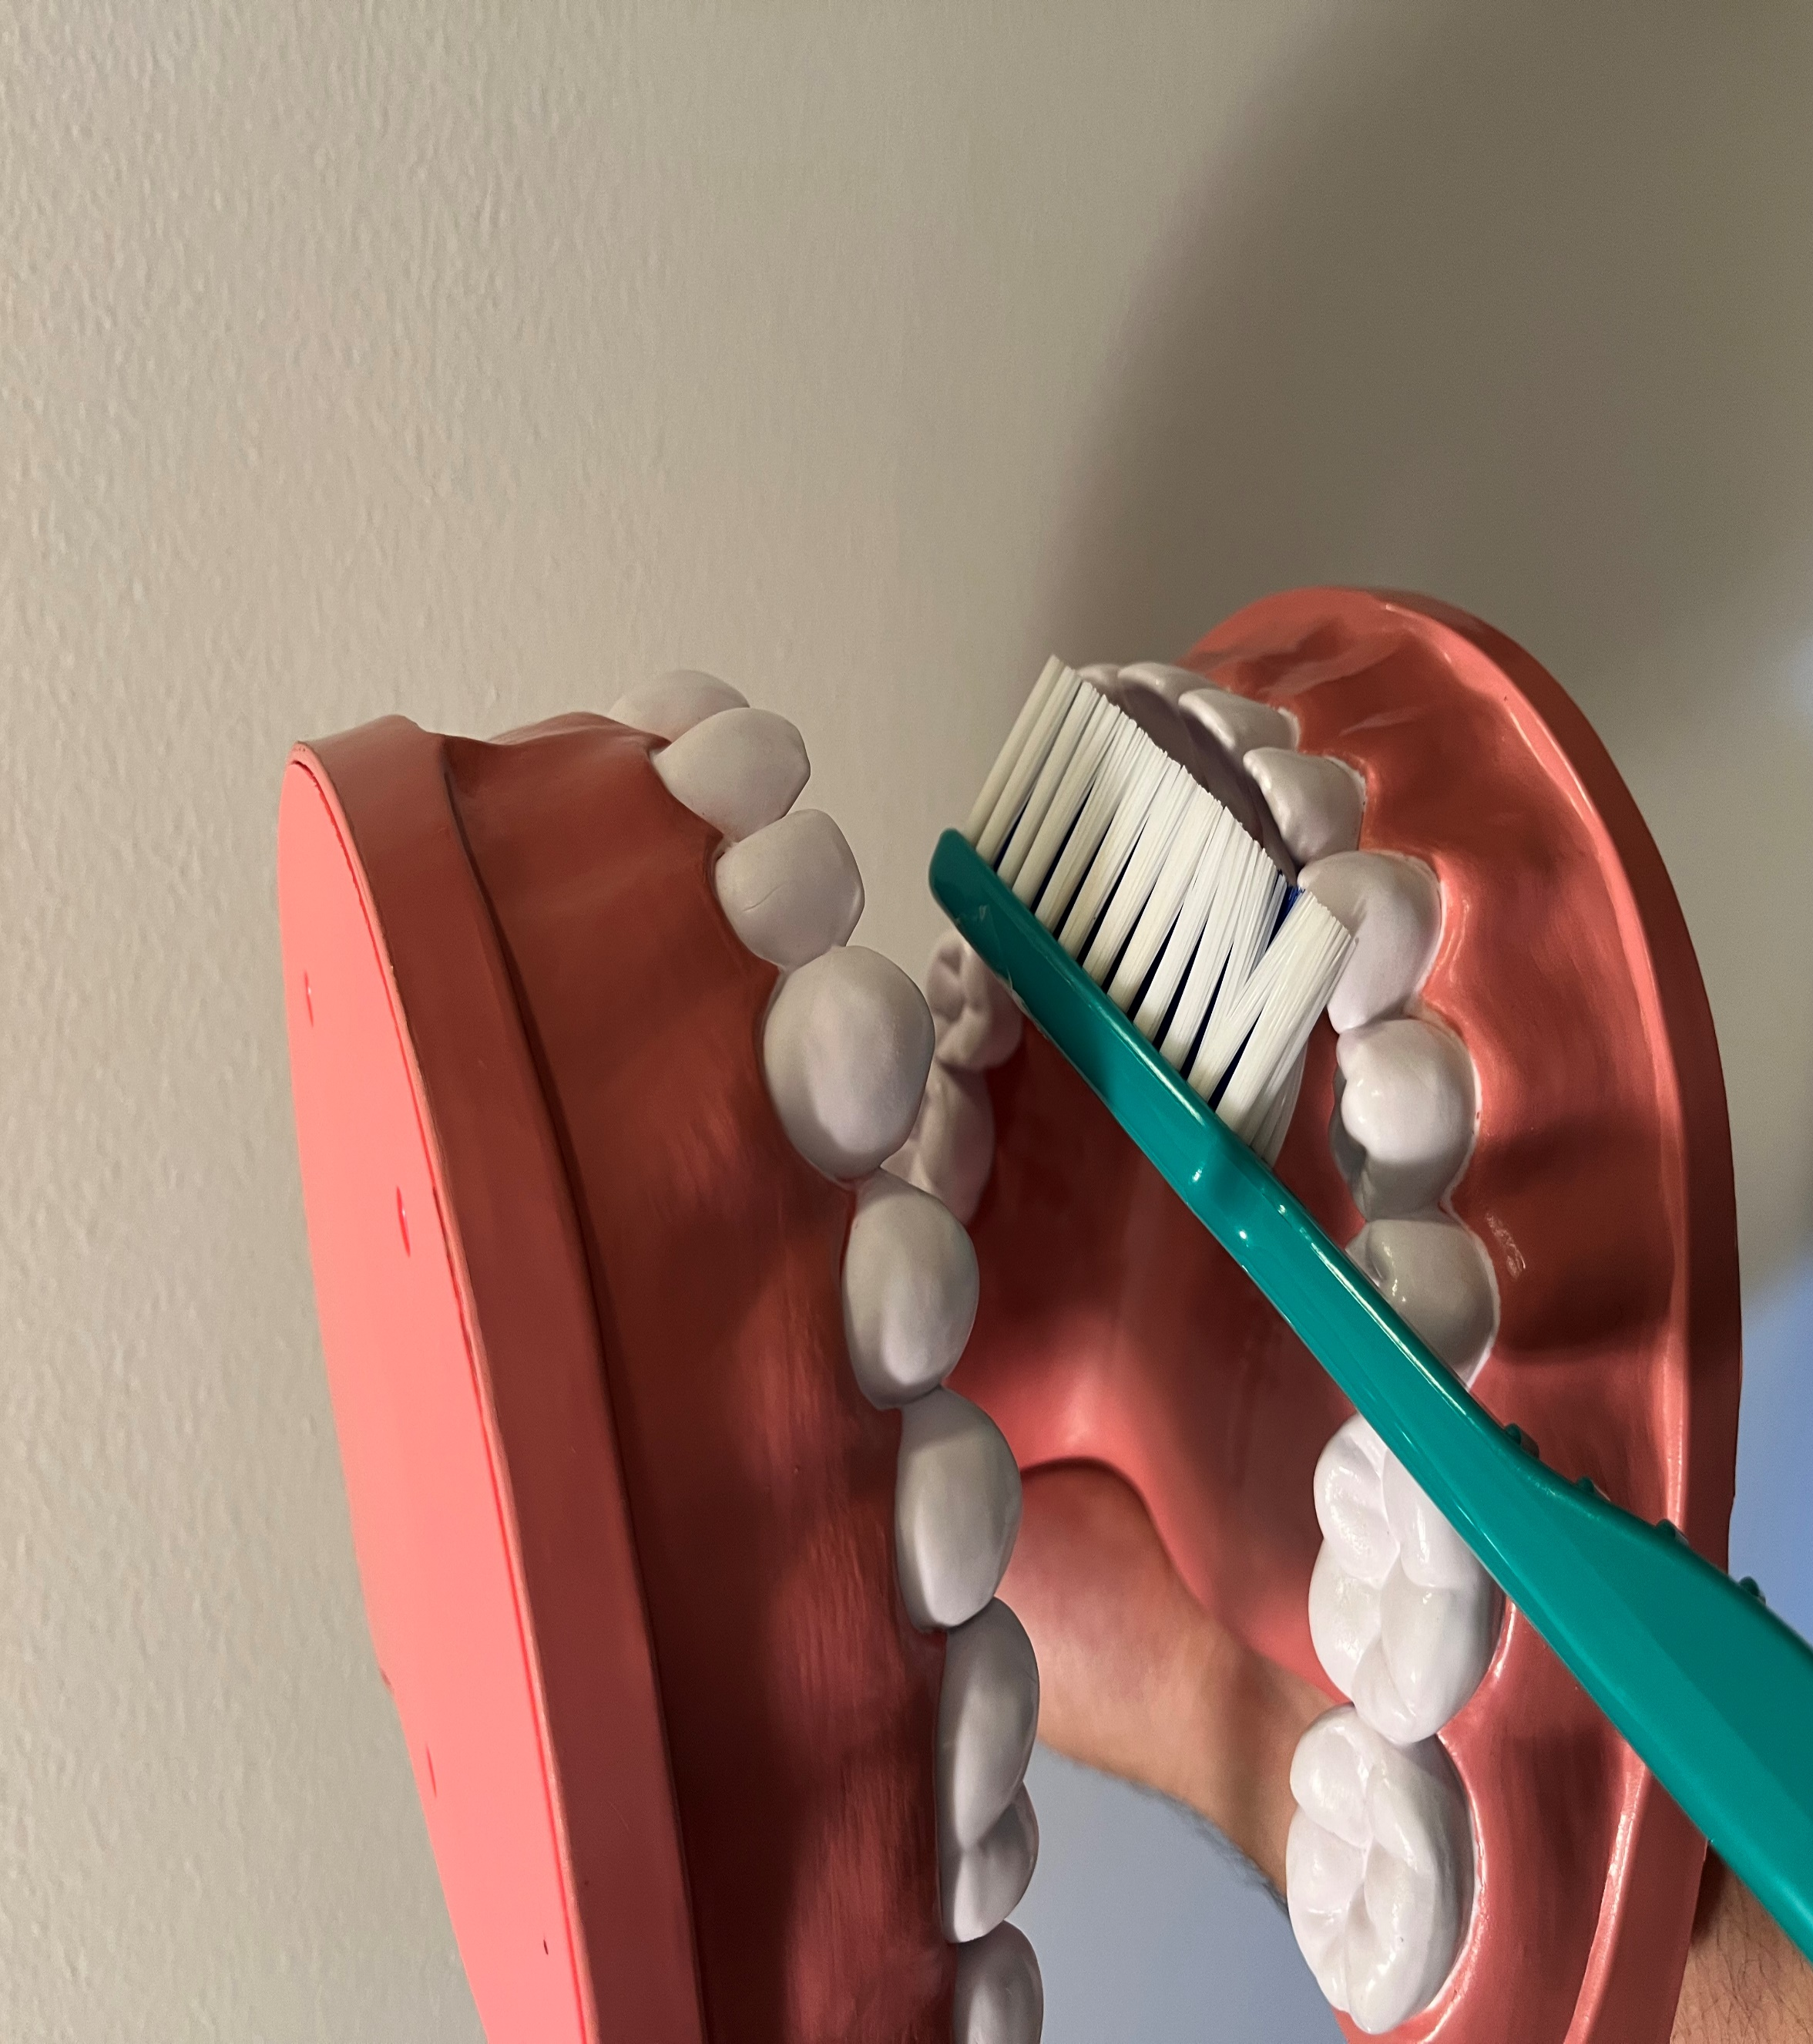
Mind, Body, and Spirit: Holistic Care in Health
Abdulmuhaimin Khatib, OMSII
LECOM Nursing and Rehabilitation
Community Site
Academic Preceptor: Leah Labranche, PhD Site Preceptor: James Stockhausen, NHA
LECOM Nursing and Rehabilitation is a skilled nursing facility providing primarily long-term care for geriatric residents, but also providing care for acute rehabilitation patients. LECOM Nursing and Rehabilitation Center provides skilled and long-term care in a bright, inviting setting with a highly trained clinical staff. This 141-bed skilled nursing facility provides short- and long-term care services, and offers a 24-hour, seven-day-a-week respiratory therapy team with a pulmonary specialist. LECOM Nursing & Rehabilitation aims to allow the residents to feel comfortable, safe, and cared for. LECOM Nursing & Rehabilitation focuses on the individual needs of each resident, allowing for excellent personalized care.
BTG Focus Areas
Chronic Disease (Diabetes, Kidney Disease, Respiratory Diseases, etc.); Elder Health and Senior Quality of Life; Heart Disease and Stroke; Mental Health; Physical Activity and Fitness
Personal Statement
“The experience I have had at the LECOM Nursing and Rehabilitation center has helped me grow and mature as a future physician. As a student studying medicine, I originally believed that everything was cookie cutter and that a physician could simply diagnose and prescribe a treatment and be done with it. However, my experience at the LECOM Nursing and Rehabilitation has taught me a great deal about the intersectionality of healthcare, especially in regards to insurance, socioeconomic status, and mental health. Working with the geriatric population is certainly a unique experience as well, and many of the residents have taught me valuable lessons about staying healthy as one ages, as well as the importance of communication and patience when treating this population. The Bridging the Gaps program has allowed me to work with a patient population that I may not normally work with and I hope to apply the knowledge gained through this program in my practice. The program is a great opportunity for medical students to broaden their horizons and learn more regarding the reality of healthcare.”
– Abdulmuhaimin Khatib
Project Goals
Improve range of motion and mobility of residents
Keep residents active and mentally engaged in activities
Talk to residents and address any mental health concerns
Incorporate Oral Health Education
Project Summary
The student intern developed a stretching program for residents to perform everyday to help increase their range of motion and improve their strength to perform physical therapy exercises. Furthermore, the intern worked with the Activities department to help introduce new games and invite a Smoothie Truck to keep the residents active and engaged at the facility. In addition, the intern worked with the Social Services department to screen new residents for any cognitive impairment and/or mental health issues such as depression in order to help the facility deliver a more holistic style of care for the residents.
Site Activities
A stretching program was developed to help increase the resident’s range of motion and stretch. In addition, new physical activities were introduced at the facility for residents to participate in and improve their physical and mental health. Screening tests were administered to new admissions to assess their mental health and ensure appropriate care is given for them.
Acknowledgements
Thank you to Dr. Labranche for assisting me with my project. I would also like to thank Jennifer Ruscitto, Julie Miller, Danielle Eccles, Maudie King, John Bokulich, and James Stockhausen for pushing me to go beyond my comfort zone and teach me life lessons in addition to their assistance with my project.

