Slide 1
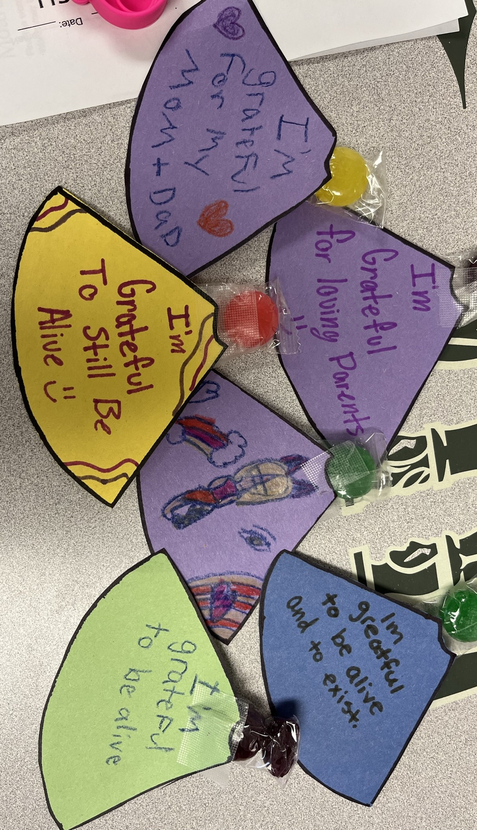
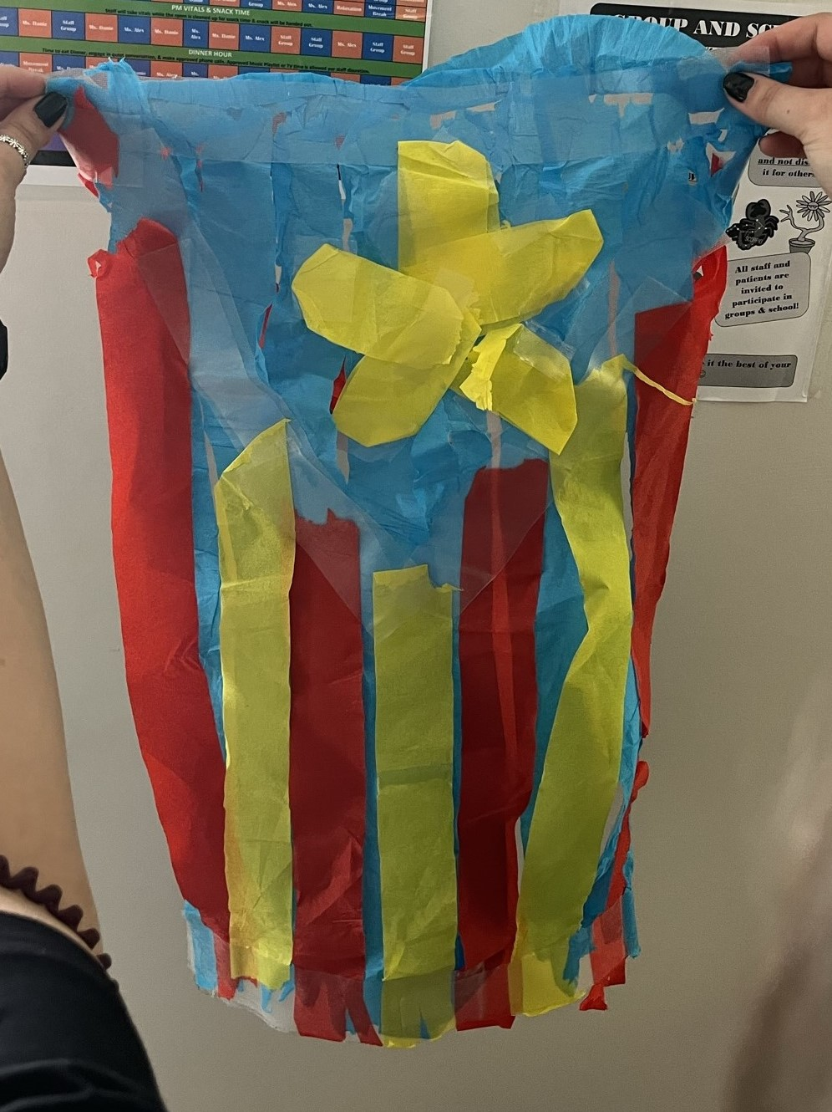
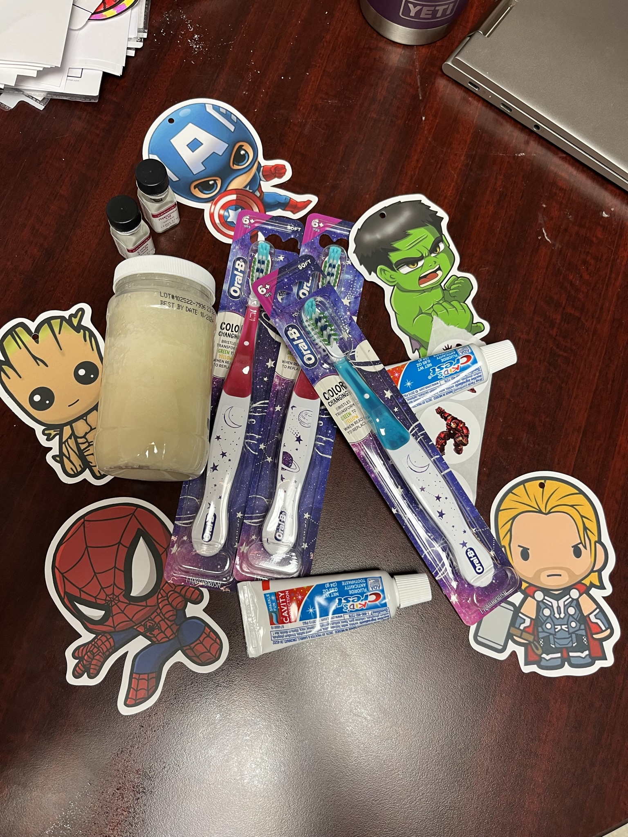
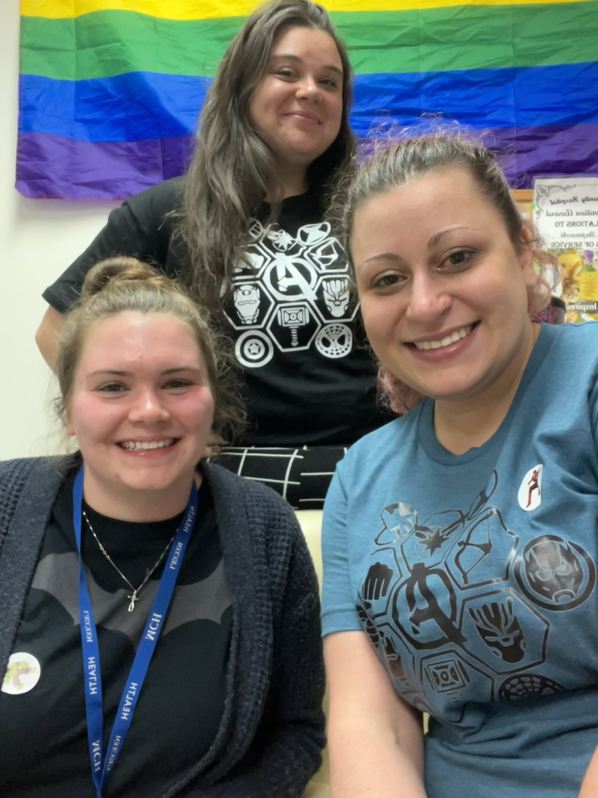
Superheroes for Our Mental Health
Samantha Sitarz, OMSII
Millcreek Community Hospital
Community Site
Academic Preceptor: Christopher Keller, PhD, CPH
Community Site Preceptor: Danielle Lesik, MA, LPC, MT-BH
Millcreek Community Hospital is a small community hospital in Millcreek, PA. Millcreek Community Hospital provides inpatient behavioral health care for children, adults, and the geriatric population. Millcreek opened its doors to inpatient psychiatric care after an increased demand for inpatient psychiatric services over twenty years ago. Patients work with teams of psychiatrists, nurses, therapists, social workers, and behavioral health technicians to manage their illness. Some of this is done through medication stabilization, individual and group therapies, and placement in long-term care facilities.
BTG Focus Areas
Mental Health, Oral Health
Personal Statement
“My internship at Millcreek Community Hospital Behavioral Health has helped me to understand the importance of patients having access to care for their mental health. I did not have much exposure to this field of medicine previously, but it impacts patients seen in every specialty. The way in which we deal with life experiences has a huge impact on our mental health, and it is especially important for children who still have so much development to do. A child’s early life experiences are going to remain with them their entire lives, and without access to mental health care, children may not ever be able to heal and effectively manage their mental health conditions. In the future, I want to be a physician that is not afraid to discuss mental health issues with patients, regardless of the specialty I end up in. Having access to care for one’s mental health drastically improves a patient’s quality of life but also the relationship with other parts of their overall health.”
– Samantha Sitarz
Site Activities
Other than Superhero week, some activities I had the opportunity to partake in included:
therapeutic coloring and worksheets
obstacle courses
painting nails
group music therapy
a second Family Feud game!
playing Uno and other card games
Project Summary
The student intern developed group therapy activities based on well-researched mental health coping skills and self-care strategies to fit alongside with a theme of superheroes from the week of July 3rd-July 7th. On Monday, July 3rd, the patients decorated superhero capes on which they wrote about people or things that they are grateful for. On Tuesday, July 4th, patients completed music therapy by drawing to the superhero soundtracks, and they designed their own superhero masks. Then, on Wednesday, July 5th, the group therapists held a superhero costume contest where the patients could design their own superhero and costume. Thursday, July 6th, the patients made their own toothpaste and got to see how well they brush their teeth by using plaque disclosing tablets. The student intern created and ran an oral health themed Family Feud game with the patients, and the patients learned to be superheroes for their oral health! On Friday, July 7th, the student intern, and group therapist held a fun day for the kids which consisted of a superhero-themed Bingo game and a cookie-shield decorating activity.
Project Goals
Encourage patients to learn healthy mental health coping skills
Teach patients about oral hygiene
Allow kids to see themselves as a superhero that can overcome their mental health struggles
Acknowledgements
Thank you Danie, Alex, and all the Unit 5 Behavioral Health Staff who helped with Superhero week and made it such a fun week for the kids! Thank you, Danie, for accommodating me this past summer and for being such a wonderful preceptor to work under!

