Slide 1
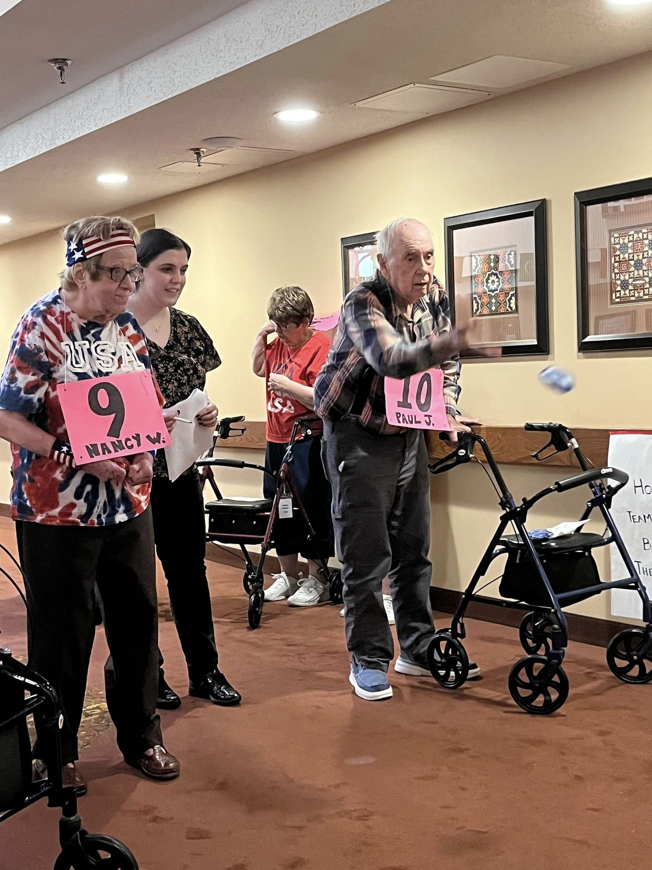
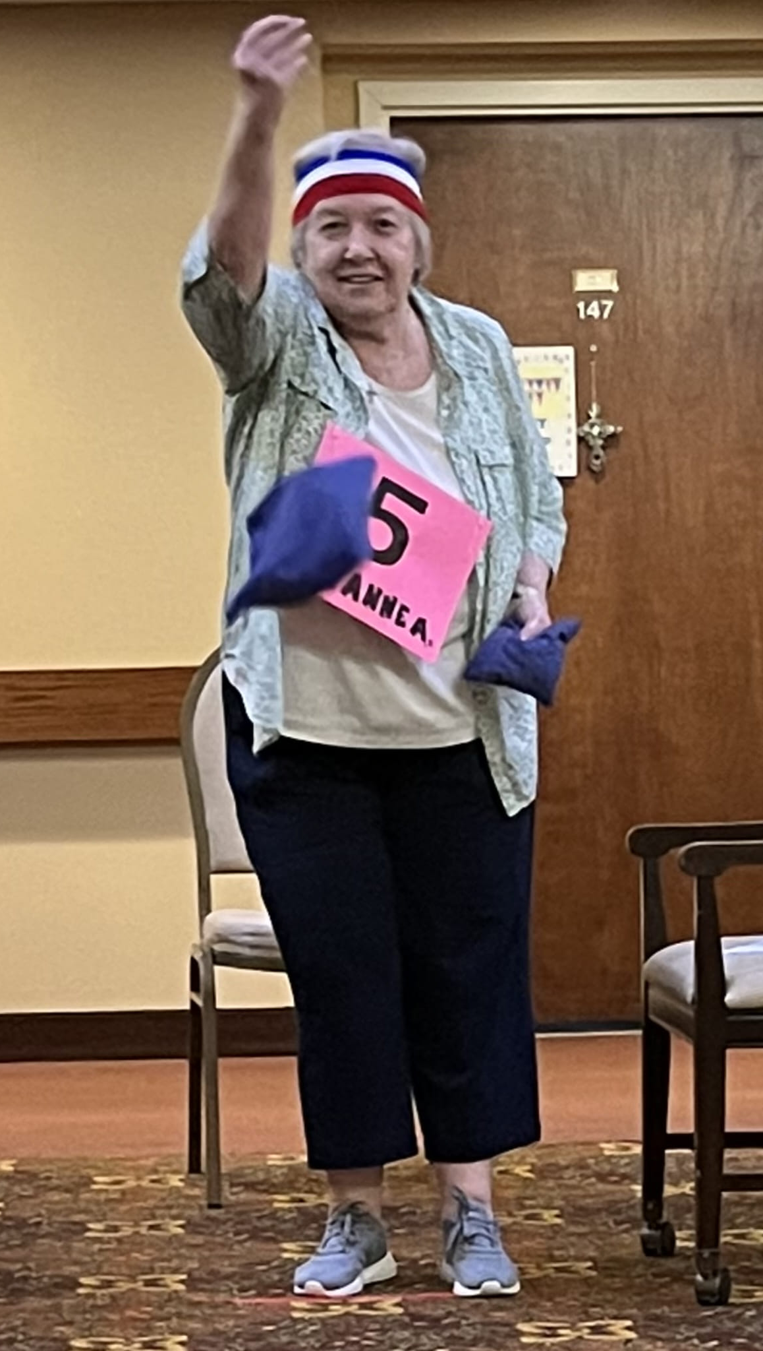
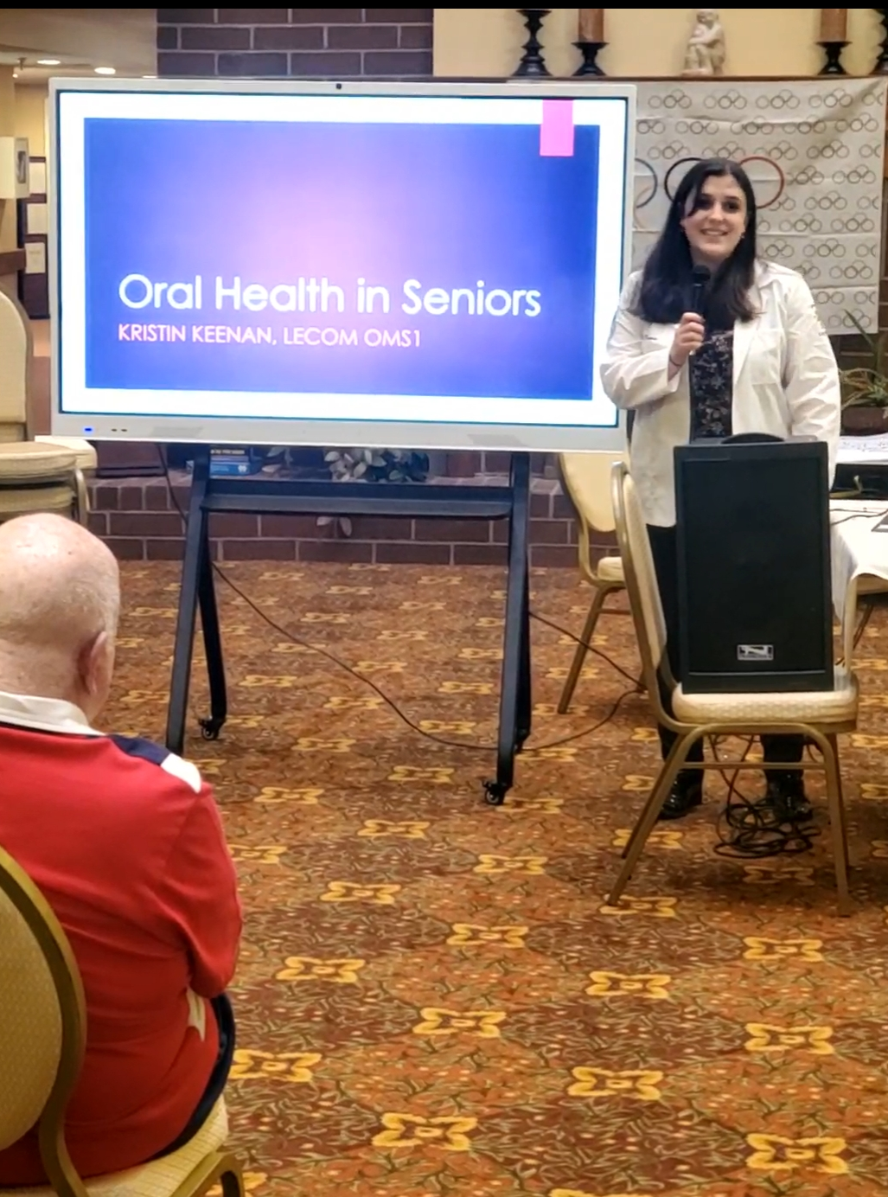
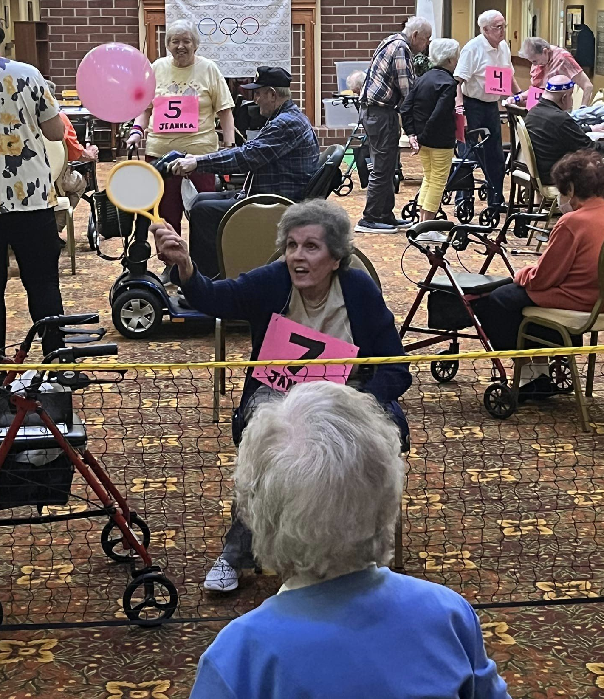
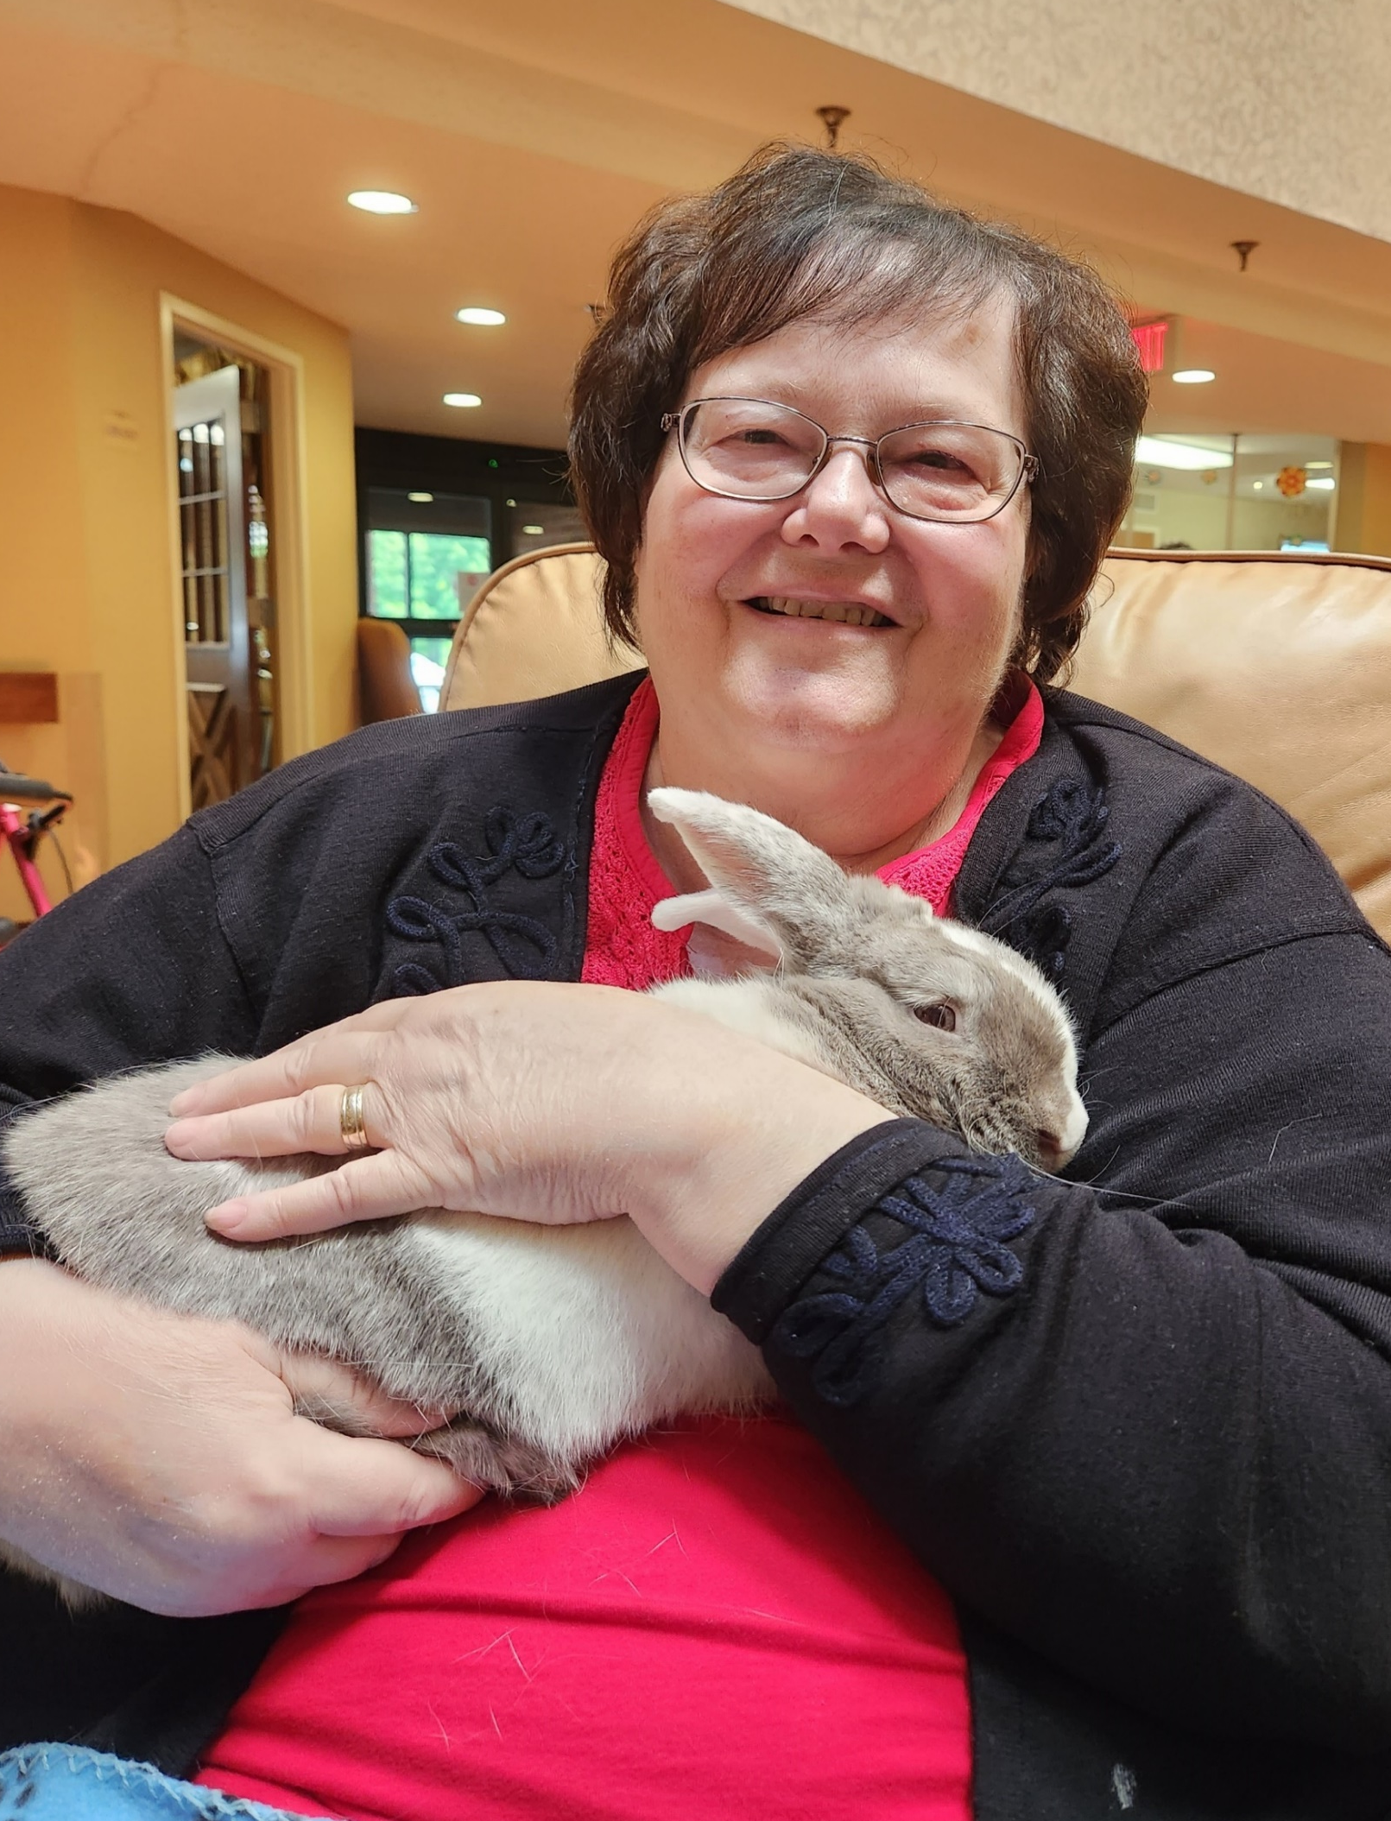
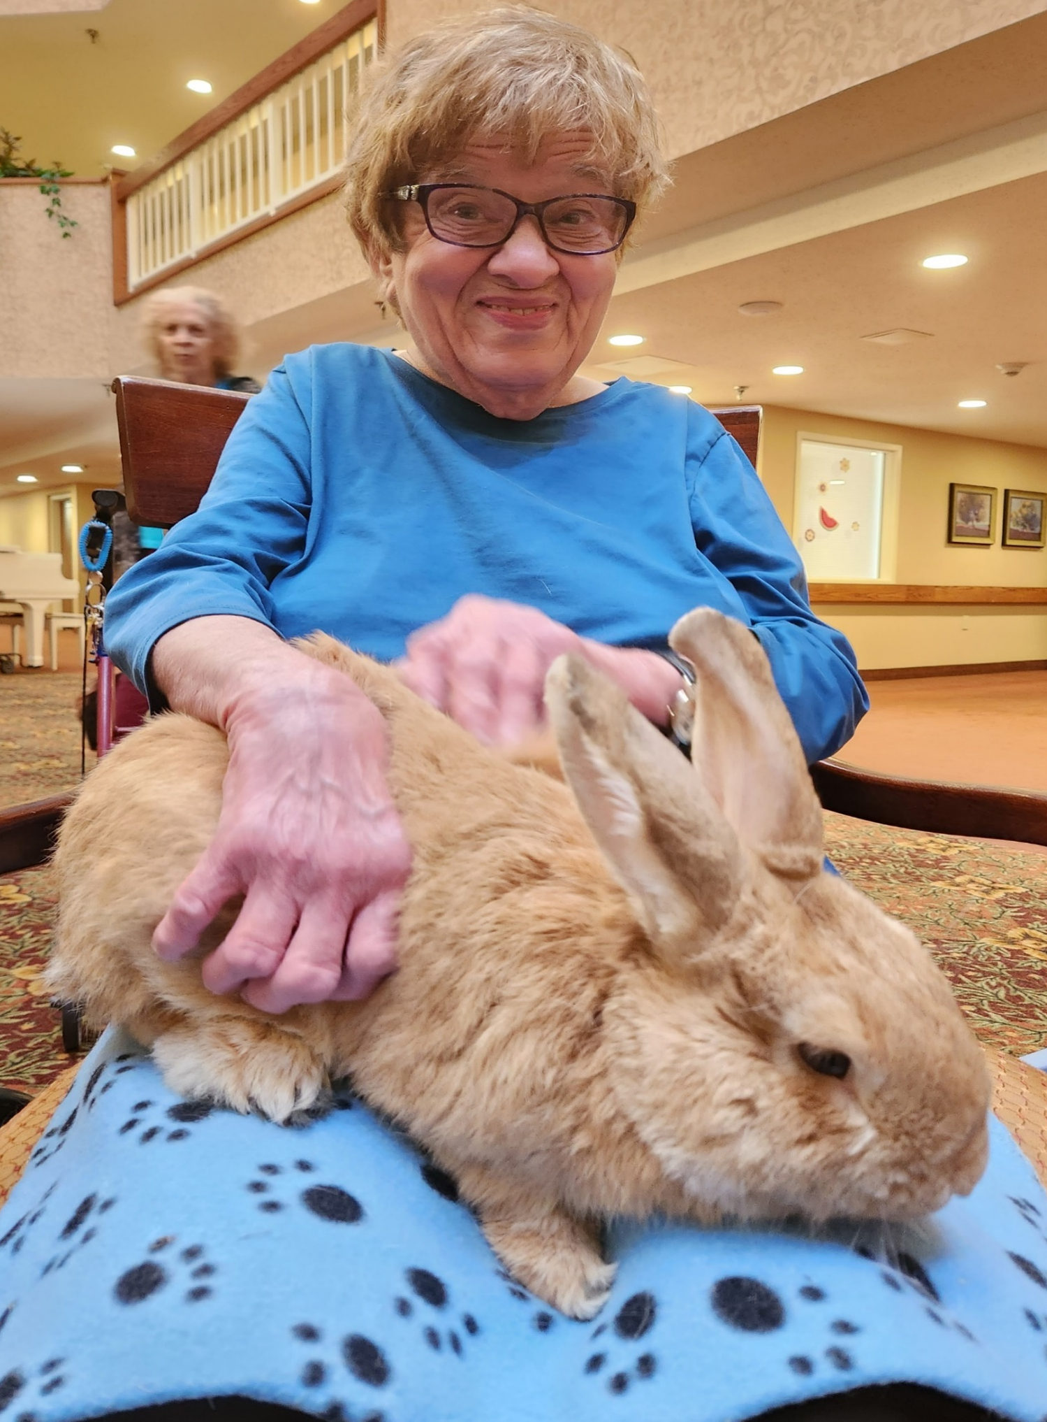
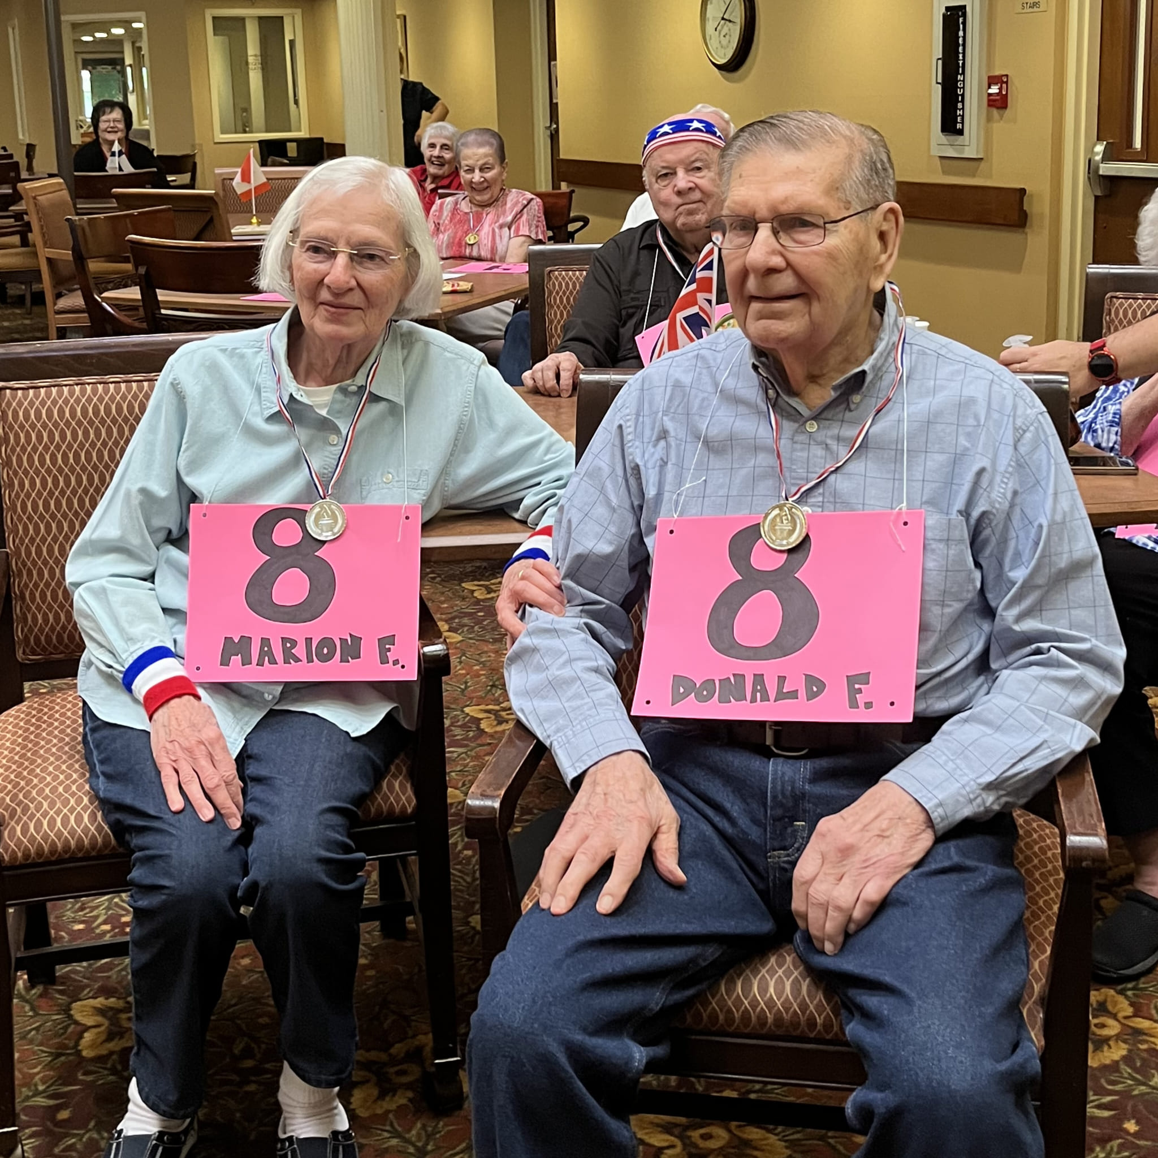
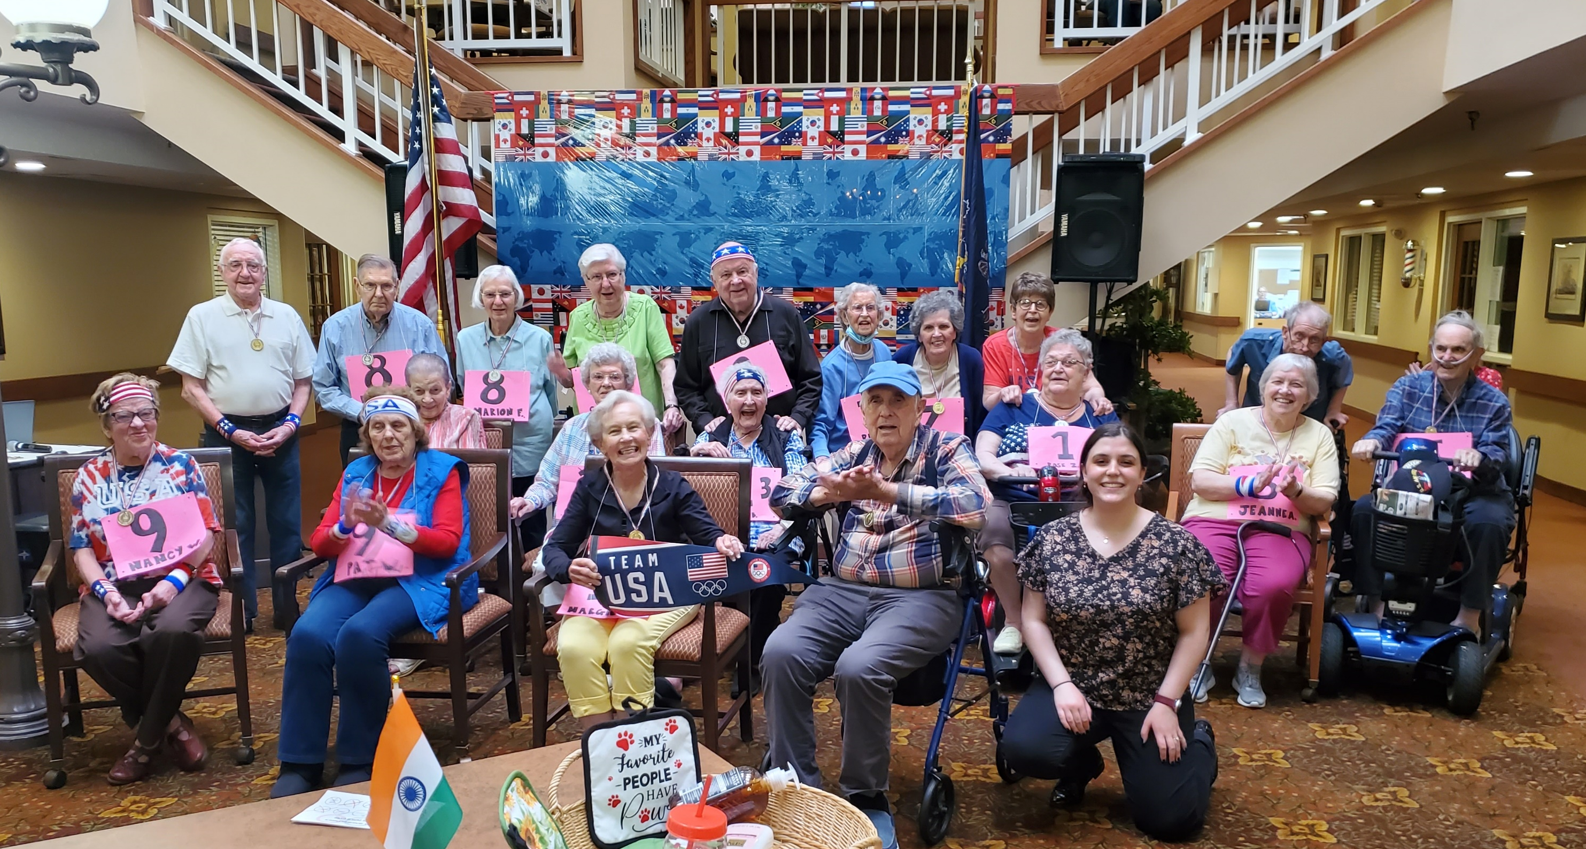
Senior Olympics: Exercising Mind and Body
Kristin Keenan, OMSII
The Regency at South Shore
Community Site
Academic Preceptor: Jack Lee, PhD
Community Site Preceptor: Jennifer Musone, PCHA
The Regency at South Shore is a full-service senior community, situated along the beautiful tree-lined streets of the former Strong Estate in Erie. The Regency offers independent living and personal care options for residents. Amenities offered include meal services, van transportation, home maintenance, housekeeping, and a surplus of daily activities.
BTG Focus Areas
Chronic Disease (Diabetes, Kidney Disease, Respiratory Diseases, etc.); Elder Health and Senior Quality of Life; Health Communication; Oral Health; Physical Activity and Fitness
Personal Statement
I genuinely believe that anyone going into healthcare should go through an experience like Bridging the Gaps. The intricacies of the health of seniors are like nothing else I have seen before, and being able to understand how their needs differ is a skill that needs to be developed through experience. I am so grateful to have gotten to learn the beginnings of this skill through my time here. I was surprised to see the varying levels of mental acuity and physical ability; this made it very important to get to know everyone as individuals, especially when designing my project. Building relationships with the residents was so special, and I can’t wait to continue building relationships with my future senior patients using the skills I have learned here.
Site Activities
The Senior Olympics consisted of a full two days of adapted physical and mental sports- trivia, bocce, basketball, baseball, golf, pasta picking, dress up race, volleyball, cup filling, toss across, cornhole, and word matching, all of which were adapted to different physical abilities. We decorated the whole first floor of the Regency with Olympic flags and décor. The Oral Health presentation involved an informative PowerPoint complete with free toothpaste, toothbrushes, and floss for the residents. The bunny therapy visit consisted of organizing 4 bunnies from EARS to come and spend time with our residents. Our Monday walking club met every Monday, where we completed half a mile of walking together. The Busy Bee activity packets contained word searches, crosswords, cryptograms, and sudoku for them to stay mentally stimulated over the weekends when no activities were planned.
Project Goals
Encourage physical and mental stimulation through Olympic themed and social activities
Improve manual dexterity through sports events
Improve mental health through animal therapy
Educate residents on oral health
Project Summary
The student intern developed projects to engage the mental and physical wellbeing of the residents at the Regency. The projects included a Senior Olympics, a therapy bunny visit from the local rabbit rescue, an oral health presentation, Busy Bee activity packets, and a weekly walking club. The Senior Olympics was a large undertaking, resulting in two days of competitive but adaptive sports for the residents, complete with a celebration at the conclusion. These projects encouraged positive interactions between the residents, physical activity, and mental stimulation.
Acknowledgements
Thank you to Jennifer Musone , Marie Heberlein, Marney Glover, and the rest of the staff of the Regency for devoting their time and effort to help with my projects. Thank you to Dr. Jack Lee, Dr. Leah Labranche, and Dr. Noelle Thielman of LECOM for their guidance throughout the entirety of the program.

