Slide 1
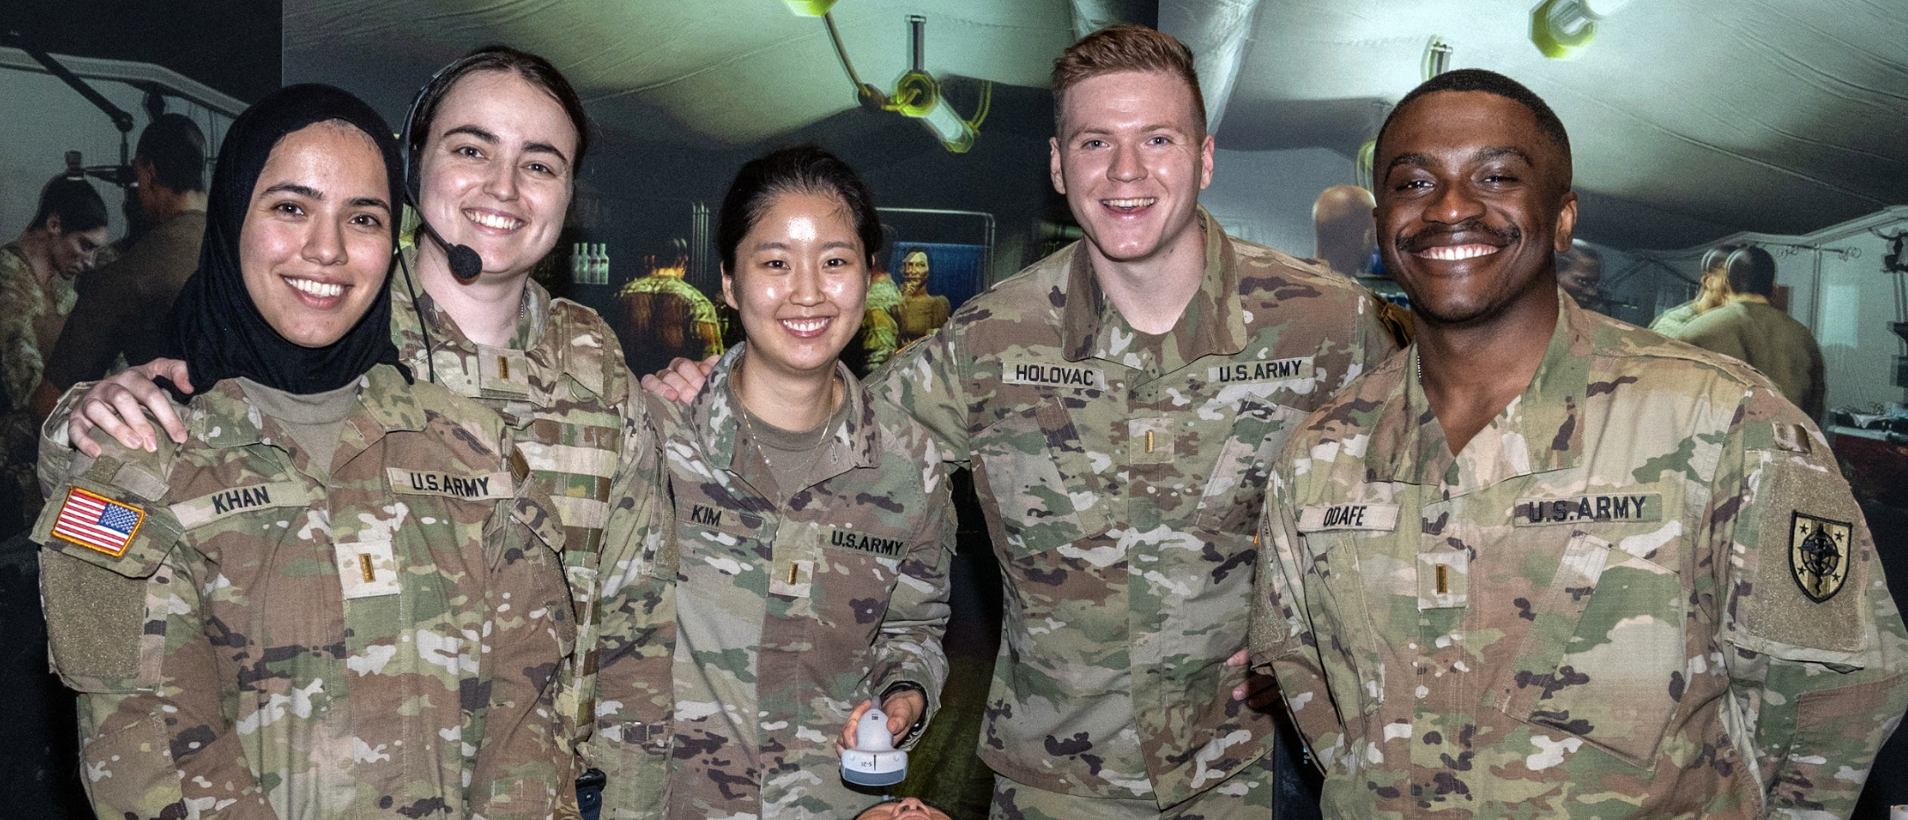
Bridging the Gaps at Uniformed Services University
Sahrain Zahoor
School of Medicine, Uniformed Services University of the Health Sciences, Bethesda, MD
BACKGROUND
RESULTS
PERSONAL EXPERIENCE
USU was founded in 1972 by an act of Congress and is composed of 4 colleges: School of Medicine (SOM), Graduate School of Nursing (GSN), Postgraduate Dental College (PDC), and College of Allied Health Sciences (CAHS).
BTG is a well-established internship program that links healthcare professions students with community organizations to expose interns to factors that impact healthcare in underserved communities.
Exposure to diversity and community service aids healthcare students develop cultural competency, which is a cornerstone for patient-centered care.
Uniformed Services University is interested in the Bridging the Gaps Internship Program due to the following synergies:
Interdisciplinary training of medical, dental, and allied health students
Commitment to initiatives that support the development of patient-centered care, along with diversity, equity and inclusion efforts
Immersive nature of BTG program aligns with USU Summer Operational Experience (SOE) objectives and general timeline
Potential Community Partners in the DMV Region
Administrative components
Initially challenging to work through the misalignment of BTG program start-date and USUHS SOM academic schedule.
Given the demands of medical school, it would be helpful for USUHS students to be offered a condensed BTG schedule lasting just 4 weeks instead of 6 weeks.
Restricting the program to the month of July would prevent any overlap with academic obligations (classes in end of June) and/or training exercises (advanced combat medical experience/ACME in early August).
Didactic sessions
Small-group sessions with students from other healthcare professions and universities facilitated the sharing of experiences and perspectives.
It may be valuable to have more speaker and panelist representation from the military community to highlight how the issues discussed (i.e. gun violence, mental health, etc.) uniquely impact active-duty and veteran populations.
USUHS SOM students currently complete clinical rotations at the DC VA, which serves a large and diverse veteran population. It is well-suited to expose BTG interns to the military’s healthcare system and its unique challenges.
Located on the same base as USU, this center offers a range of services to promote the well-being, resilience, and readiness of military personnel and their families. This center could be a potential BTG community partner by serving as a conduit for the transmission of health education materials and a means of community outreach.
Grassroots program located in Covenant House of Washington, with a focus on inner-city youth education and community outreach. USU BTG interns would be a valuable addition to Mint Project's heath literacy programs while giving USUHS students an opportunity to gain a deeper understanding of healthcare disparities.
Administrative Needs
“The BTG internship was a valuable exposure to community-based healthcare initiatives that seek to address socioeconomic disparities. I hope to one day draw on experiences like this in caring for our diverse population of servicemembers and veterans.”
In an effort to determine the logistics and practicality of BTG at USU, a feasibility study was conducted.
Community site preceptor(s): Required at each community partner site in order to coordinate student intern activities. Will be knowledgeable in the operations of their community site and be an advocate for student mentorship.
USU academic preceptor: Will serve as the student intern’s primary point of contact for all academic components of the program, such as any assignment submissions. The academic preceptor will also be a liaison between community site preceptors, students, and BTG leadership.
METHODS
First year USU medical school students were provided with BTG as one of their SOE options, to be completed in the summer before their second year, and one student (I) was selected to conduct a feasibility study.
Travel to Philadelphia allowed for attendance at the first BTG didactic session in mid-June at Temple University (meeting with fellow interns in addition to hearing from guest speakers and panels).
Following the initial in-person orientation, virtual attendance took place at weekly, Wednesday didactic sessions, led by program faculty in collaboration with community partners. These sessions highlighted common themes and issues faced by vulnerable populations.
Research was conducted, and an initial list of potential community and USU partners was assembled, based on mission alignment and ability/interest in working with summer student interns; meetings with leadership were arranged and completed.
Potential community partners were identified, and next steps for expanding BTG at USU were developed.
CONCLUSIONS
BTG offers USUHS students an opportunity to engage with the broader community by serving vulnerable populations. This exposure would augment USU’s training of students to become future military medical leaders caring for servicemembers around the globe.
Hurdles to overcome include funding of administrative needs, liability of working with youth populations, necessity of routing through the office of public affairs at USU for any public images/messaging, and the misalignment of timing regarding schedules of USUHS SOM students and the BTG program.
Opportunities for synergies already exist with other USU centers and departments (e.g. Consortium for Health and Military Performance, Center for the Study of Traumatic Stress) in addition to some student organizations, but this can further be developed in order to build working partnerships as supportive contacts may help guide the establishment of BTG at USU.
Future work will include placing USUHS students directly at community sites and further mentorship of student interns through faculty support of BTG.
.
REFERENCES
Uniformed Services University. 2022 Annual Report. Bethesda, MD. Retrieved from: https://www.usuhs.edu/sites/default/files/media/documents/2022_annual_report_acc_smaller.pdf
The opinions and assertions expressed herein are those of the author(s) and do not reflect the official policy or position of the Uniformed Services University of the Health Sciences or the Department of Defense.
Disclaimers: The contents of this publication are the sole responsibility of the author(s) and do not necessarily reflect the views, opinions or policies of The Henry M. Jackson Foundation for the Advancement of Military Medicine, Inc. Mention of trade names, commercial products, or organizations does not imply endorsement by the U.S. Government.
The opinions and assertions expressed herein are those of the author(s) and do not reflect the official policy or position of the Uniformed Services University of the Health Sciences or the Department of Defense.

