Slide 1


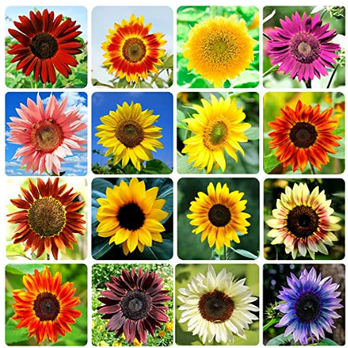
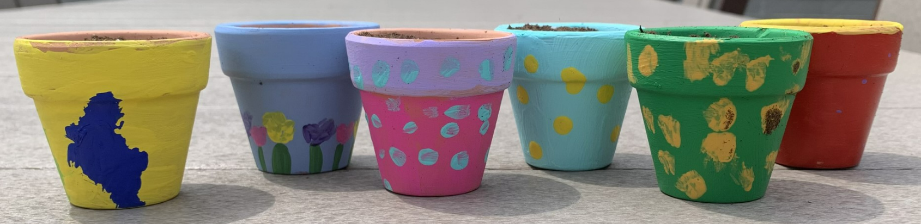
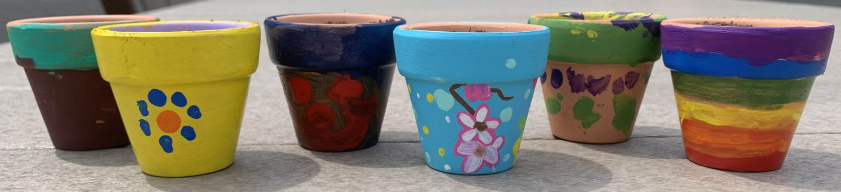
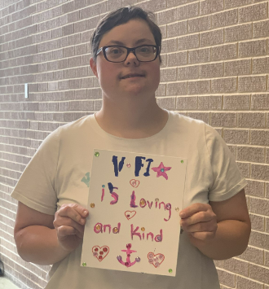
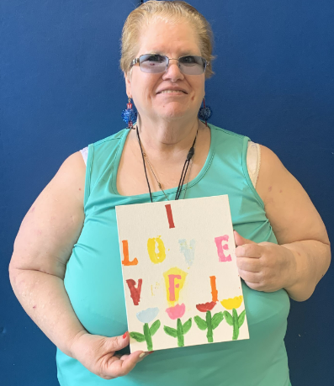
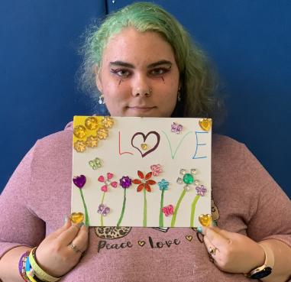
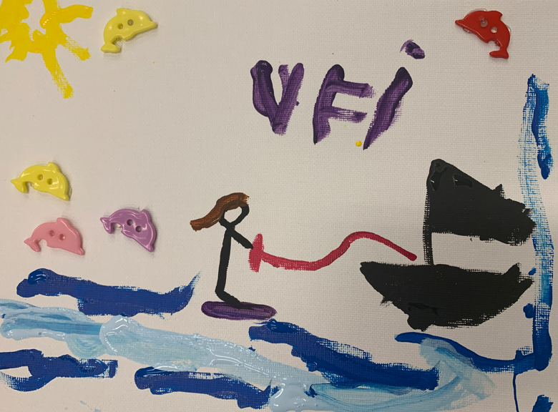
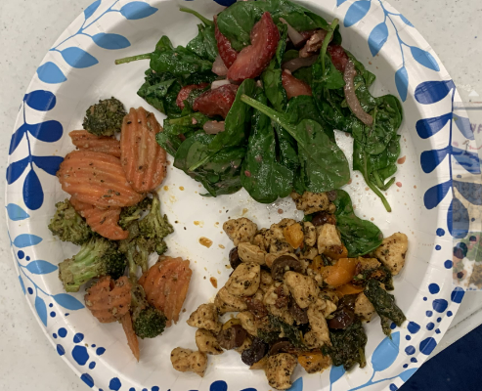
Listen to the Voices: Advocating for Independent Living in People with Disabilities
Swetha Vemuri, OMSII
Voices for Independence
BTG Focus Areas
Dental/Oral Hygiene
Disabilities and Secondary Conditions
Nutrition and Weight Status
Mental Health
Community Site
Academic Preceptor: Randy Kulesza, PhD
Community Site Preceptor: Michele Maughn, RN, Director of Nursing
Voices for Independence is a non-profit organization that helps tailor and connect resources for people with any spectrum of disability to live as independently as possible. This organization serves people with disabilities throughout 27 counties in Western Pennsylvania and helps improve their independence, dignity, and control, and quality of life. They also advocate for the disability community by supporting their ability to have the same opportunities to pursue their own destinies and freedoms.
Social collaboration: During the planting event, the terracotta pots were painted first and then we had a variety of sunflowers to choose from.
Site Activities
Community: “What does VFI mean to you?” painting event. We had markers, paints, gemstones, buttons, feathers, pencils, and pastels so people had many options in how they wanted to express themselves.
Health: A dental brochure was created to educate consumers on oral/dental hygiene like flossing and brushing
The cooking event menu was Mediterranean Chicken, Roasted Broccoli and Carrots, Strawberry Walnut Salad and Oatmeal Chocolate Chip Cookies.
Project Goals
The goal was to interact with and learn from members of the disability community through various activities held at Voices for Independence focusing on three themes:
  Community
  Health and Nutrition
  Social collaboration
Personal Statement
In working with the disability community, I gained experience in not only working with the spectrum of patients that I will come across in the disability population, but I also have developed a deep sense of respect for these patients. I have developed the tools and skills to be more comfortable communicating with these patients and feel an even stronger desire to advocate for their ability to live more independent lives. I strongly believe that with the right guidance, support, and adjustments, these patients can find a balance in living in their own homes while also adapting with their disabilities.
Project Summary
The Student Intern hosted three events: a cooking class focused on a more well-balanced meal, a summer planting event using sunflowers, and a painting event centered on “what does VFI mean to you?”.
The Student Intern also created a brochure focusing on the importance of dental/oral hygiene and health. This was made to help educate consumers on these topics and allowed them to take the information home to reference later and incorporate better flossing and brushing techniques into their lives.
Acknowledgements
Thanks to Dr. Randy Kulesza, Michele Maughn, Dr. Leah Labranche and Dr. Noelle Thielman for helping me with this project I would like to thank the Voices for Independence staff for their support and enthusiasm with this project with special thanks to Tiffany Frey, Brian Petersen, Rachel Thorpe, Heather Llera, this project would not have been possible without them!
Notes:
Community: We did an event where we had canvases and art supplies for consumers and attendants to create a piece to answer the question “What does VFI mean to you?” We had markers, paints, gemstones, buttons, feathers, pencils, and pastels so people had many options in how they wanted to express themselves.
Health: We had an event where we helped consumers and attendants cook a well-balanced meal. The menu was Mediterranean Chicken, Roasted Broccoli and Carrots, Strawberry Walnut Salad and Oatmeal Chocolate Chip Cookies.
I also created a dental brochure for information on oral health and hygiene to hand out to consumers.
Social collaboration: We did a planting activity where we had dirt, sunflower seeds, and mini terracotta pots. The consumers and attendants painted the pots and planted sunflower seeds to celebrate the summertime!

