Slide 1

BTG Community Partner Slides 2023

Slide 2
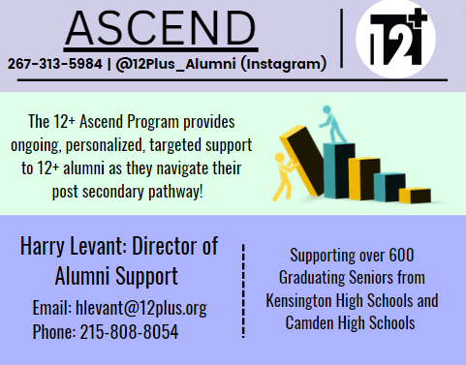

Slide 3


The African Family Health Organization (AFAHO)
Mission: We work to strengthen community health culture and facilitate social integration through the utilization of a unique peer support model that uses shared language, cultural expertise, advocacy, and system navigation knowledge to help individuals and families overcome social determinants, build community connections, and gain information and resources needed to thrive.
Contact Information: Dianne Uwayo, Health Programs Manager | dianne@afaho.org
Website: www.afaho.org
Population(s) served: African and Caribbean Immigrants and Refugees in greater Philadelphia

Slide 4

Beyond Literacy (BeLit)
Mission - To expand opportunities and improve lives by unleashing the power of literacy through free, high-quality education.
Population(s) served - Beyond Literacy provides opportunities for adults and families in our communities. The goal of BeLit's program is to assist adult learners so they can earn their GED, improve the ESL skills, Post-Secondary Education, meet employment goals, improve digital literacy skills, and citizenship classes.
Main contact Person – Lorna Jackson, Volunteer Manager ; llasterjackson@beyondliteracy.org
Secondary Contact Person – Mercy Howard, Student Support Coordinator ; mhoward@beyondlitercy.org
Website - https://beyondliteracy.org/

Slide 5

By offering Radical Hospitality to our neighbors in need, Broad Street Ministry creates connection and community; restores hope and dignity; and increases security and self-sufficiency.
Nikki Brown, MSW
(She/her)
nikkib@broadstreetministry.org
broadstreetministry.org
At Broad Street Ministry, we call our folks guests. Our guests are dynamic and resilient individuals who might be experiencing scarcity around resources such as food, benefits/income, housing and community.
*Please create a slide with the appropriate information for your organization &
upload to the link provided by BTG.

Slide 6

CARIE
Center for Advocacy for the Rights and Interest of Elders
Founded in 1975, CARIE’s mission is:
To promote the well being, rights and autonomy of older persons through advocacy, education and action.
Lori Walsh, Program Manager, walsh@carie.org
Front desk: 215-545-5728
www.carie.org
Serving: anyone who needs help accessing and navigating services for older adults

Slide 7
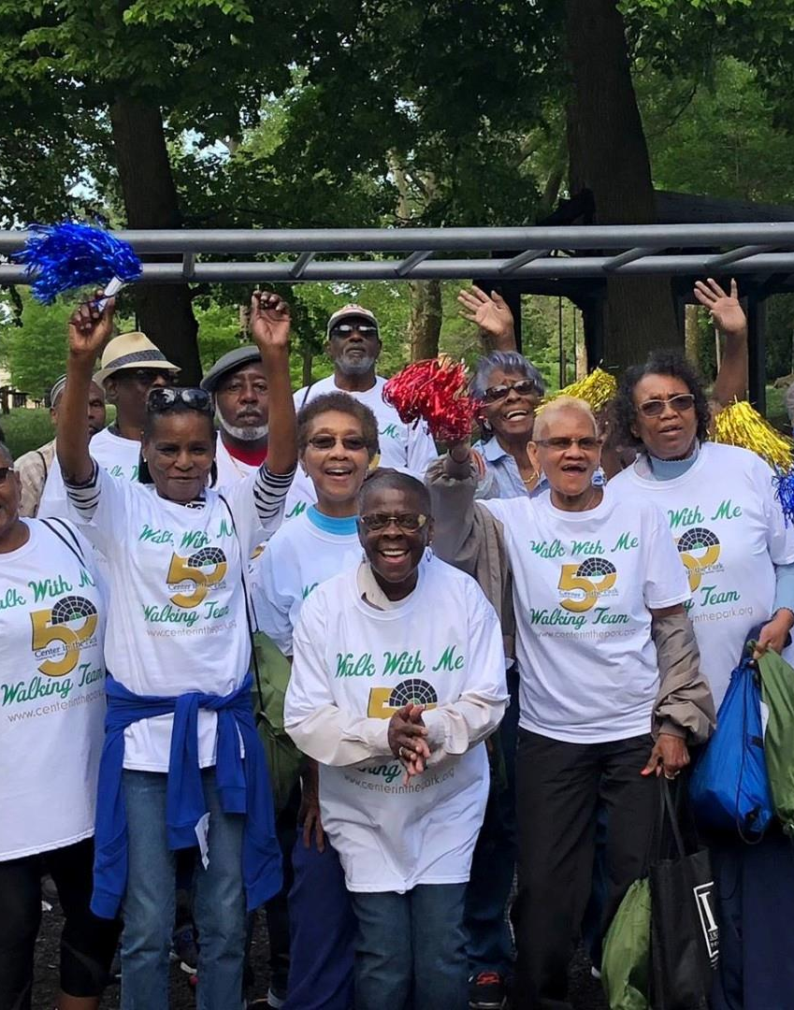

Center in the Park
Center in the Park promotes positive aging and fosters community connections for older adults whose voices are critical instruments in shaping its activities and direction.
Cleo Smalls, Director of Programs
Phone: (215) 848-7722 Ext. 224
Email: csmalls@centerinthepark.org
www.centerinthepark.org
Population(s) served: Adults ages 55 and older

Slide 8

Chester County Intermediate Unit-
Migrant Education Program
Mission: To provide quality, innovative education programs and services to the children of migrant agricultural workers so that migrant students develop to their fullest potential.
Contact Information:
Karisa Barlow | Program Coordinator
karisab@cciu.org | 484-639-5397
Website: https://www.cciu.org/migranted
Population(s) served: Migrant students ages 0-21 who have moved to a new school district in Chester, Delaware, Philadelphia, Montgomery, or Bucks counties in the past 3 years and whose parent or guardian has moved to engage in agricultural work in the past 3 years

Slide 9

Cpl. Michael J. Crescenz VA Medical Center
Center for Development & Civic Engagement
Logo
Mission: Honor America’s Veterans by providing exceptional health care that improves their health and well being.
Contact Information: Phone (215) 823-5868. Vhaphivisn4voluntary@va.gov
https://www.va.gov/philadelphia-health-care/work-with-us/volunteer-or-donate/
Population(s) served: Veterans and their caregivers

Slide 10

Depaul USA
Mission: We aim to end homelessness and change the lives of those affected by it
Contact Information: Brendan.sculley@depaulusa.org
Website: https://depaulusa.org/
Population(s) served: Men, Women, Young Adults

Slide 11






Drexel Food Lab
Mission: The Drexel Food Lab is a faculty-mentored interdisciplinary food product design and culinary innovation research lab solving real-world problems in sustainability, health promotion and access
We do this through research and programming that help us:
Understand consumers
Develop new food products
Introduce new products to market
In doing so, we not only develop new food products and menu items with entrepreneurs, industry, non-profit, and government partners, but also develop our flagship "product," graduates across disciplines who are poised to improve the food system.
–
DO GOOD, FEED WELL, AND KEEP GOING
jdeutsch@drexel.edu
rms548@drexel.edu
www.drexel.edu/foodlab
@drexelfoodlab
/drexelfoodlabfeed
/company/drexel-food-lab

Slide 12
Mission: “With humanity, humility and honor, to heal by providing exceptionally intelligent and responsive healthcare and education for as many as we can reach”. The Quality Program reflects this mission and incorporates the values of the Albert Einstein Healthcare Network (AEHN) via implementation of ongoing assessment and improvement activities.
The ‘Immunodeficiency Clinic or IDC’ seeks to provide ‘a one stop shop’ consisting of comprehensive medical services for all clients; as part of the AEHN network referral to all medical subspecialties, including obstetrics and gynecology, facilitates linkage and engagement in care.
Contact Information: Nicola D’Souza, CQI coordinator-IDC; (o) # 215-456-3465; (c) # 770-383-2017
Website: Immunodeficiency Center (IDC) - Einstein Health
Population(s) served: HIV immunocompromised, Adult population.

Slide 13

Einstein’s Pride Program
Mission: Remove barriers to care by advocating for patient needs across Einstein’s Healthcare network and attempting to interrupt systemic oppression, racism, homophobia and transphobia in the field of healthcare.
Contact Information: (215) 420-0989
Website: www.Einstein.edu/pride-program
Population served: LGBTQIA+ children and adults

Slide 14

Get Fresh Daily (GFD) is a mission-driven organization cultivating community wellbeing by integrating plant-based living experiences,
farm fresh produce, and culturally empowering wellness education.
Our programs are based at Freedom Greens + Gardens, our learning and healing space located directly across from Malcolm X Park in West Philadelphia. The garden serves as a hub for wellbeing and community connection in the heart of this neighborhood which has been deeply impacted by systemic racism, gentrification and food apartheid.
We are working towards a future where people live long,
healthy, and vibrant lives, and are sustained by nourishing food,
rich community, and a return to earth-centered living.
We have distributed over 5000 farm-fresh, local and organically-grown produce via our CSA since Fall 2021. Our programs reach over 1200 families in West Philadelphia and throughout the city.
Let’s stay in touch! Jiana@getfreshdaily.org | www.getfreshdaily.org | Instagram: @getfreshdaily

Slide 15
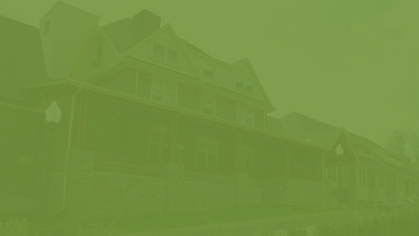

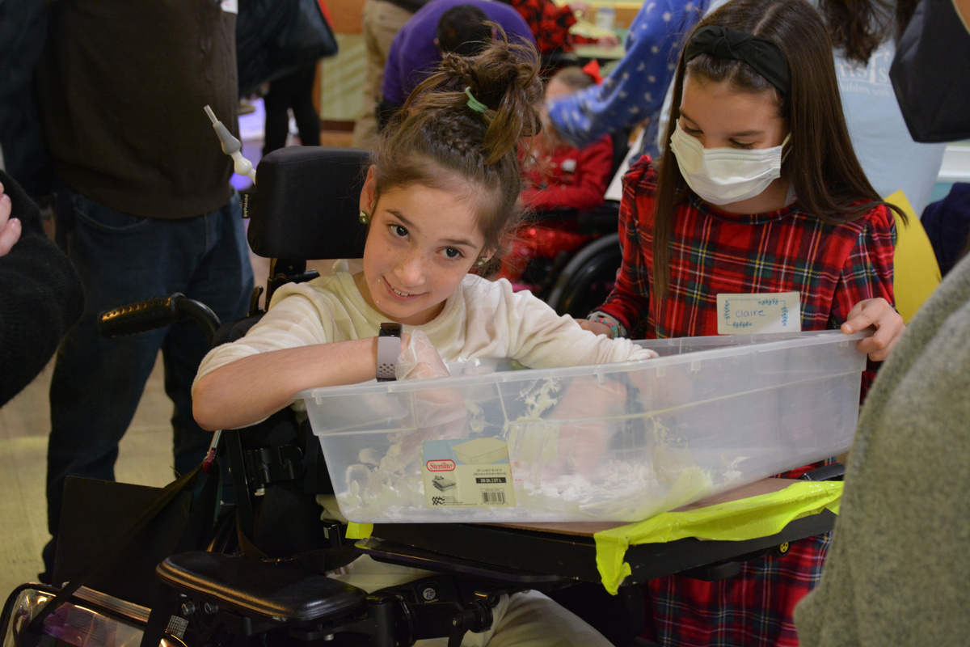
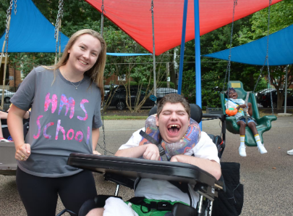
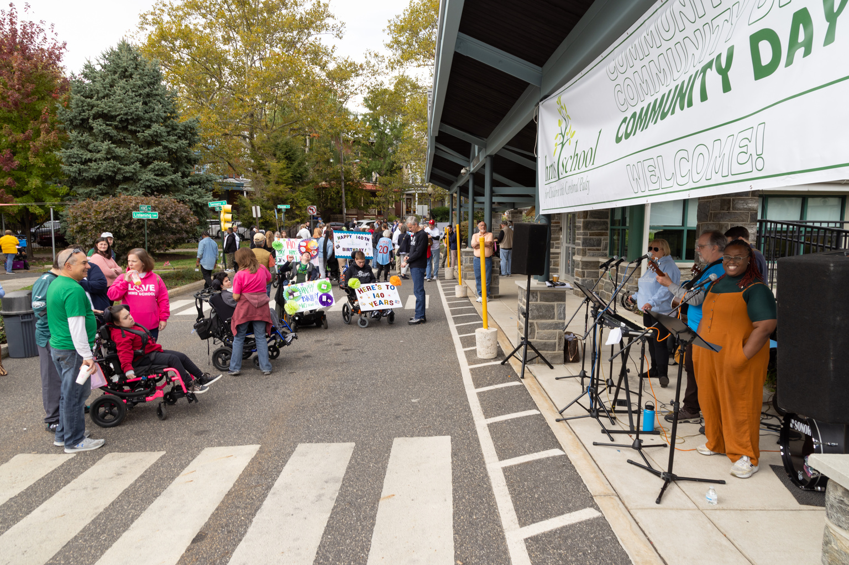
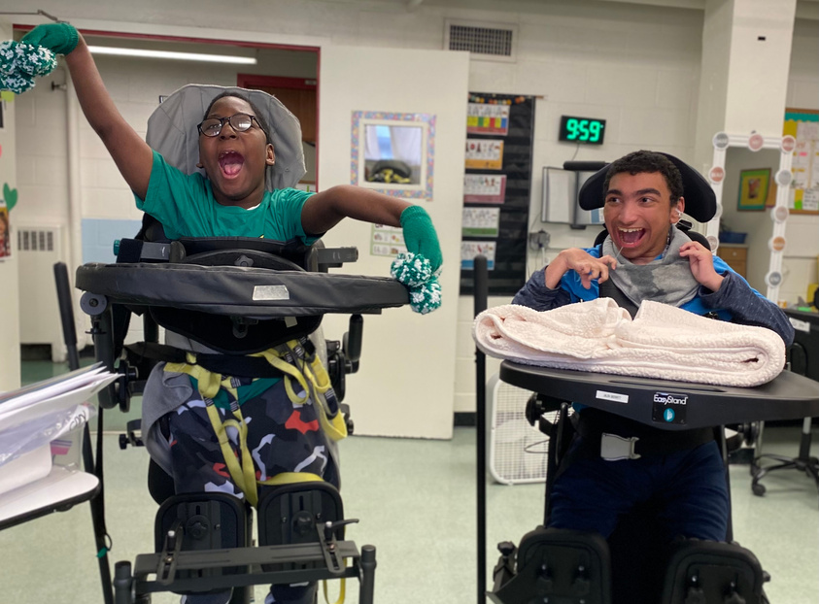
HMS School for Children with Cerebral Palsy
Our Mission
HMS School educates, nurtures, and cares for children and young adults with complex physical disabilities resulting from cerebral palsy, traumatic brain injury or other neurological impairments, with the goal of enabling each to reach his or her maximum potential. We promote independence and improve the quality of life for youth in a safe and secure environment so each can lead a fulfilling, stimulating life now and as an adult.
Our Population
We serve students from 5-21 years old, and their families, and maintain relationships with our alumni and their families.
Contact Us:
Julie Conway, SLPD, CCC-SLP, ATP
Teresa Giardina, M.Ed.
hmsconnect@hmsschool.org
www.hmsschool.org

Slide 16
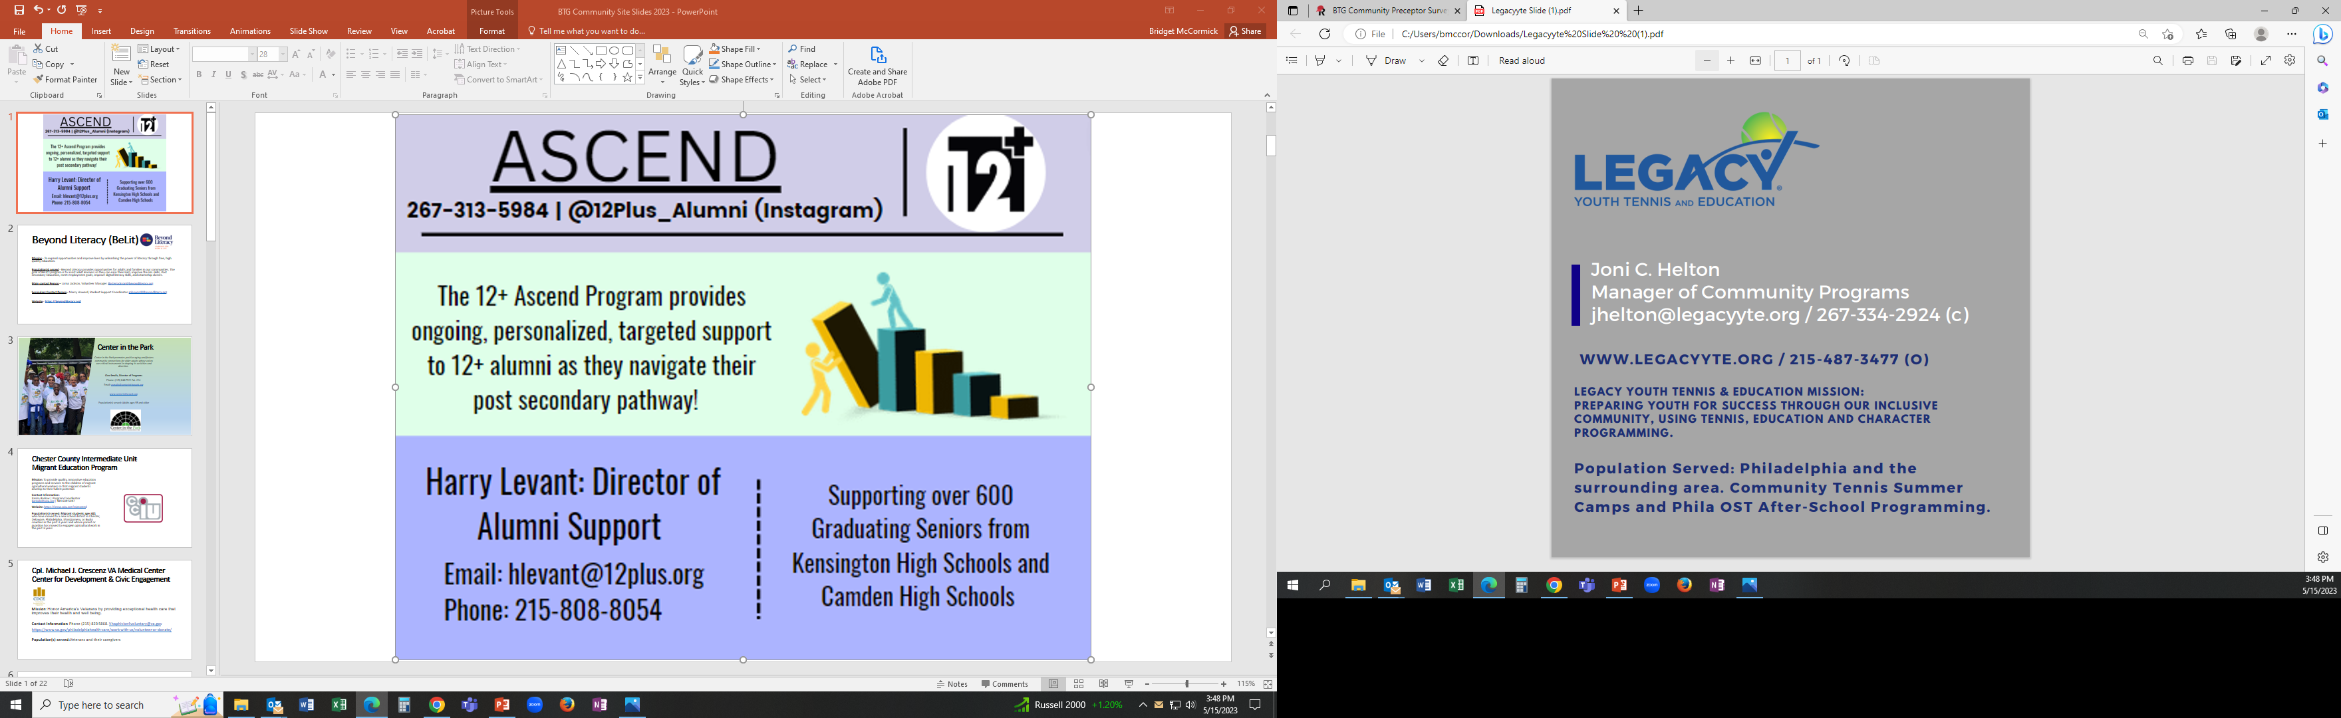

Slide 17

Lutheran Settlement House
Established in 1902, Lutheran Settlement House (LSH) is a non-profit, community-based organization committed to serving children, adults, and families living in Philadelphia. Over the past century, the programs and services offered by LSH have changed in response to the evolving needs of the community. However, the core mission of Lutheran Settlement House — “to empower individuals, families, and communities to achieve and maintain self-sufficiency through an integrated program of social, educational, and advocacy services” — has remained constant.
Population served: older adults, domestic violence survivors and their children, families experiencing homelessness, and families experiencing food insecurity
lutheransettlement.org
Meg Finley
1340 Frankford Ave, Phila, PA 19125
mfinley@lshphilly.org
215-426-8610 x1204

Slide 18

Mental Health Partnerships
Collaboratively builds hope and promotes the well-being of people in recovery through innovative peer-centered advocacy, learning and services.
Services: Recovery Learning Centers, Targeted Case Management, Residential Program and Rapid Housing, Mobile Certified Peer Specialist Teams, Representative Payee, Advocacy, CPS Training and Education for Professional and Community Members, Support Groups.
Populations served: Adults, teens and families experiencing mental health needs, substance use recovery or chronic homelessness.
Contact Info:
Debora King, MA, ATR-BC, LPC Wellness Manager
dking@mhphope.org
267 505 3370

Slide 19

Mission: NSC empowers immigrants and refugees to thrive in our communities and pursue a just future.
Contact Information:
Refugee Health – Christina Kubica, ckubica@nscphila.org
INSPIRE – Kara Friesen, kfriesen@nscphila.org
Website: www.nscphila.org
Populations Served: NSC provides services to immigrants and refugees in the Philadelphia region. In 2022, NSC served nearly 3000 clients from 124 countries.

Slide 20
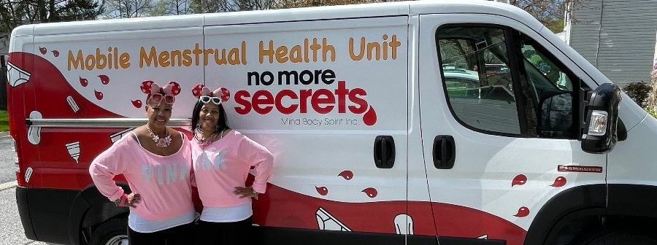


No More Secrets Mind Body Spirit Inc.
OUR MISSION
To decrease uterine care and menstrual health disparities in underserved communities through the eradication of societal stigmas and propagation of resources and scientifically based information.
POPULATIONS SERVED
Menstruating individuals and their families
CONTACT
Lynette Medley – Founder & CEO
lynettemedley@nomoresecretsmbs.org
(215)485-7881
WEBSITE
https://www.nomoresecretsmbs.org/

Slide 21

PDPH Ambulatory Health Services
The Ambulatory Health Services mission is to provide health care to Philadelphia’s poor and medically underserved residents and to do so by providing quality and dignified services that meet their personal healthcare needs and result in improved health status.
https://www.phila.gov/services/mental-physical-health/city-health-centers/
Population(s) served:
Uninsured, underinsured, low income, medically underserved
Phone Number: 215-685-6602

Slide 22

Philadelphia FIGHT- YHEP Health Center
Mission: An inclusive, trauma-informed, gender affirming approach to healthcare for adolescents and young adults (ages 13-26), providing access to comprehensive primary care, sexual and reproductive health services, integrated behavioral health, PrEP, and other relevant social services. Our mission is to improve health outcomes and expand healthcare access, regardless of insurance status or ability to pay.
Contact Information:
Rebecca Keuch, MSN, CRNP
(215) 344-1632 ext 298
rkeuch@fight.org
Website: https://fight.org/programs/y-hep-adolescent-and-young-adult-health-center/
Population(s) served: All youth ages 13-26yrs. Special focus on LGBTQIA+ youth, especially those who identify as trans or gender nonconforming; unhoused youth, immigrants, youth in the foster care system, and those with an economic disadvantage. Accept PA Medicaid, private insurance, and individuals with no insurance and/or are uninsurable.

Slide 23

Programs Employing People
PEP’S MISSION STATEMENT
Programs Employing People (PEP) is a nonprofit organization created to provide and promote social, vocational, educational, rehabilitative, recreational and employment opportunities for people with intellectual and/or physical disabilities. Our mission is to continually advance the following objectives of the organization:
To strengthen, develop and coordinate a better understanding of the challenges and needs people with disabilities and their families face everyday.
To provide pre-vocational and vocational opportunities for individuals with disabilities and to increase their employment experiences.
To provide social and recreational opportunities for individuals with disabilities.
To provide integrated community employment opportunities to those individuals who are interested in pursuing a career.
To utilize all available resources to increase educational, vocational and social skills.
To promote the principles of Everyday Lives.
Heather Kuzowsky heather.Kuzowsky@pepservices.org
www.pepservices.org
Serving about 200 individuals

Slide 24

Puentes de Salud
MISSION
The mission of Puentes de Salud is two-fold: First, to partner with local Latinx immigrant communities to build long-term prosperity by addressing immediate education, health, and social service needs. Second, to create a responsible learning environment for future generations of advocates, educators, and healthcare providers to examine social justice and structural violence and to explore their impacts on the social determinants of health within a marginalized community. Puentes de Salud believes that a comprehensive strategy to promote wellness in any community must work towards diminishing the effects of structural violence and supporting access to healthcare, economic opportunity, and education from the individual to the community.
CONTACT INFO
Mariana Argüelles, Director of Health & Wellness, mariana.arguelles@puentesdesalud.org
WEBSITE
www.puentesdesalud.org
POPULATION SERVED
Latinx immigrants

Slide 25

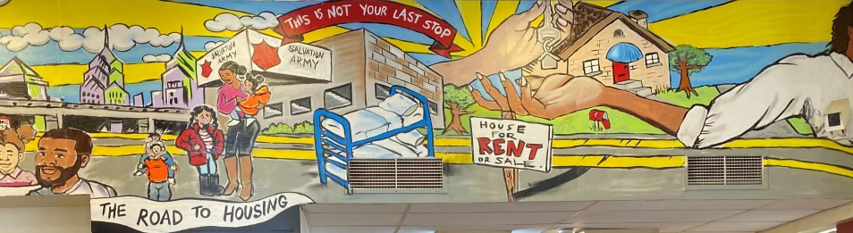
The Salvation Army
Red Shield Family Residence
The Red Shield Family Residence is a therapeutic community; where the power of the group creates healthy norms, healthy interactions, and subsequently, a positive sense of well-being for all. The community allows members to focus on movement towards the achievement of goals, emotional stability, and the ultimate aspiration of self-sufficiency.
https://easternusa.salvationarmy.org/eastern-pennsylvania/greater-philadelphia/red-shield-family-residence/
Katie Barnhart, Assistant Director Katie.Barnhart@USE.SalvationArmy.org
Population Served: Homeless Families

Slide 26

Sankofa Community Farm at Bartram’s Garden
Mission: Go back and get it!
​Sankofa Community Farm is a 3.5-acre community-based crop farm, rooted in the experience of the African Diaspora. As a spiritually centered farm, Sankofa prioritizes reverence for Spirit, human beings, and our relationship to the myriad beings beneath and above the soil.
The farm offers over 60 different crops and wild foods for our community’s healing and produces over 15,000 pounds of food annually for local farm stands and other markets. Sankofa Community Farm emphasizes intergenerational connections in learning and is powered each year by paid high school interns working alongside community elders, neighbors, and volunteers.
Contact Information: Ty Holmberg, Farm@bartramsgarden.org
Website: https://www.bartramsgarden.org/farm/
Population(s) served: Southwest Philadlephia

Slide 27


Penn Medicine Social Needs Response Team (SNRT)
Our Mission - CHEA
TO PROVIDE HIGH QUALITY PATIENT/FAMILY-CENTERED CARE FOR ALL, regardless of their background or culture.
TO INVEST IN COMMUNITY PARTNERSHIPS TO TACKLE BARRIERS to achieving optimal health for all communities that we serve.
TO ENSURE OUR CLINICAL AND LEARNING ENVIRONMENTS ARE INCLUSIVE and promote the advancement of a diverse workforce and student body.
TO DEVELOP THE EVIDENCE BASE TO INFORM EFFORTS to advance equity and inclusion.
Contact
Ana at ana.bonillamartinez@pennmedicine.upenn.edu for SNRT or submit an inquiry via our website.
Referrals please message our team pool via PennChart “Social Needs Response Team” or leave a voicemail: 267-785-2019.
Website
https://www.chea.upenn.edu/
Populations served
  The Social Needs Response Team (SNRT) is a virtual call center established in April 2020 that supports Penn patients, students, and the wider Philadelphia community with access to resources to address social needs.

Slide 28


St Chris- Cap4Kids/Summer Meals
CUC Mission: Our goal is to promote health equity to mitigate inequities and health disparities in healthcare delivery to the children and families we serve, while providing exceptional, equitable, culturally humble, comprehensive care to our families.
Update Cap4Kids and develop QR codes for EHR. M, T, Th, Fri- Lunch Distribution
Contact Information: Dr. Daniel R. Taylor drt23@Drexel.edu, 215817-1149
www.cap4kids.org/philadelphia
Populations Served: Children and their Families. 91% Medicaid, 93% BIPOC

Slide 29

St. Christopher’s Hospital-
Center for Collaborative Primary Care
At the Center for Collaborative Primary Care (CPC) we aim to be a trauma-informed, patient centered medical home for children and families with social stressors including children in the foster care system, children of parents with substance use disorder, and other similar stressors.
Contact Information: Emily Spengler, MD, eas468@drexel.edu
Ann Cushwa, MSW, ann.cushwa@towerhealth.org
Population(s) served: Children and familes affected by substance use disorder, families with DHS or foster care involvement, children of parents with intellectual disabilities, and families affected by intimate partner violence or homelessness.

Slide 30

Students Run Philly Style (SRPS):
Our mission is to transform students’ lives through mentorship over miles of long distance running and achievement.
The Sterling Commercial Building Suite #480
1819 John F. Kennedy Blvd. Philadelphia, PA 19103
267-930-3546 | www.studentsrunphilly.org | srps@studentsrunphilly.org
We serve Philadelphia students in grades 6-12.
Follow us on all social media platforms @StudentsRunPHL

Slide 31

Lenfest Center for Community
Workforce Partnerships
MISSION:
Situated under the Office of the Vice President for Diversity, Equity and Inclusion, Temple University's Lenfest Center for Community Workforce Partnerships (LCCWP) engages communities and social service agencies throughout the Commonwealth to address issues that impact health and well-being of individuals and communities.
Shirley Moy, Executive Director
Lenfest Center for Community Workforce Partnerships
Temple University
1301 Cecil B. Moore Avenue
Ritter Annex, 4th Floor
Philadelphia, PA 19122
smoy@temple.edu
Office: (215) 204-3424
Cell: (215) 307-7161
www.lenfestcenter.temple.edu
Alejandra Castano
PHA CARES Project Coordinator
Lenfest Center for Community Workforce Partnerships
Temple University
1700 North Broad Street, 3rd Floor
Philadelphia, PA 19121
Alejandra.castano@temple.edu
Opportunities for Service
Youth and Young Adults
Adult Program
Career Development Programs
Community Programs

Slide 32

To Our Children’s Future With Health, Inc.
To Our Children’s Future With Health, Inc. (TOCFWH) is a community-based, non-profit agency established in 1992. Our mission is to empower youth, adults, and communities toward healthy living by providing comprehensive community health and education services. Contact Information
Website: www.tocfwh.org
Population(s) served: TOCFWH currently serves over 1100 youth and families from primarily West and North Philadelphia representing zip codes 19104, 19131, 19139, 19151, and 19140.

Slide 33

Mission: The UUH Outreach Program supports the goals of people 60 and older in achieving independence, dignity and quality of life in their homes and communities.
Contact Information: 215-843-5881 / outreach@uuhouse.org
Website: uuhoutreach.org
Population(s) served: Adults 60 and older living independently in Northwest Philadelphia zip codes 19118, 19119, 19138, 19144, 19150, and west of Broad Street in zip codes 19126 and 19141

Slide 34

Wyss Wellness Center
Mission:
“To provide highest-quality whole-body care for immigrants, refugees, and the South Philadelphia community”
Contact Information:
Office number: 215-503-7194
Jenna Gosnay, LSW jenna.gosnay@jeffeson.edu, 215-890-3401
Website:
https://wysswellnesscenter.org/
Population(s) served:
The immigrant and refugee populations of Philadelphia, along with the surrounding South Philadelphia communities. All ages, regardless of insurance
*Please create a slide with the appropriate information for your organization &
upload to the link provided by BTG.

