Slide 1
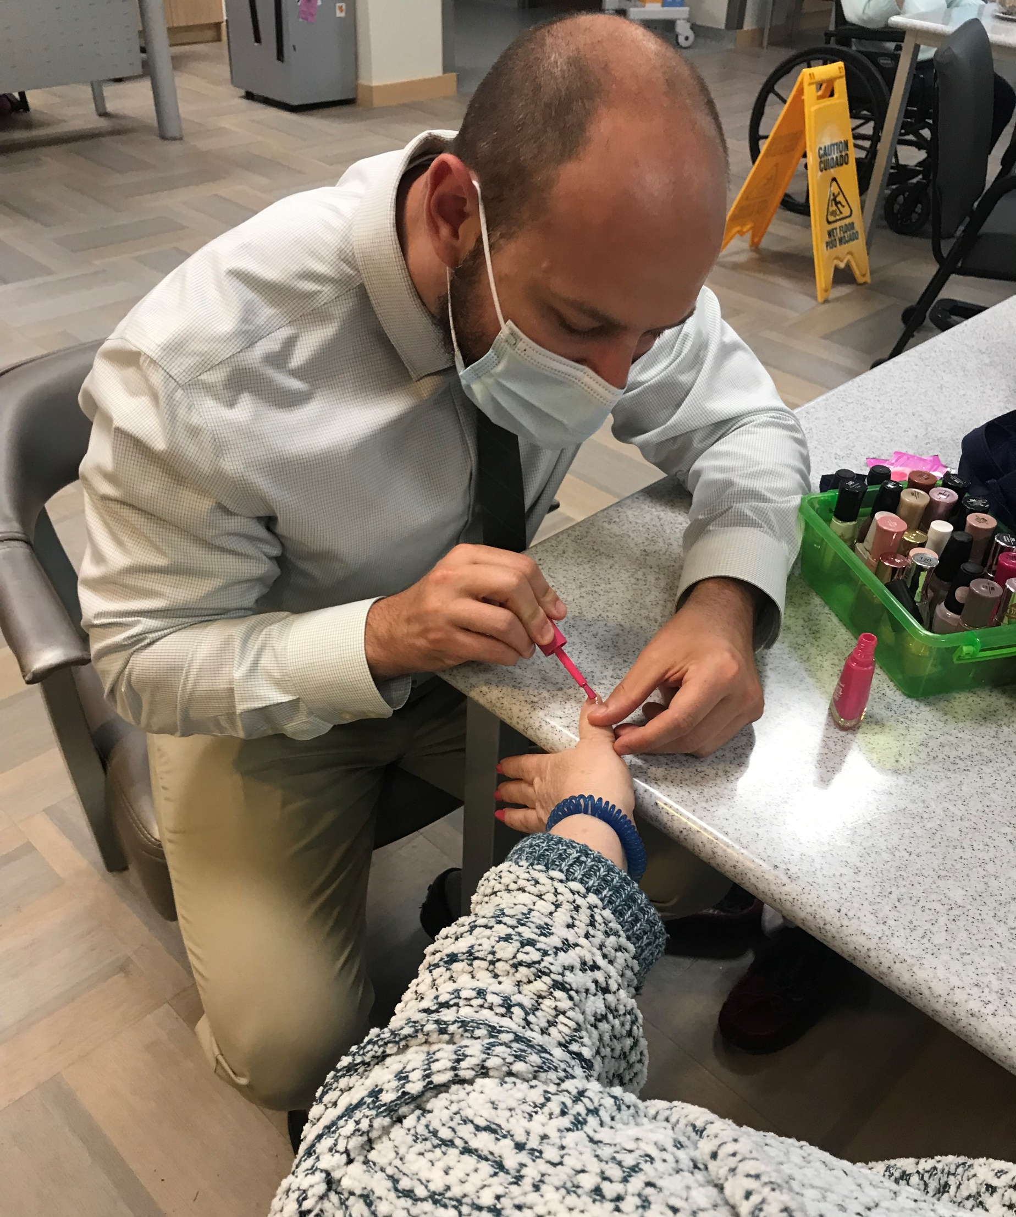
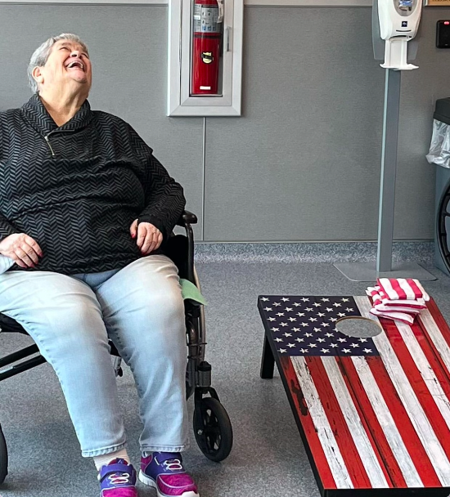
Move It or Lose It
Jeremy Berger, PA-C/OMS-II &
Matthew Waibel, MMS, OMS-II
LECOM Senior Living Center
Community Site
Academic Preceptor: Noelle Thielman, PhD
Community Site Preceptor: Ryan DiDomenico, NHA
LECOM Senior Living Center is a skilled nursing facility providing primarily long-term care for geriatric residents, and acute rehabilitation for post-operative orthopedic patients. The facility excels at providing physical and occupational therapy for both populations. Residents are provided personalized care that allows maximization of independence for the individual while in a community setting.
BTG Focus Areas
The program focused on aspects of elder health via routine range of motion exercises. The largest cause of injury to the geriatric population is falling and so maintaining mobility and balance is of paramount importance.
Personal Statement
The experiences that I had at LECOM Senior Living Center taught me so much about the geriatric population and will stay with me throughout my life. After starting, it immediately became apparent that diversity is vast with respect to medical needs and personalities of different residents. Even individuals with a common diagnosis display a wide variation in ability, both physically and cognitively. My time with LECOM Senior Living Center has helped me understand that each person has a unique back story and life experience. The Bridging the Gaps program has given me an experience I will use to better serve my patients in the future.
– Jeremy Berger, PA-C/OMSII
My time at the LECOM Senior Living Center was an invaluable experience for my personal and professional development. It was a privilege to be able to give back to the community of Erie by providing care to many of the residents. After having spent some time with the residents, I acquired a new-found appreciation towards serving the geriatric population. I will continue to utilize the skills and bed-side manner I acquired through this experience throughout my future career as a physician. In summary, I hope to be an example for how the Bridging the Gaps program is an excellent program for developing holistic, well-rounded physicians.
– Matthew Waibel, MMS, OMS-II
Project Goals
Improve range of motion
Maintain muscle mass through body weight exercises
Provide an enjoyable social interaction for residents
Instill a regimen that residents can reproduce as desired whether independent or in groups
Educate residents on oral care for natural teeth and dentures
Site Activities
The primary activity performed at the LECOM Senior Living Center fulfilled the project goals through organized group exercise. We used pool noodles as an assistive device and to encourage grip strength. In addition to the main activity a book cart was created so residents would have easy access to a variety of reading material from magazines to word puzzle books. Maintaining cognitive ability is just as important as physical fitness for overall geriatric wellness. Another activity the interns were able to spearhead was a tailgate event which included a smoothie truck, cornhole, giant size connect four, and music. Interns were able to aid the already established activities department with the robust daily entertainment events on the residents’ daily schedule. Examples of daily entertainment include Bingo, dice games, arts & crafts, time outside (when weather permits), musical acts, and plinko. A separate initiative of educating the residents on proper oral care was completed through distribution of an informative pamphlet related to both denture and natural tooth care. Interns provided free dental supplies residents.
Project Summary
The project involved creation and implementation of a stretching/exercise activity which could maintain or possibly improve extremity motion for participating residents. Residents had the voluntary opportunity to take part in small peer groups where upper and lower extremity motions focused on individually modifiable range of motion exercises. Equipment in the form of pool noodles were used to help train grip strength and foster hand eye coordination. The goal of the project is to maintain joint mobility in the geriatric population in a social and enjoyable environment.
Acknowledgements
Thank you to our academic preceptor, Dr. Noelle Thielman, our community preceptor, Ryan DiDomenico, and the LECOM Bridging the Gaps Director, Dr. Leah Labranche. Also, a special thanks to the recreation department including director, Emily Carver and recreation aids including Natalie Harmon, Jennifer Weindorf, Kimberly Muell, and Anhelina Semeniaka. Additionally, we would like to thank the housekeeping and maintenance staff at the SLC. Thanks to LECOM School of Dental Health for donating dental supplies.

