Slide 1
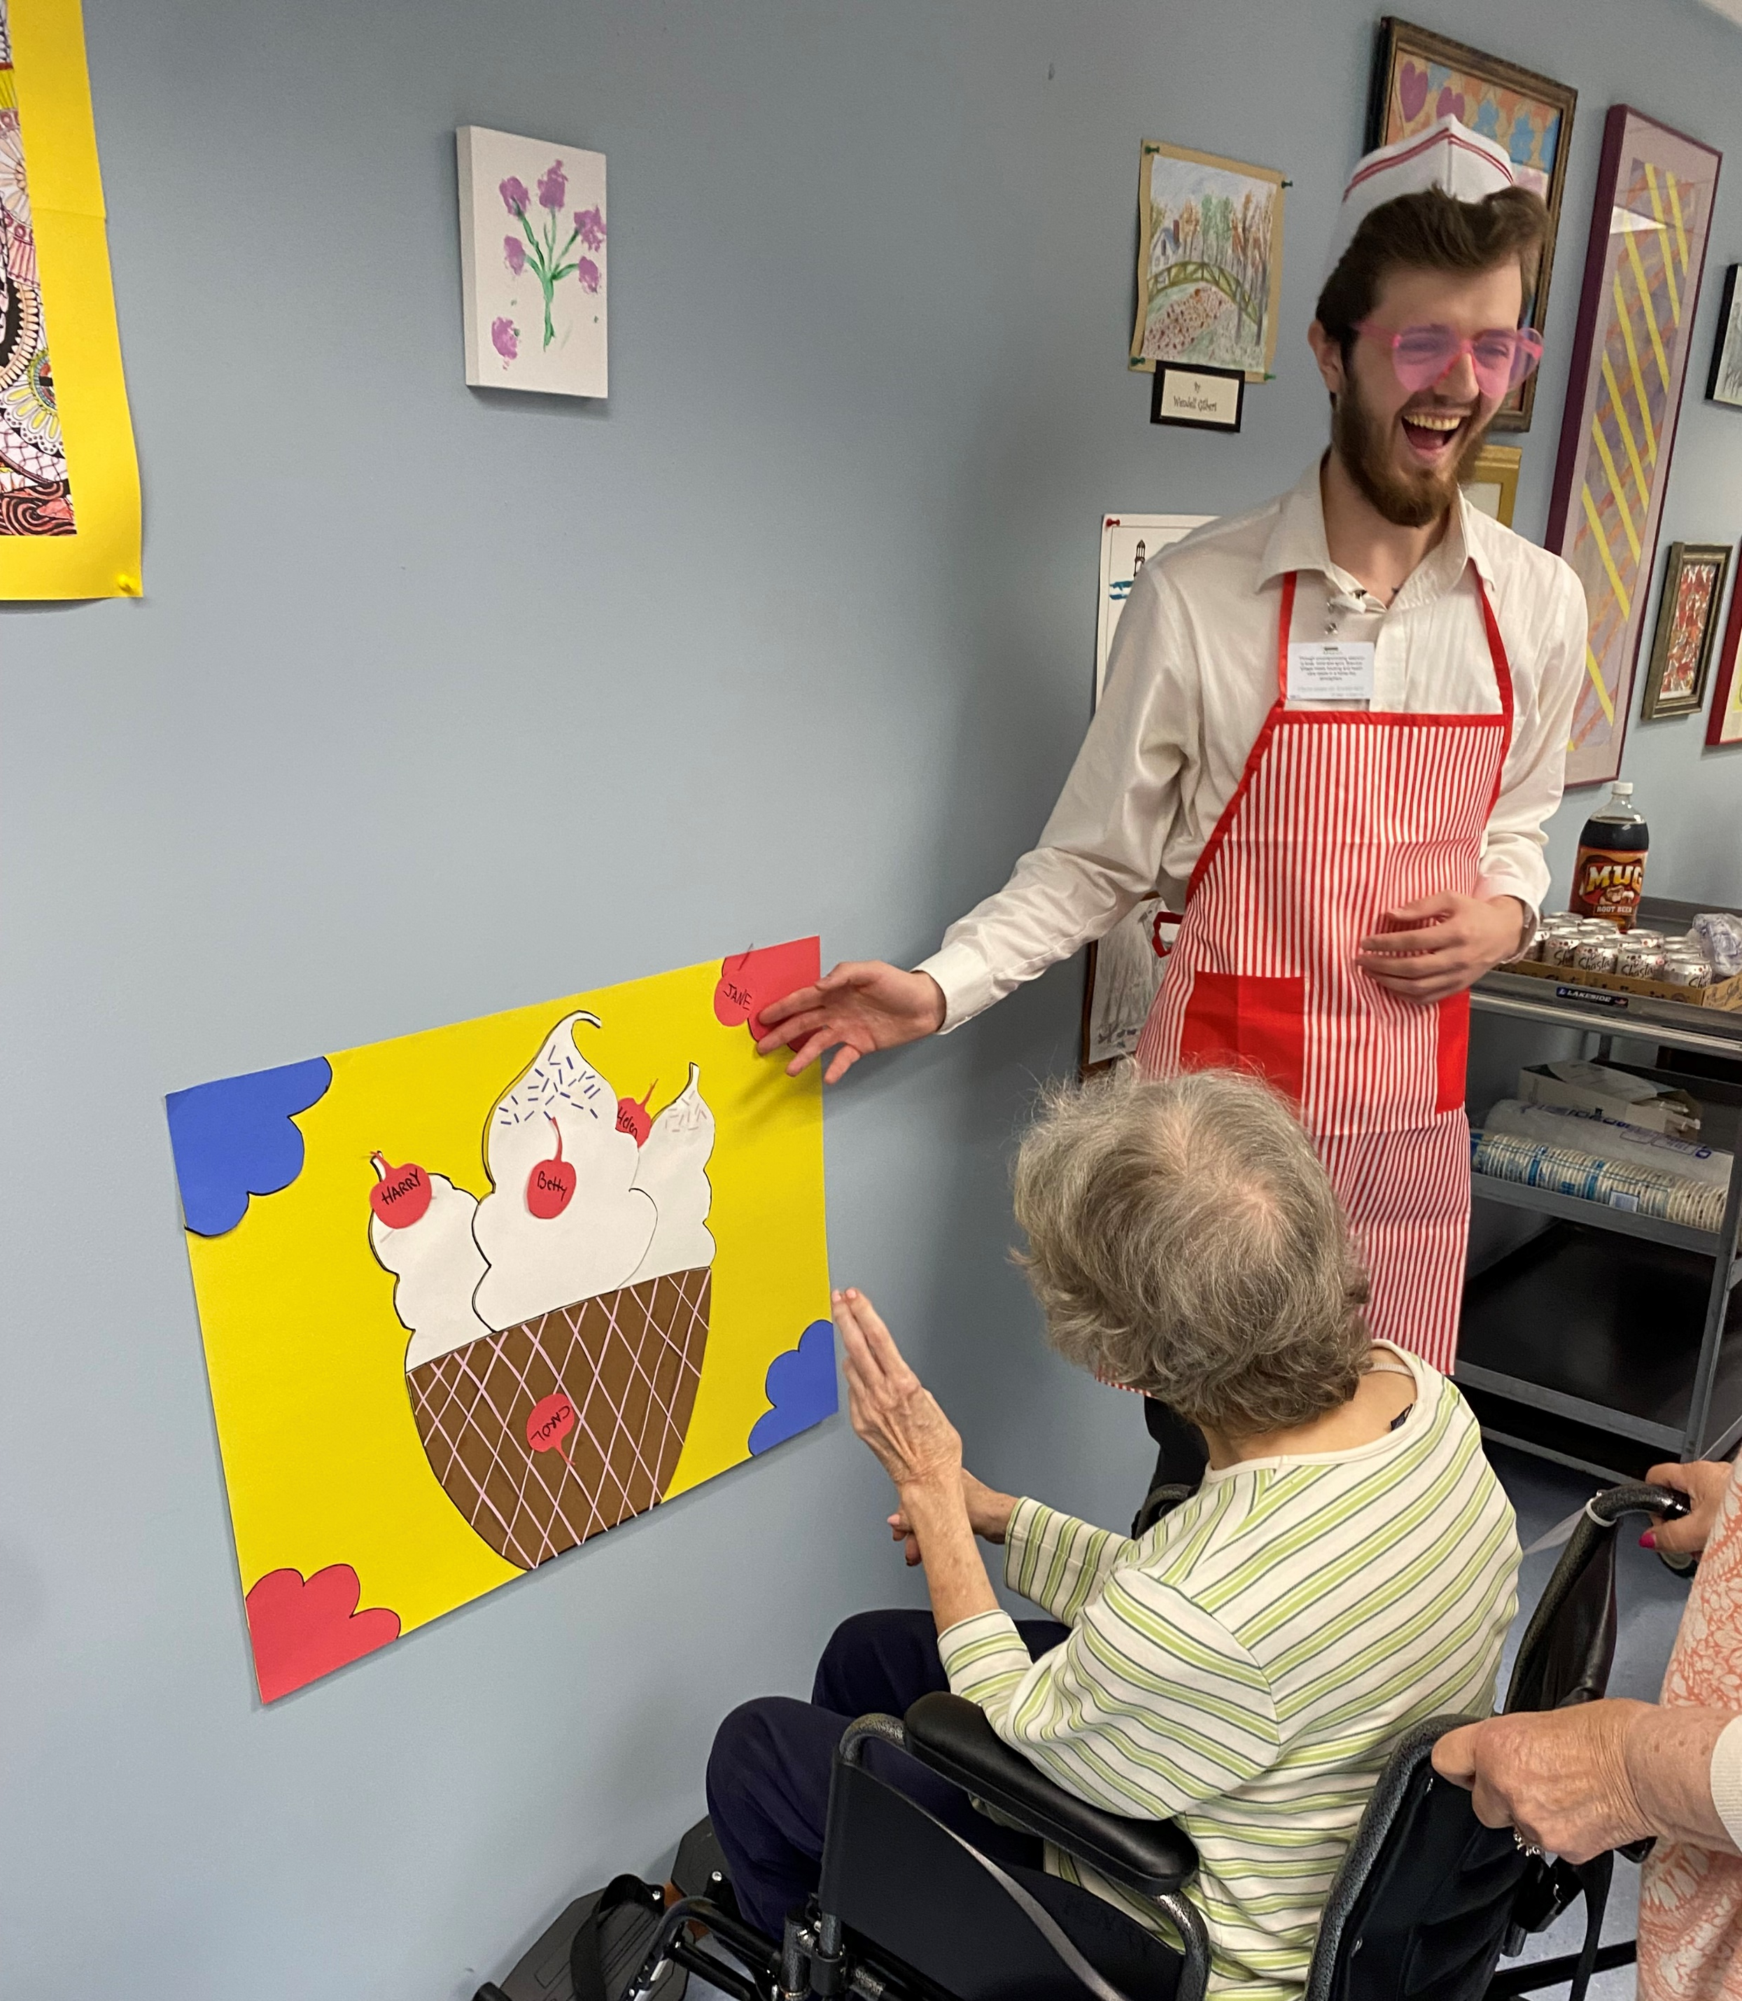
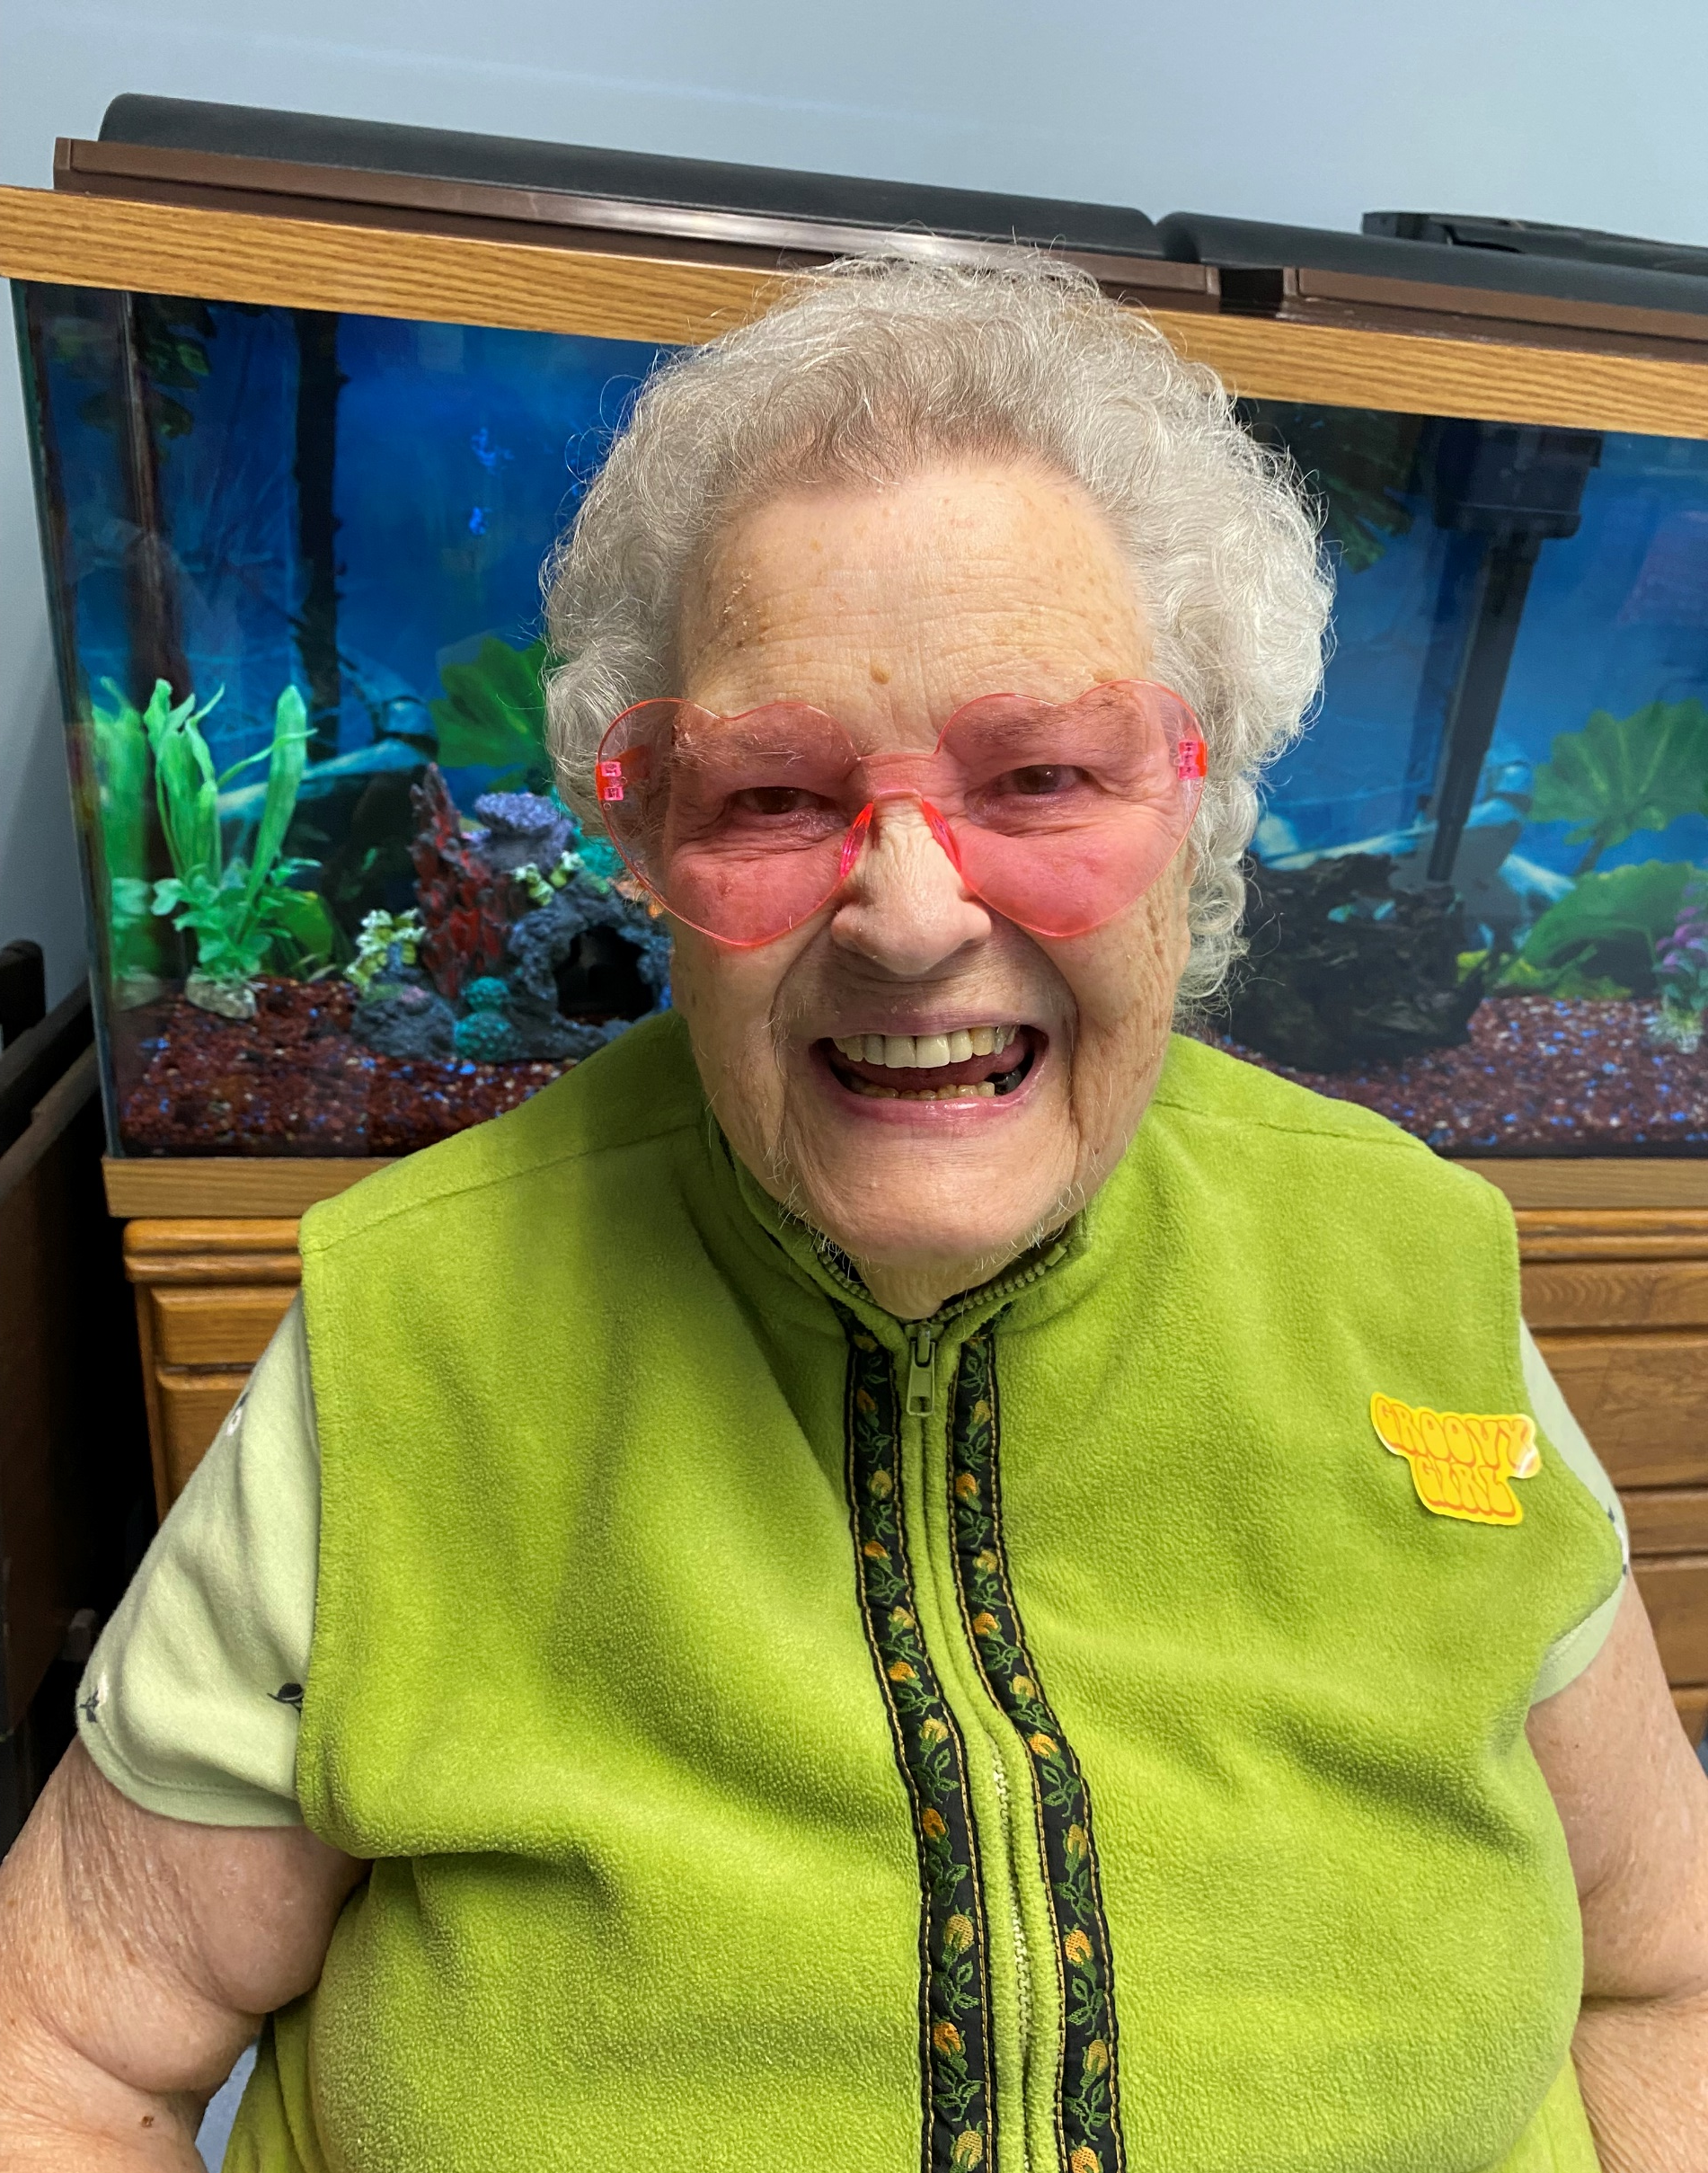
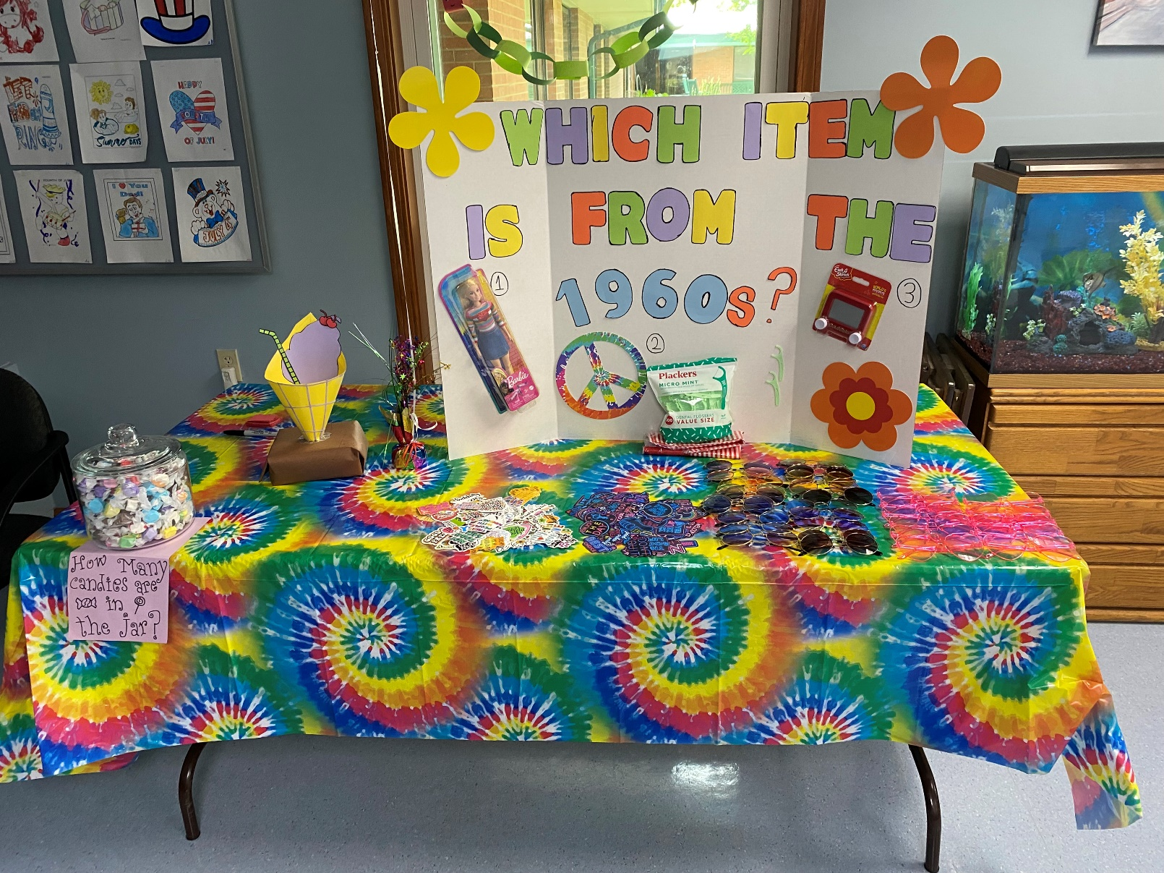
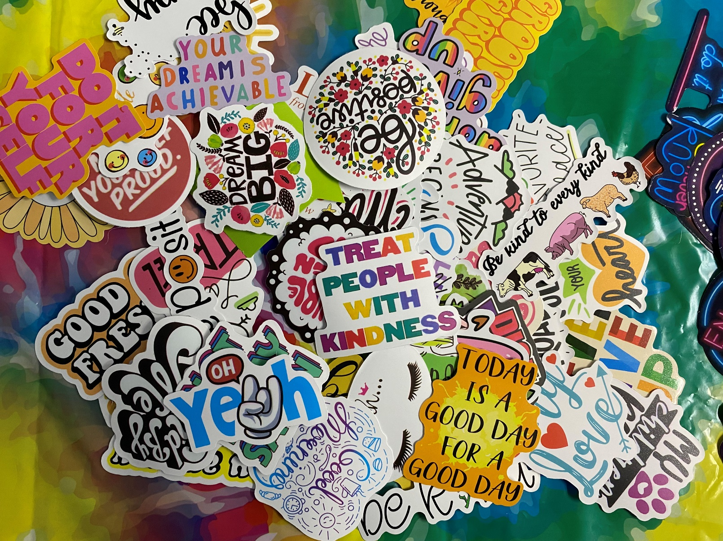
Coming Together: An Afternoon With Friends And Family
Corey Zinno, OMSII
Brevillier Village
Community Site
Academic Preceptor: Robert Waters, PhD
Community Site Preceptor: Hannah Perrin, RN
Brevillier Village is a non-profit healthcare and housing community for seniors. Brevillier Village aims to create a community for seniors with the idea that the individuals can belong to this special community and receive whatever level of care they need to thrive. Brevillier Village aims to provide comfort, safety, and a feeling of belonging to all who reside here.
BTG Focus Areas
Mental Health, Elder Health and Senior Quality of Life
Personal Statement
My time at Brevillier Village could not have been more valuable to my future career as a physician. I was constantly exposed to conditions and symptoms I have only ever read about and had real experience working with seniors who suffer from some level of dementia. Each resident was incredibly unique and an absolute pleasure to spend my time with. Each resident has a different level of memory function and different physical capabilities and I have learned to be successful working with individuals anywhere on the spectrum. I am proud to say that I became a recognizable face and was able to develop meaningful relationships with many of the residents. I would not have traded my time at Brevillier Village for anything and would recommend every medical student to take part in such a beneficial, immersive, and hands-on program provided by Bridging the Gaps.”
Pictured is Corey Zinno (top right) and Jane Nies (bottom right)
Project Goals
Provide a unique and enjoyable experience to the residents and their families
Improve the mental health of the residents
Promote and encourage the resident’s families to take an active role in their loved one’s life at Brevillier Village
Improve visitation rates for Brevillier Village residents
Pictured is Esther Northup
Site Activities
An afternoon event was held with activities that were themed in the 1950s, 1960s, and 1970s. All families of Brevillier Village residents were invited to take part in the activities of the day. Dancing, crafts, trivia, and games were the foundation to harbor a pleasant experience for all. After this event it will be better known that Brevillier Village welcomes and wants increased family participation, and future events like this will only grow that sentiment.
Project Summary
The student intern sought to improve the visitation rate for family and friends for higher-needs residents in the post COVID-19 environment. The families of each resident at Brevillier Village were sent invitations to spend an afternoon with their loved one where there would be activities and beverages. This event provided a morale boost for the residents and further pointed out that Brevillier wants and welcomes family involvement.
Acknowledgements
Thank you to my site preceptor Hannah Perrin, and to the recreational staff Lois Perrin and Kayla Turk. I could not have done it without you!

