Slide 1
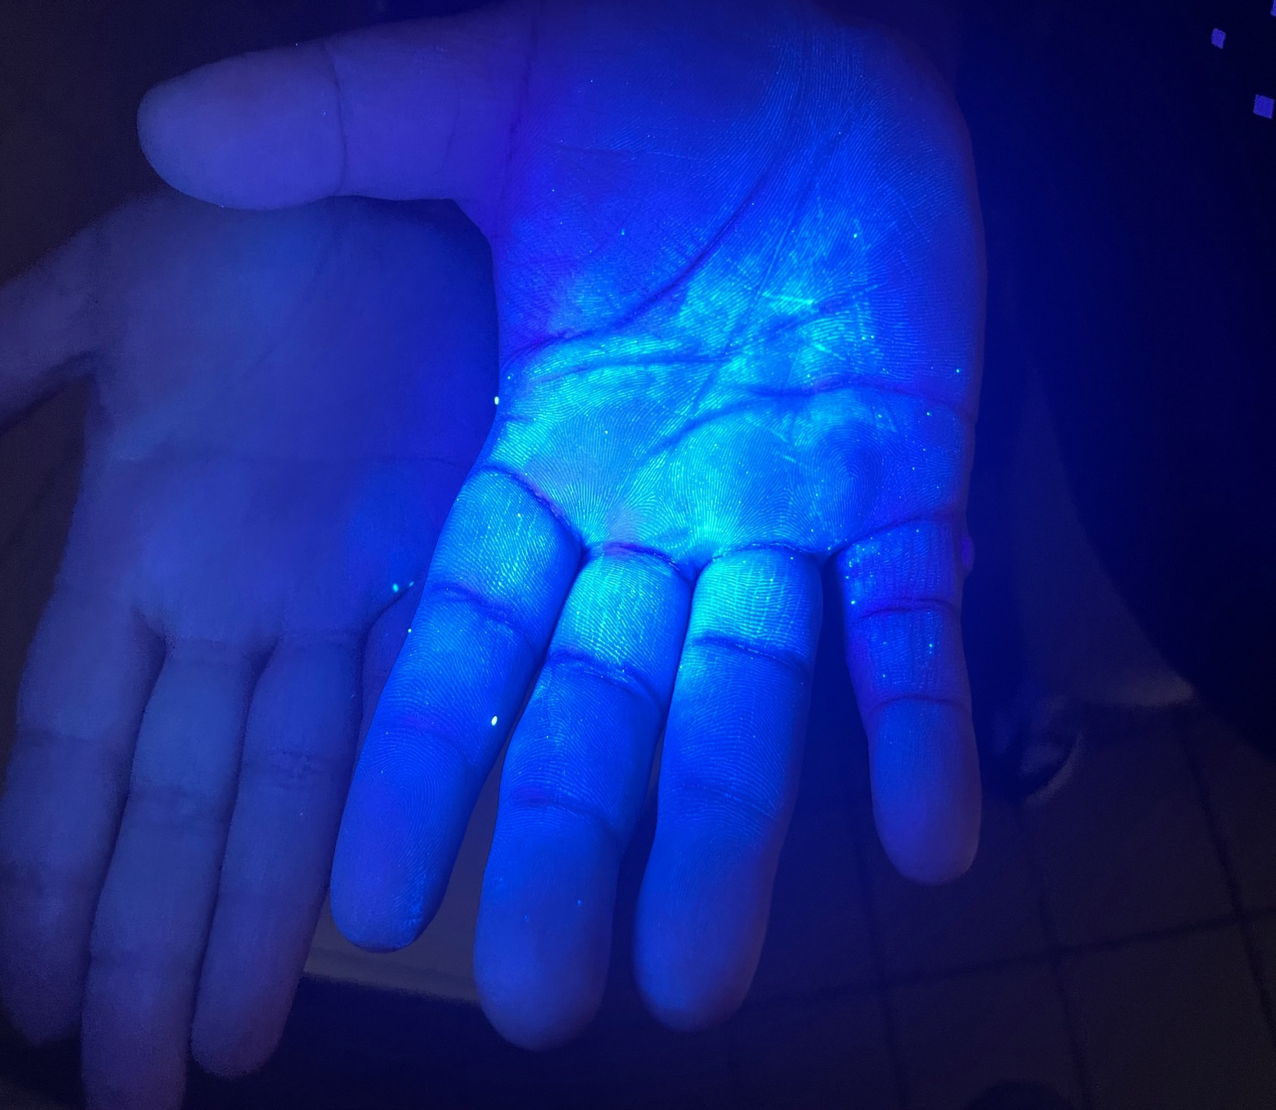
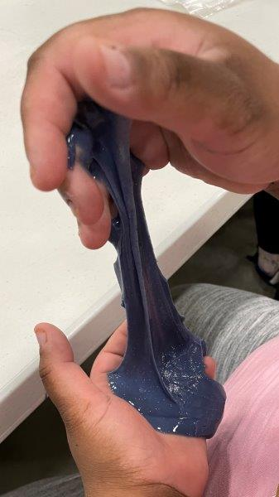
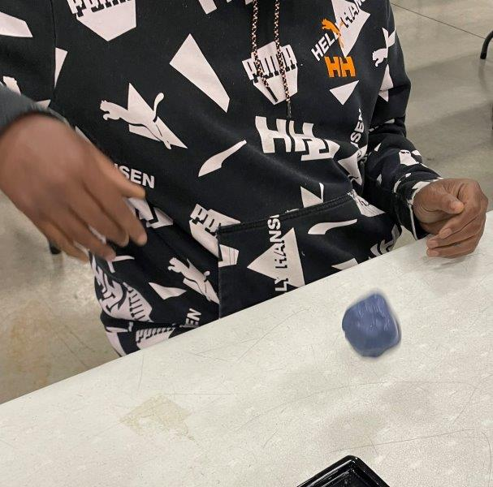
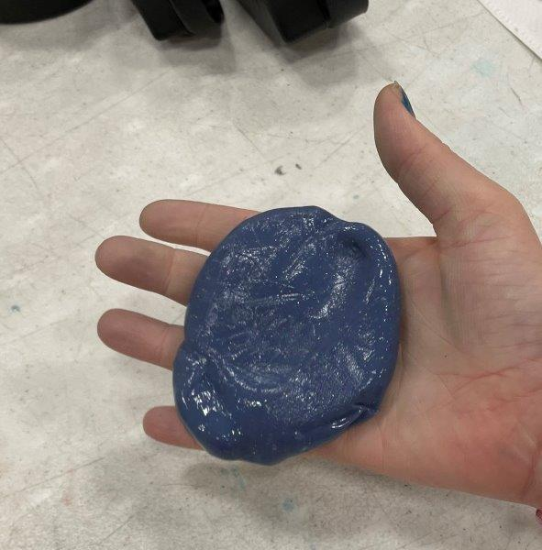
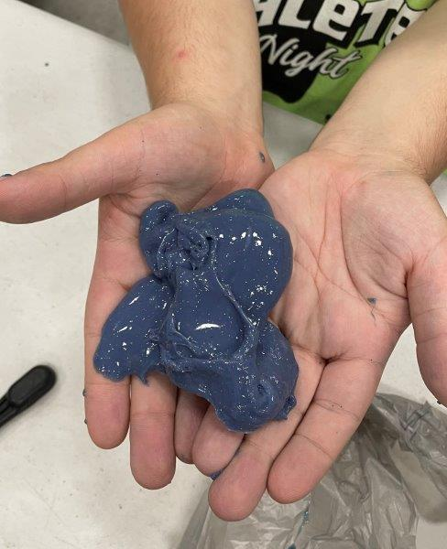
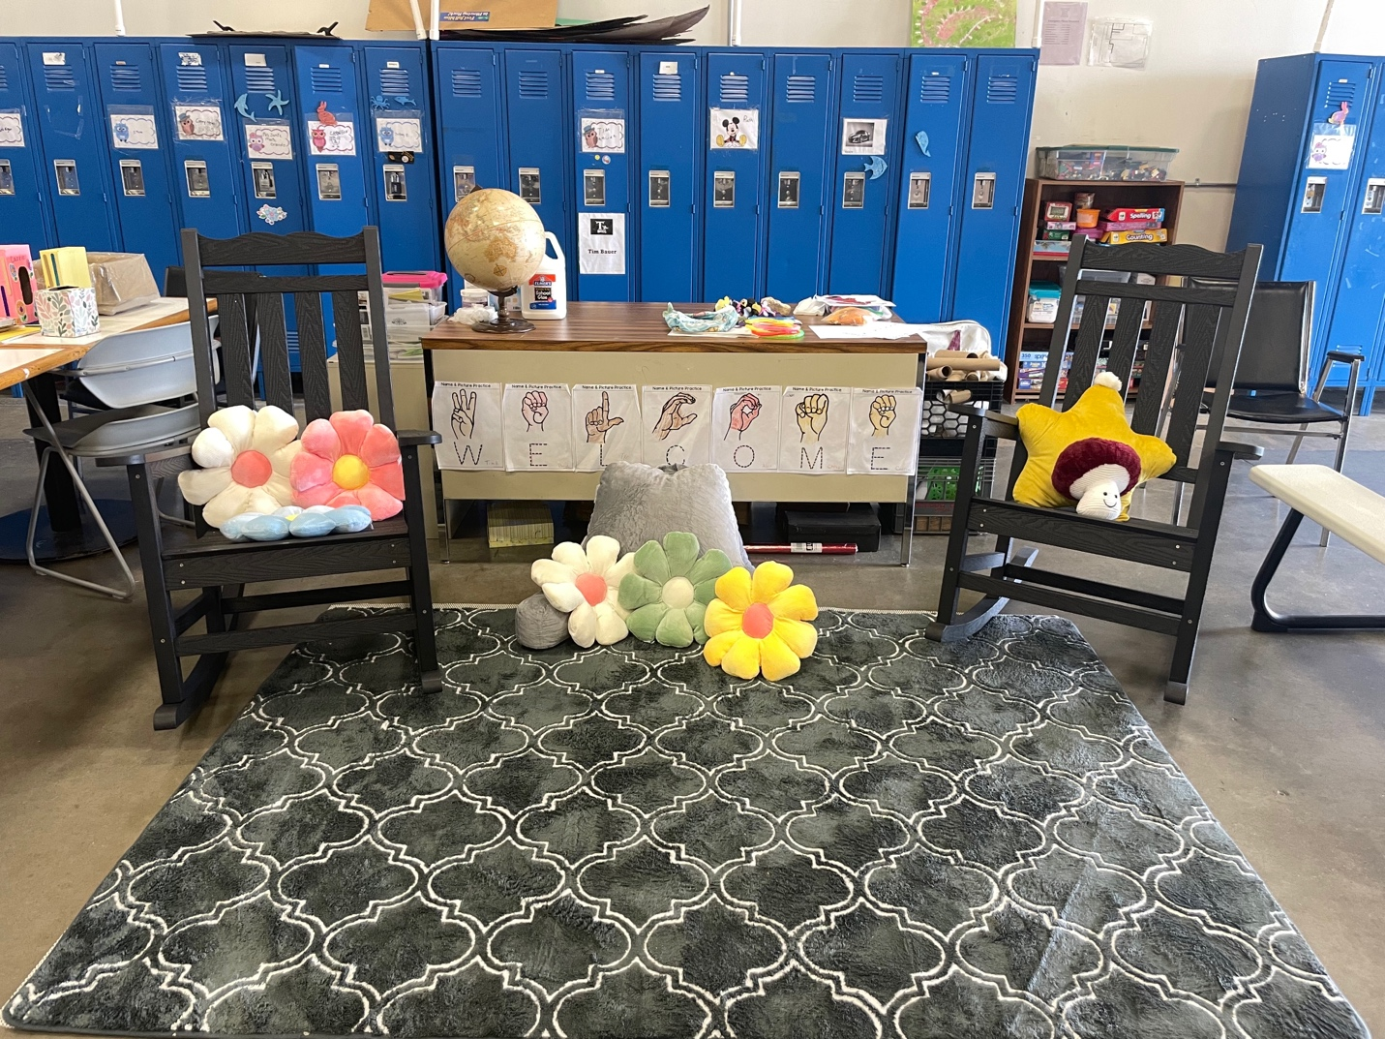
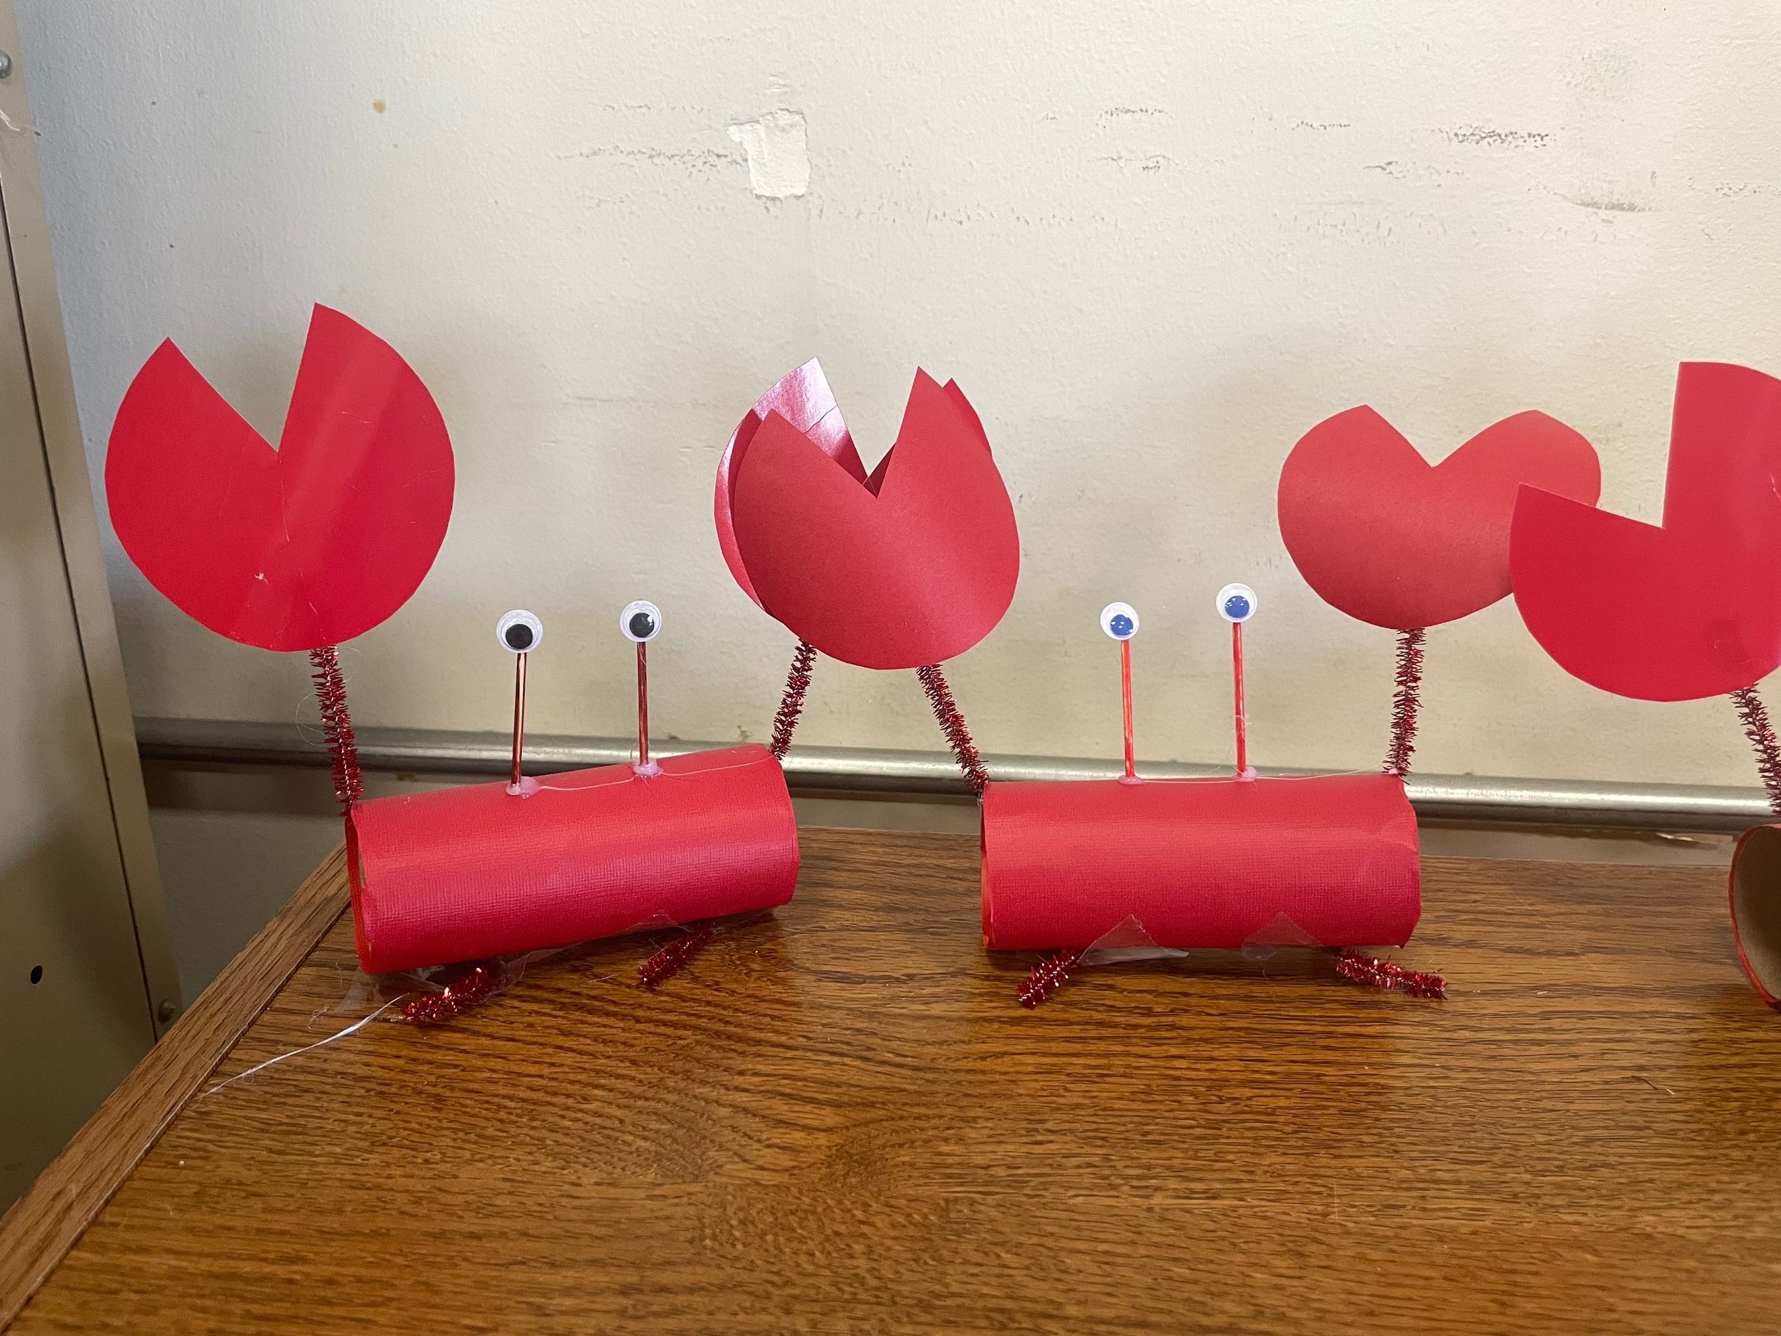
Mental Health & Relaxation
Francesca Rogozinski, OMSII
Barber National Institute
Community Site
Academic Preceptor: Colleen Cole-Jeffrey, PhD Community Preceptor: Cynthia Bravo, BA
Barber National Institute is an organization that provides hope and opportunity to individuals with autism, intellectual disabilities, or behavioral health challenges. Services are provided to individuals of all ages. At the BNI on West 16th street, a variety of services are provided such as education, job training, and community participation supports (CPS). Community participation supports has goals such as experiencing meaningful community participation and inclusion, increasing the potential for employment, increasing independence, building natural supports, developing and sustaining a range of valued social roles and relationships, and job training.
BTG Focus Areas
Oral Health
Mental Health
Environmental Health
Nutrition and Weight Status
Physical Activity and Fitness
Personal Statement
The experience that I have gained working with the Barber National Institute is one that is difficult to describe in words because it is not one that a textbook would have ever given me the knowledge of. Working with individuals with intellectual/developmental disabilities has been very valuable for my future career as a physician and how I interact with people in my own everyday life. The most valuable lesson that I have learned at the Barber National Institute is to listen; being able to sit with a client and be fully engaged in conversation and decoding the information that they are presenting to you to understand the situation fully. This is especially important in this population but also every future patient as well.
Site Activities
I wanted to incorporate an idea that could be helpful to people regardless of their physical capacity or learning and processing style. Daily, I worked with clients who were not working on a job at that time. Some had completed their work for the day, and some had chosen not to work on anything. My daily activities included playing games, creating crafts, and forming friendships and connections with the clients. I enjoyed getting to know the people I worked with and learning about their unique talents and the ways in which we were similar. Motivated by the way I related to the clients in the need for different learning formats, I decided to focus my project on mental health and relaxation at the worksite, something I also focus on in my own schoolwork. This inspired me to develop a “Chill Zone” for the clients to be able to step away from their work and be able to reset from their work, emotions, and/or stressors.
Project Goals
Create a “Chill Zone”
Educate about proper oral hygiene health
Daily Physical Activity
Understanding of Proper Nutritional Health
Acknowledgements
I want to add a significant thank you to Cynthia Bravo and Dr. Cole-Jeffrey who were all advocators for coordinating my project along with support from Dr. Labranche and Dr. Thielman. I would also like to give a huge thank you to all the staff members at the Barber National Institute at West 16th street, especially Jason who helped guide discussions with me and the clients. The BNI staff were able to teach me a large range of clinical experiences throughout my journey this summer. It was a huge help to learn from the individuals who work with the clients everyday. My time at the Barber National Institute would have been very different without the help of all of these individuals.
Project Summary
The student intern participated in a project focused on creating a space for mental health and relaxation at the Barber National Institute. To create this space, the student needed supplies such as two rocking chairs, a nonslip rug, pillows, and a laminator to be able to create a sign for the “Chill Zone”. In this space, the student had a detailed discussion with the clients on ways to improve one’s coping mechanisms to various stressors in one’s life. During the student’s time at the BNI she also ran various relaxation exercises with the clients.

