Slide 1
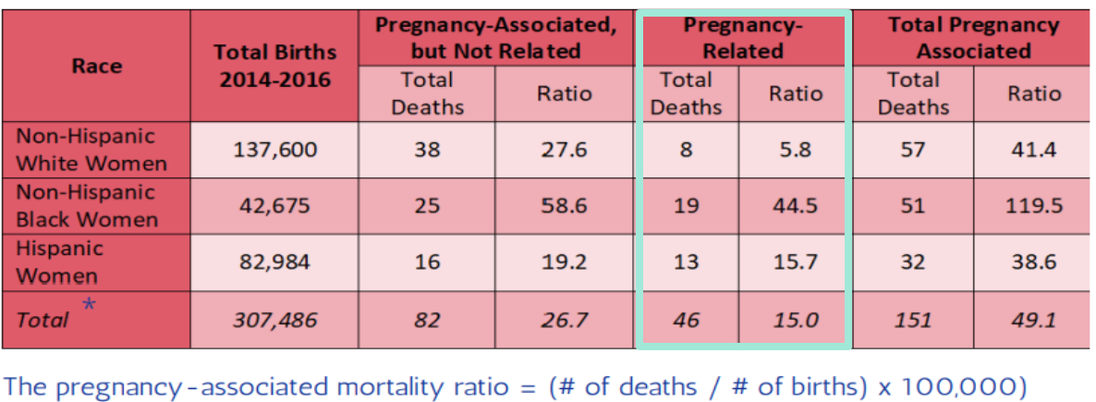
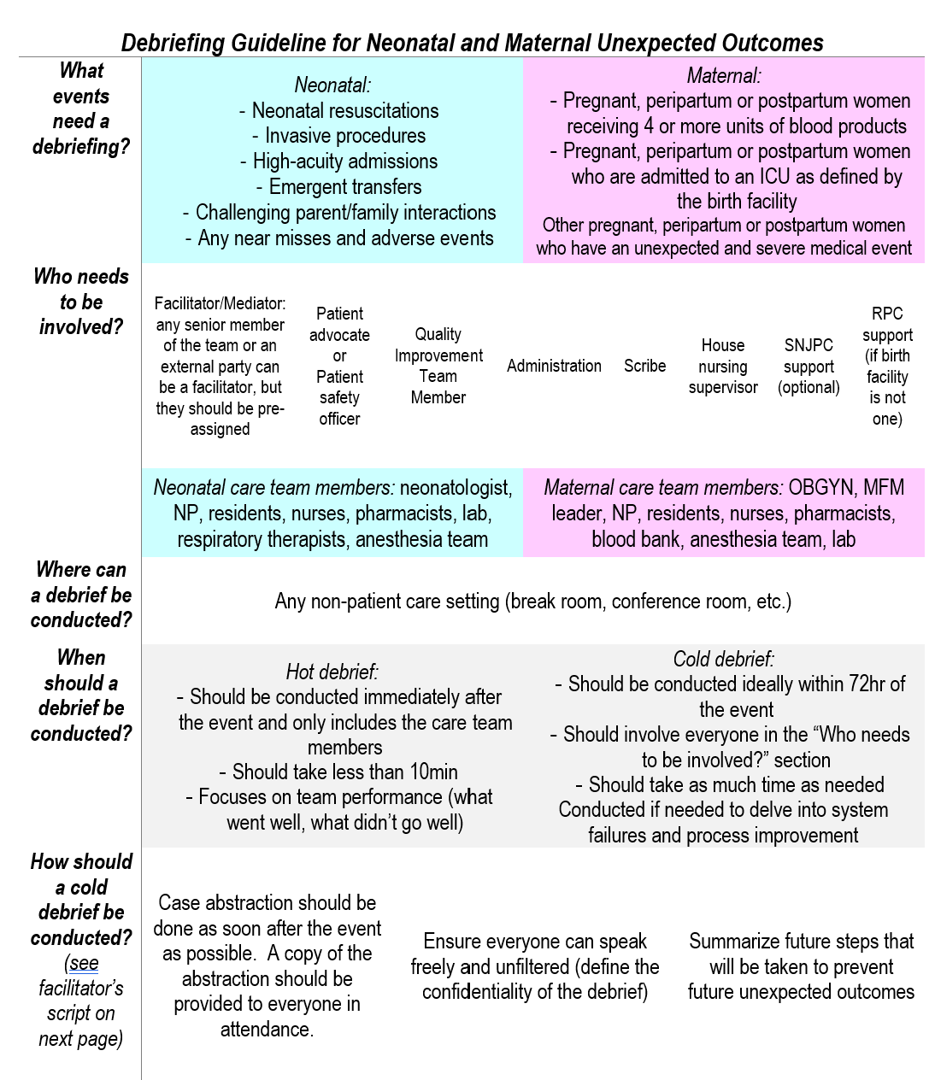
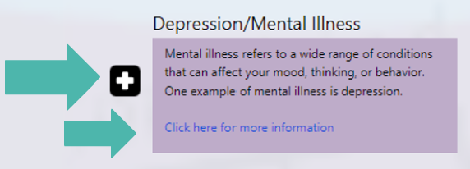
Creating a Neonatal-Maternal Unexpected Outcomes Debriefing Guide for Hospitals and Providing Inclusive and Appropriate Language for an Online Patient Portal
Student Interns: Ashley Russell, Cooper Medical School of Rowan University
Academic Preceptors: Mara Gordan, MD, Cooper Medical School of Rowan University
Behjath Jafry, MD, Cooper Medical School of Rowan University, Cooper University Health Care
Anthony Rostain, MD, Cooper Medical School of Rowan University
Community Preceptors: Barbara May, RN, MPH, Southern New Jersey Perinatal Cooperative
COMMUNITY PARTNER
The Southern New Jersey Perinatal Cooperative (SNJPC) improves the health of pregnant women, children, and families in South Jersey. SNJPC offers a comprehensive set of programs and services that enhance the system of care, strengthen communities, and provide families the tools they need to lead healthier lives.
Website: https://www.snjpc.org
BACKGROUND/CONTEXT
The pregnancy-related mortality ratio in New Jersey between 2014-2016 for all women was 15.0 deaths per 100,000
The ratio for Non-Hispanic Black women is 7.6 times higher than that for Non-Hispanic White women
The ratio for Hispanic women is 2.7 times higher than that for White women
It has been argued that some of the things contributing to this disproportionate mortality rate are social determinants of health, such as lack of transportation, food insecurity, health literacy, etc.
To combat this gap, SNJPC works with providers and the community to provide resources to patients, especially Women of Color in Camden and Atlantic City, to assist with access to food, transportation, and access to healthcare
TEAM’S EXPERIENCE
ACCOMPLISHMENTS/CHALLENGES/JOYS
The intern was partnered with the Family Engagement Network and Family Health Initiatives through SNJPC to develop the language on the newly developed patient portal for the Perinatal Risk Assessment form filled out by providers throughout South Jersey
Utilized health literacy tools learned during the BTG weekly sessions to provide a brief, basic summary of over 150 terms relating to chronic medical conditions, pregnancy-related conditions, and social determinants of health
Determined websites that offer more information on the terms in an easily understandable manner that patients will be able to access through the patient portal
The intern worked with SNJPC’s Fetal and Infant Mortality Review group to develop a novel guide for hospitals in South Jersey on debriefing after a neonatal or maternal unexpected outcome occurs
The guide outlines specifically what events need a debriefing, when the debriefing needs to be held, and who needs to attend the debriefing from the hospital and the community
The guide, which also provides a sample script for facilitators of these debriefings to follow, will be made available to providers in South Jersey to ideally assist in identifying all causes that contribute to neonatal and maternal morbidity and mortality events
As such, it will provide the foundation for instituting system-level changes to prevent some future unexpected outcomes
Patient Risk Assessment patient portal health literacy
Neonatal and Maternal Unexpected Outcome Debriefing Guide
REFLECTION
“My experience at the Southern New Jersey Perinatal Cooperative this summer has been such an incredible blessing. Everyone I have had the good fortune of interacting with at SNJPC or an affiliated organization exudes dedication and genuine concern for the families of New Jersey. No matter the program in which they work, they all maintain the same passion for caring for and serving the underserved communities in South Jersey. Their knowledge about the many resources offered through SNJPC and their compassion for helping their community has inspired me to educate myself on all the resources available for the people I serve in my community so that I can provide them the best and most useful help, both currently as a student and in the future as a provider. More specifically, though, my work this summer brought to the forefront of my mind the value of being able to explain topics and resources in the most basic terms so that they may be fully understood and effectively utilized by patients. The opportunity I had this summer to practice that skill was incredibly significant and I am so grateful to be able to apply what I have learned for the rest of my career.”

