Slide 1
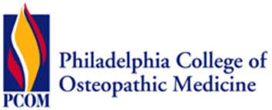
BRIDGING THE GAPS INTERNSHIP WITH GUADENZIA
Poster No.
Student Interns: Raj Madhani, Philadelphia College of Osteopathic Medicine, DO MS-2
Analise Zapadka, Philadelphia College of Osteopathic Medicine, DO MS-2
Academic Preceptors: Robert Dustin, MA, Philadelphia College of Osteopathic Medicine
Meshonea Fox, BS, Philadelphia College of Osteopathic Medicine
Community Preceptors: Valda Dawson, DC, PA-C, Gaudenzia
Sharon Herbert, RN, ASN, RN, Gaudenzia
Notes:
Hello, I am Raj Madhani. My co-intern, Analise Zapadka, and I are both 2nd year medical students at the Philadelphia College of Osteopathic Medicine. We were placed at Gaudenzia, a rehab treatment center, for the summer. We would like to thank Dr. Dawson and Nurse Sharon for the incredible project they gave us.

Slide 2
Gaudenzia
https://www.gaudenzia.org/
Inpatient and outpatient substance use disorder treatment centers
Location: Multiple centers throughout the tri-state area
Clients: Men and Women adults, Pregnant women, Mothers, Homeless individuals
Mission: Gaudenzia helps individuals and families affected by drug and alcohol dependency, mental illness, and related conditions to achieve a better quality of life and become accountable individuals.
This is accomplished through a continuum of care leading to long-term recovery guided by a philosophy of mutual concern, personal responsibility, research, and community education.

Slide 3
Project
Telehealth lecture series
Week 1: COVID-19
Week 2: Cardiovascular health and smoking cessation
Week 3: Anxiety and Mindfulness
Each lecture included:
A PowerPoint slideshow made by the interns after research was completed
A one-hour presentation of the slideshow to different groups of clients, 3-4 times per week
A question and answer session after the presentation
A reflection on what each of the clients had learned
Notes:
Our main project for the summer was to develop a telehealth lecture series that we gave weekly to 3-4 different groups at Guadenzia. Our first lecture was about COVID-19 and how we can keep ourselves and others healthy, the next week was about cardiovascular health and smoking cessation (which also included dental hygiene), and the final lecture was about anxiety and mindfulness, with an emphasis on developing healthy habits to combat anxiety. We would spend the week prior to the presentation researching and preparing our presentation. After we would present, we had question and answer sessions that were always engaging. Finally, each client would reflect on what they had learned that day.

Slide 4
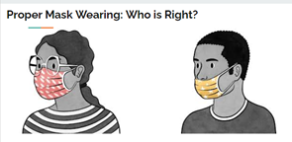
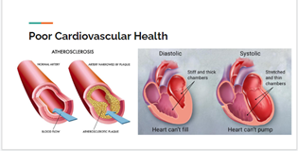
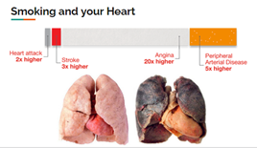
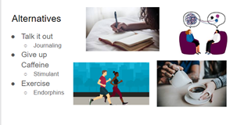
Project Results
Notes:
One method of teaching that we used in each presentation was explaining topics with pictures and diagrams. This gave the clients a way to visualize topics that were either new to them or more difficult to understand. We used them images to introduce topics, and then would build upon them as we continued through the presentation. The images were also helpful to us in that they reminded us that we needed to be explaining our topics without medical jargon that may have overhwlemed or confused any of the clients. We knew that this method was successful because at the end of each presentation, each client had learned something new, and more often than not, it was related to one of our diagrams.

Slide 5
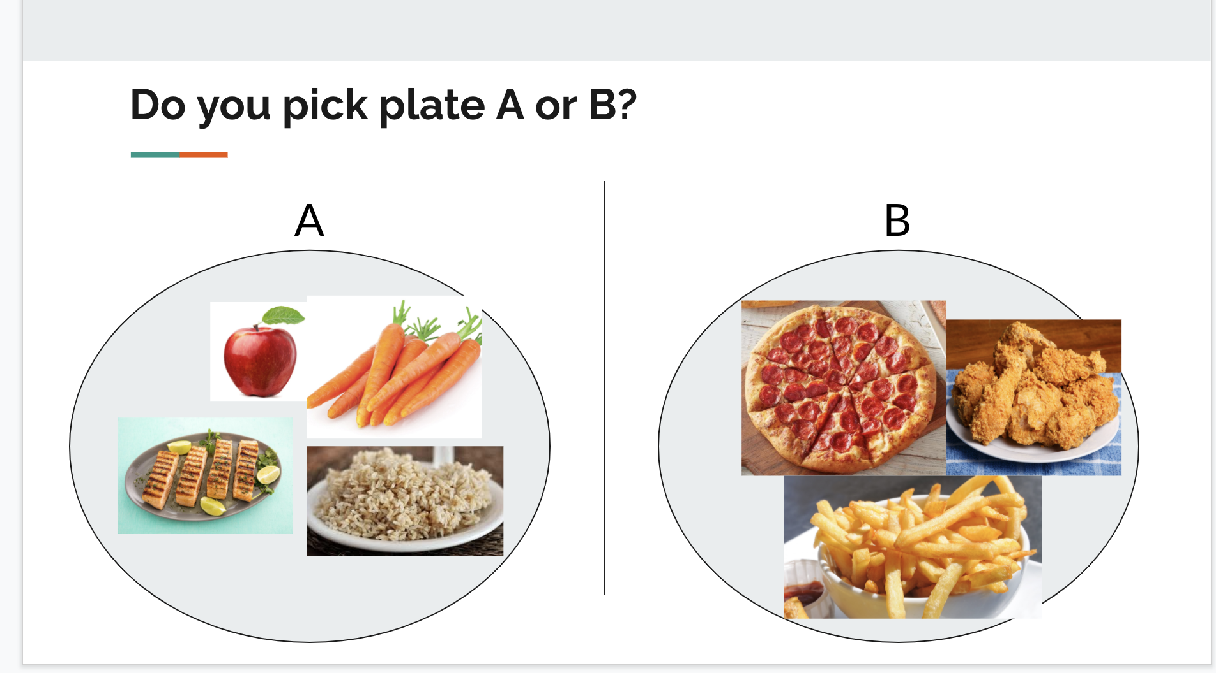
Reflection
As a future physician, I will be a resource for patient education
Tailor presentation of information to your audience
Notes:
Overall, I found this project to be an incredible learning opportunity. I learned how to appropriately present information to patients, which a task I will definitely be doing as a future physician. While, I may learn about all the nitty-gritty details of biochemistry, as you can see on the right, that may not be the most appropriate presentation of information for patients. Instead presenting information to patients in a more relatable manner will help me better connect with my patients and ensure that I can make a difference in their lives.

Slide 6
Reflection
Being an effective holistic physician involves much more than just treating the human body, including:
knowing relevant information so well that you can communicate it to all patients
staying up-to-date on topics that patients may ask you about
listening with intent
understanding and acknowledging your own limits
interprofessional collaboration provides the best outcomes for patients
Notes:
As an osteopathic medical student, we are always taught about holistic care of the patient. This projeft with Guadenzia helped me learn several important values that I will carry with me to be an effective holistic physician. Being able to teach topics to patients in simple terms requires a deeper understanding of the material. Patients may also do their own outside research before being seen, so it is important to stay up-to-date on medical topics, so that you may answer their questions. Always listen with intent, so that you can respond in an effective manner. Finally, it is important to collaborate with other medical professionals, not jus physicians, in order to provide the best outcomes for patients. This includers understanding and acknowledging your own limits and knowing when to refer a patient or ask for assistance or advice.

