Slide 1

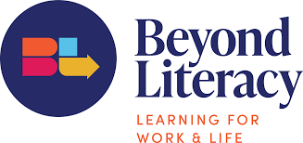
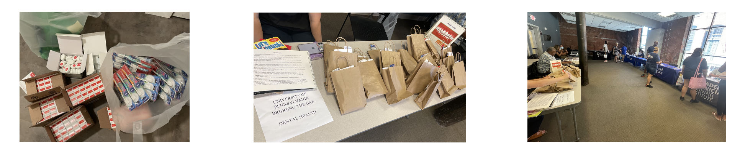
Addressing Gaps in Health Literacy
Student Interns: Qinyuan Chen, University of Pennsylvania, School of Dental Medicine; Maggie Lauderdale, University of Pennsylvania, School of Nursing
Academic Preceptors: Joan I. Gluch, PhD, RDH, PHDHP, University of Pennsylvania, School of Dental Medicine; Ann L. O’Sullivan, PhD, FAAN, CRNP, University of Pennsylvania, School of Nursing
Community preceptor: Mercy Howard, BA, Volunteer Manager, Beyond Literacy
COMMUNITY PARTNER
Beyond Literacy (BeLit) was launched in 2021 by uniting two organizations, Center for Literacy (CFL) and Community Learning Center (CLC). It is the largest literacy organization in Philadelphia with three campuses located in North Philly, West Philly and Center City. Each offers five free programs: Adult Education, English Language Proficiency, Family Literacy, Digital Literacy, and Workforce Development.
BACKGROUND/CONTEXT
1 in 3 people in Philadelphia need English as a second language services.
Growing need for ESL services in contrast to a shortage of available teachers.
GED and Citizenship exam prep classes allow for people to pursue further education, apply to better jobs, and have better governmental protection.
In the US 11% of people have no high school diploma—only counting US citizens. In Philadelphia, only 72% of students in the area schools will complete high school.
TEAM’S EXPERIENCE
ACCOMPLISHMENTS/
CHALLENGES/JOYS
Assisted in new student registration, orientations, assessments, and student intake
Held several ESL healthcare workshops
Created a glossary of useful medical and dental terms
Gathered and compiled local medical and dental clinics and resources
Distributed dental supplies
Participated in the Expungement Clinic and Community Resource Fair in North Philadelphia and promoted oral health to the local community.
Gained a better understanding and glimpse into the daily challenges of what it means to fight for a better future against multiple barriers
Worked with extremely devoted and optimistic staff members
Interacted with members of a community we had not been able to talk with before
Now have a better idea of what the data and narratives we learn looks like when it comes to health and educational disparities in a highly personal way.
REFLECTION
Through education, BeLit helps people live better, break poverty, find better jobs, obtain a high school degree and pursue higher level education.
Beyond literacy empowers people to make better futures for themselves through providing not only education, but self confidence and motivation.
Working with people who either do not speak English well or do not have a good grasp on medical vocabulary challenged our understanding of healthcare to take the complex words and concepts reduce to the basics of the English language.
Saw how much language and education barriers can impact different aspects of people’s lives, especially in getting proper health care.

